Slide 1
In your free time
Look at the diagram again, and try to understand it.
Linguistics
Sounds of language
Grammar
Meaning
Phonetics
Phonology
Morphology
Syntax
Semantics
Pragmatics

Slide 2
The origins of language

Slide 3
OUTCOMES
identify and discuss the six main theories/explanations on the origin of language according to Yule (2010)

Slide 4
The origins of language
Ability to produce sounds is located in an ancient part of the brain which we share with all vertebrates (fish, frogs, birds, mammals)
Spoken language probably developed between 100 000 and 50 000 years ago while writing only dates back to about 5 000 years ago => no direct evidence about the development of speech

Slide 5
Where do you think language comes from?

Slide 6
The origins of language
The divine source (Yule 2010:2; Fromkin 2011:309)
The natural sound source
The social interaction source
The physical adaptation source
The tool-making source
The genetic source

Slide 7
1. The divine source
In most religions, a divine source gives language to the humans
Nearly all divine theories believe that languages originated from a single source and are thus monogenetic theories of language origin
Over the ages, people carried out experiments to rediscover this original, God-given language

Slide 8
1. The divine source: The first language
Experiments: if human infants grow up in isolation, they will automatically begin to use the original God-given language!??!
Psammetichus (Egyptian pharaoh) let two newborn babies grow up in the company of only goats and a mute shepherd 2 500 years ago
  they are reported to have started saying the Phrygian (Turkey) word ‘bekos’ (bread) = original language?
  however, it is more likely that the children imitated the sounds they heard the goats make
King James of Scotland carried out similar experiment around 1 500
  the children are reported to have started speaking Hebrew = original language?

Slide 9
1. The divine source: The first language
BUT: Children discovered living in isolation do not confirm these findings but grow up with no language at all
Criticism: Divine source is impossible to prove/disprove and the ‘first language’ is impossible to reconstruct!!
Plato argues that a legislator gave the correct, natural names to all things
In many religions, only “special” languages may be used in prayers and rituals

Slide 10
The origins of language
The divine source
Natural sound source (Yule 2010:2-3; Fromkin 2011:310)
The social interaction source
The physical adaptation source
The tool-making source
The genetic source

Slide 11
2. The natural sound source: bow-wow
1. Primitive words started as imitations of the natural sounds early humans heard around them (bow-wow theory)
The imitations of sounds were then used to refer to the things associated with the relevant sound (onomatopoeia still exist in our language today: splash, rattle, boom, ...!)
For example, when a bird flew by making the sound ‘coo-coo’, it would be called ‘cuckoo’.
Criticism?

Slide 12
2. The natural sound source: bow-wow
  Criticism: how would soundless things and abstract concepts have been referred to??
  Criticism: Language is more than only a set of names

Slide 13
2. The natural sound source: pooh-pooh
2. Original sounds may have started as natural cries of emotion such as pain, anger and joy (pooh-pooh theory)
Criticism?

Slide 14
2. The natural sound source: pooh-pooh
  Criticism: these are produced with sudden intakes of breath, which is not the case for ordinary speech!! => emotional reactions contain sounds not otherwise used in speech production

Slide 15
The origins of language
The divine source
The natural sound source
Social interaction (Yule 2010:3-4; Fromkin 2011:310)
The physical adaptation source
The tool-making source
The genetic source

Slide 16
3. The social interaction source: yo-he-ho
Language arose out of the rhythmical grunts of people working together, involved in physical effort that has to be coordinated (yo-he-ho theory)
Early humans may have developed a set of grunts, groans and curses used when lifting and carrying trees/mammoths
Makes sense as early humans must have lived in groups, which require some form of organisation and hence communication to maintain => development of language placed in a social context
Criticism?

Slide 17
3. The social interaction source: la-la
Language originated from song as an expressive rather than a communicative need

Slide 18
3. The social interaction source
Criticism: apes and other primates also live in groups and use grunts etc without having developed the capacity for speech!!

Slide 19
4. The physical adaptation source
Physical features that distinguish humans from other creatures may have supported speech production
Evolutionary development resulted in partial adaptations making speech possible for early humans:
  Teeth
  Lips
  Mouth
  Tongue
  Larynx
  Pharynx

Slide 20
4. The physical adaptation source: TEETH
Upright position, not slanting outwards like those of apes
Roughly even in height
Good for grinding and chewing
Very helpful in making sounds such as ‘f’ or ‘v’

Slide 21
4. The physical adaptation source: LIPS
More intricate muscle interlacing
More flexible
Capable of a wider range of shapes
Suitable for making sounds such as ‘p’ or ‘b’

Slide 22
4. The physical adaptation source:
LARYNX AND PHARYNX
Larynx is “voice box” in your throat containing the vocal folds or vocal chords
Due to upright position, head moved directly above the spinal column and larynx dropped to a lower position
As a result, the pharynx (cavity above the vocal folds, acts as resonator) became longer => increased range and clarity of sounds
Disadvantage: due to lower position of pharynx, humans may choke more easily on food => ability to speak must have outweighed this disadvantage for humans
Criticism?

Slide 23
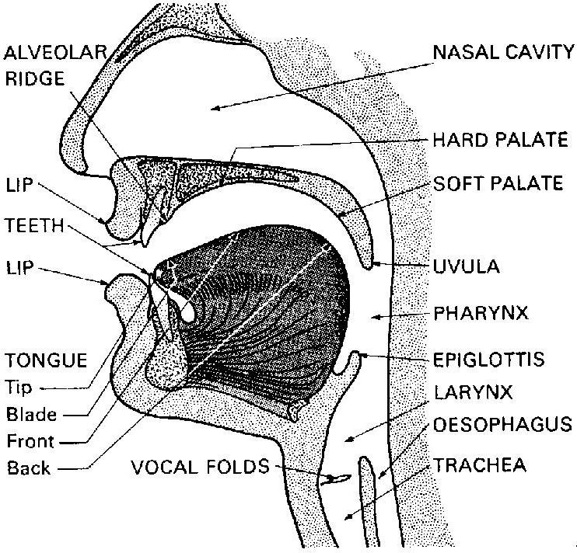
4. The physical adaptation source

Slide 24
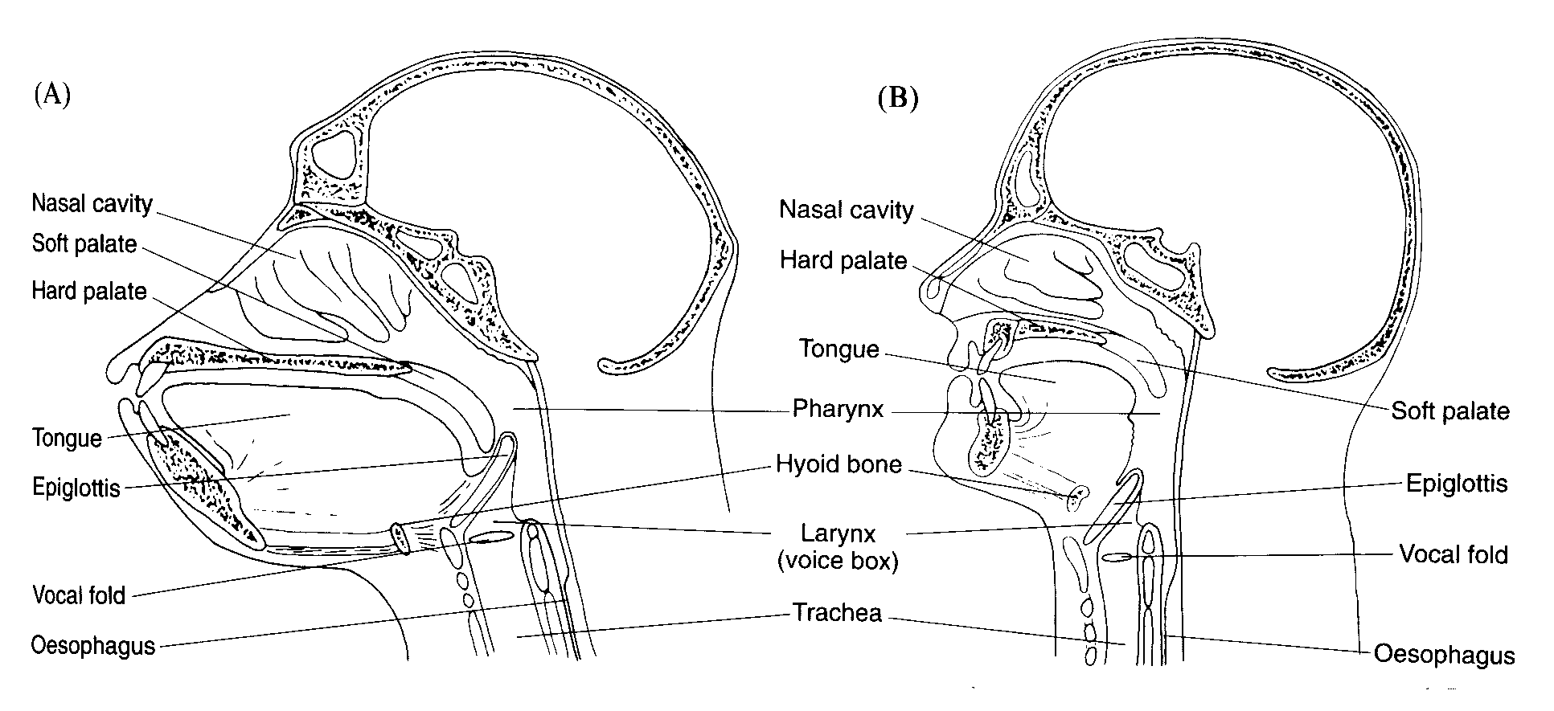
4. The physical adaptation source

Slide 25
4. The physical adaptation source
Criticism: Certain birds and parrots are able to also produce a wide variety of sounds

Slide 26
The origins of language
The divine source
The natural sound source
The social interaction source
The physical adaptation source
Tool-making source (Yule 2010:5-6; Fromkin 2011:26-28)
The genetic source

Slide 27
5. The tool-making source (hands)
Humans started making tools and manipulating objects using both hands
Manual gestures may have been a precursor of language: oral gesture theory
Bringing words together like bringing two rocks together to make a tool

Slide 28
5. The tool-making source (brain)
The functions for object manipulation and for speaking are very close to each other in the left hemisphere of the brain (lateralisation) => there may have been an evolutionary connection between the use of tools and the use of language in early humans
This theory allows for structural organisation inherent to all language (even sign languages), not only articulation of sounds to denote objects

Slide 29
The origins of language
The divine source
The natural sound source
The social interaction source
The physical adaptation source
The tool-making source
The genetic source (Yule 2010:6)

Slide 30
6. The genetic source
Young babies go through developments: small brain, larynx higher in throat => changes take place => Almost automatic set of development
Even children who are born deaf become fluent speakers of a sign language
claim that human offspring are born with a special capacity for language (innateness theory)
Capacity for language genetically hard-wired into newborn humans?

Slide 31
6. The genetic source
This applies to all language in general, not one specific language
Crucial mutation in human genetics, special “language gene” that only humans possess
This would mean that language did not result from a gradual change but happened rather quickly as a crucial genetic mutation (unlike physical adaptation, for example)
No certainty when this genetic change might have taken place and how it may relate to physical adaptation
If we have a special gene for language, can other creatures also learn language?

Slide 32
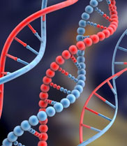

Slide 33
The origin of language
Theories | Arguments for | Arguments against | Development
The divine source (monogenetic) |  |  | Suddenly
The natural sound source (bow-wow/pooh-pooh) | Existence of onomatopoeia | Soundless things and abstract concepts Produced with intake of breath | Gradually
The social interaction source (yo-he-ho) | Early humans lived in groups | Other primates also live in groups and use grunts | Gradually
The physical adaptation source (teeth, lips, mouth, larynx & pharynx) | There’s evidence for the evolutionary changes | These changes would not themselves lead to speech production | Gradually
The tool-making source (brain) | Accounts for structural organisation of language |  | Gradually
The genetic source (innateness theory) | Automatic set of developments in young children |  | Suddenly

Slide 34
READING
Yule (2010), Chapter 1
The origins of language (pp. 1-9)
Fromkin, Rodman & Hyams (2011):
  In the Beginning: The Origins of Language (pp. 308-315)
  The Development of Language in the Species (pp. 26-28)

Slide 35
Theories of the origins of Language
The bow-bow theory: based upon the notion that speech arose through people imitating the sounds of environment, especially animal calls, the use of onomatopoeic words
The pooh-pooh theory: based on the evidence that speech arose through people making instinctive sounds
The yo-he-ho theory: based on the notion that speech arose from physical environmental needs which produced communal, rhythmical grunts which later on developed into chants

Slide 36
Human language is much flexible and complete than animal language even that of advanced animals
Languages differ from one another but their operating principles are same
All old languages were capable of doing everything
People spoke languages long before writing systems were developed
All people function on a binary system of utterance
Language has in-built mechanisms for change, adaptation, synthesis and compromise
Body gesturing especially the elements of stress and intonation are important in human communication and also grow side by side with language
Individual languages prosper or fade in parallel with the rising or falling fortunes of the cultures that support them

