Slide 1
Modern Novel
1880--1945

Slide 2
Traditional Novel
follows the pyramid of
exposition,
initial incident,
rising action,
climax,
falling action and
resolution,

Slide 3
Modernity
Paradigm shift away
From
agriculture to industry,
Religion to science,
Monarchy to democracy,
village and town to city,
low population to crowded populations,
natural to artificial,
human to machine etc.

Slide 4
The Modern Novel
The modern novel recognizes and
records these changes brought about
resultantly in the human psyche and
society.

Slide 5
Modernism
Modernism” designates an international artistic movement, flourishing from the 1880s to the end of WW II (1945), known for radical experimentation and rejection of the old order of civilization and 19th century optimism; a reaction against Realism and Naturalism
“Modern” implies historical discontinuity, a sense of alienation, loss and despair – angst -- a loss of confidence that there exists a reliable, knowable ground of value and identity.
Horrors of WW I (1914-1918)

Slide 6
The Modern Novel: Main features
Realism, not idealism
Psychological analysis of characters due to the influence of Freud.
Subjectivity and individualism of the writer.

Slide 7
Perspectivism: the locating of meaning from the viewpoint of the individual (narrator’s position important); realist novel > omniscient narrator > knows everything > background, thoughts, wishes, reasons for actions, ‘more than human’, Modernist narrator > gives his/her point of view, emotions, subjective, limited

Slide 8
Impressionism: an emphasis on the process of perception and knowing: the use of devices (formal, linguistic, representational), to present more closely the texture or process or structure of knowing and perceiving. A re-structuring of literature and the experience of reality it re-presents.
Life is not a series of gig lamps symmetrically arranged; but a luminous halo, a semi-transparent envelope surrounding us from the beginning to the end. Is it not the task of the novelist to convey this varying, this unknown and uncircumscribed spirit, whatever aberration or complexity it may display; with as little mixture of the alien and external as possible?
Virginia Woolf “Modern Fiction”

Slide 9
A break with the sequential, developmental, cause-and-effect presentation of the 'reality' of realist fiction >
presentation of experience as layered, allusive, discontinuous; the use, to these ends, of fragmentation and juxtaposition, motif, symbol, allusion.
Language is seen as a complex, nuanced site of our construction of the 'real'; language is 'thick', its multiple meanings and varied connotative forces are essential to our elusive, multiple, complex sense of and cultural construction of reality.
Experimentation in form in order to present differently, afresh, the structure, the connections, and the experience of life; an emphasis on cohesion, interrelatedness and depth in the structure of the aesthetic object and of experience (motif, juxtaposition, significant parallels, different voices, shifts and overlays in time and place and perspective)
A sense of art as artifact, art as 'other' than diurnal (daily) reality
The (re)presentation of inner (psychological) reality, including the 'flow' of experience, through devices such as stream of consciousness.

Slide 10
The use of interior or symbolic landscape: the world is moved 'inside', structured symbolically or metaphorically;
Time becomes psychological time (time as innerly experienced) or symbolic time (time or measures of time as symbols, or time as it accommodates a symbolic rather than a historical reality), not the 'historical' or railway time of realism.
A turn to 'open' or ambiguous endings, again seen to be more representative of 'reality' -- as opposed to 'closed' endings, in which matters are resolved.

Slide 11
Social and Cultural context.
The two World Wars and colonialism.
The rise of science.
The loss of faith or the individualization of faith.
The theory of evolution and Darwinism.
The appearance of psychology as a new discipline and psychological analysis or Freudianism.
The rise of Marxism and fascisms.

Slide 12
Themes
The modern scientific discoveries, the new technologies, the social and political ideologies, the ideas and the beliefs, and people’s different conceptions about themselves and about the universe at large find their way into the modern novels.
the search for a ground of meaning in a world without God > without guidance, rules, clear distinction between good and bad, without a hope for redemption > modernist redemption > art
critique of the traditional values of culture
loss of meaning and hope in the modern world and an exploration of how this loss may be faced (or overcome?).

Slide 13
CHARACTERISTICS OF THE MODERN NOVEL
Realistic. presenting a frank image of the world and all aspects of the human experience. But the modern novel abandons the realism of the nineteenth century, in which only the sordid aspects of life are depicted.
More subjective, presenting the world from the perspective of the individual character, reflecting his or her biases or distorted vision. A relativistic perception of reality replaces the objective views of the whole community.
Relative Morality The philosophized notion that right and wrong are not absolute values, but are personalized according to the individual and his or her circumstances or cultural orientation.

Slide 14
Psychological.
Tends to reveal the hidden inner motives behind
people’s actions—Sigmund Freud,
emphasis on interior characterization, and on the
motives, circumstances, and internal action which
springs from, and develops, external action.
Pessimistic.
The impact of the two world wars—a deep sense of
pessimism replaced the nineteenth-century optimism.
Symbolical.

Slide 15
The search for symbolic ground or an ontological or epistemic ground for reality, especially through the device of 'moment of being' (Woolf)
If my life has a base that it stands upon, if it is a bowl that one fills and fills and fills-then my bowl without a doubt stands upon this memory. It is of lying half asleep, half awake, in bed in the nursery at St. Ives. It is of hearing the waves breaking one, two, one, two, and sending a splash of water over the beach; and then breaking, one, two, one, two, behind a yellow blind... It is of lying and hearing this splash and seeing this light, and of feeling, it is almost impossible that I should be here; of feeling the purest ecstasy I can conceive... the feeling, as I describe it sometimes to myself, of lying in a grape and seeing through a film of semi-transparent yellow."
Virginia Woolf, “Moments of Being”

Slide 16
Unconventional plots.
A break with the linear, developmental, cause-and-effect presentation of the 'reality‘ and with the chronological order of the plot mark a large number of modern novels.
Objective treatment of themes, rather than
didactic.
Experimental narrative and use of language.
The stream of consciousness – the character’s jumbled flow of perceptions, memories and feelings.

Slide 17
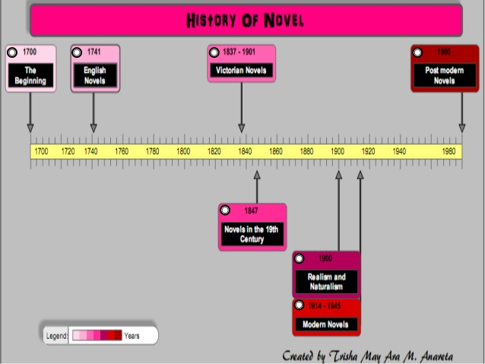

Slide 18
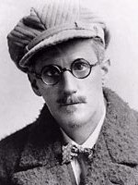
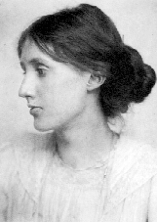
Stream of Consciousness
Narration that mimics the ebb and flow of thoughts of the waking mind
Uninhibited by grammar, syntax or logical transitions
A mixture of all levels of awareness – sensations, thoughts, memories, associations, reflections
Emphasis on how something is perceived rather than on what is perceived
James Joyce, Dorothy Richardson, Virginia Woolf, Thomas Wolfe, William Faulkner
James Joyce
1882-1941
The Dubliners
Portrait of an Artist
Ulysses
Finnegan’s Wake
Virginia Woolf
1882-1941
To the LightHouse
The Waves
Mrs. Dalloway
Orlando

Slide 19
Stream of consciousness: the continuous flow of sense perceptions, thoughts, feelings, and memories in the human mind; or a literary method of representing such a blending of mental processes in fictional characters, usually in an unpunctuated or disjointed form of interior monologue. Stream of consciousness is a special style of interior monologue that without the apparent intervention of a summarizing and selecting narrator, mingles the thoughts of the character with impressions and perceptions, often violating the norms of grammar, syntax, and logic.
Example of stream of consciousness: Joyce’s Ulysses
Pineapple rock, lemon platt, butter scotch. A sugar-sticky girl shoveling scoopfuls of creams for a christian brother. Some school great. Bad for their tummies. Lozenge and comfit manufacturer to His Majesty the King. God. Save. Our. Sitting on his throne, sucking red jujubes white.

