Slide 1
Government and Case Theories
Lect. 11
Dr. Amal Alsaikhan

Slide 2
This lecture discusses the following topics
STRUCTURAL RELATIONS AND AGREEMENT PATTERNS
C-COMMAND
*****
M-COMMAND
*****
GOVERNMENT
*****
CASE THEORY-DEFINITION
*****
ABSTARCT CASE&MORPHOLOGICAL CASE
*****
NOMINATIVE CASE & ACCUSATIVE CASE
********
THE CASE FILTER

Slide 3
Structural Relations
In this section we discuss the structural relation c-command. We shall also return to the notion of government and try to define it in terms of c-command. To illustrate the role of the notion c-command in the theory, we first consider agreement patterns.

Slide 4
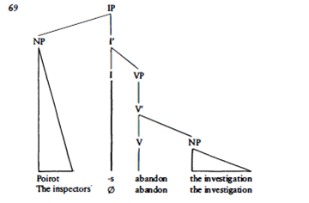
2

Slide 5
SPECIFIER-HEAD AGREEMENT
Head and specifier share features such as number, gender, person. Languages vary with respect to the extent to which agreement between specifier and head are morphologically realized.
In English there is little overt agreement, but again we have adopted the assumption that INFL is specified for abstract [AGR) in (2):
2a. Poirot abandons the investigation.
2b. The inspectors abandon the investigation.
2c. We abandon the investigation.

Slide 6
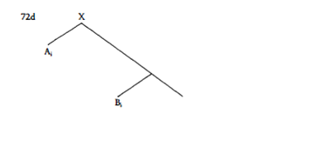
C-command and Government
C-COMMAND AND THE FIRST BRANCHING NODE
Consider the following representation where co-subscripted nodes indicate agreement:
3.

Slide 7
When we consider the geometrical relations between agreeing pairs of elements it appears that one agreeing element is always higher in the tree than the element it agrees with.
In (3) X, the first branching node dominating A, the highest member of the agreeing pair, also dominates B, the lowest member of the agreeing pair. A itself does not dominate B and B does not dominate A.
The relation which is schematically represented in (3) is one that has been labeled c-command.

Slide 8
C-command (i)
Node A c-commands node B if and only if
(i) A does not dominate B and B does not dominate A; and
(ii) the first branching node dominating A also dominates B.
Given a node A it is easy to determine which nodes it c-commands. The procedure is as follows: starting from A we move upward till we reach the first branching node dominating A; then we move downwards following the branches of the tree and every node that we find on our way is c-commanded by A, regardless of whether we move rightward or leftward. [Spec, NP] c-commands all the nodes dominated by NP.

Slide 9
C-command domain
The total of all the nodes c-commanded by an element is the c-command domain of that element. The NP is the c-command domain of the determiner. The subject NP c-commands the entire IP; IP is the c-command domain of the subject. The c-command domain of an element is of necessity a constituent, given that it consists of all the material dominated by one node, hence the term c (= constituent)command.

Slide 10
GOVERNMENT
At this point let us return to our definition of government in terms of sisterhood. Recall that we restrict our attention to government by heads. A, a head, governs B
W
A B
From our discussion of c-command above it follows that A, the governor, c-commands B, the governee; and conversely, B, the governee, c-commands A, the governor. Government could he defined as a relationship of 'mutual c-command'.

Slide 11
Government
A governs B if and only if
(i) A is a governor; and
(ii) A c-commands B and B c-commands A.

Slide 12
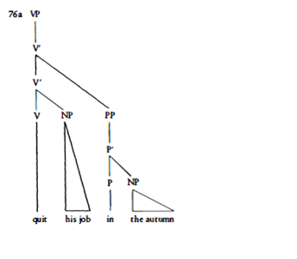
M-COMMAND AND GOVERNMENT
4a.

Slide 13
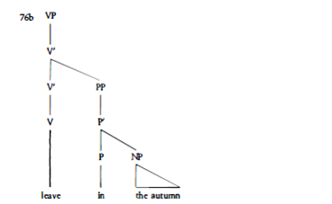
4b.

Slide 14
If we adopt our definitions of c-command above the relation between V and the PP in the autumn in (4a) is quite different from that between V and the PP in the autumn in (4b), although in both cases the PP is a time adjunct.
In (4a) the V quit c-commands the NP his job, which it governs and indeed theta-governs. Following our definitions, the V quit does not c-command the time PP in the autumn. V does not c-command the PP because the first branching node that dominates it is the lower V', which does not dominate the PP.

Slide 15
In (4b), the V leave c-commands the PP in the autumn: the first branching node dominating V is the topmost V', which also dominates the PP. PP also c-commands V since the first branching node dominating PP is the higher V', which also dominates V. We conclude that in (4b) V and the PP in the autumn c-command each other. V does not c-commands P and NP; P and NP do not c-command V.

Slide 16
We are thus led to conclude that V governs and c-commands the PP in the autumn in (4b) and it fails to do so in (4a). This seems a rather unsatisfactory state of affairs: intuitively one feels that both verbs, quit and leave, have the same relation to the PP in the autumn.
It has been proposed that in configurations like those in ( 4) the V should uniformly govern the PP in both (a) and (b). This will capture our intuition that the relation between V and PP is the same in the VPs in (4a) and (4b). In order to arrive at this conclusion, both the notions of c-command and of government have been reformulated in terms of maximal projections.

Slide 17
C-command ii(m-command)
In Barriers, a Chomsky ( 1986b:8) proposes the following definition of c-command:
C-command (ii)
A c-commands B if and only if A does not dominate B and every X that dominates A also dominates B.
For the choice of X, two options are considered. When X is equated with the first branching node we obtain the c-command definition given before. This structural relation is sometimes referred to as strict c-command. Alternatively, X is interpreted as a maximal projection. Under the latter interpretation of c-command, A m-commands B.

Slide 18
Using the notion of m-command Chomsky (1986b: 8) proposes that government be defined as follows:
Government
A governs B if and only if
(i) A is a governor; and
(ii) A m-commands B; and
(iii) no barrier intervenes between A and B.
Maximal projections are barriers to government.
Governors are heads.

Slide 19
Case Theory

Slide 20
Case theory: definition
Case theory accounts for some of the formal properties of overt NPs and integrates the traditional notion of case into the grammar.

Slide 21
Morphological Case and Abstract Case
Consider the examples in (1):
5. The butler attacked the robber.
(5) is a simple sentence, containing two NPs, the butler and the robber.
Let us replace the argument NPs in ( 5 ) by the corresponding pronouns:
6. He attacked him.

Slide 22
When the pronoun is the internal argument of attack it takes the form him. Adopting the terminology of traditional grammar we call this form the ACCUSATIVE case. When the third person pronoun is the external argument of attack it takes either the form he or the form him. The latter form is again the ACCUSATIVE case of the pronoun; the form he will be called the NOMINATIVE case.

Slide 23
A third case form found in English NPs is the GENITIVE, illustrated in (6a) and (6b).
6a The butler's coat was too big.
6b His coat was too big.
In English, the overt morphological realization of case in full lexical noun phrases is restricted to the GENTIVE case.

Slide 24
As seen in ( 5 ), NOMINATIVE and ACCUSATIVE are not realized overtly in modern English full NPs, though these case forms were overtly marked in earlier stages of the language.
The overt distinction of NOMINATIVE and ACCUSATIVE forms in modern English is still to be found in the pronoun system, though even there we find several examples of case syncretism: two case forms having the same morphological realization.

Slide 25
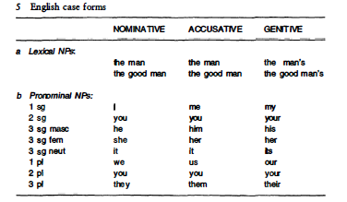

Slide 26
Structural Case: NOMINATIVE and
ACCUSATIVE
In this section we concentrate on the distribution of NOMINATIVE and ACCUSATIVE case forms.
As can be seen in (6), the NOMINATIVE case (he) is reserved for the NP in the subject position of finite clauses. The ACCUSATIVE case (him) is used both for the object NP of a transitive verb and for the NP complement of a preposition.
John moved towards him/-he.

Slide 27
Complements: ACCUSATIVE
V AND P AS CASE ASSIGNERS
Following traditional accounts of case we might say that transitive verbs and prepositions assign ACCUSATIVE case to the NP they govern. They case-mark an NP which they govern.

Slide 28
NPs acquire case under government.
The structural relation government is defined again as:
Government
A governs B if and only if
(i) A is a governor;
(ii) A m-commands B;
(iii) no barrier intervenes between A and B. where
(a) governors are the lexical heads (V, N, P, A) and tensed I;
(b) maximal projections are barriers.

Slide 29
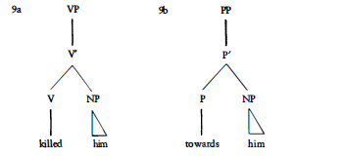

Slide 30
The possibility of case assignment is also a function of the type of verb, i.e. the governor. Only transitive verbs and prepositions assign case. Intransitive verbs like wander or overeat cannot assign case to a complement NP:
7a *He wandered them.
7b *He overate them.
Nouns and adjectives also do not assign ACCUSATIVE case
8a * Poirot's attack him.
8b *Poirot is envious him.
We shall classify transitive verbs and prepositions as ACCUSATIVE case assigners.

Slide 31
Subjects: NOMINATIVE and ACCUSATIVE
NOMINATIVE SUBJECTS
Subjects of finite clauses have NOMINATIVE case. Let us try to link the assignment of NOMINATIVE case to a governing head just as we have linked the assignment of ACCUSATIVE case to V or to P.
One important element in the discussion is the contrast between the subjects of finite clauses and those of infinitivals: subjects of finite clauses are NOMINATIVE, subjects of infinitivals are ACCUSATIVE

Slide 32
The distinction between finite and non-finite clauses can be drawn in terms of the feature composition of the head of the clause, INFL or I. In finite clauses INFL is [+Tense, +AGR}; in non-finite clauses INFL is [-Tense, -AGR]. This suggests that the assignment of NOMINATIVE case can be associated with finite INFL.

Slide 33
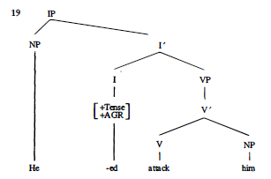
Consider the tree diagram

Slide 34
In order to ensure that I can case-mark [Spec, IP] under government we are forced to adopt the definition of government in terms of m-command.
A definition in terms of c-command would not suffice: I does not c-command [Spec, IP] . On the other hand, for case assignment by V (or by P) both a definition in terms of c-command and one in terms of m-command would do: in the example above V c-commands the object NP.

Slide 35
It has been proposed (Sportiche 1988) that the subject NP in [Spec, IP] is assigned NOMINATIVE case not by virtue of government by I but rather by virtue of the specifier-head agreement between the subject NP and INFL.
It could thus be argued that case-marking is achieved either via government or via specifier-head agreement.

Slide 36
Case filter
Every overt NP must be assigned abstract case.
This requirement is called a filter because it 'filters out' any construction containing an overt NP which is not assigned case. We assume, from now on, that the case filter applies to all overt NPs

Slide 37
Thank you

