Slide 1
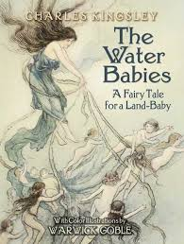
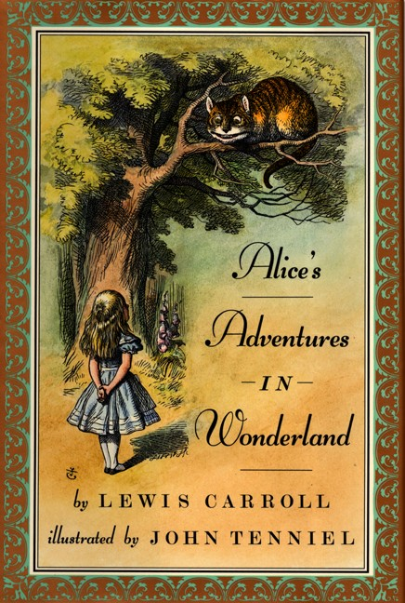
Early Modern
Classics
Late 19th c

Slide 2
Charles Kingsley, The Water-Babies: A Fairy Tale for a Land Baby 1863
Carlo Collodi, The Adventures of Pinocchio 1883
The Princess and the Goblin and its sequel The Princess and Curdie, by George MacDonald 1872 and 1883,
Treasure Island and Kidnapped, both by Robert Louis Stevenson, 1880s.
Rudyard Kipling's The Jungle Book 1894
J. M. Barrie, Peter Pan
Johanna Spyri Heidi 1880 and 1881
Louisa May Alcott, Little Women 1868.
Mark Twain, Tom Sawyer 1876

Slide 3

1865

Slide 4
Alice's story was written and illustrated between 1862 & 1864.
- Alice in Wonderland is not a moral tale, but it is a metaphysical one.
The story functions as comedy, with the mixing of fantasy and comical actions.
Reading Alice leaves us with a series of disconnected episodes.

Slide 5
About Alice’s Adventures in Wonderland
An example of literary nonsense genre.
* witty language.
* illogic – chaos
A nonsense text is a text which has no logical meaning. But nonsense is also a literary genre. Literary Nonsense is a style of literature where conventional rules of language and general logic do not apply.
The origin of the genre is unclear, but may have roots in traditional folklore and nursery rhymes.

Slide 6
It gained popularity during the Victorian era. Though not the first to write this hybrid kind of nonsense, Edward Lear developed and popularized it in his many limericks.
Lewis Carroll continued this trend, making literary nonsense a worldwide phenomenon with Alice's Adventures in Wonderland .

Slide 7
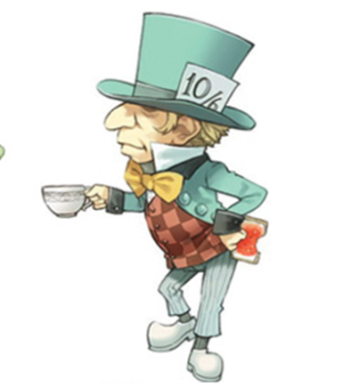
About Alice’s Adventures in Wonderland
A fairytale breaking from old tradition :
* no conventional story line.
* episodes.
* in the form of a dream.
* Alice doesn’t represent the “morally good” heroine + no moral lesson.
* full of humor – riddles
* satirizes Victorian conventions ( poems).

Slide 8
Plot:
Alice falls down a rabbit whole into a fantasy world that gets "curiouser and curiouser." She encounters puzzling creatures and incidents.
Conflict :
Resolution:
Alice meets new strange characters, and she is puzzled by their behavior.
It is a dream after all.

Slide 9
Major Theme:
Adolescence vs. Childhood
* physical and psychological changes ( puberty ).
* being confused by the adult world.
* anxieties and mysteries of identity as one grows.

Slide 10

Chapter 1
Down the Rabbit Hole
Alice follows a rabbit down a hole.
Alice shrinks in size in hope of entering the garden.
Alice grows up to 9 feet tall after eating a cake.

Slide 11
Chapter 2
The Pool of Tears
Alice doubts her identity and feels sad.
She swims in her tears with some animals to get to the shore.

Slide 12
Alice is told in the form of a dream; because it’s the story of Alice's dream, which is told in the third person point-of-view.
Poetry and songs are also used by the author as means of entertaining “ Twinkle, Twinkle, Little Bat“ is a poem recited by the Mad Hatter in chapter seven.

