Slide 1
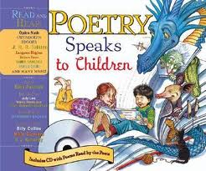
Late 19th century Classics II
Poetry
Dr. Sabah Aisawi

Slide 2
Poetry allows children to experience the world with new understanding and share feelings, experiences and vision with the poet.
Poetry encourages children to play with words.
It gives children pure enjoyment.
Children identify with characters and situations.
Poetry is a way of expressing a mood.
It makes children gain insight into themselves.
Norton, Through the Eyes of a Child. 1983

Slide 3

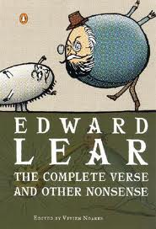
The Complete Verse and Other Nonsense
By Edward Lear

Slide 4
Nonsense
A nonsense text is a text which has no logical meaning. But nonsense is also a literary genre. Literary Nonsense is a style of literature where conventional rules of language and general logic do not apply.

Slide 5
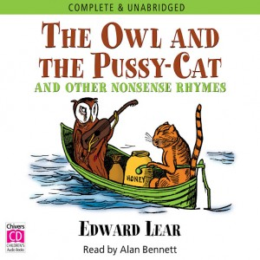
“The Owl and the Pussy-cat”
The poem tells the adventures of two characters ( owl + cat ) at sea.

Slide 6
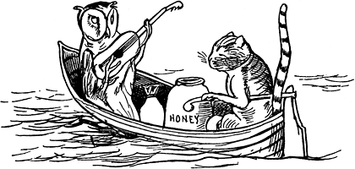
I
The Owl and the Pussy-cat went to sea
In a beautiful pea green boat,
They took some honey, and plenty of money,
Wrapped up in a five pound note.
The Owl looked up to the stars above,
And sang to a small guitar,
'O lovely Pussy! O Pussy my love,
What a beautiful Pussy you are,
You are,
You are!
What a beautiful Pussy you are!'

Slide 7
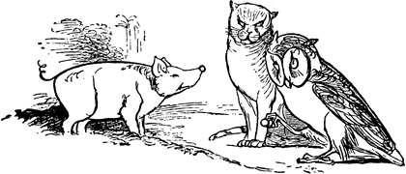
II
Pussy said to the Owl, 'You elegant fowl!
How charmingly sweet you sing!
O let us be married! too long we have tarried:
But what shall we do for a ring?'
They sailed away, for a year and a day,
To the land where the Bong-tree grows
And there in a wood a Piggy-wig stood
With a ring at the end of his nose,
His nose,
His nose,
With a ring at the end of his nose.

Slide 8
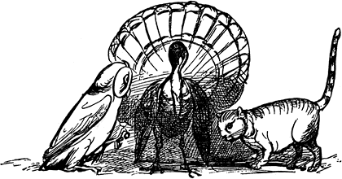
III
'Dear pig, are you willing to sell for one shilling
Your ring?' Said the Piggy, 'I will.'
So they took it away, and were married next day
By the Turkey who lives on the hill.
They dined on mince, and slices of quince,
Which they ate with a runcible spoon;
And hand in hand, on the edge of the sand,
They danced by the light of the moon,
The moon,
The moon,
They danced by the light of the moon.

Slide 9
About the Poem
Nonsense poem : * cat vs. owl → nonsense
        * made-up words (runcible ).
Personification: Human qualities to animals ( sing – sail ).
Style : * 3 stanzas ( 11 lines).
* rhyme + repetition of sounds and words.

Slide 10
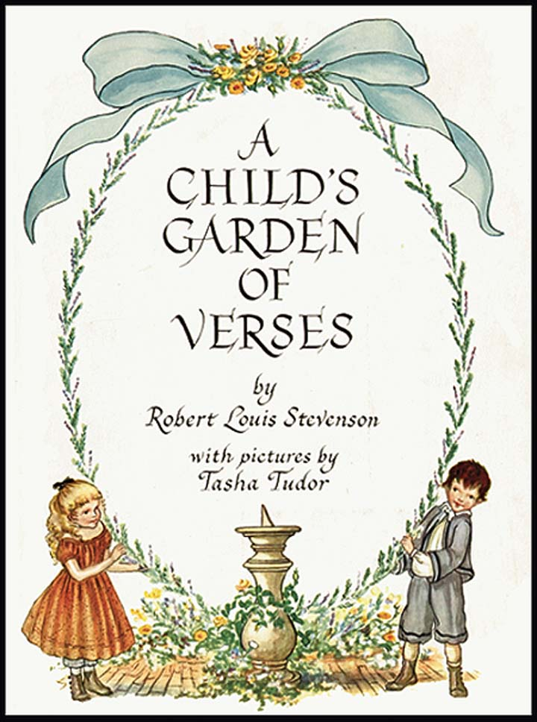

Slide 11
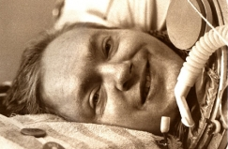
My Shadow
I have a little shadow that goes in and out with me,
And what can be the use of him is more than I can see.
He is very, very like me from the heels up to the head;
And I see him jump before me, when I jump into my bed.
The funniest thing about him is the way he likes to grow—
Not at all like proper children, which is always very slow;
For he sometimes shoots up taller like an india-rubber ball,
And he sometimes gets so little that there's none of him at all.
He hasn't got a notion of how children ought to play,
And can only make a fool of me in every sort of way.
He stays so close beside me, he's a coward you can see;
I'd think shame to stick to nursie as that shadow sticks to me!
One morning, very early, before the sun was up,
I rose and found the shining dew on every buttercup;
But my lazy little shadow, like an arrant sleepy-head,
Had stayed at home behind me and was fast asleep in bed.

Slide 12
About the poem
The poem sheds light on the imaginative life of a child.
Personification: shadow as a human friend.
Autobiographical : some critics interpreted the poem as a representation of Stevenson’s lonely childhood.

Slide 13
Sources :
http://www.hekupu.ac.nz/Journal%20files/Issue1%20June%202012/Nonsense%20and%20Early%20Childhood.pdf
http://learnenglishteens.britishcouncil.org/2012/05/09/alice-wonderland-stuff-and-nonsense
http://www.alice.id.tue.nl/references/senna-1984.pdf
http://english.illinoisstate.edu/rlbroad/archive/teaching/studentpubs/OneWishEnglish/bush.pdf

