Slide 1

Case Studies of major linguists
1- William Labov
2- Peter Trudgill

Slide 2


William Labov’s biography
William Labov | His name
1927 , Rutherford , New Jersey | His birth
Discipline of variationist Sociolinguistics . | His field
Studies at Harvard , Columbia ( 1948 ) | His education
An industrial chemist | First ( 1949 – 1961 )
He became a linguist | Then
MA ( 1963 ) and PhD ( 1964 ) at Columbia Uni : Studying verities of English in New York City . | Cont.
“an enormously original and influential figure who has created much of the methodology" of sociolinguistics | According to people

Slide 3
Cont.
He became a professor later in ( 1971 ) at University of Pennsylvania .
Then he became a director of the university's Linguistics Laboratory (1977).

Slide 4
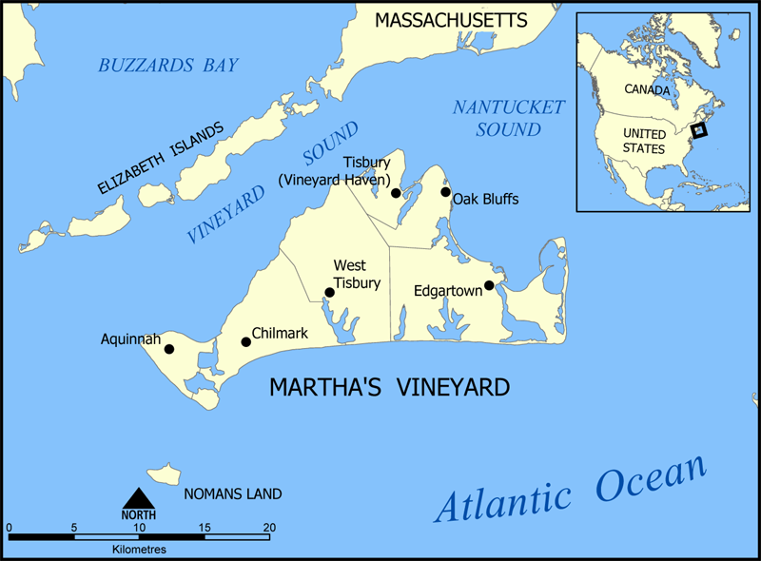
Martha’s Vineyard study ( 1963 )
It is an island about 3 miles off New England on the US East Coast .
Permanent population about : 6000 .
In Summer : 40,000 visitors .
Eastern part of it called “Down Island”
and favoured by the visitors .
Western “Up Island” has more original inhabitants , residents and it is strictly rural , which refers to a geographic area that is located outside cities and towns.

Slide 5
Martha’s Vineyard demographics
The permanent population consists of Yankees
( descendants of early settlers ) .
Portuguese ( recent immigrants ) and native Americans , especially around Chilmark , because of the fish industry : 2.5% of population that still involved in fishing .
Other islanders considered as independent , skillful , physically strong .

Slide 6
Labov’s study
He focused on pronunciation of /au/ : out , house , how and /ai/ : while , pie , tie .
He noticed that locals had a tendency to pronounce these diphthongs with a more central start point
( əi , əa ) .
He collected date by interviewing 69 informants , talking randomly by using words with these vowels .
He got some recordings of school pupils reading text.
He brought data from 30’s of Linguistic Atlas of New England .
He said about the “Degree of centralization” that is fairly subjective .

Slide 7
Initial results :
The usage of the centralized vowel against various factors :
Age.
Population group.
Occupation.
Location .

Slide 8
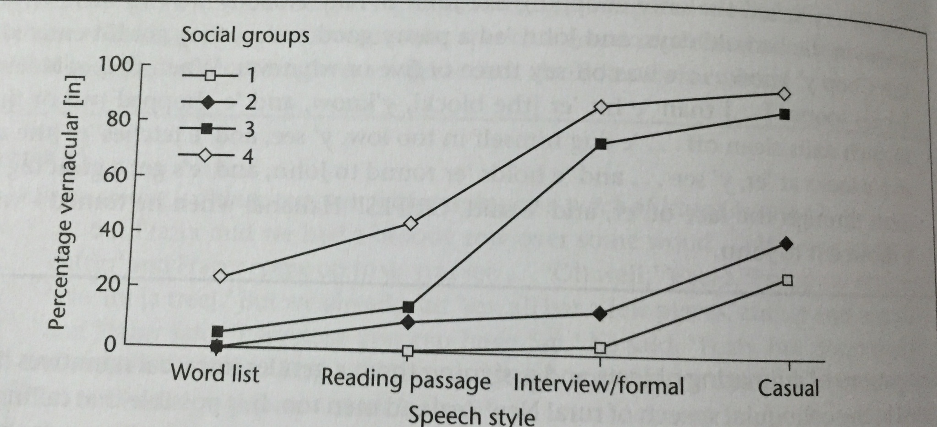

Slide 9
Summary the results :
Centralization most occurred in age group ( 31-45 ) .
Origin : By the Yankees . ( less )
Occupation : Fishermen , less in people working in tourist industry .
Location : Up islands residents around Chilmark .

Slide 10
How?
Labov’s explained how the centralizing tendency was actually diminishing at time of 1930s survey , but it remind as a dialect in the middle-aged rural fishermen.
The factor tourism had an effect on unconscious change in accent among those who most closely identified with the island .
Labov tested his theory by assessing informants’ attitudes and feelings about the island .
By asking : Why 31-45 years old most marked groups?
The younger ones were unsure and the older ones were more set in their ways .

Slide 11
Why is this study significant?
Because dialect studies had focused on rural speakers and had ignored social factors .
The Urban accents were thought to be too diverse and too heterogeneous to study .
Labov’s conclusion was that social factors were in fact significant and important .
see page(251-255)

Slide 12

Social Stratification of (r) in New York City

Slide 13
William Labov worked on a classic study on social stratification for New York City speech. He was able to illustrate the social stratification of (r) in N.Y.C. department stores. The variants of the phonological variable (r) are either presence or absence of post-vocalic /r/. That is, in expressions such as fourth floor, whose pronunciation was tested by Labov, /r/ was either pronounced or omitted.

Slide 14
. Historically, New York City speech had been known as r-less, i.e. it featured a non-rhotic accent. However, the general attitude towards this accent feature was rather negative and the pronunciation of /r/ seems to have been reintroduced to New York City speech. Labov found that in New York City the pronunciation of /r/ occurred and its frequency of use depended on the speakers’ membership to particular socioeconomic status groups, i.e. social classes

Slide 15
Methods
Labov’s department store survey was threefold in character:
(1) He studied the speech of employees in three department stores in Manhattan: Saks Fifth Avenue (an expensive upper middle-class store), Macy’s (a less expensive middle-class store),S. Klein (a discount store frequented mainly by working-class New Yorkers).
In order to study the pronunciation of /r/ by the employees of the three department stores, Labov asked questions which should elicit the lexical items (‘fourth floor’) containing the desired accent feature in the employees’ speech:
1st question: “Where can I find the lamps?” Elicited answer: “fourth floor.”
2nd question:“Excuse me?” Answer: repeated and more careful utterance of fourth floor.
Each employee thus could pronounce post-vocalic /r/ four times (twice each in fourth andfloor).

Slide 16
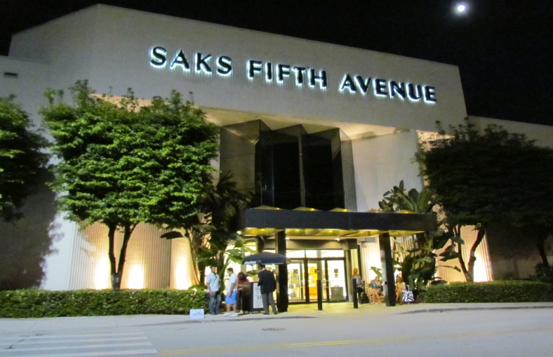
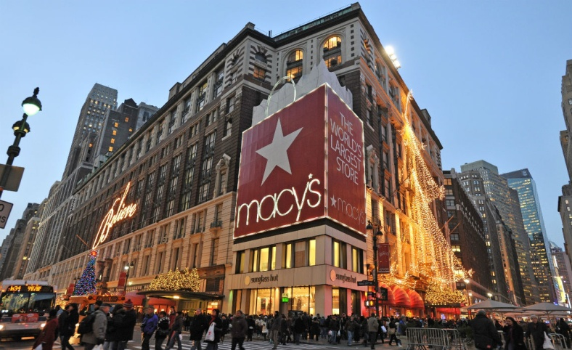
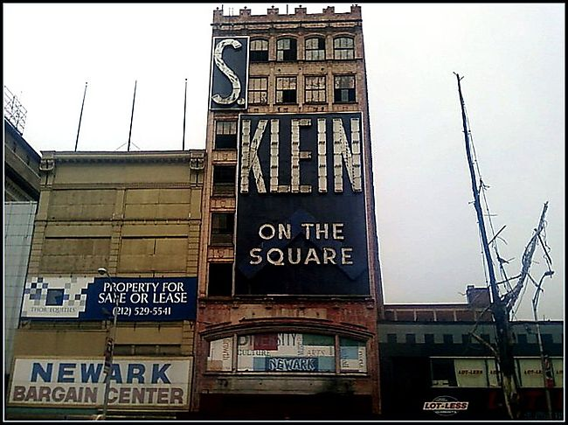
Three Large
Department Stores
Differential ranking
  Location
  Advertising
  Price of goods and emphasis on price
  Physical plant
Saks Fifth Avenue (Highest)
Macy’s (Middle)
S. Klein (Lowest)

Slide 17

Gathering Data Through Observation
Tape recorded interviews
  Speech is formal
Alternatives
  Natural social context
  No explicit observation

Slide 18
Overall Stratification of (r)
Three Categories
  All (r-1)
  Some (r-1)
  No (r-1)
Results
  62% Saks
  51% Macy’s
  20% Kleins
Emphatic Results
  (r-1) is most appropriate for emphatic speech
  Linguistic security

Slide 19
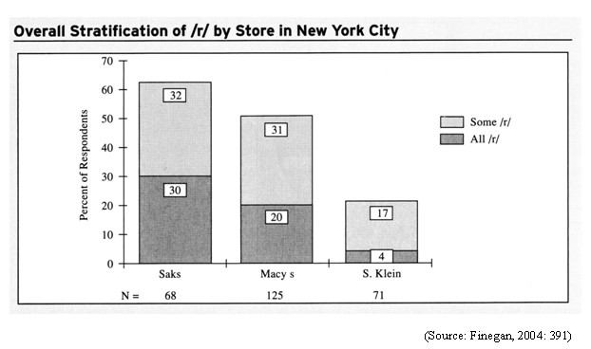

Slide 20
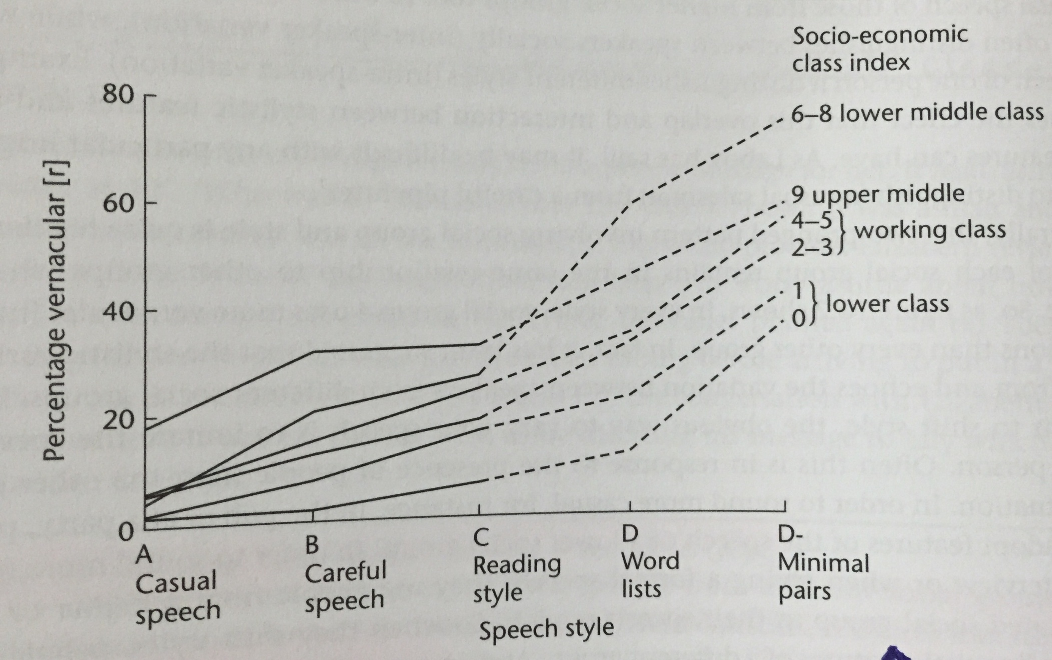

Slide 21
Result
The results illustrated that (r) in New York City was stratified by class. The pronunciation of /r/ depended on the social-class of the employees:
Those with higher socioeconomic status pronounced /r/ more frequently than those with lower socioeconomic status.
see page (255-257)

Slide 22


Slide 23


Q. Give a similar situation where linguistic variance associated with socioeconomic factor occurs in KSA ?

Slide 24

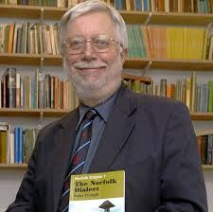
Peter Trudgill
Trudgill Biography:
Born in 7 November 1943.
He is a sociolinguist, academic and author.
He was born in Norwich, England, where he attended the City of Norwich School from 1955.
Trudgill studied modern languages at King’s Colllege, Cambridge and obtained a PhD from the University of Edinburgh .
He become a professor of sociolinguistics at the University of Essex and retires in 2005.
Norwich speech was studied by Peter Trudgill in the 1970s to find out how and why people's ways of speaking varied.

Slide 25
Trudgill studies
One of the variables Trudgill studied was the final consonant in words like walking, running.
For Example: In standard British English, the sound spelled-ng is a velar nasal.
In Norwich,however, the pronunciation waikin', talkin' is frequently heard.
Trudgill notes that this feature is not unique to Norwich:
"nearly everywhere in the Eng- speaking world we find this alternation between higher-class ̸formal ng and lower class ̸ informal n. it goes back to fact that in Old English (and later) there where two forms, a gerund ending in – ing ( walking is good for you) and a present participle ending in – end (he was walking). The –end form was the ancestor of –n' and –ing (obviously) of –ing.
The two merged – though the storing out of the two forms in terms of prestige and "correctness" is something which occurred in the last 300 years. The famous "hunrin' shootin' of upper class Edwardians shows just how recent this storing out has been.

Slide 26
Trudgill’s study discovered the following
In all social classes, the more careful the speech, the more likely people were say walking rather than walkin'.
The proportion of walkin' type forms was higher in lower social classes.
The nonstandard –in' forms occurred much more often in men's speech than in women's, and this was true for all social classes.
When women were questioned about what they thought they were saying, they tended to say they used the standard –ing forms more often than they really did.
When men were questioned about what they thought they were saying, they tended to say they used the nonstandard –in' forms more often than they really did.

Slide 27
* Trudgill's figures for social class and sex differences in the use of the standard, prestige –ing form in Norwich when people used a formal style of speaking are as follows:
(-ng) in Norwich by social class and sex for Formal style .
* Linguistic Insecurity:
Real pronunciation vs. perceived pronunciation
Seeking the prestigious pronunciation
Consequence of linguistic insecurity

Slide 28
More studied:
Prestigious pronunciations:
Tune, student, music
These words have variants in Norwich: ̸ ju: ̸ et ̸ u: ̸
̸ tju:n ̸ (considered more prestigious)
̸ tu:n ̸ (considered less prestigious)

Slide 29
Two steps in this study:
Trudgill interpretation (1)
Women:
are more preoccupied with the desire to adopt what is promoted as a more socially acceptable behavior, in this case, language.
" women are more likely to have social class aspirations than men"
Men:
Do not tend to desire to adopt what is promoted as a more socially acceptable behavior, in this case, language.
Trudgill interpretation (2):
Linguistic security vs. insecurity.
The anxiety experienced by speakers and writers who believe that their use of language does not conform to the principles and practices of (e.g. Standard English).
see page (164-174)

