Slide 1
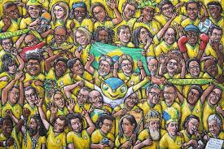
Networks
James and Lesley Milroy

Slide 2
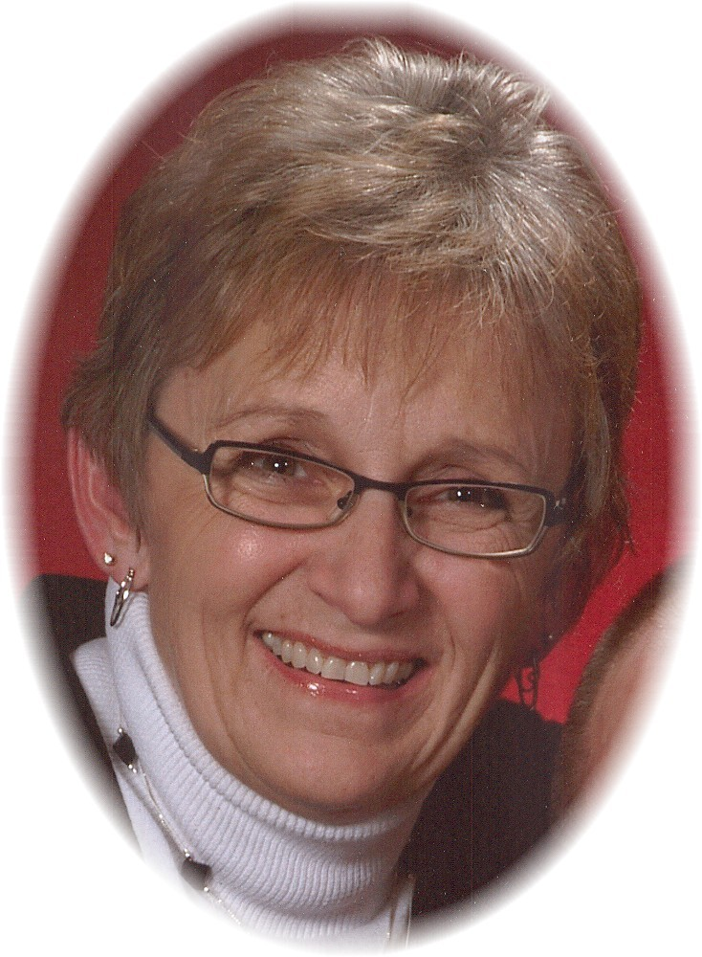

James & Lesley Milroy
Social network as analytical framework

Slide 3
Lesley & James Milroy
is a sociolinguist, and a professor emerita at the University of Michigan. She was born in Newcastle upon Tyne, United Kingdom in 1944. She studied and began her work in sociolinguistics in the UK. Lesley's work in sociolinguistics focuses on urban and rural dialectology, language ideology and standard.
Perhaps Milroy's most famous work studying examined social networks and linguistic variation in Belfast in the 1970s.
She wrote over seven books and fifteen journal articles, worked as an editorial board member for several research journals, and lectured around the world on her research. Milroy moved to the United States in 1994, where she worked as a professor and the chair of the department of linguistics at the University of Michigan, and retired in 2004. She has since done some Sociolinguistic teaching and lecturing at Oxford University.

Slide 4
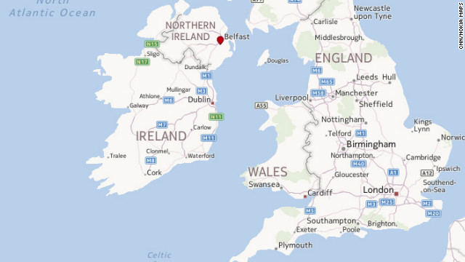
Belfast

Slide 5
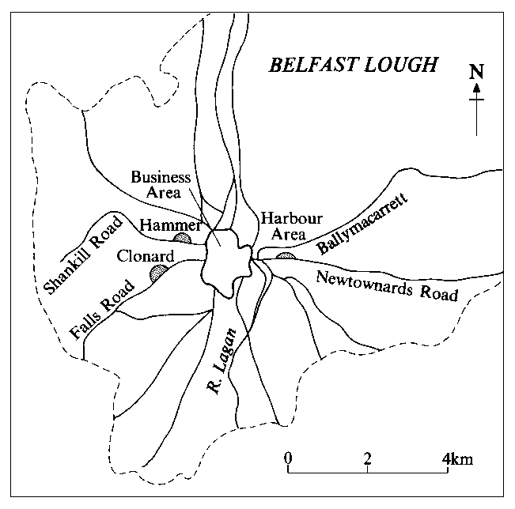
The Belfast study:
It was a community study carried out in Belfast by James and Lesley Milroy. The study was carried out in order to study local practices in interpreting socio-linguistic patterns, by gaining access to everyday speech.

Slide 6
Background:
The researchers, James and Lesley Milroy realised a community study in Belfast, they wanted ti gain access to everyday working class speech to study local practices in interpreting sociolinguistic patterns.
Thus Milroys’ major hypothesis was that even when the variables age, sex and social class are held constant. the closer an individual’s network ties with his/her local community are, the closer his/her language approximates to localised vernacular norms.
To avoid the observation effect and the outsider effect as far as possible, the Milroy’s decided on participant observation technique. That means that the subjects did not know about this sociolinguistic study at all and thus were not influenced by social desirability effects while being recorded.

Slide 7
AREAS CHOSEN:
On the basis of general ethnographic factors which seemed likely to give rise to linguistic differences within the same social class three low status urban working class communities were chosen:
1. Ballymacarrett
2. The Hammer area
3. The Clonard

Slide 8
Cont.
The river Lagan splits Belfast into two sides. And because of inter-ethnic conflicts, Belfast is highly segregated: Ballymacarrett mainly consists of Protestants who almost never cross the river. The Cloned has Catholic inhabitants and the Hammer area is occupied by Protestants. There is almost no interaction between the Clonard and the Hammer inhabitants. Most of them do not even use the same facilities.
All three areas are so called “ lighted areas” with a high level of social malaise, i.e. high unemployment rates, juvenile crime, sickness, early deaths from disease, and illegitimacy.

Slide 9
proceeding:
Lesley Milroy herself was the fieldworker. She had an initial link person who belonged to one community group and knew about the study. This contact person gave her a list with names and addresses, but did not introduce of acccopany her to the group. When Milroy then approximated these people, she took the role of a “friend of a friend”, i.e. of the contact person. She introduced herself “a friend of X, he thought you might be able yo help me”. it was necessary to have a female fieldworker because a solitary woman is less attacked to seen as a threat when she entered a new seen as a proof of good faith by the group members and they directly accepted and enmeshed Milroy in their network.

Slide 10
Cont.
Lesley Milroy spent time with the community members, fetched the youths and did individual members some favours. All the time, she recorded their conversations. By integrating into the community networks, Milroy also got known by others and became part of the members’ exchange and obligation relationships, but always stayed “friend of a friend”, i.e. a second-order network contact for the others. Because of a rather standardised speech style, priests, teachers and community leaders were avoided.

Slide 11
Data:
The language patterns of a total of 48 live speakers were recorded. This means that there were 16 speakers for each community. These 16 people consisted of 4 young men and 4 young women aged 18 to 25 years, and 4 middle aged men and 4 middle aged women aged 42 to 55 years. All subjects had a relatively dense and multiplex social typical for traditional, long established working class communities, because they are minimally impacted by social or geographical mobility.

Slide 12
Cont.
Their networks were measured by each individual’s answer to the questions whether they:
1. Were member in a high density, territorially based cluster.
2. Had substantial ties of kinship in the neighbourhood (more than one householdd in addition to their own nuclear family)
3. Were working at the same place as at least two others from the same area.
4. Were working at the same place was at least two others of the same sec from the area.
5. Voluntarily spend leisure hours with workmates (only asked if conditions 3 and 4 were fulfilled).
The network strength score was counted by one point for each “yes”- answer and zero points for each “no”, so that the maximum score was 5 points.
Because of possible interaction effects (e.g. between gender and age) subgoups were formed (e.g., young Clonard women) to show all differences and not compare the group means only. Of course, the deviation was very difficult.

Slide 13
VARIABLES:
The independent variables for this community study were age, sex and area (Ballymacarrett, the Clonard or the Hammer area).
The dependent variables consisted of eight phonological varusbles that were clearly indexical of the belfast urban speech community. These were analysed on relation to every informant then had an own network score. Now the scientists examined the impact of this network score on the speaker’s language use. The Milroys used stoical methods and graphs; they counted the correlation and made use of the analysis of the links between linguistic and extralinguistic variables. It was necessary to show that the data although from a small scale study only was representative; otherwise a generalisation of the pattern wouldn’t have been possible.
Linguistic Variables:
(a),(e), ( ),(ai),(th

Slide 14
RESULTS:
Statistical analyses showed that the strongest vernacular speakers were generally those who had the strongest neighbourhood network ties.
The Milroy’s hypothesis that the extent of individuals’ use of vernacular variants would be strongly influenced by the level of integration into neighbourhood networks could be validated.
We can thus say that a close-knit network is important for dialect maintenance. Locally relevant ties seem to be those of kin, friendship, work and neighbourhood.
Besides some smaller findings, this study also revealed a significant difference in speech style between male and female groups concerning some of the dependent variables. For these variables we can conclude that they serve as sex markers.

Slide 15
Most important findings of Belfast study
The social network approach uncovers local social structures and links them to community-wide social and economic patterns. The strongest vernacular speakers are those with the highest level of integration into neighbourhood network . A close-knit network is important for dialect maintenance.
( Labov confirmed the pattern found by the Milroys.)

Slide 16
we can quantify individual’s informal social contacts
Social network as a speaker variable
How many people in the community do they know ?
How many of these know each other ?
In what capacities?
Key insight : network are “closer” to the individual than social classes. They enable us to see the influences on the individual.

Slide 17
4 principle indicators of a person’s integration into a network:
1- Neighbourhood of residence (physical rootedness)
2-Kinship
3-Occupation
4- Voluntary association

Slide 18
Social network as a speaker variable
Class-based approaches ascribe group membership . Network approaches focus on individual agency ( =avowed membership )
Voluntary association = chosen modes of informal interaction in community “centers ”

Slide 19
The individual as a free agent :
i.e choice of interactions within the network play a crucial role in predicting linguistic behavior
“Belfast : change and variation in an urban vernacular “ (Milroy&Milroy,19780

Slide 20
Background 2 , 1970s Belfast:
Influx of population the potato famines of the 19th century Belfast communities differed in recency of settlement .

Slide 21
Methods 1 :
Conducted an ethnography of the community :
1- position of the community in relation to the wider urban area .
2- network pattern within the community .
3-Linguistic and non-linguistic norms governing face-to-face interaction .
4- characterization of sociolinguistically significant personality types :
a) Oddballs
b) Insiders

Slide 22
Methods 2 :
Speakers drawn from 3 core neighbourhoods : each working class, economically depressed :
Under redevelopment Location of shipyard :
16 respondents
2 genders
2 age cohorts : young = 18-25 ; middle-aged = 42-55
48 respondents .
Clonard | Hammer | Ballymacarrett
West | West | East
Catholic | Protestant | Protestant

Slide 23
Calculating network strength :
Example 2 :
For each condition met , the speaker was assigned 1 point . Scores could range from 0 points ( no conditions met ) to 5 ( of 6 possible point values )

Slide 24
Cont.
Paula | Hanna
Large family , all residing locally | No kin in the area ; no family of her own
Visits to her neighbours are frequent | Dose not interact with neighbours
Belongs to a weekly bingo group | Spends evenings /weekends at home watching TV
Cares for disabled woman 2 miles | Works in the cafeteria of the Royal Victoria Hospital
from Clonard (Ballymacarrett side of the River Lagan ) | Child of a prot/catholic mixed marriage .
 | Workmates are not from the Clonard

Slide 25
cont.
scores on the Belfast network strength scale : | P | H
1-Membership in a high-density , territorially-based cluster | 1 | 0
2-Substantial kinship ties within the neighbourhood | 1 | 0
Employed in the same place s at least 2 others | 0 | 0
Workmates include member of the same gender | 0 | 0
Voluntary association with workmates | 0 | 0
Total | 2 | 0

Slide 26
Example 2 cont.
Main finding : linguistic variable scores turn out to be closely related to (i.e., to co-vary with) the variable of “personal network “
Scores assigned on 8 linguistic variables :
8 | 7 | 6 | 5 | 4 | 3 | 2 | 1
(E)² [Q] in disylls. | (E)¹ [Q] “slept” | (√)² [√,¨] “pull” | (th) [O] “mother” | (√)¹ [U] “hut” | (I) 1-3pts | (a) 1-5pts “bag” [bEg], but”man” [mç.´n] | (ai) 1-3pts [EI eI] “night” | Variable:
25% | 66.7% | 0% | 0% | 0% | 1.2 | 1.05 | 1.4 | Hanna
47.83% | 100% | 70.48% | 58.34% | 9% | 2.5 | 2.63 | 2.4 | Paula

Slide 27
Results 1:
Speakers drawn from 3 Core neighborhoods: each working class, economically depressed
Ballymacarrett | Hammer | Clonard
East | We | West
Protestants | Protestants | Catholic
 | Under redevelopment | Location of shipyard

Slide 28
Results 1:
Characterization of the communities showed that B, H, and C were characterized by dense overlapping kin and friendship networks that tended not to cross the territorial boundaries perceived by the residents.
Close-knit networks were maintained through:
+ residents’ regular visits to each others’ homes
+ prolonged visits
+ corner hanging
+ common form of employment
+ local place of occupation (reinforcing traditional gender roles)
Why is this relevant? “The degree to which people use vernacular speech norms seems to correlate to the extent to which they participate in close-knit networks.”

Slide 29
Results 2:
(a), (e), ( ), (ai), (th):
1.) IS shows a shift away from casual speech or SS (expected)
e.g., (th)-deletion reveals that speakers who delete in SS do not delete at all when reading a wordlist
2.) WLS scores closer to casual speech (unexpected), counter to predictions of social class model
  e.g., Ballymaccarrett (ai) and Clonard ( ) defy the expected pattern

Slide 30
Results 3:
cont.,
3.) Participation in newer local changes
e.g., (a) Clonard females as innovatory: shows stylistic variation as (th) does, however, WLS closer to the vernacular form than IS

Slide 31
Discussion: Key findings of Social network studies
Fine grained-view of the relationship between speaker variables and linguistic variables, showing:
  individual’s behavior (range of within-speaker variability)
  the forces that impact individual behavior
  Social networks allow the investigagion of forces that impact individual behavior better than social classes (they are better able to explain individual behavior)
Tightly-knit, territorially-based social networks are norm-enforcing mechanisms, leading to the conservation of vernacular norms (e.g., local dialect), and resisting pressures from the outside.
“The degree to which people use vernacular speech norms seems to correlate to the extent to which they participate in close-knit networks. (Milroy and Milroy 1988:185)”

Slide 32
Other Studies
Martha’s Vineyard, Labov (1963)
Reading adventure playgrounds, Cheshire (1982)
Detroit Black English Vernacular (AAVE), Edwards (1992)
Grossdorf, Lippi-Green (1987)

Slide 33
Applying the notion of the Social network
Hymes, 1974 reserves the notion of community for “local units” characterized for their members by common locality and primary interaction.
How might we define a “local unit” or pre-existing group?
  pre-existing social cluster: urban village, neighborhood cluster
  Two approaches to quantifying social integration into a pre-existing group:
    1. Milroy and Milroy: network strength score
    2. Labov: Sociometric diagram with reciprocal naming

Slide 34
Social networks:
Quantifying network strength
Boissevain, 1972 (anthropologist)
Social networks: the web of social relations within which every individual is embedded.
    points = individuals
    anchored to ego

Slide 35
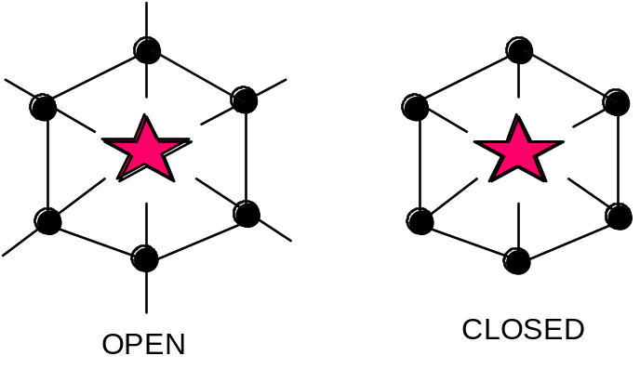
Social networks:
Quantifying network strength
We may characterize networks in terms of their:
--structure (density) --direction of movement
--content (multiplexity) --frequency of interaction
Characterizations:
Open vs. Closed
Dense
Multiplex

