Slide 1
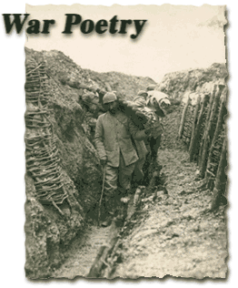

Slide 2
War poetry
War poets were classical because poetry they wrote was of an incident that occurred and disturbed the whole modern world when it started. So as an action war poet started to write in order to enlighten the public.
In war poetry one sees that it was as a result of the beginning of the war. Actually writing started earlier before the war broke out. At the beginning of the early decade of war poetry, those poets were enthusiastic and show patriotism which is very significant in war poetry. This poetry was nationalistic.

Slide 3
One notices that at the beginning of the twentieth century, as in the Victorian period of time, there was skepticism and loss of faith which was one of the major themes of modern poetry. Towards these new features of loss of faith and skepticism, the materialistic kind of life that man is experiencing and the contentious change, added a kind of a shift in the literary writings.
Literature here adapted certain alien features or new that the earlier generations have not experienced because the influences were all over the world like symbolism of French school that affected the European mind and philosophies of Nietzsche. All of these affected literature themes with certain alien features that it was not used to. It did not only affected the themes, but also the forms and techniques of modern poetry.

Slide 4
War poets were classified into two stages:
Pre-War poetry
and
Post-War Poetry.

Slide 5
Pre-War poetry
Pre-War poetry was the earlier poems that were written before the war by a month earlier of the beginning of the war in 1914. Most of these poems in Britain were patriotic in their themes. They were self-sacrifice, courage, enthusiasm, glorifying the war and many others. They were celebrating, not afraid or worried about the war. All soldiers were enthusiastic about war at this early stage of writing poetry.
Most of the soldiers were poets themselves. When they participated in the war, they were shocked by the devastation that they saw, fear, horrible great numbers of deaths and thousands that were killed by one bomb. They were shocked by the horrible face of war. As a result, they started to change their attitude towards the war. They could not continue, because most of the participants or soldiers were young. Many thousands of young people faced death. The famous poet of this group was Rupert Brooke.

Slide 6

Rupert
Brooke

Slide 7
Rupert Brooke was the most famous poet of this group. That is because he started to write poems when he was a soldier and he was so enthusiastic about the war, but he never participated in the battle or faced a real contact. He was a soldier and went with the navy to Greece and participated there, but he never faced a real battlefield
In this first group, most of the poets actually started in such enthusiastic flavor, but when they participated in the real war, they changed their attitude, because they saw the real ugly face of war. They agreed that they will speak of the truth. They became realistic spokesmen of the war.

Slide 8
Post-War Poetry
One notices that the Post-War poetry are not patriotic any more. They are not talking about talking or preaching self-sacrifice. They are not talking about courage or the glory of war. They are talking about horror, bloodshed, great deaths, disappointment which is one of the major themes of the post-war poetry. They were disillusioned because the war in its essence was not their right. It was written to defend the European other nations. It was actually a war of muscles. Every nation wanted to show the power. Everyone discovered new weapon like artillery, air planes, horrible bombs and devastating gas bombs. It was like a race of inventing destructions of man and that was a shock for literary men who were also soldiers.
There was the theme of disillusionment and disappointment. The poetry here tends to be poetry of pity with a satirical tone. They satirized the leaders and system.

Slide 9
The most famous Post-War poets are Siegfried Sassoon and Wilfred Owen. They were disillusioned by the decisions of their leaders. Both of them were injured and went into a hospital and as their colleagues, they found out that this war was not on real bases, but just a war on rivalry between nations, so they decided to speak out truly and they started to write great poems satirizing their leaders. Upon them, was Sassoon who was the attacker of his own leaders with several poems. Post-war poetry emerged because of the disillusionment and it became poetry of pity and satire.
Generally speaking, themes of war poetry were patriotism, self-sacrifice, devotion for country, courage, loyalty, and then post-war poetry was about victims, suffering, peace and courage.

Slide 10
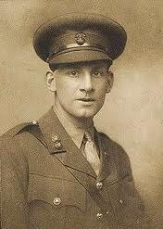
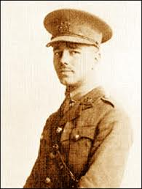
Siegfried Sassoon
Wilfred Owen

Slide 11
Techniques of War Poetry:
Concerning technicalities used in modern poetry, there are new developments in literary production; poetry turned from being poetic into more colloquial style and sometimes it turns to be conversational. It is not a poetic, metaphorical language, but colloquial and conversational.
In the techniques, satire and irony were used in Modern poetry. It tended to use free verse that does not follow certain rules.

Slide 12
Forms of War Poetry:
The same forms were used like sonnets, but modern poets tended to use new kinds of techniques like using heroic diction, emotional references and satirical style, in addition to realistic pictures and images of war. It turned to be documentary episodes of things that happen at that time. It is a documentary poetry as several of these poems have references to titles or names of battles like the Battle of the Somme which was one of the great and horrible battles in the whole world between both British and French armies against the German army. Both the German and the British sides lost more than ninety thousand lives in that one battle.
The British poets did not experience the horror of the war on their land, because most of the battlefields were in Europe as in France, Belgium, but not in England. They did not experience the horror of the war. Earlier they only read about it in the newspapers. Later on, they experienced it. At the beginning they had nationalistic feelings.

Slide 13
Good Luke
Group names:
Nouf Hadan
Abeer Gahtani
Noura Al.bogami
Dalal Al-katheer

