Slide 1
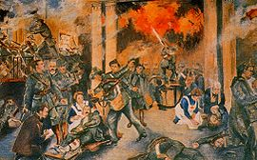
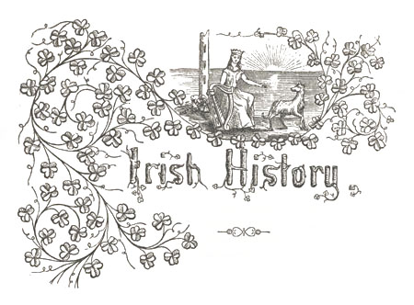
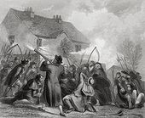
Irish Poetry

Slide 2
Wafa Abdullah Al-Aqeel

Slide 3
Introduction
The history of Irish poetry includes the poetries of two languages, one in Irish and the other in English . The complex interplay between these two traditions, and between both of them and other poetries in English, has produced a body of work that is both rich in variety and difficult to categorize.
The earliest surviving poems in Irish date back to the 6th century, while the first known poems in English from Ireland date to the 14th century. Although some cross-fertilization between the two language traditions has always happened, the final emergence of an English-language poetry that had absorbed themes and models from Irish did not appear until the 19th century. This culminated in the work of the poets of the Celtic Revival at the end of the 19th and beginning of the 20th century.

Slide 4
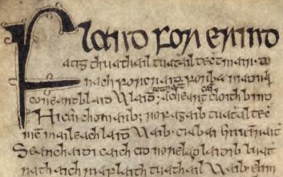
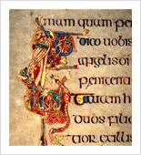
Towards the last quarter of the century, modern Irish poetry has tended to a wide range of diversity, from the poets of the Northern school to writers influenced by the modernist tradition and those facing the new questions .posed by an increasingly urban and cosmopolitan society

Slide 5
Muneerah Saud Al Azman

Slide 6
History of Ireland
Early Ireland History: By the start of the Christian Era the various Celtic tribes inhabiting Ireland were apparently divided into the five kingdoms of Ulster; Meath, Leinster, Munster, and Connaught, whose rulers were subject to a high king dwelling at Tara.
The Invasion of Ireland: In 795 the Normans invaded Ireland, settling along the coast and raiding the interior and its Irish people. Two centuries later the country was temporarily united under Brian Boroimhe {Brian Boru}, and in 1014 the Normans were finally defeated at the Battle of Clontarf. In 1155, however, Pope Adrian IV authorized Henry II of England to take Ireland as a papal fief, and not long afterward an English army invaded Ireland to restore Dermot MacMurrough, the deposed Kind of Leinster, to his throne. English soldiers and settlers occupied the eastern kingdom, and Henry granted large estates in Ireland to English nobles. But many of these immigrants adopted the ways and attitudes of the Irish natives, and England soon controlled only a few towns and the Pale, a district around Dublin.

Slide 7
Political Conflict in the Country of Ireland: In 1778 the Irish people were given the right to acquire land, open schools, and exercise their religion with fewer restrictions, but in 1800, after further revolts, the Act of Union abolished the Irish Parliament, making Ireland a part of the United Kingdom. Only Protestants represented the country in the British Parliament until 1829, when the Emancipation Act opened the way for Catholics to serve in the legislature.
To the poverty caused by land and trade laws favoring English landowners, was added in 1847-48 the terrible potato famine, which took a million Irish lives within a few years and stimulated mass emigration to the United States.
The Irish-American Fenians inspired another revolt in 1867, and Parliament passed some reform measures.
In 1898 local self-government was obtained. Despite these reforms, however, agitation was revived under John Dillon and John Redmond. In 1903 the Land Purchase Act made it possible for Irish tenants to by land from the great landlords on easy terms. Eleven years later a home-rule bill was passed which was later suspended as a result of the protest of Northern Ireland and the outbreak of World War I.

Slide 8
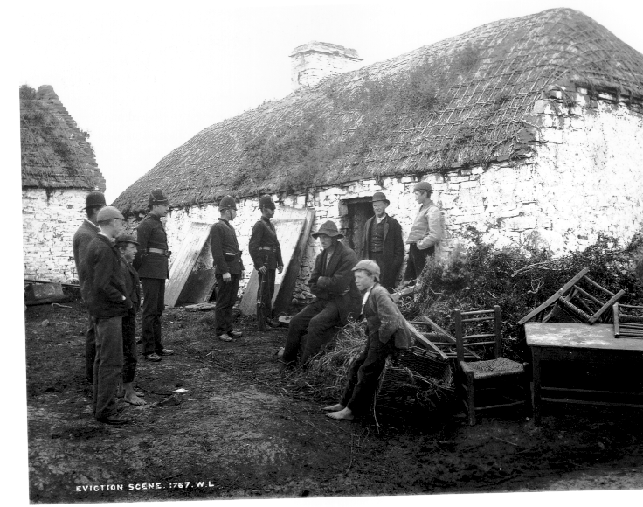
The Final Struggle of the Irish People: in 1921 resulted in the establishment of the Irish Free State as a self-governing dominion. Refusing to join in this new arrangement, Northern Ireland began its separate existence as a part of the United Kingdom.
In 1937, the Irish Free State became "Eire", "A sovereign, independent, democratic state".

Slide 9
Fatmah Saad Al-Kaboor

Slide 10
Irish Poetry Through The Centuries…
For centuries, the storytelling tradition of Ireland has remained an important facet of the country and its culture.
-Throughout history, the Irish have been renowned for their “gift of gab” – a particular facility with self-expression, language, and dramatic flair
-Indeed, since the sixth century, when poets penned sagas on the pages of illuminated manuscripts (such as the Pangur Ban, written by an Irish monk), Irish poetry has remained a singular and hypnotic art form.
-The best Irish poetry focuses on the country and its people – whether sophisticated or “folk” in tone, it always honors the experience of being Irish…
In the 6th century, poetry was mostly written in prose form (unstructured and conversational); this tradition continued right up to the 11th century
In the court of an Irish chieftain, the poet, would wear many hats (metaphorically speaking).
A poet would be a jester, who was there to keep the chieftain happy and entertained…but he would also be a historian, who recorded the events of the day in poetic form. These stories would be passed down, as written or verbal records of the Irish people and all of their struggles and victories…
3-The poets moved Irish poetry forward; they were quite organized, and they valued tradition, clan, and patriotism…naturally, these themes were also common in their spoken and written work.
4-These poet-courtiers began to use techniques such as alliteration to their poems. The use of syllabic meter helped to create a specific style that was more controlled and uniform.

Slide 11
The End Of The Bards Signalled A New Direction In Irish Poetry…
1-In time, the influence of the poets - and their traditions faded…by the 17th century, poets were no longer full-time courtiers. Instead, they were everyday people
2-Poetry became a part-time occupation…a passion, or even an escape from the 2-mundane. As this shift occurred, the Early Modern Irish period began..During this phase, the rapidly changing face of Irish society was examined in verse – political themes were commonplace. Gaelic poetry during this time frame really reflected the face of a new society…
The modern age still referenced the bards and the storytelling tradition – poets such as William Butler Yeats (perhaps Ireland’s greatest poet) produced legendary work that echoed the past.
…here is an excerpt from one of his greatest poems, The Song Of Wandering Aengus (read it aloud to get the full effect: it has a hypnotic rhythm):
Though I am old with wandering
Through hollow lands and hilly lands,
I will find out where she has gone,
And kiss her lips and take her hands;
And walk among long dappled grass,
And pluck till time and times are done
The silver apples of the moon,
The golden apples of the sun.
— William Butler Yeats

Slide 12
Sarah Salem Al-Khaldi

Slide 13
The 20th century
Yeats and modernism
In the 1910s, Yeats became acquainted with the work of James Joyce, and worked closely with Ezra Pound, who served as his personal secretary for a time. Through Pound, Yeats also became familiar with the work of a range of prominent modernist poets. He learned from these contacts, and from his 1916 book Responsibilities and Other Poems onwards his work, while not entirely meriting the label modernist, became much more hard-edged than it had been.
A second group of early 20th century Irish poets worth noting are those associated with the Easter Rising of 1916. Three of the Republican leadership, Patrick Pearse , Joseph Mary Plunkett and Thomas MacDonagh, were noted poets. Although much of the verse written by them is predictably Catholic and Nationalist in outlook, they were competent writers and their work is of considerable historical interest.

Slide 14
However, it was to be Yeats' earlier Celtic mode that was to be most influential. Amongst the most prominent followers of the early Yeats were Padraic Colum (1881–1972), F. R. Higgins (1896–1941), and Austin Clarke (1896–1974). In the 1950s, Clarke, returning to poetry after a long absence, turned to a much more personal style and wrote many satires on Irish society and religious practices. Irish poetic Modernism took its lead not from Yeats but from Joyce.
While Yeats and his followers wrote about an essentially aristocratic Gaelic Ireland, the reality was that the actual Irish Free State of the 1930s and 1940s was a society of small farmers and shopkeepers. Inevitably, a generation of poets who rebelled against the example of Yeats, but who were not Modernist by inclination, emerged from this environment. Patrick Kavanagh (1904–1967), who came from a small farm, wrote about the narrowness and frustrations of rural life. John Hewitt (1907–1987), whom many consider to be the founding father of Northern Irish poetry, also came from a rural background but lived in Belfast and was amongst the first Irish poets to write of the sense of alienation that many at this time felt from both their original rural and new urban homes. Louis MacNeice (1907–1963), another Northern Irish poet, was associated with the left-wing politics of Michael Roberts's anthology New Signatures but was much less political a poet than W. H. Auden or Stephen Spender, for example. MacNeice's poetry was informed by his immediate interests and surroundings and is more social than political. In the South, the Republic of Ireland, a post-modernist generation of poets and writers emerged from the late 1950s onwards. Prominent among these writers were the poets Antony Cronin, Pearse Hutchinson, John Jordan, Thomas Kinsella and John Montague, most of whom were based in Dublin in the 1960s and 1970s. In Dublin a number of new literary magazines were founded in the 1960s; Poetry Ireland, Arena, The Lace Curtain, and in the 1970s, Cyphers .

Slide 15
Sarah Mansour Al-Otaibi

Slide 16
Irish Poetry Today
Irish poetry in the 21st Century is undergoing development as radical as the 1960s. Increased globalisation has led to a younger generation of poets seeking influences and precursors as varied as post-war Polish poets and Contemporary Americans. An explosion of talent and publishing has been one of the consequences of free secondary school education introduced in the 1960s, allowing many southern poets (e.g. Thomas McCarthy, John Ennis, Dennis O’Driscoll, Nuala Ní Dhomhnaill) to come to wider notice.
Among the significant Irish poets to have emerged in recent years are: Pat Boran, Mairéad Byrne, Ciarán Carson, Patrick Chapman, Harry Clifton, Tony Curtis, Padraig J. Daly, Gerald Dawe, Greg Delanty, Séan Dunne, Paul Durcan, Eamon Grennan, Vona Groarke, Kerry Hardie, and others
While academic attention has remained, perhaps disproportionately, focused on poetry from Northern Ireland, several of the younger generation of Irish poets (William Wall, Justin Quinn, Caitriona O'Reilly) have proved perceptive and independent critics of the contemporary scene.

Slide 17
Women Poets
The second half of the century also saw the emergence of a number of women poets of note. Two of the most successful of these are Eavan Boland (born 1944) and Eiléan Ní Chuilleanáin (born 1942). Boland has written widely on specifically feminist themes and on the difficulties faced by women poets in a male-dominated literary world. She is professor of English at Stanford University . Ní Chuilleanáin's poetry resists easy summaries and shows her interest variously in explorations of the sacred, women's experience, and Reformation history. She has also translated poetry from a number of languages. Ní Chuilleanáin is a Fellow of Trinity College Dublin where she is an associate professor of English Literature. Other women poets of note are; Vona Groarke ; Kerry Hardie; Medbh McGuckian ; Paula Meehan ; and Nuala Ní Dhomhnaill , whose first language is Irish, but whose work has been translated into English

Slide 18
The End

