Slide 1

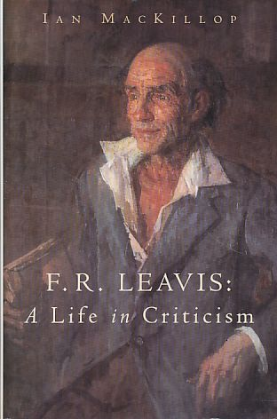
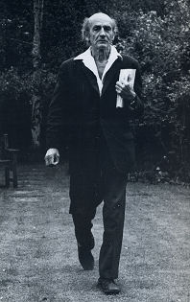
F.R.LEAVIS

Slide 2

F.R.LEAVIS
Frank Raymond Leavis CH (July 14, 1895 - April 14, 1978) was an influential British literary critic of the early-to-mid-twentieth century. He taught and studied for nearly his entire life at Downing College, Cambridge. Leavis is most closely associated with the New Critics. New Criticism, simultaneously together with Russian Formalism introduced greater rigor into literary studies.
The New Critics moved away from treating literature as a cultural artifact to be studied for its historical significance. Instead, they emphasized study of the text itself. While Leavis was a proponent that literary studies would focus on the text, he nonetheless was skeptical that literature could be divorced from moral concerns.

Slide 3
Leavis, F. R Criticism
Leavis was one of the most influential figures in twentieth-century English literary criticism. He introduced a "seriousness" into English studies, and the modern university subject has been shaped very much by Leavis’ approach to literary studies. He insisted that evaluation was the principal concern of criticism, and that it must ensure that English literature should be a living reality operating as an informing spirit in society, and that criticism should involve the shaping of contemporary sensibility (Bilan 61).
Leavis’s criticism is difficult to directly classify, but it can be grouped into four chronological stages. The first is that of his early publications and essays including New Bearings in English Poetry (1932) and Revaluation (1936). Here he was concerned primarily with reexamining poetry from the seventeenth to twentieth centuries, and this was accomplished under the strong influence of T.S. Eliot. Also during this early period Leavis sketched out his views about university education.

Slide 4
Leavis, F. R Criticism
He then turned his attention to fiction and the novel, producing The Great Tradition (1948) and D.H. Lawrence, Novelist (1955). Following this period Leavis pursued an increasingly complex treatment of literary, educational and social issues. Though the hub of his work remained literature, his perspective for commentary was noticeably broadening, and this was most visible in Nor Shall my Sword (1972).
Two of his last publications embodied the critical sentiments of his final years; The Living Principle: ‘English’ as a Discipline of Thought (1975), and Thought, Words and Creativity: Art and Thought in Lawrence (1976). Despite a natural aversion to it in the early part of his career, his criticism became progressively philosophical in nature during the last years of his life.

Slide 5

F R Leavis on Poetry:
Though his achievements as a critic of fiction were impressive, Leavis is often viewed as having been a better critic of poetry than of the novel. In New Bearings in English Poetry Leavis attacked the Victorian poetical ideal, suggesting that nineteenth-century poetry sought the consciously ‘poetical’ and showed a separation of thought and feeling and a divorce from the real world. The influence of T. S. Eliot is easily identifiable in his criticism of Victorian poetry, and Leavis acknowledged this, saying in The Common Pursuit that, ‘It was Mr. Eliot who made us fully conscious of the weakness of that tradition’ (Leavis 31). In his later publication Revaluation, the dependence on Eliot was still very much present, but Leavis demonstrated an individual critical sense operating in such a way as to place him among the distinguished modern critics.

Slide 6
F R Leavis on Poetry:
The early reception of T. S. Eliot and Ezra Pound's poetry, and also the reading of Gerard Manley Hopkins, were considerably enhanced by Leavis's proclamation of their greatness. His criticism of John Milton, on the other hand, had no great impact on Milton's popular esteem. Many of his finest analyses of poems were reprinted in the late work, The Living Principle.

Slide 7
Some of the accusations of Leavis:
One of the misrepresentation concerned Leavis’s views on university education.
He was accused of being both elitist and anti-democratic, when he protested against “the transition from quality to quantity in education,” against the universities “turning out hordes of ‘substandard’ would-be researchers,” thereby debasing ”research,” and against the accelerating drift of Americanization leading us headlong towards the Comprehensive University; and when he suggested that “neither democratic zeal nor egalitarian jealousies should be permitted to dismiss or discredit the fact that only a limited portion of any young adults is capable of profiting by, or enjoying, university education. The proper standard can be maintained only if the students the university is required to deal with are-for the most part, at any rate of university quality. If standards are not maintained somewhere the whole community is let down.”

Slide 8
Some of the accusations of Leavis:
another misrepresentation Leavis suffered from all his life concerned his English style. He was frequently accused of “clumsiness of expression,” “nervous mannerisms of style,” “ramshackle use of language.” One critic compared his English to “a third former’s translation of Cicero”; another described it as “cokelike in its roughness and chill”; and still another blamed him for his “imprecise prose and bad temper.”
. When Leavis’s book on Lawrence was being published in America the publisher’s “stylist” wrote to Leavis suggesting that he clarify a particular sentence in the book. Leavis’s reaction was: “I am not going to attempt that kind of paraphrase for the American or any other reader. It’s like being asked to have a different kind of mind and to have written a different kind of book.
There I stand and, as Luther said, ‘I can no other.’ I tried the sentence on Q.D. Leavis (my severest critic), and she says it would give no trouble to anyone who can read the book.” Clarity of expression, A.E. Housman said, is not a virtue but a duty. But so is fidelity to one’s own thought in all its subtlety and complexity.

Slide 9
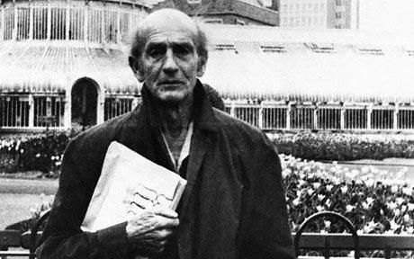
Some of the accusations of Leavis:
F.R.Leavis did not have a theoretical approach to criticism. Or rather, he did not overtly have one. Roland Barthes would have criticized him for not declaring his ideology: his value system. Therefore, it is hard to determine whether he had any consistency in his criticisms. Leavis objected to ideologies, such as Marxism, because they dealt with abstractions and a whole world outside the text, whereas his concern began and ended with the printed word. As Eagleton writes ,the text almost became ‘reified’ as Leavis limited his focus to it. If a text can be studied in isolation, then the question raised is why Leavis needs to write about Wordsworth, the poet, instead of just his work. By writing about Wordsworth, Leavis has gone beyond the text.

Slide 10
Some of the accusations of Leavis:
There is more than just a hint that Leavis knows something of Wordsworth’s life: ”his generously active sympathies had involved him in emotional disasters that threatened his hold on life.”
However, Leavis has not begun with a close reading of any literary text, as he wanted to do. Rather, it would appear that this is an examination of Wordsworth, itself and himself; for Wordsworth can mean both text and author, just as Shakespeare can. To do this it means involves using psychology. It would appear that Leavis is writing with an ideology in mind, and that he is guilty of the same crime that he has accused others of. For instance, Leavis uses abstractions. “Impersonality” is certainly treated as one by Vincent Buckley and, according to him, it is not the only word that Leavis employs in a specialized way.

Slide 11
Some of the accusations of Leavis:
Another accusation of Leavis is that even though he had written with critical acumen and insight on Mark Twain and T.S. Eliot, the Ezra Pound of Hugh Selwyn Mauberley, as well as about “The Americanness of American Literature,” where he referred to the “American centra1 tradition ” “carrying with it the promise of a robust continuing life” and suggested that “in Jane Austen, Dickens, Hawthorne, Melville, George Eliot, Henry James, Conrad, and D.H. Lawrence we have the successors of Shakespeare,” he was accused of being anti-American. And this because, among other things, he contemplated, as he calls it, “the nightmare of the intensification of what Matthew Arnold feared,” namely, the danger of England becoming a greater Holland or a little America; interpreted the general acceptance, in England, of Hemingway as a great writer, as a sign of the collapse of standards; and showed his astonishment at American academics writing on novels from Jane Austen to D.H. Lawrence with “utter insensitiveness to those refinements of perception, distinction, valuation and interest which imply the collaboratively created human reality they depend on, and, voided of which the novelist’s theme becomes a mere opportunity for such gratuitousness of ‘interpretation’ as the critic’s need to be original may prompt him (or her) to contrive.”

Slide 12

Some of the accusations of Leavis:
Another thing which is Leavis’s commitment to creativity which needs to be stressed because his detractors have chosen to ignore it, dismissing him as a ‘righteous moralist’ instead of examining what he actually says. The critic’s task, wrote Leavis was ‘not to subscribe to or apply some specific ethical theory or scheme’ to a work, but to keep alive a sense of the literary heritage, that world of ‘human values and significances which is created and maintained by continuous collaborative human activity’ (1972: 174). Leavis is very careful not to define these ‘human values and significances’ because that would be to limit them, to enclose them within the bounds of an enlightenment view of language as purely a means of expression.

Slide 13
F.R.LEAVIS
Thank you for Listening
Alyah Al-Ghamdi
Marwa Al-Omran
Amal Al-Shammary
Ahlam AL Motary
Dalia Al-Essa
Aishah Mebhi

