Slide 1
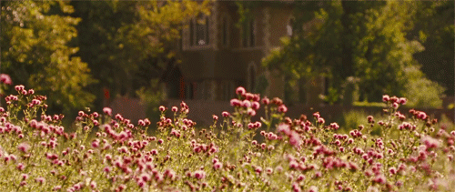
Good Morning

Slide 2
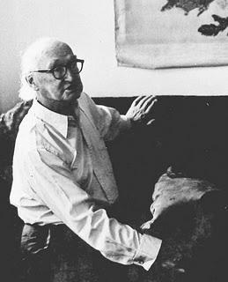
I. A. Richards
A modern critic (1893 -1979)

Slide 3
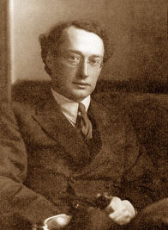
* His Life in General :

Slide 4
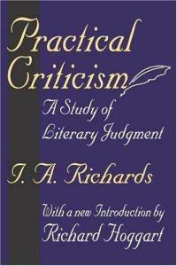
Ivor Armstrong Richards (26 February 1893 in Sandbach, Cheshire – 7 September 1979 in Cambridge).
influential English literary critic and rhetorician.
His education.
His books.
The concept of 'practical criticism' .
His career.
*Maha Naser

Slide 5
: * His Contributions

Slide 6
Richards' life and influence can be divided into periods, which correspond roughly to his intellectual interests.
1 _ Collaboration with Ogden
Richards' collaborator with Ogden on three of the most important projects of Richards' life.
1 Foundations of Aesthetics ; Richards maps out the principles of aesthetic reception which lay at the root of Richards' literary theory (the principle of "harmony," or balance of competing psychological impulses).
2 The Meaning of Meaning: A Study of the Influence of Language upon Thought and of the Science of Symbolism, Richards and Odgen work out the triadic theory of semiotics which, in its dependence on psychological theories, prefigures the importance of psychology in Richards independently authored literary criticism.
3 The General Basic English Dictionary and Times of India Guide to Basic English, Richards and Ogden developed their most internationally influential project—the Basic English program for the development of an international language based with an 850-
word vocabulary.
Areej AlShehri

Slide 7
Aesthetics and literary criticism
Richards' impact on the field of literary criticism was immense. Adams calls it as influential as that of T.S. Eliot.^{[1]} Like Matthew Arnold, he was interested in the experience of reading poetry and the impact of poetry on the reader. In particular, he believed that "balancing and organizing conflicting impulses is characteristic of the experience of poetry and that this experience has particular importance in an age during which canons of moral and social authority are crumbling."
Areej AlShehri

Slide 8

His Works :
*The Foundations of Aesthetics
*Principles of Literary Criticism
*Science and Poetry
*Practical Criticism
*Coleridge on Imagination
*Speculative Instruments
*'So Much Nearer
Rhetoric, semiotics and prose interpretation
*The Meaning of Meaning
*Mencius on the Mind
*Basic Rules of Reason
*The Philosophy of Rhetoric
*Interpretation in Teaching
*Basic in Teaching
*How To Read a Page
*The Wrath of Achilles
*'So Much Nearer
*Complementarities
*Times of India Guide to Basic English
Areej AlShehri

Slide 9
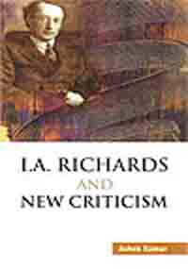

His Theories :

Slide 10
The Main Theories are :
Theory of Literature
Theory of “ The meaning of the meaning “
Theory of Metaphor
Theory of Value
Salha S. AlGhamdi

Slide 11
Thank yon for listening

