Slide 1
Opposition to the New Critics
Lama K. AlNaimi
Abrar A Al-johi
Eman Al-saleh

Slide 2
First:
Ren’e Wellek
Abrar A Al-johi

Slide 3
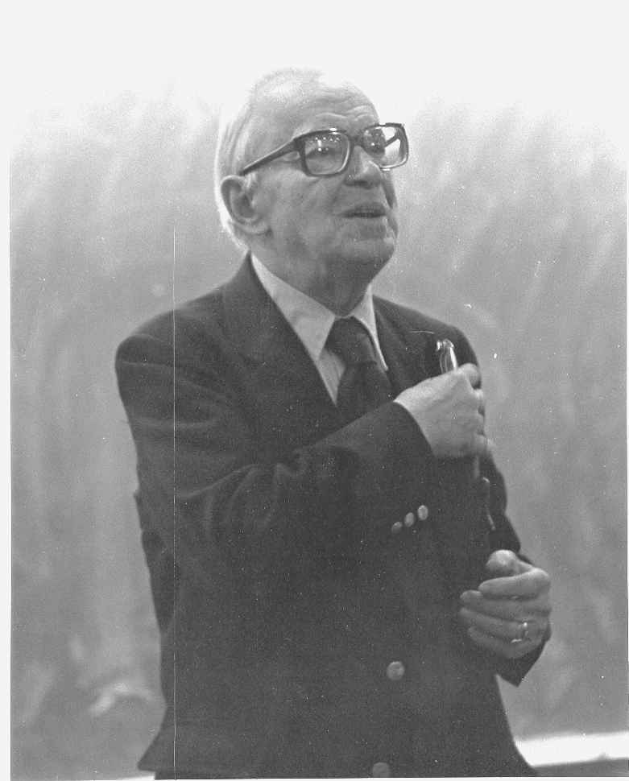
Ren’e Wellek
In his essay “The New Criticism: Pro and Contra” said: “Today the new criticism is considered not only superseded, obsolete, and dead but somehow mistaken and wrong. Four accusations are made most frequently”:

Slide 4
First:
The new criticism is an “esoteric aestheticism”, a revival of “Art for Art’s Sake”, uninterested in the human meaning, the social function, and effect of literature.
The new critics are called FORMALISTS, an opprobrious term used by the Marxists against a group of Russian scholars in the twenties.

Slide 5
Second:
The new criticism is Unhistorical. It isolates the work of art from its past and its context.
Third:
The new criticism is supposed to aim at making criticism scientific, or at least “ bringing literary study to a condition rivaling that of science”.

Slide 6
Finally:
The new criticism is being dismissed as a mere pedagogical device, a version of the French explication de texte, useful at most for American college students who must learn to read and to read poetry in particular.
Ren’e Wellek also says: “ I think that much of what new criticism taught is valid and will be valid as long as people think about the nature and function of literature and poetry”

Slide 7
Second:
Terence Hawkes
Cleanth Brooks
Eman Al-saleh

Slide 8
Terence Hawkes and Cleanth Brooks ..
One of the most common grievances against the New Criticism, iterated in numerous ways, is an objection to the idea of the text as autonomous; detractors react against a perceived anti-historicism, accusing the New Critics of divorcing literature from its place in history. New Criticism is frequently seen as “uninterested in the human meaning, the social function and effect of literature.

Slide 9
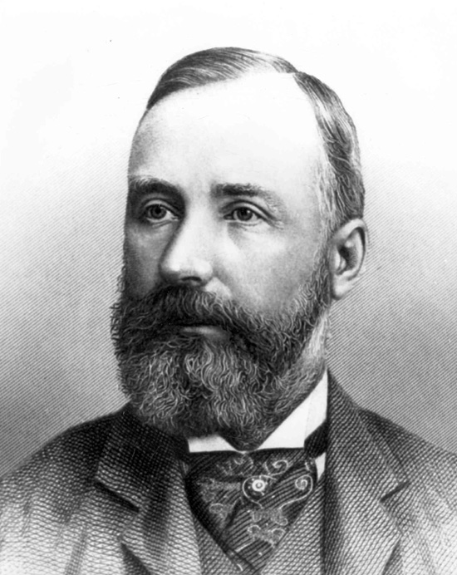
Indicative of the reader-response school of theory, Terence Hawkes writes that the fundamental close reading technique is based on the assumption that “the subject and the object of study—the reader and the text—are stable and independent forms, rather than products of the unconscious process of signification," an assumption which he identifies as the "ideology of liberal humanism,” which is attributed to the New Critics who are “accused of attempting to disguise the interests at work in their critical processes.”[For Hawkes, ideally, a critic ought to be considered to “[create] the finished work by his reading of it, and [not to] remain simply an inert consumer of a ‘ready-made’ product.

Slide 10
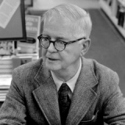
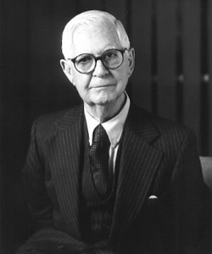
In response to critics like Hawkes, Cleanth Brooks, in his essay "The New Criticism" (1979), tried to argue that the New Criticism was not diametrically opposed to the general principles of reader-response theory and that the two could complement one another. For instance, he stated, "If some of the New Critics have preferred to stress the writing rather than the writer, so have they given less stress to the reader--to the reader's response to the work. Yet no one in his right mind could forget the reader. He is essential for 'realizing' any poem or novel. . .Reader response is certainly worth studying." However, Brooks tempers his praise for the reader-response theory by noting its limitations, pointing out that, "to put meaning and valuation of a literary work at the mercy of any and every individual [reader] would reduce the study of literature to reader pscyhology and to the history of taste."

Slide 11
Third:
The Chicago School
Lama K. AlNaimi

Slide 12
Chicago School
The Chicago School of literary criticism was a form of criticism of English literature begun at the University of Chicago in the 1930s, and lasted until the 1950s.
It was also called Neo-Aristotilianism, due to its strong emphasis on Aristotle’s concepts of plot, character and genre.
It was partly a reaction to New Criticism, a highly popular form of literary criticism, which the Chicago critics accused of being too subjective and placing too much importance on irony and figurative language.

Slide 13
They aimed for total objectivity, and a strong classical basis of evidence for criticism.
The New Critics regarded the language and poetic diction as most important, but the Chicago School considered such things merely the building material of poetry.

Slide 14
Limitations of the New Critics According to the Chicago School
The limitations and short comings of the New Critics as brought out by the censure of die Chicago group may be summed up as follows:
1. The New Critics are not too much pre-occupied with textual analysis. Their excessive pre-occupation with words, images, paradox, irony, etc., makes them forget that the poem is an organic whole. In their pre-occupation with the parts they ignore the beauty of the whole.

Slide 15
Limitations of the New Critics According to the Chicago School
2.Their approach is dogmatic and narrow. According to them, it is through Textual study and analyses alone that truth can be arrived at. However, there are a number of other approaches : the historical, the sociological, the psychological, etc., and each has its own value and significance. All possible ways should be tried to arrive at the full truth
about a poem.

Slide 16
Limitations of the New Critics According to the Chicago School
3. The New Critics are wrong in ignoring the study of the history of literary criticism. A historical study shows that various critical tools have been used effectively in different ages and countries, and their use may be worthwhile in the present also. Thus, for example, the Aristotelian literary philosophy and poetics may still be of use in evaluation and interpretation. A historical study is the only way of understanding the comparative merits of the rival schools of criticism. The critic must, therefore, master the critical traditions and from among the rival critical techniques choose the one best suited to his purposes.

Slide 17
Thank you for listening

