Slide 1
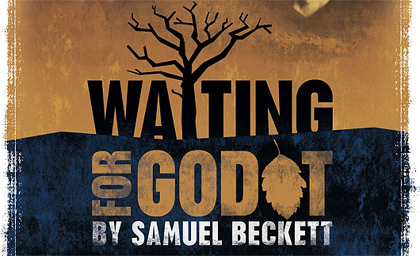

Slide 2
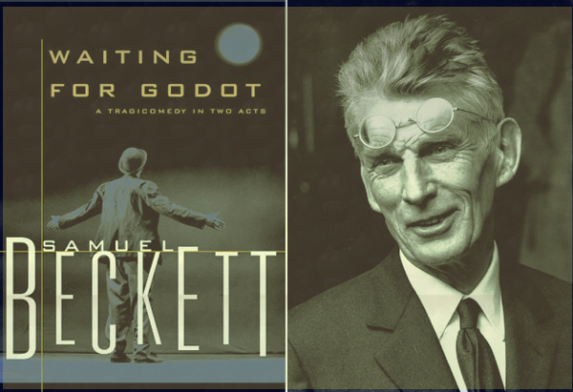

Slide 3
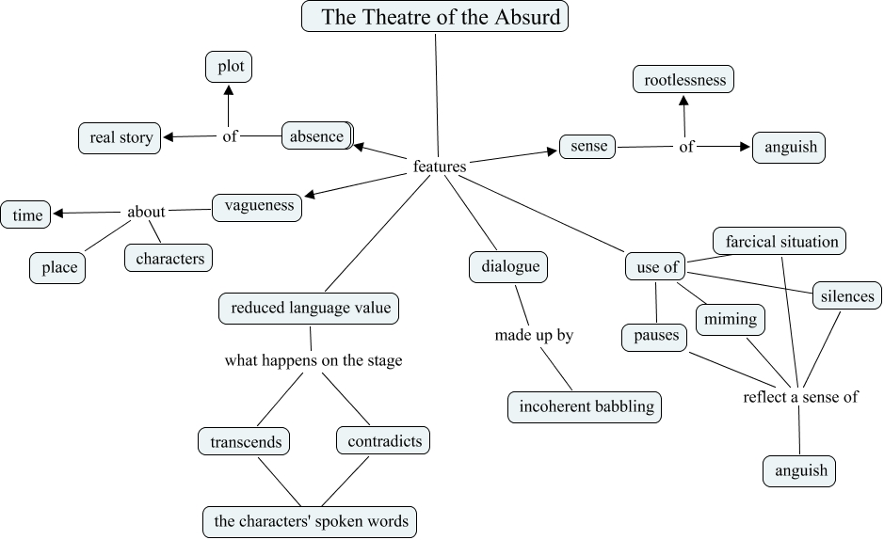

Slide 4

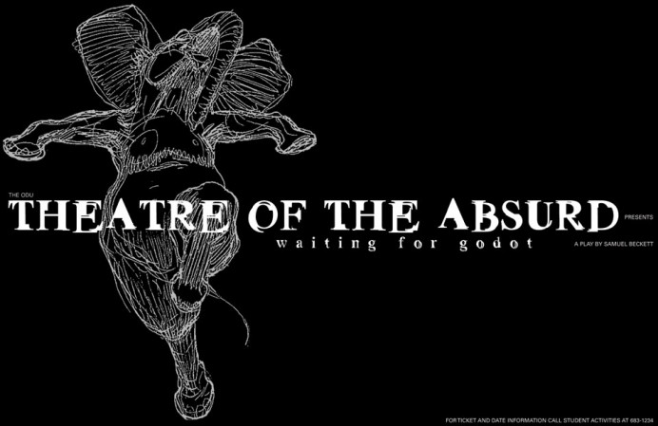

One of the most important aspects of absurd drama was its distrust of language as a means of communication. Language had become a vehicle of conventionalized,, meaningless exchanges. Words failed to express the essence of human experience, not being able to penetrate beyond its surface.
Objects are much more important than language in absurd theatre: what happens transcends what is being said about it. It is the hidden, implied meaning of words that assume primary importance in absurd theatre, over an above what is being actually said.
No dramatic conflict in the absurd plays! Dramatic conflicts, clashes of personalities and powers belong to a world where a rigid, accepted hierarchy of values forms a permanent establishment. Such conflicts, however, lose their meaning in a situation where the establishment and outward reality have become meaningless.

Slide 5
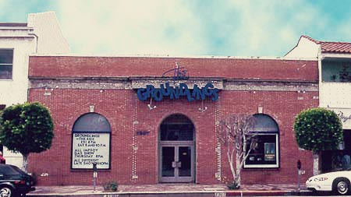
The Groundlings theatre which newly opened in May 2010,
was host to Samuel Beckett’s play for the final performance of its
second run in Gunwharf Quays on Sunday 20th March 2011.

Slide 6
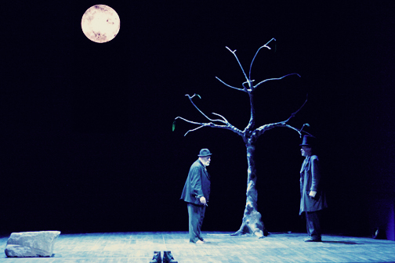
As the play opens, we are faced with a wonderfully dynamic set of scenery,
depicting a sandy desert-like stage backed with
various freestanding canvases painted
with seemingly never-ending desert wasteland,
with puzzle-like pieces of white space
breaking through each panel. A tree constructed of what looked
like scrap metal fragments and a few rocks gave the play
a very industrial feel bringing it right up to date for a contemporary audience.
Simple enough to create a powerful image of isolation from a breezy Portsmouth
Spring evening, the audience were immediately transported to
a sort of limbo where Beckett’s words came to life.

Slide 7
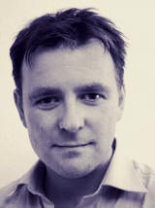
Director Richard Stride’s interesting choice to replace the traditionally
all-male cast, with Estragon and Lucky both played by women,
provided an a very thought-provoking new angle to the themes of the play. Waiting for Godot
, a stranger, to give them hope their relationship as a married couple was perhaps easier to relate to for a mixed audience.

Slide 8
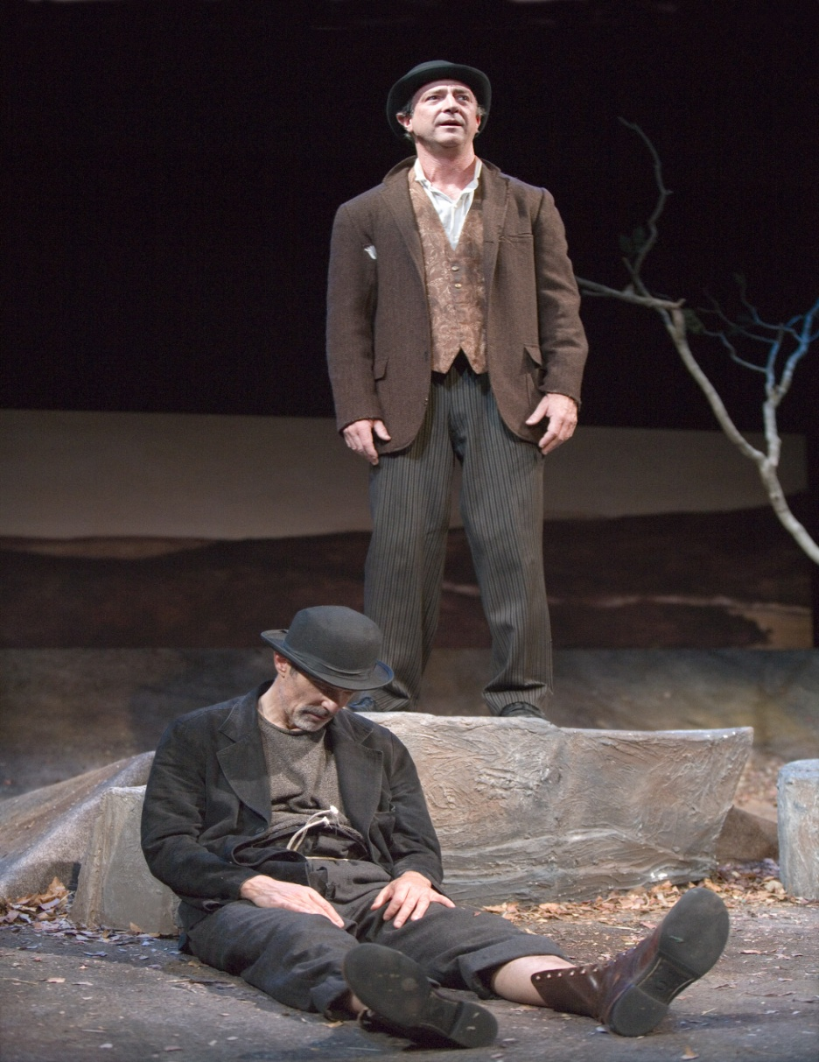
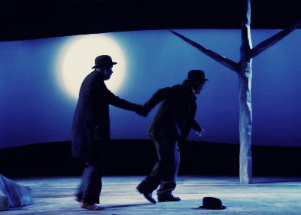
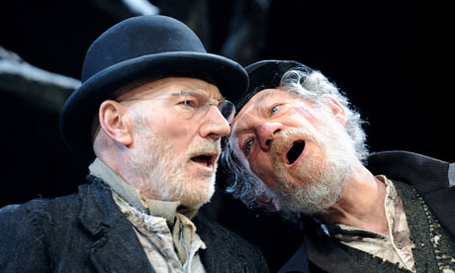
Characters

Slide 9
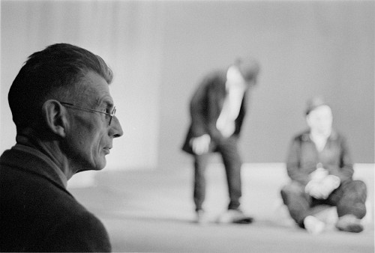
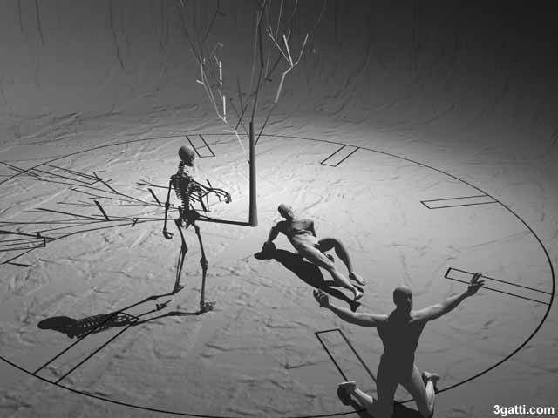

Slide 10
Characters
Estragon
Vladamir
Boy
Lucky
Kirsty Malloy
Tom Fisher
Natalie Ryan
Eddie Manning

Slide 11
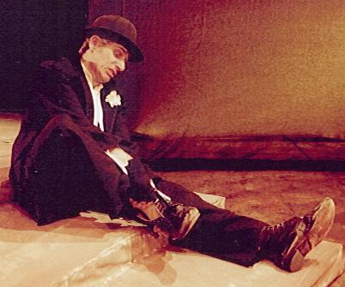
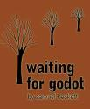
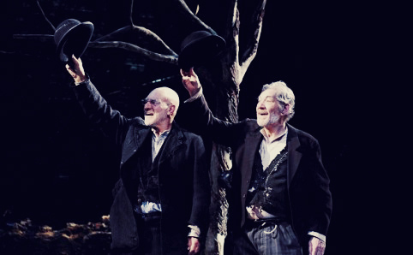

the Rising Moon
Tree
Hat
Boot

Slide 12
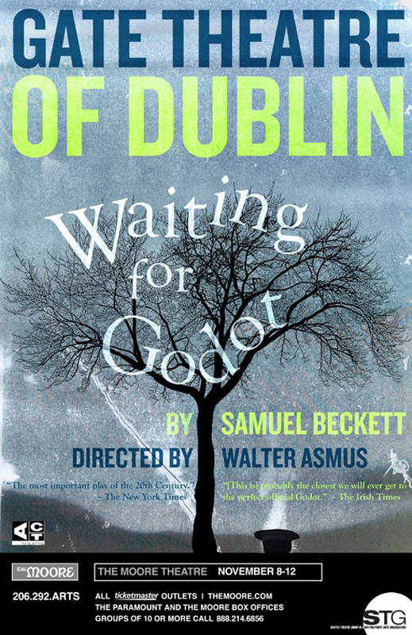
The performance at the Gate Theatre in 1988.
The cast and director from the Gate Theatre‟s (Dublin) production of Waiting for Godot discuss this well-known and enigmatic classic by Samuel Beckett. They explore the play, considered a comedy of the absurd, providing insights into Beckett‟s view of the human condition and the characters‟ vacillation between hope and despair. The program also includes performance excerpts from the film version of the play at key points throughout the discussion

Slide 13
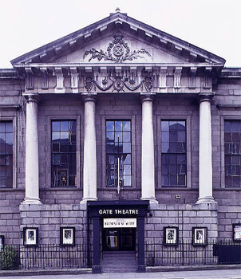
About the Gate Theatre
When the Gate Theatre was established in 1928, it offered Dublin audiences an introduction to the world of European and American avant-garde theater, as well as vibrant productions from the modern and classic Irish repertoire. Over the years the Gate has developed unique relationships with many playwrights including Samuel Beckett and Harold Pinter. Waiting for Godot was first performed at the Gate Theatre in 1988 following a meeting between Michael Colgan and Samuel Beckett, at which the latter asked if the Gate would be interested in the production, directed by Walter D Asmus.. Since then, the Gate production of Godot has toured extensively both at home and abroad. The first Beckett Festival was presented by the Gate in 1991 during which all 19 of Beckett‟s plays were performed over a three week period. The Gate Theatre presented their production of Waiting for Godot at the Kennedy Center in October 2006.

Slide 14
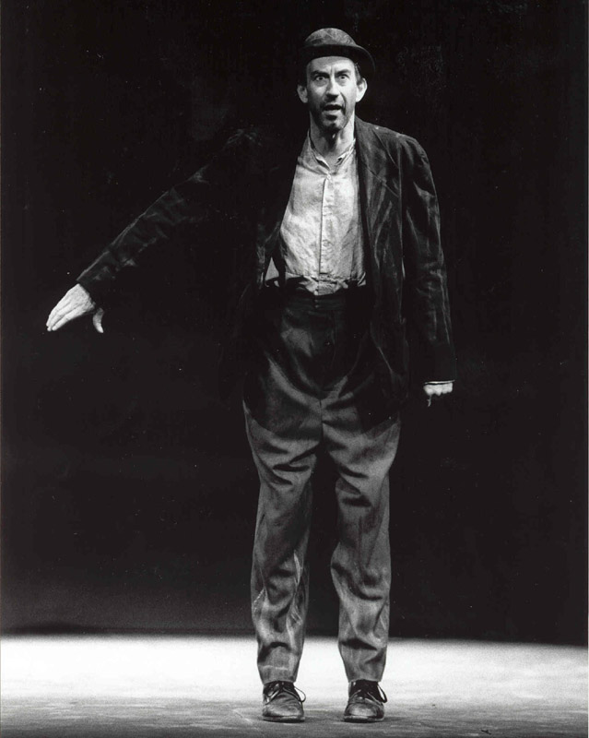
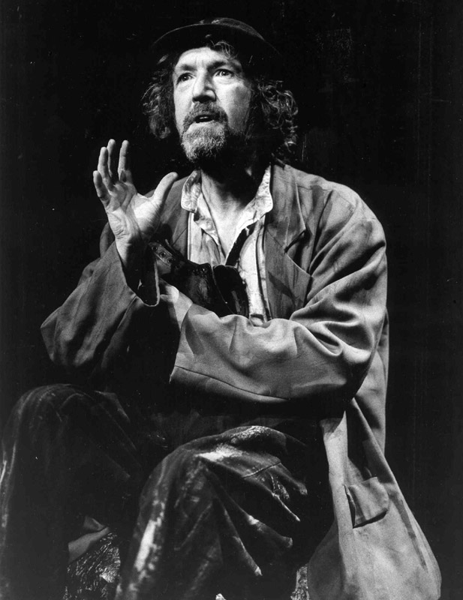
The characters
Barry Mcgovern (valdimir)
Johnny Murphy (Estragon)

Slide 15
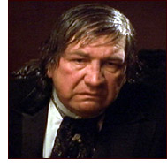
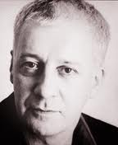
The characters
Alan Stanford (Pozzo)
Stephen Brennan (Lucky)

Slide 16
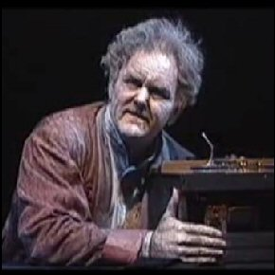
Walter D. Asmus (Director)
He is a well-known German theatre director who worked with Samuel Beckett on many occasions for the stage and television from the time they first met at the Schiller-Theatre in Berlin 1974, and he became Beckett's assistant director on the famous production of Waiting for Godot which toured internationally.

Slide 17


