Slide 1
Kim (1901) by: joseph rudyard kipling
Criticism 2nd Term Fourth Year

Slide 2
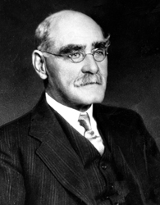
Joseph Rudyard Kipling
Born
30 December 1865
Bombay, British India
Died
18 January 1936
Middlesex Hospital, London, England
Nationality
British
Genres
Short story, novel, children's literature, poetry, travel literature, science fiction

Slide 3
Childhood and early life
Rudyard Kipling was born on 30 December 1865 in Bombay, in British India to Alice Kipling (née MacDonald) and (John) Lockwood Kipling. Alice Kipling (one of four remarkable Victorian sisters)[ was a vivacious woman about whom a future Viceroy of India would say, "Dullness and Mrs. Kipling cannot exist in the same room. Lockwood Kipling, a sculptor and pottery designer, was the principal and professor of architectural sculpture at the newly-founded Sir Jamsetjee Jeejeebhoy School of Art and Industry in Bombay.
The couple, who had moved to India in the same year Rudyard was born, had met in courtship two years previously at Rudyard Lake in Rudyard, Staffordshire, England, and had been so taken by its beauty that they now named their firstborn after it. Kipling's maternal aunt, Georgiana, was married to the painter Edward Burne-Jones and his aunt Agnes was married to the painter Edward Poynter. His most famous relative was his first cousin, Stanley Baldwin, who was Conservative Prime Minister of the UK three times in the 1920s and 1930s Kipling's birthplace home still stands on the campus of the Sir J.J. Institute of Applied Art in Mumbai and for many years was used as the Dean's residence. Mumbai historian Foy Nissen points out however that although the cottage bears a plaque stating that this is the site where Kipling was born, the original cottage was pulled down decades ago and a new one built in its place. The wooden bungalow has been empty and locked up for years In November 2007, it was announced that his birthplace in the campus of the J J School of Art in Mumbai will be turned into a museum celebrating the author and his works. He completed his college education in St.Xaviers College in Mumbai.

Slide 4
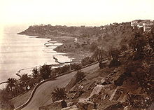
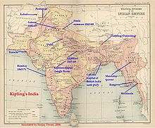
Kipling's India: map of British India

Slide 5
Kipling is a writer who wrote colonial literature , like Kim he expressed that the British came to civilize the Indians. Kipling and others consider the white race as superior.

Slide 6
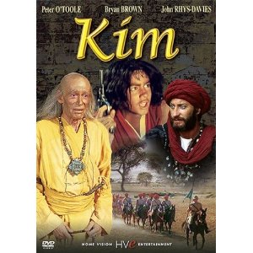
Characters
Kim– is an orphan son of an Irish soldier, "A poor white, the poorest of the poor"
the Teshoo Lama – a Tibetan Lama: abbot of the Such-zen monastery in the western Himalayas, on a spiritual journey.
Mahbub Ali – a famous Pashtun horse trader and spy for the British.

Slide 7
Characters
Colonel Creighton – British Army officer, ethnologist and spy
Lurgan Sahib – a Simla gem trader and master spy
Hurree Chunder Mookherjee ( Babu) – a Bengali intelligence operative working for the British; Kim's direct superior
the Woman of Shamlegh (Lispeth) who helps Kim and the Lama to evade the Russian spies and return to the plains
Arthur Bennett – the Church of England chaplain of the Mavericks, the Irish regiment to which Kim's father belonged
a Lucknow prostitute whom Kim pays to help disguise him.

Slide 8
Setting & Theme
Setting
The novel begins in the Indian city of Lahore. The time is the late nineteenth century and the British are in political control of India.
Theme
Equality and Unity
The ideal of the equality and unity of men echoes across several motifs in Kim, most notably through the Buddhist teachings of Teshoo Lama. He tells Kim, "To those who follow the Way there is neither black nor white, Hind nor Bhotiyal. We be all souls seeking to escape." This ideal of the equality and unity of men transcends the in classes.

Slide 9
Cont.
Theme.
Kim's identity
Kim defines his identity during his adventures by being open to influences; responding positively to people he can look up to, while warding off influences which he finds abrasive.
When the story opens the influences on him have been almost exclusively Indian. As previously noted, he has grown up dressing like an Indian, thinking like an Indian, his skin burned as brown as an Indian's, and feeling entirely happy and at home among the poor people of Lahore. But even at this stage he cannot think of himself as a native. He remembers his father and his prophecy, carries his identity papers in a leather amulet case around his neck, and of course his skin is white. And inwardly his attitudes are already at least partly those of a white ruler. The opening paragraph showing him sitting astride the cannon shows that he feels it natural to claim the position of power, a position he asserts with a game of 'king-of-the-castle' in which he prevents the native boys, both Moslem and Hindu, from taking his place. And, as we have seen, this inherited assumption that he is entitled to the position of power over his native peers is matched by his assumption of 'ownership' of the lama. 'The lama was his trove, and he proposed to take possession' (Ch 1. p.60).
His white skin, his identity papers, and this in-built tendency to own and rule will prove to be central to the identity he is seeking to build, but neither at the beginning nor the end does he think of himself as a 'sahib', and his encounter with the white man's world is at first a traumatic experience which he resists with all his might

Slide 10
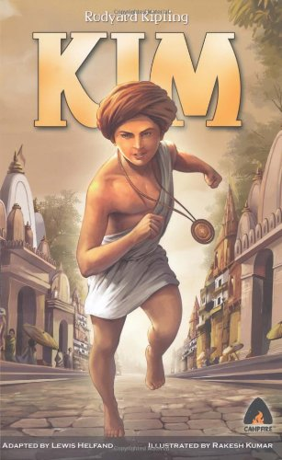
Kim
The story unfolds against the backdrop of The Great Game, the political conflict between Russia and Britain in Central Asia. It is set after the Second Afghan War .
The novel is notable for its detailed portrait of the people, culture, and varied religions of India.

Slide 11
The Great Game
Is a term used for the strategic rivalry and conflict between the British Empire and the Russian Empire for supremacy in Central Asia. The classic Great Game period is generally regarded as running approximately from the Russo-Persian Treaty of 1813 to the Anglo-Russian Convention of 1907. A second, less intensive phase followed the Bolshevik Revolution of 1917. The Great Game dwindled after the United Kingdom and Russia became Allies of World War II.
The term "The Great Game" is usually attributed to Arthur Conolly (1807–1842), an intelligence officer of the British East India Company's Sixth Bengal Light Cavalry.^{[1]} It was introduced into mainstream consciousness by British novelist Rudyard Kipling in his novel Kim (1901).

Slide 12
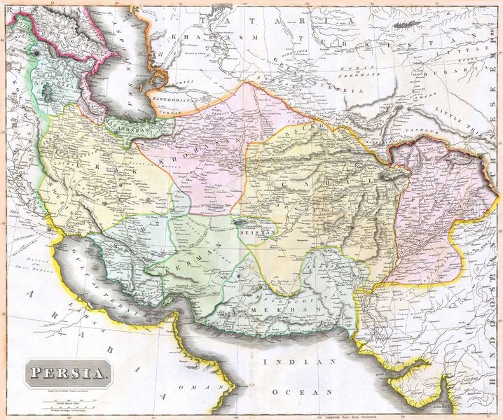
Map

Slide 13
Plot
Kim is the orphaned son of an Irish soldier and a poor white mother who have both died in poverty. Living a vagabond existence in India under British rule in the late 19th century, Kim earns his living by begging and running small errands on the streets of Lahore.

Slide 14
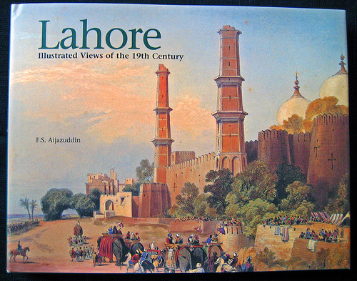
He occasionally works for Mahbub Ali. Kim is so immersed in the local culture, few realize he is a white child, though he carries a packet of documents from his father entrusted to him by an Indian woman who cared for him.

Slide 15
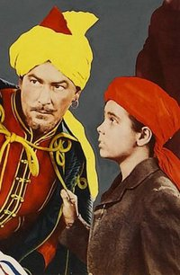
Kim befriends an aged Tibetan Lama who is on a quest to free himself from the Wheel of Things by finding the legendary 'River of the Arrow'. Kim becomes his chela, or disciple, and accompanies him on his journey. On the way, Kim incidentally learns about parts of the Great Game and is recruited by a British officer to carry a message to the British commander in Umballa. Kim's trip with the Lama along the Grand Trunk Road is the first great adventure in the novel.

Slide 16
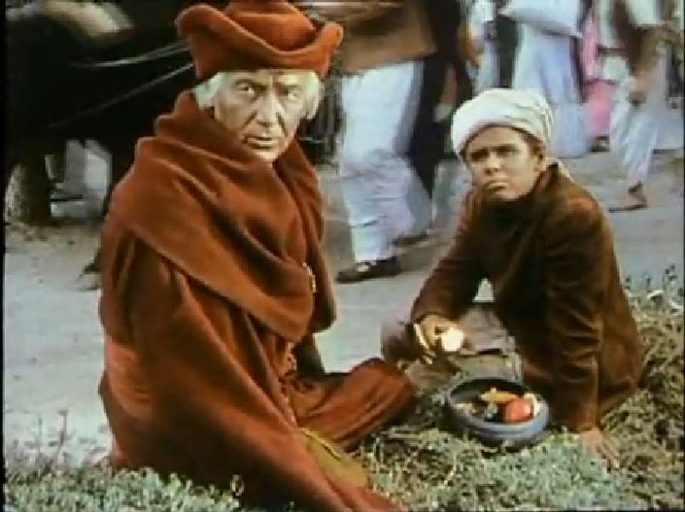
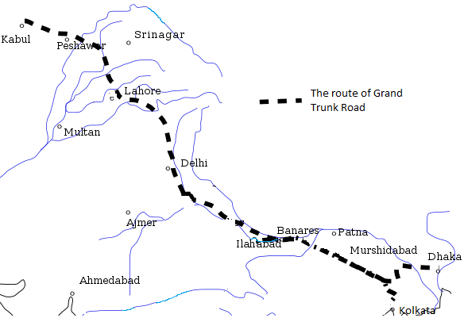

Slide 17
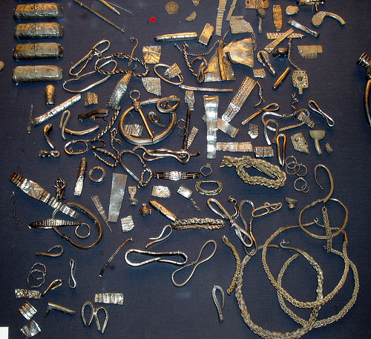
By chance, Kim's father's regimental chaplain identifies him by his Masonic certificate, which he wears around his neck and Kim is forcibly separated from the Lama. The Lama insists that Kim should comply with the chaplain's plan because he believes it is in Kim's best interests and the boy is sent to a top English school in Lucknow. The Lama funds Kim's education and Kim remains in contact with this Holy Man he has come to love throughout his years at school. Kim also retains contact with his secret service connections and is trained in espionage while on vacation from school by Lurgan Sahib, at his jewellery shop in Simla. As part of his training, Kim looks at a tray full of mixed objects and notes which have been added or taken away, a pastime still called Kim's Game, also called the Jewel Game.

Slide 18
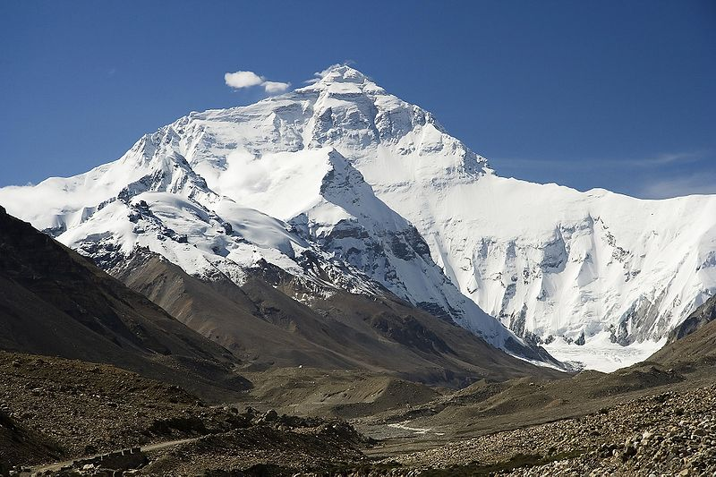
After three years of schooling, Kim is given a government appointment so that he can begin his role in the Great Game. Before this appointment begins however, he is granted time to take a much-deserved break. Kim rejoins the Lama and at the behest of Kim's superior, Hurree Chunder Mookherjee, they make a trip to the Himalayas. Here the espionage and spiritual threads of the story collide, with the Lama unwittingly falling into conflict with Russian intelligence agents. Kim obtains maps, papers, and other important items from the Russians working to undermine British control of the region. Mookherjee befriends the Russians under cover, acting as a guide and ensures that they do not recover the lost items. Kim, aided by some porters and villagers, helps to rescue the Lama.

Slide 19
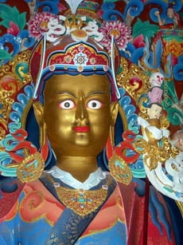
^_^
The Lama realizes that he has gone astray. His search for the 'River of the Arrow' should be taking place in the plains, not in the mountains, and he orders the porters to take them back. Here Kim and the Lama are nursed back to health after their arduous journey. Kim delivers the Russian documents to Hurree, and a concerned Mahbub Ali comes to check on Kim. The Lama finds his river and achieves Enlightenment. The reader is left to decide whether Kim will henceforth follow the prideful road of the Great Game, the spiritual way of Tibetan Buddhism, or a combination of the two. Kim himself has this to say: "I am not a Sahib. I am thy chela."

Slide 20
The End
Thank you for your Attention
Done by: Amal Aqil Al-Shriedah .

