Slide 1
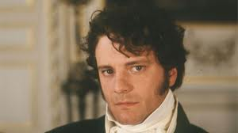
Tools of Characterization in the text
Actions are most important in the case of Darcy.
cold demeanor
less-than-friendly conversation,
it's Darcy's actions that demonstrate his true character.
gives credit for the whole affair to Mr. Gardiner.
His actions reveal him to be an honorable, caring man.

Slide 2
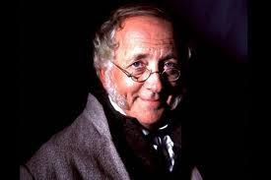
Direct characterization from Jane Austen:
“Mr. Bennet was so odd a mixture of quick parts, sarcastic humour, reserve, and caprice, that the experience of three-and-twenty years had been insufficient to make his wife understand his character. Hermind was less difficult to develop. She was a woman of mean understanding, little information, and uncertain temper. When she was discontented, she fancied herself nervous. The business of her life was to get her daughters married; its solace was visiting and news. ”

Slide 3
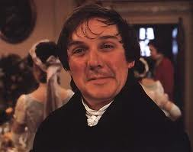
Social status.
indeterminate position in the social scale.
he owes his job to Lady Catherine
he is in a better social position.
he kind of transcends class altogether by of borrowing Lady de Bourgh's status to boost his own.
when he proposes to Elizabeth, he stresses that one of the top things he has to offer is the awesomeness of being Lady de Bourgh's second most favorite lapdog.
By constantly quoting her, it's almost like he's trying to become her.

Slide 4
Dialogue:
[Miss Bingley:] "How delighted Miss Darcy will be to receive such a letter!"
He made no answer.
[Miss Bingley:]"You write uncommonly fast."
[Mr. Darcy:] "You are mistaken. I write rather slowly."
[Miss Bingley:]"How many letters you must have occasion to write in the course of a year! Letters of business, too! How odious I should think them!"
[Mr. Darcy:] "It is fortunate, then, that they fall to my lot instead of yours."
[Miss Bingley:] "Pray tell your sister that I long to see her."
[Mr. Darcy:] "I have already told her so once, by your desire."
[Miss Bingley:] "I am afraid you do not like your pen. Let me mend it for you. I mend pens remarkably well."
[Mr. Darcy:] "Thank you-but I always mend my own."
[Miss Bingley:] "How can you contrive to write so even?"
He was silent. (10.3-14)

Slide 5
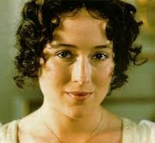
The novel’s protagonist.
the most intelligent and sensible of the five Bennet sisters.
She is well read and quick-witted,
It shows in her dialogue.

Slide 6
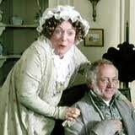
A stereotype of an English lady in the 18th C.
Mrs. Bennet is a tiresome character.
Noisy and foolish, she is a woman consumed by the desire to see her daughters married and seems to care for nothing else in the world.
Austen uses her continually to highlight the necessity of marriage for young women.
Mrs. Bennet also serves as a middle-class counterpoint to such upper-class snobs as Lady Catherine and Miss Bingley, demonstrating that foolishness can be found at every level of society.
A product of her society.

Slide 7
Style
Jane Austen's lucid narrative style was unique in her time.
It was an era in literature given to Romanticism and emotional excess.
It is told in a readable prose without a single superfluous word, and it frequently breaks into dialogue.
In some passages the author enters into the mind of one or another of her characters, most often into her heroine Elizabeth's, and there she reveals her character's capacity for humor and self-criticism.
Austen's style is so lucid that we can hardly believe she submitted her writing to so much polishing and revision.

Slide 8
language
Jane Austen’s choice of diction is important .
She uses a variety of vocabulary and sentence structure.
the structure allows the paragraph to flow. The length of sentences varies and creates a rhythm.
Austen’s vocabulary seems to be archaic which demonstrates the time period in which it was written.
“They were noticed only by a curtsy; and on their being seated, a pause, awkward as such pauses must always be, succeeded for a few moments. It was first broken by Mrs. Annesley, a genteel, agreeable looking woman, whose endeavor to introduce some kind of discourse, proved to be more well-bred than either of the others; and between her and Mrs. Gardiner, with occasional help from Elizabeth, the conversation was carried on. ”

Slide 9
The vocabulary choice seems archaic because in modern English words like “genteel” and “agreeable” aren’t often used.
The choice of diction becomes of crucial importance because it gives personality to the story which influences the reader’s mind.
as seen from the excerpt: the two sentences are of different lengths the first is short the other is quite wordy. This sentence variation gives structure.

Slide 10
Examples of archaic spellings and word usages:
At the Netherfield Ball, after dancing with him twice, ‘the moment of her release from him was exstacy’,
balanced sentences used to illustrate the contrast between people or the duality of situations:
Bingley ladies on the Bennets –
“and though the mother was found to be intolerable, and the younger sisters noted worth speaking to, a wish of being better acquainted with them was expressed towards the two eldest.”

Slide 11
Themes
Love and Marriage vs Property and Marriage:
Darcy and Elizabeth: most complete, Darcy overcomes his pride and Elizabeth her prejudice.
Bingley and Jane: based on love.
Mr and Mrs. Bennet: old fashioned based on not understanding eachother.
Charlotte Lucas and Mr Collins: a practical marriage not based on either love, mutual attraction or shared interests. Charlotte says: "Happiness in marriage is entirely a matter of chance."
Wickham and Lydia: most depressing marriage that will fail.

Slide 12
Reputation vs Social class:
Most of the characters are deeply concerned about their 'reputation' - how others see them and their standing in society.
This is linked to 'class‘ ,but a character's reputation isn't necessarily linked to their social standing (for example, Wickham).
appearance versus reality

Slide 13
Setting
Time: a period between (1797–1815)
Place: Longbourn, in rural England
The country house.
The relationship between man and house.

Slide 14
protagonist · Elizabeth Bennet
Antagonist ( the adversary of the hero or protagonist of a drama or other literary work ), opponent, competitor, enemy, rival , “'A person, or a group of people who oppose the main character, or the main characters “: Snobbish class-consciousness (epitomized by Lady Catherine de Bourgh and Miss Bingley)

