Slide 1

Victorian Novel
Nineteenth Century Novel

Slide 2
Features of the Victorian Novel
Most Victorian novels are directly concerned with the issues and problems of contemporary society. They usually create a richly detailed and “realistic” sense of 19th Century life.
The novels are very long because they were often published in serial form.

Slide 3

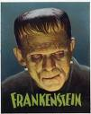
Mary Shelley
Frankenstein
The Last Man

Slide 4
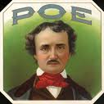
Edgar Allan Poe
His stories filled everyone with interest and fear.
Was born in the United States but went to school near London.
Tales of Mystery and Imagination

Slide 5
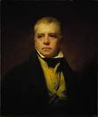
Sir Walter Scott
He wrote good poems.
Waverley is one of his best novels (mostly historical)
Power of description/ but difficult to read

Slide 6
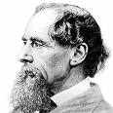
Charles Dickens
The secret of his popularity lies in an immense vitality which swirls round his creations and creates a special Dickensian world which has its own logic and laws and its own special atmosphere.
He is a master of the grotesque and his characters are really “humours”
He is concerned with the problems of crime and poverty, but he does not seem to believe that matters can be improved by legislation or reform movements.

Slide 7
His novels fall into groups:
Picaresque novels: Pickwick Papers
Historical novels: Barnaby Rudge, A Tale of Two Cities
Social novels: Oliver Twist, Hard Times, Christmas Carol, Nicholes Nickleby, Great Expectations
Autobiographical novels: David Copperfield.
Picaresque is a type of novel that is usually satirical and depicts, in realistic and often humorous detail, the adventures of a roguish hero of low social class who lives by his wits in a corrupt society.

Slide 8
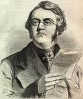
William Thakeray
He wrote of the upper classes and was anti-romantic.
Vanity Fair tells of the careers of two girls with sharply contrasted characters: Becky Sharp and Amelia Sedley.
The Newcomes
The Virginians (historical novel)

Slide 9
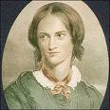

The Brontes
Charlotte Bronte
The Professor
Villette
Jane Eyre: a genuine love story of great realism, full of sharp observation.

Slide 10
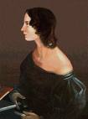
Emily Bronte
Wuthering Heights: a masterpiece/ is the very heart and soul of the romantic spirit, with its story of wild passion set against the Yorkshire moors.
Was compared to Shakespeare’s King Lear.

Slide 11

George Eliot
Mary Ann Evans
The great Victorian novelist of the inner moral life.
The political and social worlds of her novels are as vast and detailed as any thing in Dickens or Thackeray, yet their primary concern is always with the free will and moral intelligence of her characters as they try to establish their true identity and role in life.

Slide 12
Eliot’s novels are not only among the greatest of the age; they are among the greatest novels ever written in English
Adam Bede
The Mill on the Floss
Middlemarch
Daniel Deronda

Slide 13

William Collins
The first English novelist to write detective stories.
The Woman in White
The Moonstone

Slide 14
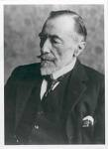
Joseph Conrad
He wasn’t English, he was born in Poland.
One of guiding beliefs was that a man must always be faithful.
Lord Jim
Youth
Heart of Darkness
Typhoon

Slide 15

Thomas Hardy
Nature plays an important part in his novels.
Most of his novels are pictures of human beings struggling against fate or chance/ extremely sad.
His most famous novels are:
Tess of the D’Urbervilles
Jude the Obscure
The Return of the Native,

