Slide 1

Good afternoon

Slide 2
U2: City life Part (1)

Slide 3
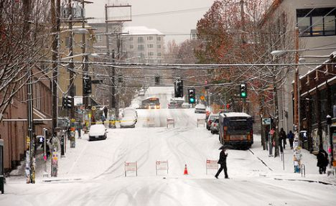
“Snow blows across the highway before me as I
walk—little, wavering trails of it swept along like a
people dispersed. The snow people—where are
they going? Some great danger must pursue them.
They hurry and fall, the wind gives them a push,
they get up and go on again.”
JOHN HAINES, FROM “SNOW”

Slide 4

“ A description is an account that creates a vivid mental image”

Slide 5
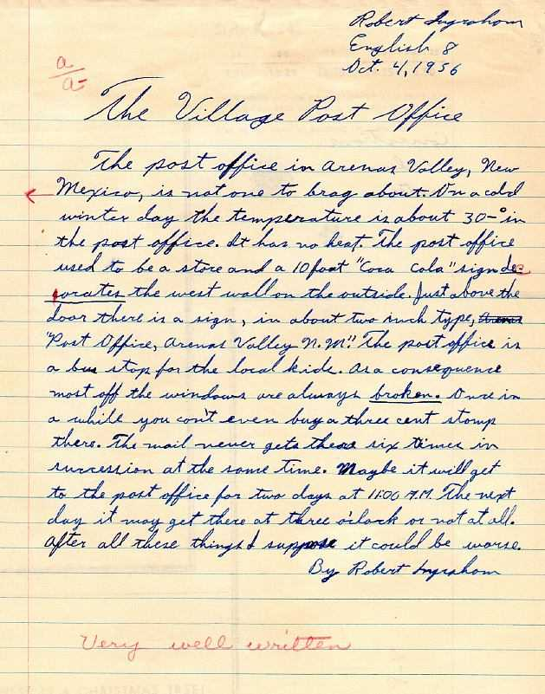
In this chapter we will learn how to write:
a descriptive paragraph

Slide 6

“ Successful descriptive writers are the ones who let their readers see, hear, touch and feel what they write”
Do you want to be one of them?!

Slide 7
Before you write:
1- Set your main idea. ( the place you want to describe)
Let’s choose one of the two pictures on pg.24 to describe.
2- Explore ideas
Look at the picture. Write about it as much as you can.
Focus on sense details and feelings!!
Use the list on pg.25.

Slide 8
A good description should include:
1- sense details: the things you can see, hear, touch, taste and smell.
2- your feelings about the place
SO, KEEP in MIND!!

Slide 9
Before you write:
3- Build up you vocabulary. (Think of descriptive words and phrases)
Let’s do Ex. 7,8,9 on pg.26-26
4- Organize your idea. ( Use a mind map)
pg.29-30
WHY? / HOW?

Slide 10
WHY?
1- helps you develop & organize your ideas
2- shows how ideas are connected to each other
3- helps you identify irrelevant ideas ( Let’s do Ex.13 on pg.30)
HOW?
1- Write the TOPIC sentence in the center ( How can I write a topic sentence for my descriptive paragraph?) pg.28
2- Write the main supporting details
3- Write the secondary details

Slide 11
A good topic sentence should:
1- tell the main idea generally
2- grab your readers’ attention
3- indicate your feelings about the place
(try to use more specific & vivid adjectives
SO, KEEP in MIND!!

Slide 12
Now!!
Go to “My Neighborhood” article on pg.26.
Read the last sentence!
How is it related to the topic sentence? Why?

Slide 13
A concluding sentence can:
1- summarize the main idea of the paragraph
OR
2- give your personal opinion about the place you describe
pg.31
SO, KEEP in MIND!!

Slide 14
U2: City life Part (2)

Slide 15
m
I. Developing Cohesion and Clarity:
A- Giving Reasons with Since
Because & since have almost the same meaning
They both express a cause
They often introduce a dependant clause in complex sentences.
A clause that contains a subject and verb but cannot stand alone

Slide 16
Examples:
Since quite a few people in the neighborhood from the Middle East , there are many great Middle Eastern shops and restaurants here.
There are many great Middle Eastern shops and restaurants here since quite a few people in the neighborhood from the Middle East.

Slide 17
I. Developing Cohesion and Clarity:
B- Strategy: Varying Sentence Structure
Look at the paragraph on pg.33 and tell me what do you think about it? Why?
So, to make your paragraph more interesting, try to vary your sentences structure by beginning some of the sentences with dependant clauses beginning with words like because, since, when, after or with prepositional phrases beginning with words such as at, in, on, from or with

Slide 18
U2: City life Part (3)

Slide 19
I. Revising and Editing:
A- Correcting Comma Splices
What is a comma splice?
It is an incorrect sentence made of two independent clauses connected with a comma.

Slide 20
Example:
I am living in a dormitory room , it is much too small for my roommate.
How can we correct this comma splice?
A comma splice can be corrected in three ways.

Slide 21
1. Change the comma to a period (.) or a semi colon (;)
Example: I am living in a dormitory room.
It is much too small for my roommate and me
2. Change the comma splice into a sentence with a dependant clause.
Example: I am living in a dormitory room that
is much too small for my roommate and me

Slide 22
3. Use a conjunction such as and, but, or so to connect the two independent clauses.
Note that the comma usually comes before the conjunction
Example: I am living in a dormitory room , but it is much too small for my roommate and me

Slide 23
This is your life , shape it or someone will do
Have a nice day!!

