Slide 1

Good afternoon

Slide 2
Ch3: Business & money

Slide 3

The main objective of this chapter is:
to write a formal letter

Slide 4

What are the purposes of writing formal letters?
To response to an article
To complain
To apply for a job, etc.

Slide 5
Nevertheless, all the formal letters, for any purpose, should be:
In the correct format
Short & to the point
Clear & simple
Polite & well presented
Free of informal language

Slide 6
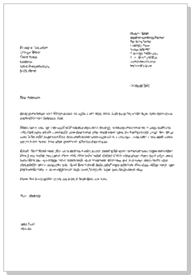
Format of formal letter:
3. Date
1. Your Address
2. The Recipient Address
4.Salutation
6.Ending
5. Body

Slide 7
Format of formal letter
1) Your Address
The return address should be written in the top right-hand corner of the letter.
2) The Address of the person you are writing to
The inside address should be written on the left, starting below your address.
3) Date
Different people put the date on different sides of the page. You can write this on the right or the left on the line after the address you are writing to. Write the month as a word.

Slide 8
4) Salutation or greeting:
Dear Sir or Madam/ Name,
If you do not know the name of the person you are writing to, use this. It is always advisable to try to find out a name.
If you know the name, use the title (Mr., Mrs., Miss. or Ms., Dr., etc.) and the surname only. If you are writing to a woman and do not know if she uses Mrs. or Miss, you can use Ms, which is for married and single women.

Slide 9
5) Body
First paragraph:
The first paragraph should be short and state the purpose of the letter- to complain, request something, etc.
The paragraph or paragraphs in the middle of the letter should contain the relevant information behind the writing of the letter. Most letters in English are not very long, so keep the information to the essentials and concentrate on organizing it in a clear and logical manner rather than expanding too much.
Last Paragraph:
The last paragraph of a formal letter should state what action you expect the recipient to take- to refund, send you information, etc.

Slide 10
6) Ending a letter
1) Yours faithfully/sincerely
If you do not know the name of the person, end the letter with “faithfully”. If you know the name of the person, end the letter with “sincerely”.
2) Your signature
Sign your name, then print it underneath the signature.

Slide 11

Now,, Let’s analyze the formal letter on pg.49

Slide 12
Now,, Let’s read the article on pg. 45 and response to the editor in a formal letter but before that let’s discuss the quotes on pg.44

Slide 13
End of class,,
Bye for now,,

