Slide 1
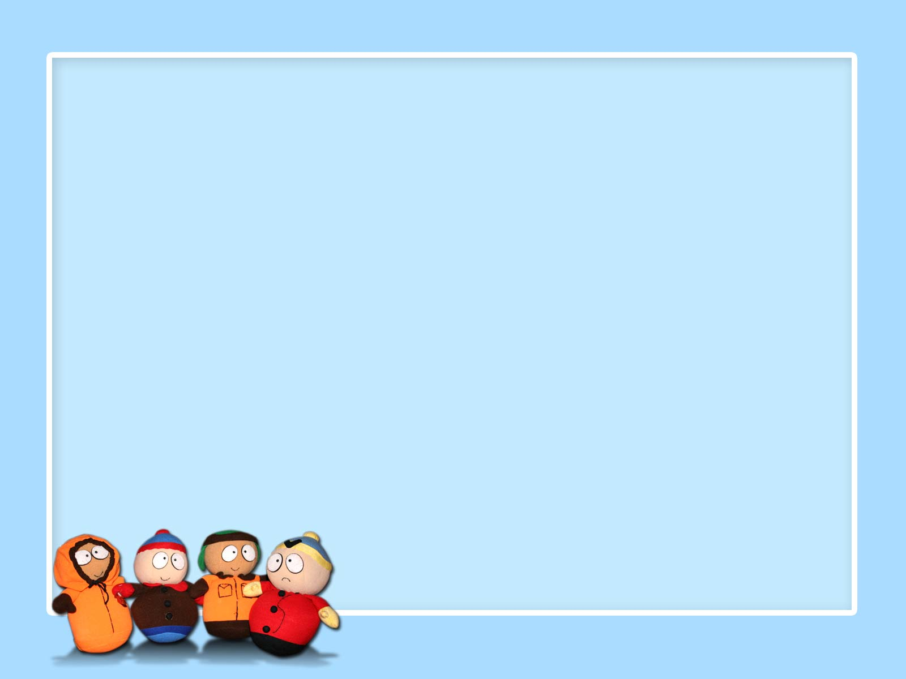
Good afternoon

Slide 2
Ch3: Business & money
Part (2)

Slide 3
After learning:
1- the purposes of writing formal letters
2- the format of formal letter
Now!! let’s learn how to develop a formal letter (the content)

Slide 4
1st paragraph:
State why you are writing this letter (eg. responding to an article, applying for a job, complaining
Other paragraph/paragraphs:
Give explanation (eg. opinions, reasons, details of a problem, obligations, suggestions, advice….. etc.)
Last paragraph:
State what you want.

Slide 5
Let’s analyze the content of the letter we wrote in the previous class

Slide 6
September 30,2012
Dear Editor,
As regards the article about the fortunate day, my opinion is that the motorists have to return the money back to the company.
First of all, those motorists ,whom I deep down believe, are thieves will hardly enjoy the money they took . The nature of human being can't bear the feelings of taking things of their not own. That is why most of the thieves still feel anxious and suspicious and even are not able to sleep. Hence, I can guarantee that the money would absolutely steel the joy from their lives.
The second reason is the motorists should take the chance given to them. Returning the money would allow them to earn some money legally.
Finally, the way the motorists were on might be provided with safety road cameras which would absolutely catch them, so it would be as easily for the government to prosecute and convict them. The motorists must not keep the money for even one hour more.
Sincerely,
Ms.Nehad

Slide 7
Use modals to: express obligation & give advice

Slide 8
Giving Advice
Should/ shouldn’t
E.g. They should take the chance given to them.
Expressing Obligation
E.g. 1- The motorists have to return the money back.
2- The motorists must not keep the money for one hour more.
Have/not have to/ must/ must not

Slide 9
Use examples to: support your opinions

Slide 10
If your write an opinion ,in your letter, or any general truths which are still opinions ,not fact, follow them with supporting examples.
E.g. The nature of human being can't bear the feelings of taking things of their not own. That is why most of the thieves feel anxious and suspicious and even not able to sleep.

Slide 11
Now, let’s analyze t the letter on pg.59

Slide 12
Enjoy your day,,

