Slide 1

Good afternoon

Slide 2
U4: Jobs & Professions
Part (1)

Slide 3
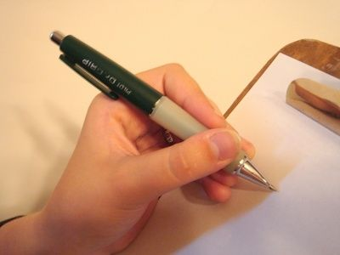
In this chapter we will focus on:
narrative writing

Slide 4

What is a narration?
It tells a story.
Where can we find it?
Fiction
Nonfiction
Biography
Autobiography

Slide 5
Today we will concentrate on how to write an autobiographical narrative paragraph
What is an autobiographical narrative paragraph?
It’s a personal narrative.
An autobiographical means about you.

Slide 6
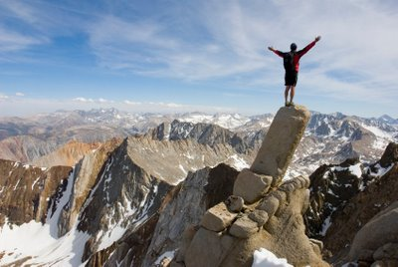
Why do we need to write an autobiographical paragraph?
To write bout our personal history, accomplishments, talents, qualities…..etc. for any purpose.

Slide 7
Before you write:
1- Set your main idea. ( writing about my accomplishments)
2- Explore ideas (think of your accomplishments)
Let’s discuss the questions on pg.66
Strategy 1: How to write about my personal accomplishments?
Show that you are special or different in some way
Focus on your good points
Describe qualities that indicate that you are the best person for the job or college you are applying.

Slide 8
Before you write:
3- Build up you vocabulary. (Think of vocabulary that describe your personal characteristic)
Let’s do Ex. 3 on pg.67
Using Antonyms:
An antonym = a word that has an opposite meaning
some of them are completely different words:
difficult – easygoing
some of them are different forms of the same word:
attractive - unattractive

Slide 9
Strategy 2: Making direct statements and implying:
To write about yourself, there are two ways: direct and indirect:
You can state directly that you have specific talents or qualities and then approve this with an example or an experience
You can describe an accomplishment or an experience that show you have certain talents or qualities

Slide 10
Before you write:
4- Organize your idea. ( Use a spider map)
= It’s a type of graphic organizer that allows you to develop several aspects of one central idea.
Let’s look at the spider map on pg.70

Slide 11
Strategy 3: Using more than one paragraph:
You will be able to write about your experience in one paragraph. However, if the experience has several parts, you can use two paragraphs.
BUT REMEMBER!!
Each paragraph should have its own topic sentence.

Slide 12
Strategy 4: Writing a topic sentence:
The topic sentence for your autobiographical paragraph should:
tell that you are going to talk about your personal accomplishments, talents, qualities…..etc.
grab your readers’ attention.
give a positive feeling to your readers.
Let’s discuss the topic sentences on pg.71

Slide 13
Strategy 4: Writing a concluding sentence:
The concluding sentence for your autobiographical paragraph can:
tell what you learned about yourself from the experience you chose.
describe a hope for the future.
state that your accomplishments will be a great help for your success.
Let’s discuss the concluding sentences on pg.72

Slide 14
Part (2)

Slide 15
I. Developing Cohesion and Clarity:
A- Using the correct tense: Simple Past, Present Perfect or Present Perfect Continuous

Slide 16
Simple Past
Use the past tense in only 1 case:
1- To talk about actions started and ended at a particular time in the past
e.g. I was in Beirut in 2009.
I graduated from high school before three years.

Slide 17
Present Perfect
Use the present perfect in 3 cases:
1- to talk about actions started in the past and continues to the present
(for – since )
e.g. I have gone to Beirut since 2009.
e.g. She has lived in Beirut for three years.

Slide 18
Present Perfect
2- to talk about actions happened before now at unspecified time
(ever, never, already, yet, still, twice, three or four…etc. times recently )
TIME ?
e.g. I have been to Beirut many times.

Slide 19
Present Perfect
3- To talk about actions that happened short time ago
(just)
e.g. I have just finished writing my report.

Slide 20
Present Perfect Continuous
Use the Present Perfect Continuous in 1 case:
1- to talk about actions that are currently in progress as well as how long it has been in progress up until now.
(for – since – so far- up to now- all morning- all day- all week)
e.g. I have been learning English since 2010.
e.g. She has been working at school all week.

Slide 21
ATTENTION!!
1) DON’T use the present perfect continuous with most nonaction verbs (stative verbs). Instead, use the present perfect tense
Incorrect: I have been knowing Maha for years.
Correct: I have known Mah for years.

Slide 22
Examples of nonaction verbs (stative verbs):
Verbs describe States:
Mental State: know- believe – forget – think – understand – remember – need – want – imagine
Emotional State: love – hate – like – please – amaze – surprise

Slide 23
Verbs describe States:
C) Possession: possess – have – own – belong
D) Sense perceptions: taste – hear – feel- see – smell
E) Existing States: seem – look -contain – include – sound – be - exist

Slide 24
ATTENTION!!
1) A few verbs ,such as live, make, study, think, work and teach are used with the present perfect or present perfect continuous with little or no difference in meaning when a time expression is used.
Correct: She has worked at this company for five years.
Correct: She has been working at this company for five years.

Slide 25
Read the following sentences:
When I was 15, I read a book about Sammy Sosa. That was the first time I thought about becoming a professional baseball player.
What is the function of ‘that’/ ‘those’ ?
Do they refer to a singular or plural?
Do they refer to something happened in the past or present?
I used to spend my vacations at my grandfather’s organic farm in the country until I was 10 . Those vacations were the best in my life.

Slide 26
So, we use ‘that’ and ‘those’ to refer to things and experiences in the past.
‘that’ is used for singulars and ‘those’ is used for plurals.

Slide 27
Read the following sentences:
I have a very naughty child . This reason deprives me from attending party.
What is the function of ‘this’/’these’?
Do they refer to a singular or plural?
Do they refer to something happened in the past or present?
My classmates and I have gotten very close. These students have taught me that language doesn’t have to a barrier to friendship.

Slide 28
So, we use ‘this’ and ‘these’ to refer to things and experiences in the past.
‘this’ is used for singulars and ‘these’ is used for plurals.

Slide 29
What do we call ‘this’, ‘these’, ‘that’ and ‘those’ in English?
Demonstratives

Slide 30
“ Every accomplishment starts with a decision to try”
Enjoy your day,,

