Slide 1
Understanding Verbals
A verbal is a verb that is being used as another part of speech rather than a verb.

Slide 2

There are three types of Verbals
Participles
Gerunds
Infinitives
Examples
  The frightened cat scratched my eye.
  Running seems tiresome at first.
  Sometimes I like to swing and sometimes I like to slide at the park.

Slide 3
Verbals
A verbal is a verb that is being used as another part of speech rather than a verb.
Examples
  The frightened cat scratched my eye.
  Running seems tiresome at first.
  Sometimes I like to swing and sometimes I like to slide at the park.
Participle
Gerund
Infinitive

Slide 4

Participles
A participle is a verbal that acts as an adjective.
  The crying woman left the movie theater.
  The frustrated child ran away from home.

Slide 5
Participles
A participle is a form of a verb that acts as an adjective.
  The crying woman left the movie theater.
  The frustrated child ran away from home.

Slide 6
Past or Present Participles
Participles ending in an “ing” are Present Participles
Participles ending in an “ed” are Past Participles

Slide 7
Identify the Participles in the following sentences
Sometimes my gurgling stomach keeps me from concentrating
While sleeping with the TV on, the tormented child dreamt of monsters.
Screaming adults tend to be very impatient.

Slide 8
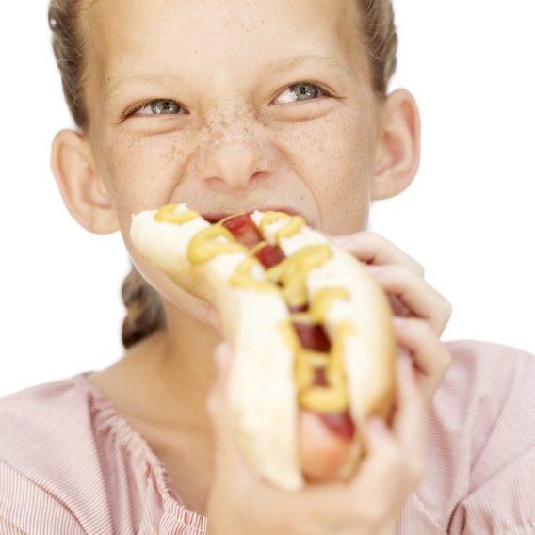
Gerunds
A gerund is a verbal that acts as a noun.
-Running is great exercise
-Most people enjoy eating.

Slide 9

Gerunds
A gerund is a verbal that acts as a noun. (always end in “ing”)
-Running is great exercise
-Most people enjoy eating.

Slide 10
Identify the Gerunds in the following sentences
Talking is a disruptive activity.
My son loves playing with his toy dinosaur.
The doctor gave studying all of his attention.

Slide 11
Infinitives
An infinitive is a Verbal that appears with the word “to” and acts as a noun, adjective, or adverb
  2 types of infinitives
    Present infinitive (only “to” + verb)
    Perfect infinitive (“to have” or “to have been” + past tense version of the verb)

Slide 12
Infinitive examples
Present
  I like to debate.
  To play with matches is wrong.
Perfect
  I would have liked to read the paper.
  To have been mentioned would have been enough.

Slide 13
Identify the verbals in the following sentences and identify them as a participle, a gerund or an infinitive.
Meditating on positive ideas brings great physical health.
The explorer struggled to find the remote colony.
The heated pool is great for sore muscles

