Slide 1

Writing 1

Slide 2
Letter Writing

Slide 3
Objectives
1. Enabling students to write personal / friendly letters.
2. A detailed discussion on the mechanism involved in letter writing.

Slide 4
Kinds of letters
Informal Letters
Personal Letters / Social Letters – Relatives and Friends
Formal Letters
Business Letters – Traders / Firms and companies for business purposes
Official Letters – Letter of Application / Letter to Government officials and Newspaper, Termination Letters, Job Letters, Recommendation / Reference Letters
Complaint Letter
Request Letter
Enquiry Letter

Slide 5
Parts of a Letter
Irrespective of the type of letter there is certain
matter of forms, which are applicable to all letters.
1. Heading
2. The Salutation--------Greetings
3. Body---------Communication /Message
4. Subscription ----Leave taking/conclusion
5. Signature-------Name of the writer
6. Address

Slide 6
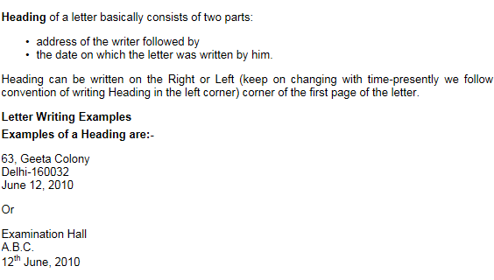
1. Heading

Slide 7
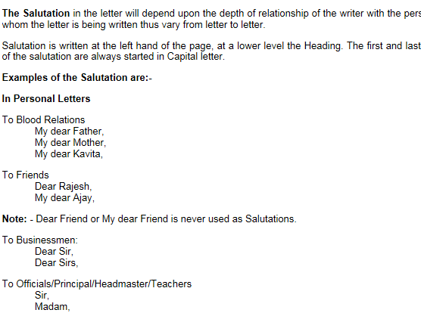
2. Salutation

Slide 8
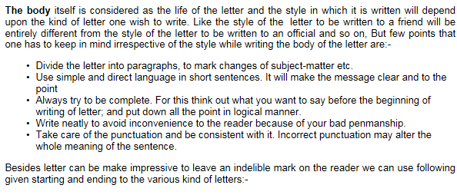
3. Body

Slide 9
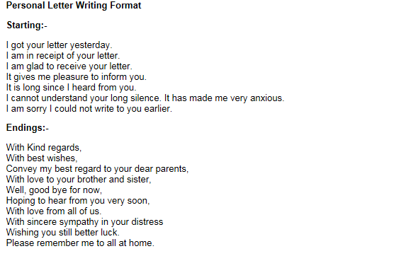
4. Starting / Endings

Slide 10
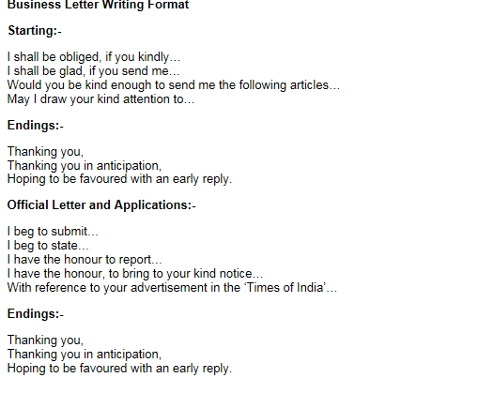

Slide 11
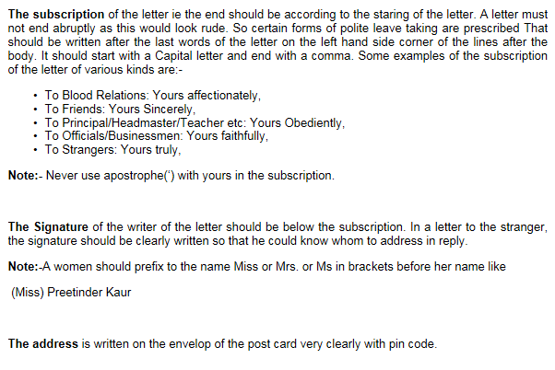
5. Subscriptions

Slide 12
Friendly Letter Writing
Purpose of a Friendly Letter
A friendly letter (or informal letter) is a way of communicating between two people (sometimes more) who are usually well acquainted. There are many uses and reasons for writing a friendly letter but friendly letters will usually consist of topics on a personal level. Friendly letters can either be printed or hand-written.
Friendly Letter Writing
The friendly letter is typically less formal than that of a business letter. Usually the first paragraph of the body will consist of an introduction which will give the recipient an idea about why you're writing to them with a short summary of the main topic of your letter. If you don't know the person you are writing to, you may want to introduce yourself in this introductory paragraph as well.
The next few paragraphs will usually consist of the message you want to get across along with any details you may want to convey.
The last paragraph will usually be the conclusion where you wrap everything up. You can sum up your main idea in this paragraph, thank the recipient for their time, wish the recipient well, and/or ask any questions.
Since friendly letters are less formal, you can feel free to write it however you like, but the above format is fairly common.

Slide 13
Friendly Letter Format
Return Address Line 1
Return Address Line
Date (Month Day, Year) 2
Dear Name of Recipient, 3
Body Paragraph 1
. . . . . . . . . . . . . . . . . . . . . . . . . . . . . . . . . . . . . . . . . . . . . . . . . . . . . . . . . . . . . . . . . . . . . . .
. . . . . . . . . . . . . . . . . . . . . . . . . . . . . . . . . . . . . . . . . . . . . . . . . . . . . . . . . . . . . . . . . . . . . . .
Body Paragraph 2
. . . . . . . . . . . . . . . . . . . . . . . . . . . . . . . . . . . . . . . . . . . . . . . . . . . . . . . . . . . . . . . . . . . . . . .
. . . . . . . . . . . . . . . . . . . . . . . . . . . . . . . . . . . . . . . . . . . . . . . . . . . . . . . . . . . . . . . . . . . . . . .
Body Paragraph 3
. . . . . . . . . . . . . . . . . . . . . . . . . . . . . . . . . . . . . . . . . . . . . . . . . . . . . . . . . . . . . . . . . . . . . . .
. . . . . . . . . . . . . . . . . . . . . . . . . . . . . . . . . . . . . . . . . . . . . . . . . . . . . . . . . . . . . . . . . . . . . . .
Closing (Sincerely...), 5
Signature 6

Slide 14
A letter to a friend, stating your first impression of college
Baloch House, Street 6
Jubail
March 4, 2013
Dear Samahir,
I have been attending college for the last few days. Indeed it is a new experience for me. I feel quite a change
in me. The college has played a great role in it.
College has a peculiar charm. It greets the newcomers with open arms. It makes them conscious of their
hidden qualities. It teaches them to act and behave as honorable young individuals. It gives them freedom of
thought and action.
College has offered me a chance to develop my personality in every aspect – social, moral and intellectual.
Pay my best regard to your dear parents.
Yours Sincerely,
Amal

Slide 15
Write a letter to your friend inviting her to attend your sister’s wedding.

Slide 16
Thank you☺

