Slide 1

English Literature of
Seventeenth and Eighteenth
Century
Instructors: Dr. Hala Owaidat
Meraj Tabassum Syed
Department of English
College of Education, Jubail
University of Dammam,
Kingdom of Saudi Arabia

Slide 2
17th & 18th Century Literature
The objectives :
Know the meaning of Literature and it’s divisions.
Understand what does genre mean.
Grasp the three main genre’s of literature
Known the categories in which Prose , Poetry and Drama are divided

Slide 3

Literature

Slide 4
Literature is "acquaintance with letters” The word literature literally means "things made from letters“

Slide 5
LITERATURE
Literature falls into two major types that are : written and oral literature.
Written Literature has drama, novel, poetry and nonfictional literature.
Oral literature includes ballads, myth, jokes, folktales and fables.

Slide 6
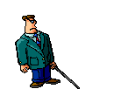
The Major Genres
Literature
Prose
Poetry
Drama
Department of English

Slide 7

PROSE
Prose is writing that is organized in sentences and paragraphs.
It imitates the spoken language.

Slide 8
PROSE
Prose is the ordinary form of spoken and written language whose unit is the sentence, rather than the line as it is in poetry.
The term applies to all expressions in language that do not have a regular rhythmic pattern.
Department of English

Slide 9

Prose
Literature
Prose
Poetry
Drama
FICTION NON-FICTION
-Short Stories -Biographies
-Fairy Tales - Letter
-Novels -Memoirs
- Historical Essays
-Reports

Slide 10

Poetry
Literature
Prose
Poetry
Drama
Poetry is language written with rhythm and is organized in lines and groups of lines called stanzas.
Major Types of Poetry
Lyric Poetry
Narrative Poetry
Concrete Poetry

Slide 11


Lyric Poem
Lyric poem is a highly musical verse that expresses the observation and feelings of a single speaker.

Slide 12
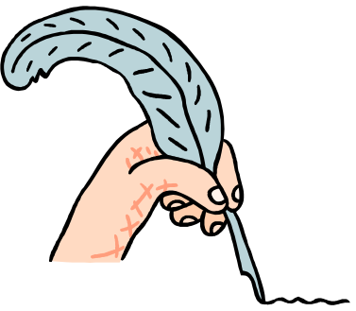
Narrative Poem
Narrative Poem is a story told in verse.
Narrative poems often have all the elements of short stories, including characters, conflict, and plot.

Slide 13
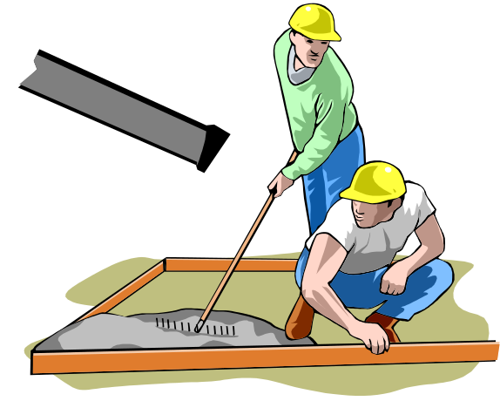
Concrete Poem
Concrete Poem is one with a shape
that suggests its subject.
The poet arranges the letters, punctuation, and lines to create an image or picture, on the page.

Slide 14
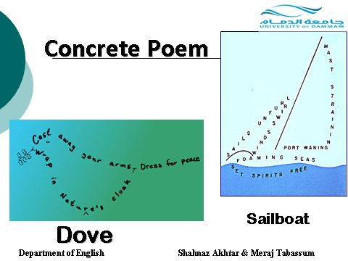

Slide 15
Literature
DRAMA
Prose
Poetry
Drama
Drama is a story written to be performed by actors.
Although a drama is meant to be performed, one can also read the script, or written version, and imagine the action.

Slide 16
Folk Literature
Most works of prose or poetry travel from the author’s imagination to a page.
Folk literature makes a different and longer journey, from the mouths of many tellers to the ears of many listeneres.

Slide 17
Folk Literature
Folk literature -including myths, folk tales and legends.
It is shaped by a group or culture over many years before being written down.
It expresses the hopes and values of the culture that creates it.
Department of English

Slide 18
How does Drama differ from Fiction and Poetry?
Absence of narrator/mediator (usually): we have to construct meaning directly.
Stagecraft: lighting & other elements to create setting/mood on stage.

Slide 19
How does Drama differ from Fiction and Poetry?
Collaborative effort: director & actors must interpret the playwright’s words.
Every production of a play is different.
Theatre is a group experience: actors affected by audience response; audience members affect each other.
Department of English

Slide 20
Literary Elements
Department of English

Slide 21

Elements of a Literary work
Setting
Characters
Plot
Conflict
Mood
Action
Point of View
Theme
Department of English

Slide 22
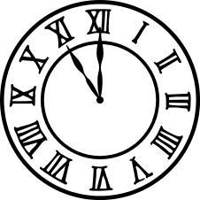

Setting
Time and place are where the action occurs
Details that describe:
  Furniture
  Scenery
  Customs
  Transportation
  Clothing
  Dialects
  Weather
  Time of day
  Time of year
Department of English

Slide 23
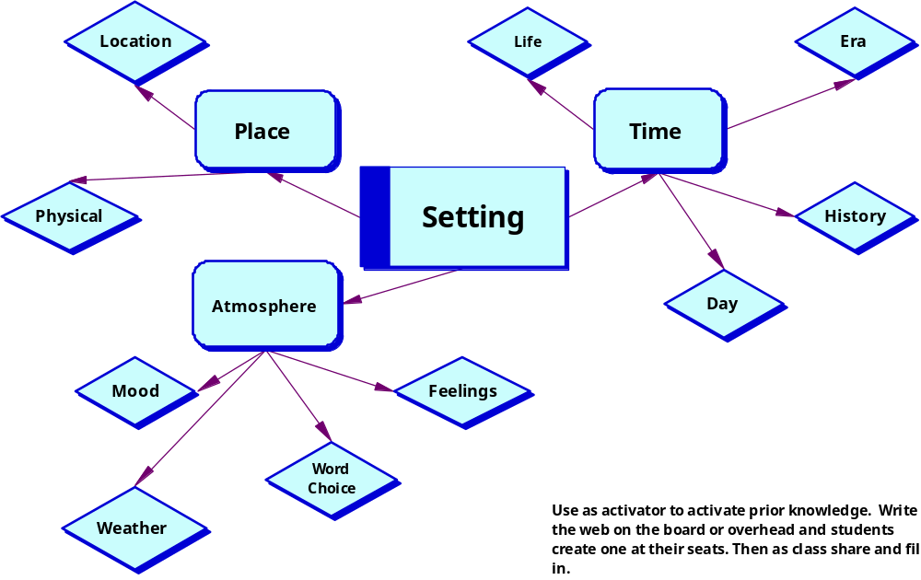
Elements of a Setting
Department of English

Slide 24
The Functions of a Setting
To create a mood or atmosphere
To show a reader a different way of life
To make action seem more real
To be the source of conflict or struggle
To symbolize an idea
Department of English

Slide 25

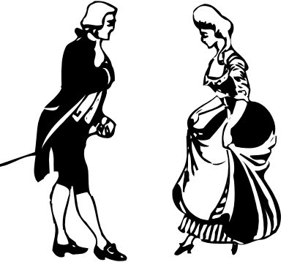
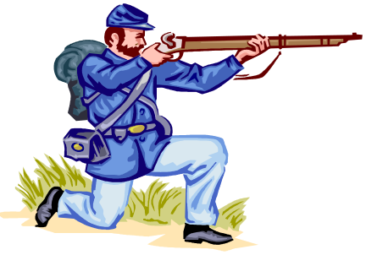
Types of Characters
People or animals
Major characters
Minor characters
Round characters( Dynamic)
One that grows and changes due to the challenges and conflicts he/she encounters
Flat characters ( Static)
One that never changes from the beginning of the story to the end
Department of English

Slide 26
Characterization
A writer reveals what a character is like and how the
character changes throughout the story.
The two primary methods of characterization:
  Direct- writer tells what the character is like
  Indirect- writer shows what a character is like by describing what the character looks like, by telling what respond to that character the character says and does, and by what other characters
Department of English

Slide 27
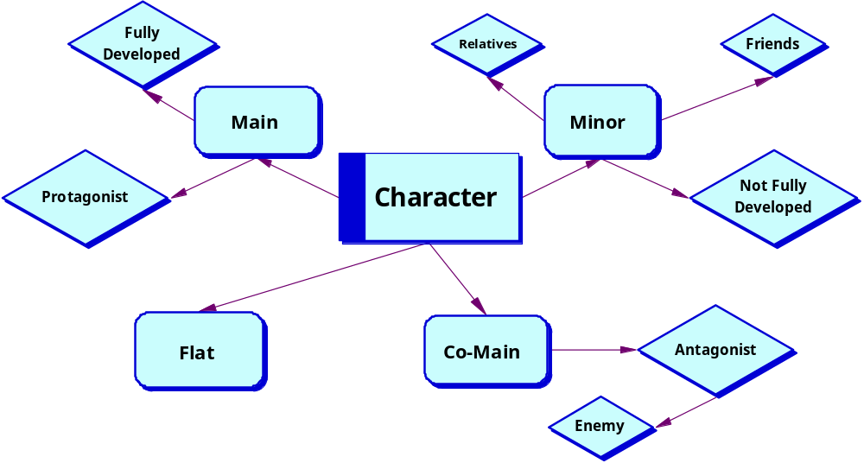
Elements of Character
Department of English

Slide 28

Factors in Analyzing Characters
Physical appearance of character
Personality
Background/personal history
Motivation
Relationships
Conflict
Does character change?
Department of English

Slide 29
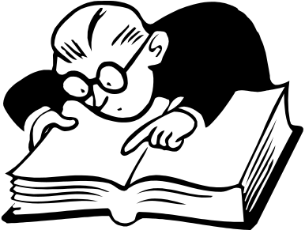
Plot
Plot is what happens and how it happens in a narrative. A narrative is any work that tells a story, such as a short story, a novel, a drama, or a narrative poem.
Department of English

Slide 30
Parts of Action in the Conflict of the Plot
Exposition or Inciting incident – events that gives rise to conflict (opening situation)and introduce the situation
Rising action or Development- events that occur as result of central conflict
Climax- highest point of interest or suspense of story
Falling action: when complications start to be solved
Resolution- {or the end}when the conflict ends
Department of English

Slide 31
Diagram of Plot
Climax
Falling action
Development/
Rising Action
Exposition
Resolution
Inciting incident/
Opening situation
Department of English

Slide 32

Special Techniques of Plot
Suspense- excitement or tension
Foreshadowing- hint or clue about what will happen in story
Flashback- interrupts the normal sequence of events to tell about something that happened in the past
Surprise Ending- conclusion that reader does not expect
Department of English

Slide 33
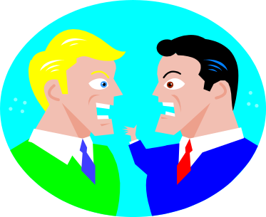
Conflict
Conflict is a struggle between opposing forces
Every plot must contain some kind of conflict
Stories can have more than one conflict
Conflicts can be external or internal
  External conflict- outside force may be person, group, animal, nature, or a nonhuman obstacle.
  Internal conflict- takes place in a character’s mind
Department of English

Slide 34
Conflict
  Character v Character
  Character v Nature
  Character v Supernatural
  Character v Society
  Character v Self
Department of English

Slide 35
Mood
  Characters’ feelings
  Reader’s feelings
Department of English

Slide 36
Point of View
First Person
Third Person Omniscient
Third Person Limited Omniscient
Department of English

Slide 37
Point of View
First Person: One of the characters is the narrator of the story; uses personal pronouns I, me, my, mine, we, us, out, ours
Third Person Omniscient: narrator is NOT one of the characters in the story; narrator can read everyone’s thoughts and feelings and can be in all places at all times
Third Person Limited Omniscient: narrator is NOT one of the characters in the story; narrator can read the thoughts and feelings of only one character (usually the protagonist) and can only be in the same place as the “host” character. The reader does not have access to all of the characters’ thoughts and feelings all of the time … some thumbs up, some thumbs down.
Department of English

Slide 38
Theme
A central message, concern, or insight into life expressed through a literary
work
Something about life that is common to all cultures
Can be expressed by one or two sentence statement about human beings or about life
May be stated directly or implied
Interpretation uncovers the theme
Department of English

Slide 39
Example of Theme
“This is the function of a storyteller”
Spencer Holst
Department of English

Slide 40
Drama Definition
Martin Esslin in Anatomy of Drama has the following definitions of drama:
Drama can be seen as a manifestation of the play instinct as in children who are playing mother and father.
2. Drama is something one goes to see, which is organized as something to be seen.

Slide 41
Drama Definition
3. In arts, drama is the most elegant expression of thought nearest to the truth (reality).
4. It is the most concrete form in which art can recreate human situation, human relationship.
5. It is an enacted fiction an art form based on mimetic action.
Department of English

Slide 42
Aristotle’s definition
Aristotle:
Defines drama simply as an imitation
of an action.
Links it to the mimetic impulse in human beings like children playing father and mother in a childhood play.

Slide 43
Aristotle: Elements of Drama
Plot: action of drama--what happens
Character: revealed in time; motivation
Thought
  theme
  issues addressed
  statement on society

Slide 44
Aristotle: Elements of Drama
Diction: dialogue & soliloquy
Music: song
Spectacle
Costume
Scenery
Department of English

Slide 45
Types of Drama
Tragedy
Comedy
Tragicomedy
Melodrama
The term melodrama refers to a dramatic work which exaggerates plot and characters in order to appeal to the emotions
Farce
A farce is a comedy which aims to entertain the audience by means of unlikely, extravagant, and improbable situations, disguise and mistaken identity, verbal humor

Slide 46
Dramatic terms
Aside: This type of speech occurs when a character speaks directly to the audience. Though other characters may be on stage, they cannot hear what the speaker is saying.
Catharsis: In tragedy, the release of strong emotion in the audience.
Monologue: A long speech delivered by one character to one or more other characters on stage.

Slide 47
Dramatic terms
Dialogue: A back-and-forth conversation between two or more characters.
Soliloquy: A long speech given by one character alone on stage. The purpose is to reveal to the audience a character’s intimate thoughts and desires
Department of English

Slide 48
Dramatic terms
Tragic hero: A character whose basic goodness and superiority is marred by a tragic flaw—a fatal error in judgment that leads this character’s downfall.
.
Department of English

Slide 49
Dramatic terms
Protagonist: The character who is the object of the conflict. This character is usually the central character in a story or drama, the one with whom readers are supposed to sympathize.
Department of English

Slide 50
Dramatic terms
Antagonist: The character who initiates the conflict and can be considered an enemy of the hero.

Slide 51
Poetic Figurative Language
Personification
Onomotopoeia
Simile
Metaphor
Alliteration
Hyperbole
Oxymoron
Department of English

Slide 52
Figurative Language
1.Figurative Language gives colour and life to a written piece of work.
2.Personification: Giving an inanimate object the qualities and characteristics of a PERSON or human being
3.Onomotopoeia: The imitation of a sound using a word
4.Simile: The comparison of two basically unlike things use the words ‘like’ or ‘as’
5.Metaphor: The comparison of two basically unlike things NOT using the words ‘like’ or ‘as’
6.Alliteration: The repetition of a consonant sound
7.Hyperbole: Great exaggeration
8.Oxymoron: A combination of contradictory words
Department of English

Slide 53
English Literature of Seventeenth
and
EighteenthCenturies
ALL THE BEST!
Department of English

