Slide 1



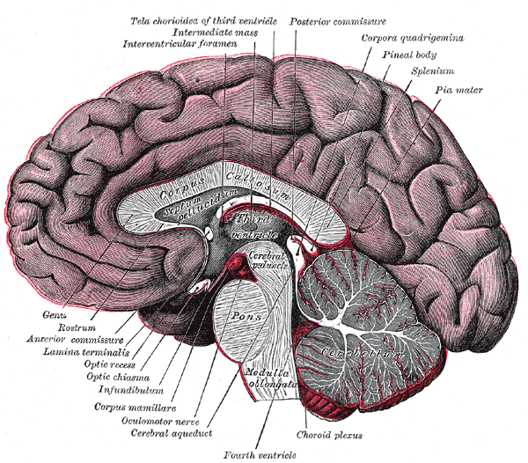
Introduction to Psycholinguistics

Slide 2
PSYCHOLINGUISTICS
Psycholinguistics or psychology of language is the study of the psychological and neurobiological factors that enable humans to acquire, use, and understand language.

Slide 3
Metaphor and Irony
The use of figurative devices in speech such as metaphor and irony is widespread and also brings variety to our speech.
Fortunately people do not use simple, active, declarative sentences all the time!

Slide 4
Metaphor
These are very common and are typically used to express an idea which cannot be expressed as powerfully any other way.
They differ from a simile because they use the verb 'to be' rather than 'as' or 'like' and imply a very direct comparison.
A typical metaphor is:
Driving is a piece of cake

Slide 5
Metaphor
Metaphors have three main components. These are the topic or tenor, the vehicle, and the ground.
In the example above, the tenor is driving. The vehicle is what is asserted, in this case piece of cake.
The ground is the relationship between them.
Three views on metaphor which have been put forward are (these are not necessarily mutually exclusive)

Slide 6
Metaphor
Substitution - metaphors are dispensable linguistic devices which can be replaced by a literal paraphrase;
2. Comparison - metaphor is an implicit comparison;
3. Interaction view - knowledge associated with terms in metaphor interacts to produce something new

Slide 7
IRONY
A good example of an ironic utterance is
What lovely weather!
The key aspects of irony are that:
1 ) it seems to involve saying the opposite of what is really the case;
2) a particular voice tone is often adopted;
3) it usually has a victim;
4) it is usually used to criticize rather than praise.

Slide 8
WRITING SYSTEMS
Pictographic - iconic (not arbitrary), an idea is represented by a drawing of it.
Logographic (Ideographic) - individual characters stand for individual words, but do not represent them pictorially, e.g. Kanji.
It is not possible to tell how to pronounce a word you have not seen before. (Symbols such as £ and & are examples with which you will be familiar).
Syllabic - each written character represents a syllable, e.g. Kana.

Slide 9
Alphabetic
Alphabetic - individual characters stand for individual letters, e.g English. Note that dictionaries have fossilised spellings, but pronunciations continue to change.
This means that it is harder to spell a word when hearing it now than it was in the 15th century.
Most words were then written as they were pronounced.
However, to avoid confusing repetitions of up and down strokes changes were introduced, particularly in frequent words such as wimin, which became women (Stubbs, 1980).

Slide 10
Alphabetic
The introduction of printing also led to standardisation.
Many spellings were altered to reflect their Latin and Greek origins,
e.g. dette became debt from the Latin debitum. Further effects of this can be seen in words
such as knife, which in the seventeenth century would have had the k pronounced.

Slide 11
Acquired Dysgraphia
Proposes two spelling systems. One is lexically based, the other is non-lexical and uses rules. The two different forms of dysgraphia can be understood by reference to each of these systems.
Phonological Dysgraphia - spelling of real words preserved, whilst spelling of new or non-words is impaired. This implies problems with the non-lexical spelling system.
Surface Dysgraphia - Spelling of non-words good, real words often mispelled, but spellings use rules (so 'search' becomes 'surch'). This implies problems with the lexical spelling system.

Slide 12
David Pearson (1985) referred to the comprehension revolution.
By this he meant the movement from traditional views of reading based on behaviourism to visions of reading and readers based on cognitive psychology.
What follows in this section are major findings from cognitive psychology regarding:

Slide 13
New and old definitions of the reading process.
Important findings about reading and learning from cognitive psychology.
Characteristics of poor and successful readers.
Milestones in reading research.
* Characteristics of successful teaching/learning environments.

Slide 14
What are speech and language disorders?
Speech and language disorders are inabilities of individuals to understand and/or appropriately use the speech and language systems of society.
Such disorders may range from simple sound repetitions or occasional misarticulations to the complete absence of the ability to use speech and language for communication.

Slide 15
Types of speech and language disorders
Fluency disorder - an interruption in the flow or rhythm of speech characterized by hesitations, repetitions, or prolongations of nouns, syllables, words, or phrases.
* Articulation disorder - difficulties with the way sounds are formed and strung together, usually characterized by substituting one sound for another (wabbit for rabbit), omitting a sound (han for hand), and distorting a sound (ship for sip).

Slide 16
Types of speech and language disorders
* Voice disorder - characterized by inappropriate pitch (too high, too low, never changing, or interrupted by breaks); quality (harsh, hoarse, breathy, or nasal); loudness, resonance, and duration.

Slide 17
LANGUAGE AND BRAIN
Of course, language is a function of the peculiar structure of the human brain.
Several areas of the brain have been identified with linguistic skills, such as producing and understanding speech.
Furthermore, people with brain damage in specific areas have difficulties with very specific aspects of language, implying that it is a highly compartmentalized process.
Furthermore, human brains are functionally asymmetrical, concentrating many areas essential for speech production in one hemisphere.

Slide 18
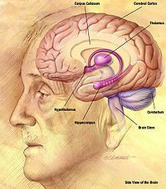
LANGUAGE AND BRAIN
In many animals that use sound for communication, the brain is lateralized, placing the control of sound production in one hemisphere of the brain (usually the left); this takes place quite strongly in songbirds and somewhat in monkeys, dolphins, and mice.

Slide 19
LANGUAGE AND BRAIN
The phenomenon of lateralization is extremely strong in humans, and in the vast majority language areas are concentrated in the left hemisphere.
The right hemisphere controls language in only about 3% of right-handers and 19% of left-handers, and another 68% of left-handers have language circuitry in both hemispheres.

Slide 20
LANGUAGE AND BRAIN
There are two major areas of the human brain that are responsible for language: Broca's area, which is though to be partially responsible for language production (putting together sentences, using proper syntax, etc.) and Wernicke's area, which is thought to be partially responsible for language processing (untangling others' sentences and analyzing them for syntax, inflection, etc.).

Slide 21
LANGUAGE AND BRAIN
Other areas involved in language are those surrounding the Sylvian fissure, a cleavage line separating the portions of the brain that are exclusively human from those we share with other animals.
In general, the areas that control language would be adjacent to one another if the human brain was laid out as a flat sheet.

Slide 22
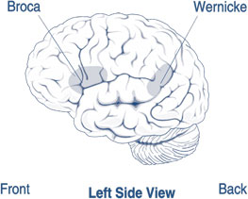
BROCA'S APHASIA
When people experience damage to Broca's area or its surroundings, their disorder is called Broca's aphasia.
As predicted by the central role of Broca's area in language production, Broca's aphasics produce slow, halting speech that is rarely grammatical.

Slide 23
WERNICKE'S APHASIA
When people experience damage to Wernicke's area, the result is a disorder called Wernicke's aphasia, which is in some ways the opposite of Broca's aphasia.
Wernicke's aphasics are able to produce generally grammatical sentences, but they are often nonsensical and include invented words.

Slide 24
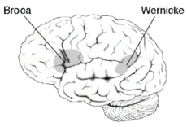
WERNICKE'S APHASIA
Wernicke's aphasics show few signs of understanding others' speech, and have difficulty naming objects; they commonly produce the names of related objects or words that sound similar to the object's name.

Slide 25
THANK YOU

