Slide 1

Grammar

Slide 2
Present perfect simple
To talk about an action that started in the past and continues to the present.
I have worked in America for 3 years .
My husband and I have had this place since 2001.
2. When we don’t know the exact time in the past.
We have been to Paris.
Have / Has + V3

Slide 3
Past simple
To talk about an action that happened and finished in the past.
I worked in America last year.
2. When we know the exact time in the past.
We went to Paris 3 months ago.
V2

Slide 4

We must use the past simple with phrases that say a definite time (ago ,in 1997 , last week, at 10 o’clock ,etc.) :
I went there two years ago.
Not I’ve been there two years ago.

Slide 5
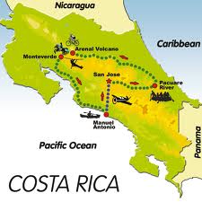
Positive and negative
I /you/ we/ they + have / haven’t + V3
He/ she/ it + has/ hasn’t + V3.
You haven’t worked in Costa Rica.
She hasn’t been to the USA.

Slide 6

questions
(question word) + have/has +subject + past participle V3.
How long have you lived here?
Has she been there before?

Slide 7

{For and since}
We use for with a period of time ( how long ):
I’ve lived in this country for three years.
We use since with a point in time ( when something started ):
My husband and I have had this place since 2001.

Slide 8
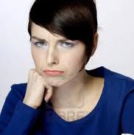
Been and gone
Go has two past participle , been and gone.
We use been to mean go and come back:
I’ve just been to San Isidro to Pick up a guest ( I’m back at the place I started from now).
We use gone to mean “ go, but not come back yet ):
My husband’s just gone to see some friends off ( he is not back yet ).

Slide 9
Adverbs and time phrases
We can use these phrases with the present perfect simple :
Never
Ever
recently
lately
before
This week
just
yet
already

Slide 10
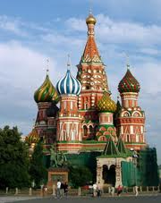
never
I’ve never been to Russia.

Slide 11
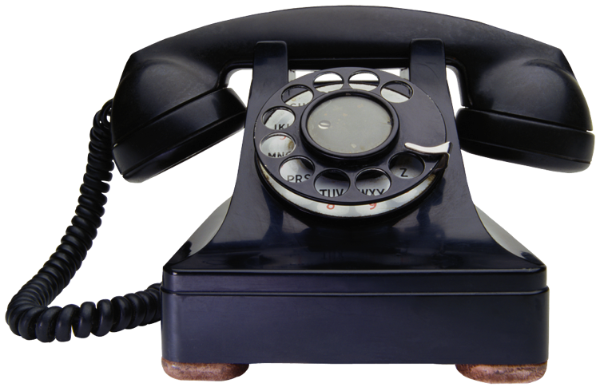
just
We use just to say something happened a short time ago.
We don’t use just in negative sentences:
Jo’s just phoned. Has Jo just phoned?
Not Jo hasn’t just phoned
We put just before the past participle.

Slide 12

yet
We use yet to say something hasn’t happened , but we think it will happen in the future.
We don’t use yet in positive sentences :
He hasn’t finished it yet.
Have you finished it yet?
Not I’ve finished it yet.
We put yet at the end of a sentence or clause.

Slide 13
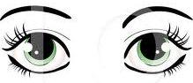
already
We use already to say something happened some time in the past ,maybe sooner than we expected.
We don’t use already in negative sentences:
We’ve already seen it . Have you already seen it ?
Not I haven’t already seen it.
We put already before the past participle.

Slide 14
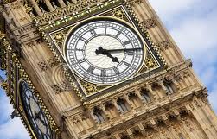
Recently and lately mean “not long ago”:
I haven’t been to London recently / lately.
We use the present perfect simple after this is the first time , this is the second time , etc.:
This is the first time we have been here.
Not ( This is the first time we are here.)

Slide 15
Tip!
We also use the present perfect simple with this week /month/ year ,etc.
And with this morning, this afternoon , etc. if it is still that time of day.

Slide 16
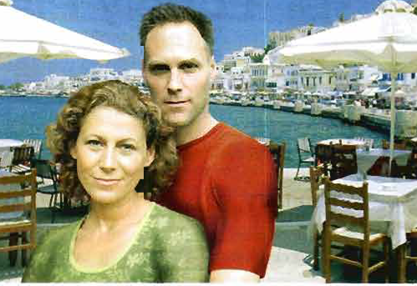
Read about Kara and Brian’s restaurant in Greece .
Put the verbs in brackets in the present perfect tense or past simple.

Slide 17
H . W
7
Page 102
3A

