Slide 1


Slide 2
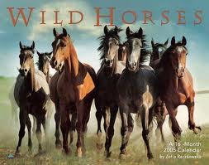

Slide 3
4
Born to be wild
4A riders

Slide 4
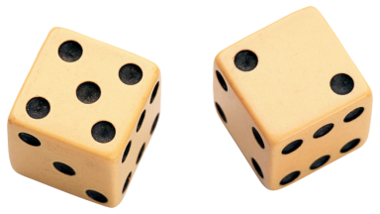
Review
Work in pairs : choose an adjective and your friend gives the noun of this adjective.

Slide 5
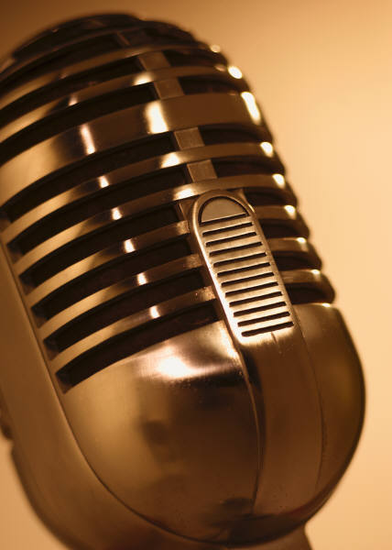
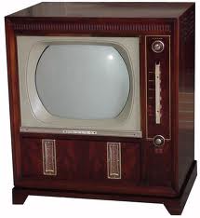
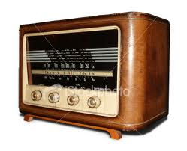
What do you usually like to watch?
Which radio station do you normally listen to ?
What is your best TV show , and who is your favorite singer, actor or actresses ?

Slide 6
3-Reading and grammar
Rock’n’roll Riders

Slide 7
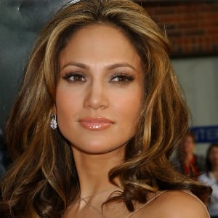
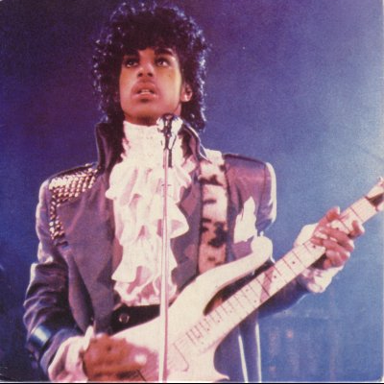
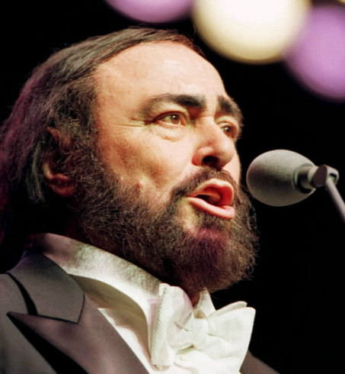
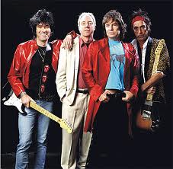
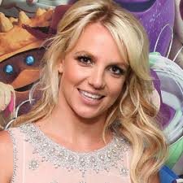
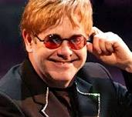
A) Work in pairs:
What do you know about these people /bands?

Slide 8
1.Elton John
2.The rolling stones
3.Jennifer lopez
4.Britney spears
5.Prince
6.Luciano Pavarotti
7.Foreigner

Slide 9
4
Past simple and past continuous

Slide 10
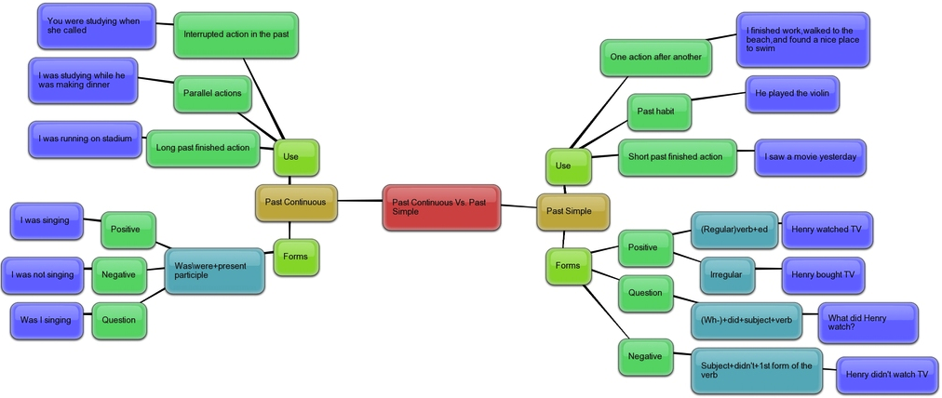

Slide 11


We use the past simple for :
A single completed action in the past :
In 2001 she went to Miami.
A repeated action or habit in the past :
He always said what size sofa he wanted .
A state in the past :
He wanted everything in his hotel room covered in clear plastic.

Slide 12

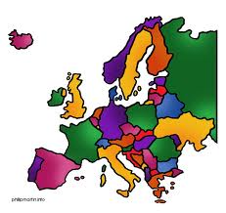

We use the past continuous for:
A longer action in the past :
In 1998 they were touring in Europe and the USA for most of the year.
Action that were in progress when another (shorter) action happened:
While they were having their end-of-tour party , they threw the pies at each other .

Slide 13
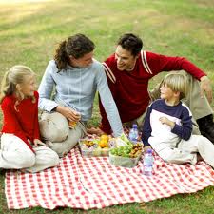
Tips
We can also use the past continuous when the longer action is interrupted :
While we were having a picnic, it started to rain (so we stopped having the picnic).

Slide 14
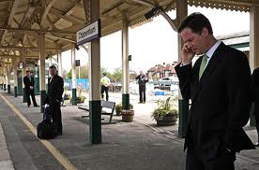
We can use when and while with the past continuous only :
He called me when/while I was waiting for the train.

Slide 15
We don’t usually use while with the past simple :
While he called me , I was waiting for a train .

Slide 16
Past simple
We make the past simple positive of regular verbs by adding -ed or –d to the infinitive :
Work worked
Live lived
There are no rules for irregular verbs.

Slide 17
We make the past simple negative with :
Subject + didn’t + infinitive.
He didn’t go to work yesterday.

Slide 18

We make past simple questions with :
(question word) + did + subject +infinitive.
What time did he go out?

Slide 19

Past continuous
We make the past continuous positive and negative with:
Subject + was /were +(not)+ verb+ing
I /he /she/it was /wasn’t working when you called.
We make past continuous questions with:
(question word) + was /were + subject +verb+ing
What were you /we /they /doing when he called?

Slide 20
Let’s practice

Slide 21
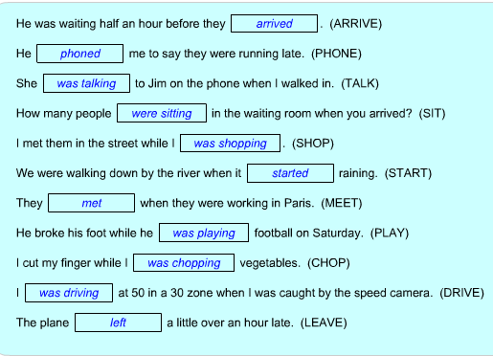

Slide 22
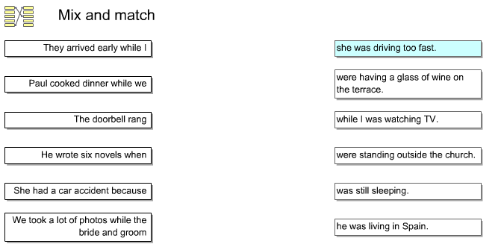

Slide 23
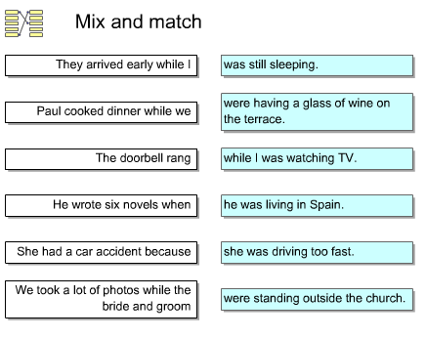

Slide 24
7 used to

Slide 25
Used to
Repeated habit in the Past
*Jerry used to study English.
*Sam and Mary used to go to Mexico in the summer.
*I used to start work at 9 o'clock.
*Christine used to eat meat, but now she is a vegetarian.
Past Facts and Generalizations
*I used to live in Paris.
*Sarah used to be fat, but now she is thin.
*George used to be the best student in class, but now Lena is the best.
"Used to" vs. Simple Past
Both Simple Past and "Used to" can be used to describe past habits, past facts and past generalizations; however, "used to" is preferred when emphasizing these forms of past repetition in positive sentences. On the other hand, when asking questions or making negative sentences, Simple Past is preferred.

Slide 26
Positive and negative
positive
Subject + used to + infinitive ( to + basic verb form ).
He used to be famous.
Negative
Subject + didn’t use + infinitive .
They didn’t use to go on tour very often.

Slide 27
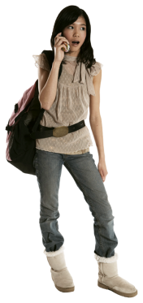
Questions
(question word)+did + subject +use to +infinitive
.
Where did you use to live when you were young?
Did she use to go out a lot ?

Slide 28
7-a)
They used to take their own furniture.
He always said what size sofa he wanted.
They once asked for twelve fruit pies.
Which sentences talk about repeated actions or habits in the past ?
Can we use used to in sentences b) and c) ? Why ?/why not ? With sentence b) because –repeated action. Not with c)
Which verb form comes after used to ?
a
infinitive

Slide 29
Tips
The short answer to yes /no questions with used to are:
Yes , I did./ no , I didn’t…….etc.
In the negative we can use didn’t use to or never used to
I never used (or I didn’t use) to go to gigs when I was young.

