Slide 1


Slide 2
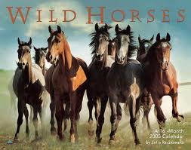

Slide 3
4B- Adventurers

Slide 4
Vocabulary
Character adjectives

Slide 5
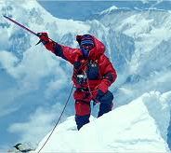
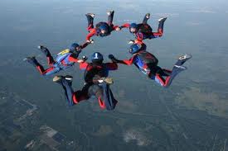
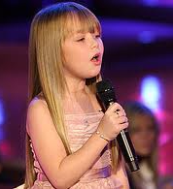
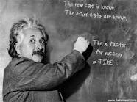
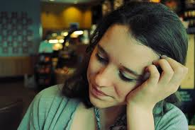
Adventurous:
People like visiting new places
and having new experiences
Talented:
People have a natural ability to do something like paint, write ,write , play, music ,etc.
Sensible:
People can make good decisions based on reasons and facts.
Sensitive:
People are able to understand
other people’s feelings and problems
and help them in away that doesn’t upset them.

Slide 6
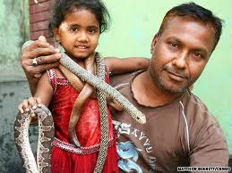
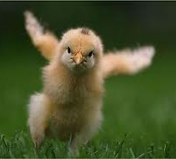

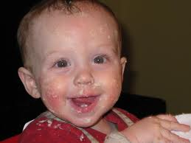
Brave :
People are not frightened in
dangerous or difficult situations.
Determined:
People want to do something very much and don’t allow anything to stop them.
Reliable:
People always do what you want
or expect them to do.
Independent:
People don’t need or want
other people to do things for them .

Slide 7


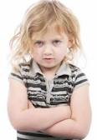
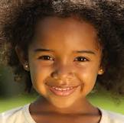
Organized:
People plan things well and don’t waste time.
Ambitious:
People want to be
very successful or powerful.
Stubborn:
People won’t change their ideas
or plans when other people want them to .
Confident:
People are sure that they can
do things successfully or well.

Slide 8
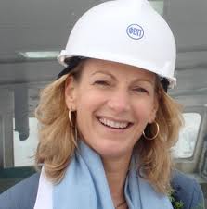
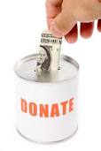


Practical:
People are good at planning things
and dealing with problems.
Generous:
People like giving money
and presents to other people.
Mean:
People don’t like spending money
or giving things to other people .
Responsible:
People behave sensibly and
can make good decisions on their own.

Slide 9
Adventurous | Talented | Sensible | Sensitive
Brave | Determined | Reliable | Independent
Organized | Stubborn | Ambitious | Confident
Practical | Generous | Mean | responsible
Think of five people you know . Choose adjectives from the table to describe them .

Slide 10
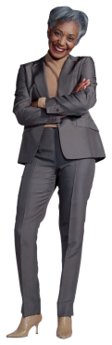
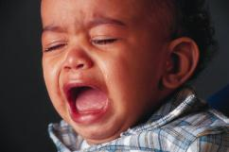
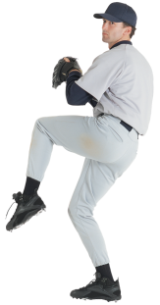









Slide 11

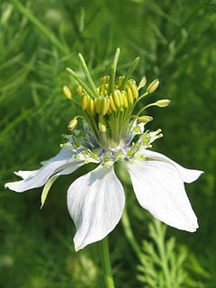
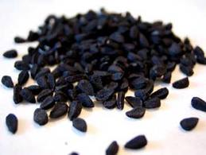




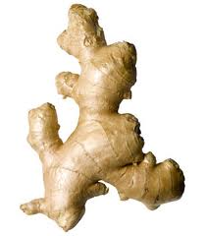

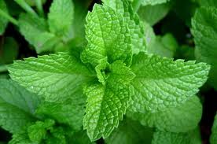
Have you or people you know , ever used medicine made from plants or flowers ?
Do you think these medicines are as good as normal medicine?
Nigella sativa

Slide 12
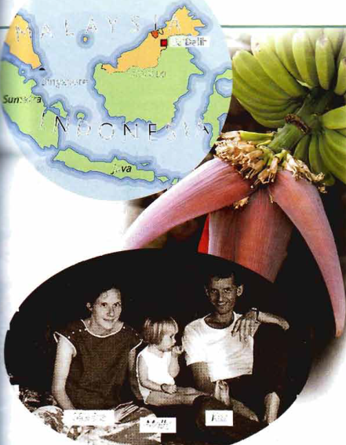
4 -listening
look at the map and the photos. What is the connection between them, do you think? What's the name of the plant ?

Slide 13
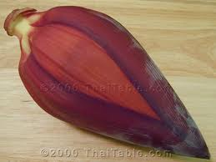
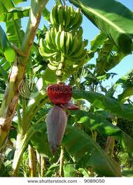
Listen & Answer
Why were Monica and Kaz living with the Pa’Dalih people ?
How old was their daughter Molly?
What happened to Molly?
Monica is an anthropologist and she was
studying how the people of Pa’Dalih grow rice.
18 months
Teapot full of boiling water fell on her.

Slide 14
5- work in pairs
What do you think Monica and Kaz did next ?
How did the Pa’Dalih people help them ?

Slide 15
4
Review

Slide 16
3-a)change
I started school when I was five.
I got into trouble a lot.
I smoked.
I did a lot of sports .
I spent lots of time playing computer games.
I hated my last year at school.
I left when I was 16

Slide 17
3-b) write a question with you for each sentence in 3a). Use use to+ infinitive where possible.
4-a)make a list of character adjectives?
B) swap papers with another student . How many are the same?

Slide 18
H.W p.35/2

Slide 19


