Slide 1

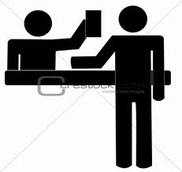
Check out of (somewhere)
Go to the reception desk to pay your bill before you leave.
Example : We checked out of the hotel early this morning.

Slide 2
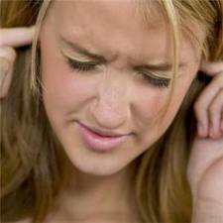
Put up with (sth)
Accept a situation that you don’t like because you can’t change it :
I don’t know how you put up with all this noise.

Slide 3
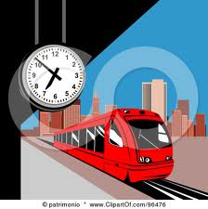

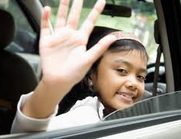
See (sb) off
Go to the place where somebody is leaving from (for example , an airport or a station ) to say goodbye to them.
My parents came to see me off at the airport.

Slide 4
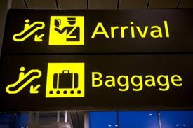
Pick (sb) up
Go to a place where somebody is waiting and take them where they want to go:
Can you pick me up from the station?

Slide 5

Got back (to / from a place)
return to a place after you have been somewhere else:
When did you get back from South Korea?

Slide 6
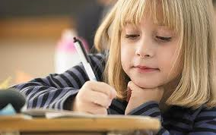
Looking forward to (sth)
Feel happy and excited about something that is going to happen:
I’m really looking forward to meeting my friends in the party.

Slide 7
Let’s practice
In my job I have to a lot of difficult customers.
My sister me this red bus form London as a souvenir.
I'm really going on holiday next week.
I can’t the noise any longer.it’s driving me crazy.
I haven't the hotel yet.
The best way to Scotland is to hire a car.
deal with
brought
back
looking forward to
put up with
checked into
get around

Slide 8
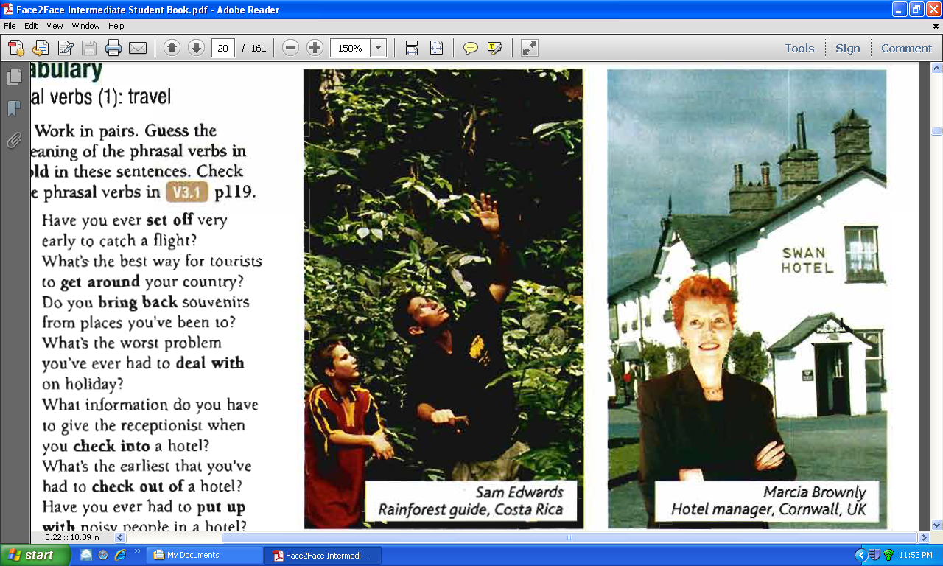
Listening and grammar

Slide 9

2- a)
1) Do they like their jobs?
2) What problems do they have in their jobs?
Sam likes his job but Marcia doesn’t
Sam has to deal with difficult people.
For Marcia people complain all the time
Some visitors steal things from the room.
Also, either she or her husband has to be at the hotel.

Slide 10
b) Work in pairs
1) I’ve worked in two central American countries and I had a great time in both places.
2)we have been away together a few times, but each time there was a problem at the hotel.
3)I started working in the hotel industry 14 years a go.
4) last month tow guys set off on their own.
5) I have lived in this county for three years.
6) my husband and I have had this place since 2010.
7) I’ve just been to San Isidro to pick up a guest.
8) my husband’s gone to see some friends off.
Sam
Marcia
Marcia
Sam
Sam
Marcia
Sam
Marcia

