Slide 1

Prepared by,
Mrs. Azzah

Slide 2

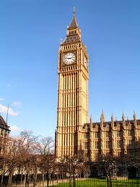
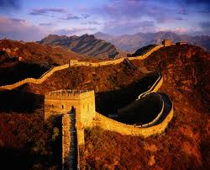

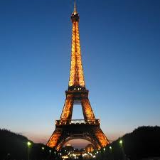

Do you like travelling ?
Tell us about the countries that you have been to ?

Slide 3
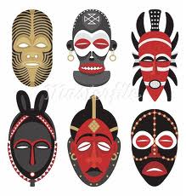

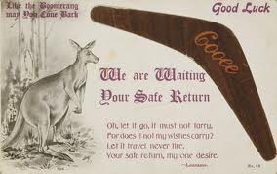
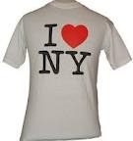

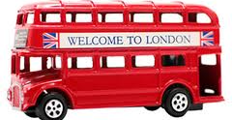


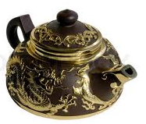

Do you like to collect souvenirs from different countries?

Slide 4
3
The tourist trade
3A)
Your holiday , my job

Slide 5
Vocabulary phrasal verbs
(1) travel
What is a phrasal verb ?
A phrasal verb is a verb plus a preposition or adverb which creates a meaning different from the original verb.

Slide 6
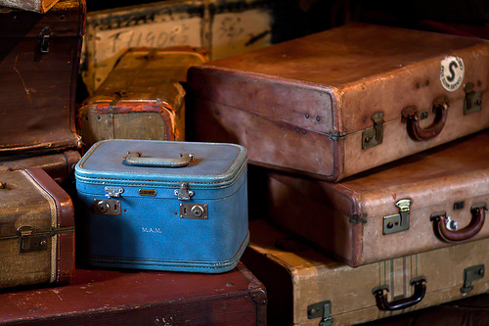
Set off
Start a journey
Example : They set off at 5 a.m.

Slide 7
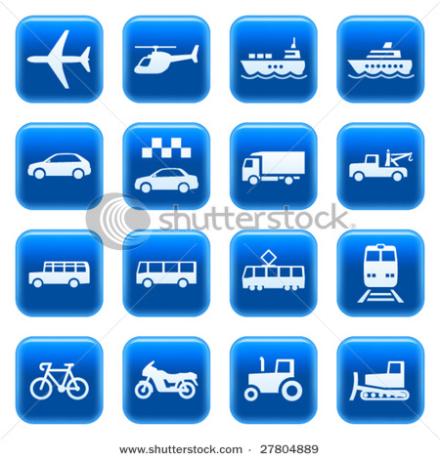
Get around
Travel to different places in the same town /city/area
Example :
What is the cheapest way to get around?

Slide 8

Bring (sTh) back from a place
Return from a place with something you bought there.
Example : We brought this carpet back from turkey.

Slide 9

Deal with (sth)
Do something in order to solve a problem or achieve something .
Example : I’ve to deal with a lot of difficult customers as part of my job.

Slide 10
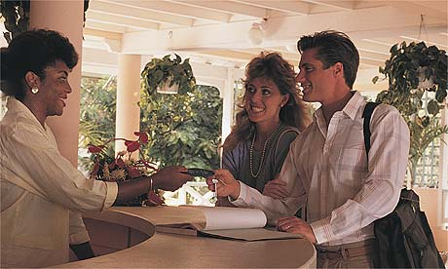
Check into (somewhere)
Go to the reception desk to say you have arrived and to get the key to your room:
Example : Have you checked into the hotel yet?

