Slide 1
Computer Graphics
CSC342
Instructor: Dr. Shereen Aly Taie

Slide 2
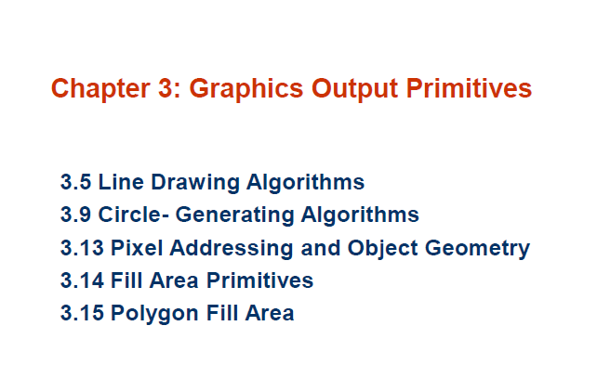

Slide 3

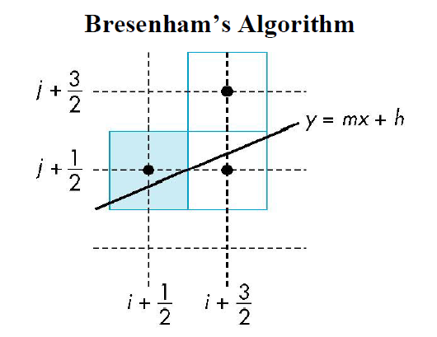

Slide 4
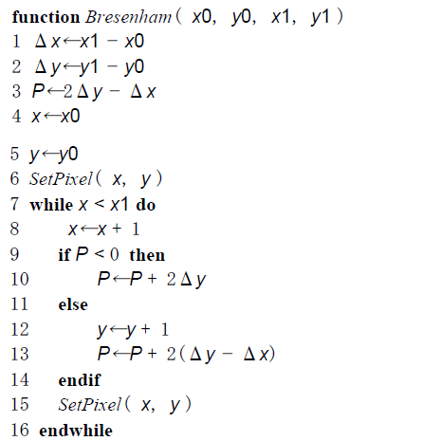

Slide 5
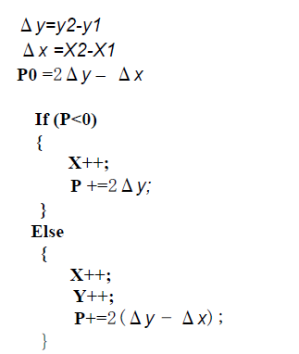

Slide 6
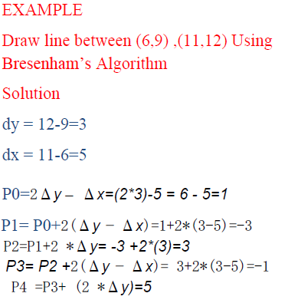
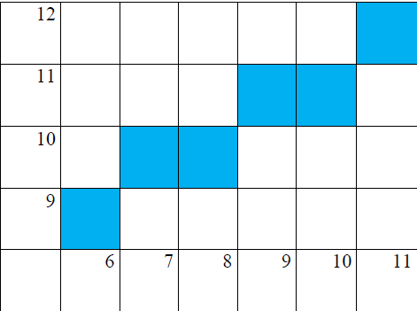
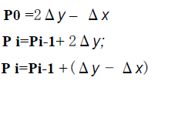
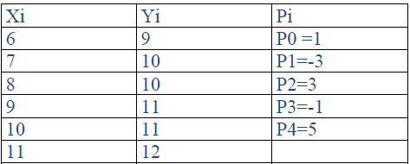
If (P>0)

Slide 7
A Simple Circle Drawing Algorithm
The equation for a circle is:
where r is the radius of the circle
So, we can write a simple circle drawing algorithm by solving the equation for y at unit x intervals using:

Slide 8
A Simple Circle Drawing Algorithm (cont…)

Slide 9
A Simple Circle Drawing Algorithm (cont…)
However, unsurprisingly this is not a brilliant solution!
Firstly, the resulting circle has large gaps where the slope approaches the vertical
Secondly, the calculations are not very efficient
  The square (multiply) operations
  The square root operation – try really hard to avoid these!
We need a more efficient, more accurate solution

Slide 10
Eight-Way Symmetry
The first thing we can notice to make our circle drawing algorithm more efficient is that circles centred at (0, 0 ) have eight-way symmetry
(-x, y)
(x, y)
(-y, x)
(y, x)
(-y, -x)
(y, -x)
(-x, -y)
(x, -y)

Slide 11
Mid-Point Circle Algorithm
Similarly to the case with lines, there is an incremental algorithm for drawing circles – the mid-point circle algorithm.
In the mid-point circle algorithm:
We use eight-way symmetry
So only ever calculate the points for the top right eighth of a circle
Then use symmetry to get the rest of the points.

Slide 12
Mid-Point Circle Algorithm (cont…)
Assume that we have
just plotted point (x_{k}, y_{k})
The next point is a
choice between (x_{k}+1, y_{k})
and (x_{k}+1, y_{k}-1)
We would like to choose
the point that is nearest to
the actual circle
So how do we make this choice?
(x_{k}, y_{k})
(x_{k}+1, y_{k})
(x_{k}+1, y_{k}-1)

Slide 13
Mid-Point Circle Algorithm (cont…)
Let’s re-jig the equation of the circle slightly to give us:
The equation evaluates as follows:
y evaluating this function at the midpoint between the candidate pixels we can make our decision

Slide 14
Mid-Point Circle Algorithm (cont…)
Assuming we have just plotted the pixel at (x_{k},y_{k}) so we need to choose between (x_{k}+1,y_{k}) and (x_{k}+1,y_{k}-1)
Our decision variable can be defined as:
If p_{k} < 0 the midpoint is inside the circle and and the pixel at y_{k} is closer to the circle
Otherwise the midpoint is outside and y_{k}-1 is closer

Slide 15
Mid-Point Circle Algorithm (cont…)
To ensure things are as efficient as possible we can do all of our calculations incrementally
First consider:
or:
where y_{k+1} is either y_{k} or y_{k}-1 depending on the sign of p_{k}

Slide 16
Mid-Point Circle Algorithm (cont…)
The first decision variable is given as:
Then if p_{k} < 0 then the next decision variable is given as:
If p_{k} > 0 then the decision variable is:

Slide 17
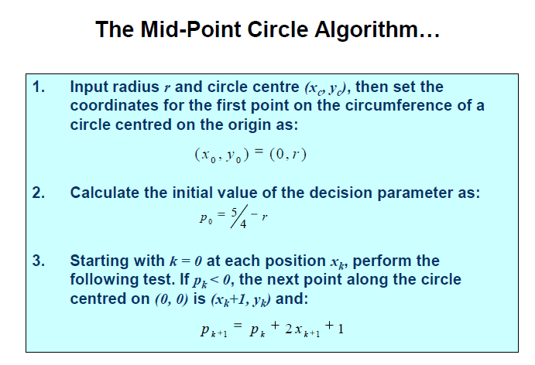

Slide 18
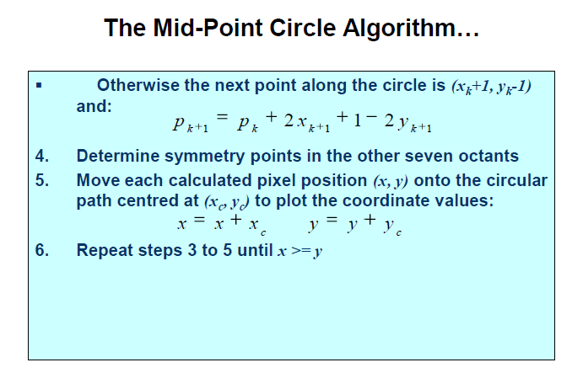

Slide 19
Mid-Point Circle Algorithm Example
To see the mid-point circle algorithm in action lets use it to draw a circle centred at (0,0) with radius 10

Slide 20


If p_{k} < 0, the next point along the circle centred on (0, 0) is (x_{k}+1, y_{k})
and:
Otherwise the next point along the circle is (x_{k}+1, y_{k}-1) and:

Slide 21
Mid-Point Circle Algorithm Example (cont…)
10
k | p_{k} | (x_{k+1},y_{k+1}) | 2x_{k+1} | 2y_{k+1}
0 1 2 3 4 5 6
9
8
7
6
5
4
3
2
1
0
0
1
2
3
4
5
6
7
8
9
10

Slide 22
Mid-Point Circle Algorithm Exercise
Use the mid-point circle algorithm to draw the circle centred at (0,0) with radius 16

Slide 23
Mid-Point Circle Algorithm Exercise (cont…)
16
k | p_{k} | (x_{k+1},y_{k+1}) | 2x_{k+1} | 2y_{k+1}
0 1 2 3 4 5 6 7 8 9 10 11 12
15
14
13
12
11
10
9
8
7
6
5
4
3
2
1
0
0
1
2
3
4
5
6
7
8
9
10
11
12
13
14
15
16

Slide 24
Mid-Point Circle Algorithm Summary
The key insights in the mid-point circle algorithm are:
  Eight-way symmetry can hugely reduce the work in drawing a circle
  Moving in unit steps along the x axis at each point along the circle’s edge we need to choose between two possible y coordinates

