Slide 1
Literary Devices in Jane Eyre

Slide 2
Antagonist
Definition: the adversary of the hero or protagonist of a drama or other literary work
Jane meets many people that test her integrity, liberty, and happiness. Among those are Aunt Reed, who torments her, and Mr. Rochester, who urges her to ignore her conscious and succumb to passion.

Slide 3
Conflict
Definition: to come into collision or disagreement; be contradictory, at variance, or in opposition; clash
Man vs. Man (Jane vs. John and Aunt Reed)
“I am glad you are no relation of mine; I will never call you aunt again as long as I live” (30).

Slide 4
Dramatic Irony
Definition: irony that is inherent in speeches or a situation of a drama and is understood by the audience but not grasped by the characters in the play
[Mr. Brocklehurst]’…each of the young persons before us has a string of hair twisted in plaits which vanity itself might have woven; these, I repeat, must be cut off; think of the time wasted, of—‘ Mr. Brocklehurst was here interrupted: three other visitors, ladies, now entered the room. They ought to have come a little sooner to have heard his lecture on dress, for they were splendidly attired in velvet, silk, and furs. The two younger of the trio (fine girls of sixteen and seventeen) had grey beaver hats, then in fashion, shaded with ostrich plumes, and from under the brim of this graceful head-dress fell a profusion of light tresses, elaborately curled; the elder lady was enveloped in a costly velvet shawl, trimmed with ermine, and she wore a false front of French curls. (VII, 56)
The irony is that he had just told all the girls to cut off their hair, when his wife and daughters walk in with the latest hairdos.

Slide 5
Euphemism
Definition:
“She kissed me, and I her, and we both soon slumbered” (59)
Jane and Helen are discussing Helen’s impending death, and ‘slumbered’ or ‘slept’ is one way to speak of dying.

Slide 6
Foreshadowing
Definition: to show or indicate beforehand; prefigure
As I looked up at them, the moon appeared momentarily in that part of the sky which filled their fissure; her disk was blood-red and half overcast; she seemed to throw on me one bewildered, dreary glance, and buried herself again instantly in the deep drift of cloud. The wind fell, for a second, round Thornfield; but far away over wood and water, poured a wild, melancholy wail: it was sad to listen to, and I ran off again. (243)
These are things that happen the night before Jane’s wedding, warning of what will happen during the ceremony.

Slide 7
Genre
Definition: The major category into which a literary work fits
Gothic Genre
”I lifted up my head to look: the roof resolved to clouds, high and dim; the gleam was such as the moon imparts to vapors with strange anticipation; as though some word of doom were written on her disk. She broke forth as newer moon yet burst from cloud: a hand first penetrated the sable folds and waved them away; then not a moon, but a white human form shone in the azure, inclining a glorious brow earthward. It gazed and gazed on me. It spoke to my spirit: immeasurably distant was the tone, yet so near, it whispered in my heart ..”

Slide 8
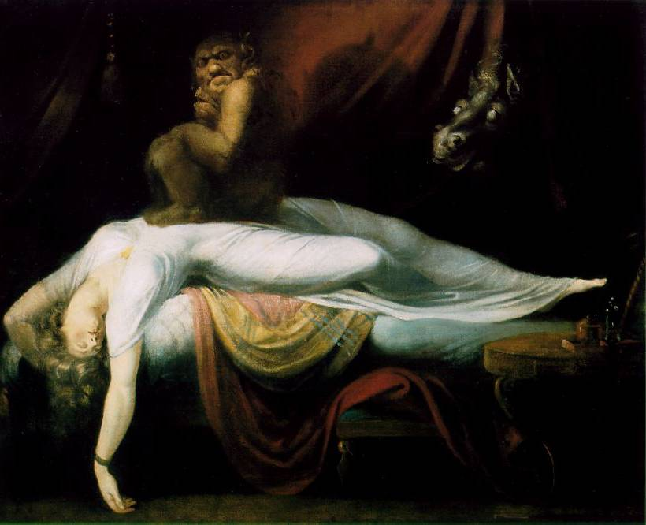
Jane Eyre and the Gothic Plot
“Dark Romanticism”
Mystery
Haunted castle or house
Dreaming and nightmares
Physical imprisonment
Psychological entrapment and helplessness
Involvement of the supernatural
Psychology of horror and/or terror
Henry Fuseli’s The Nightmare, 1781

Slide 9

Charlotte’s Gothic Influence
Jane Eyre displays some characteristics of the gothic novel:
  Imprisoned women
  A heroine who faces danger
  Supernatural interventions at crucial moments in the plot
  A romantic reconciliation

Slide 10
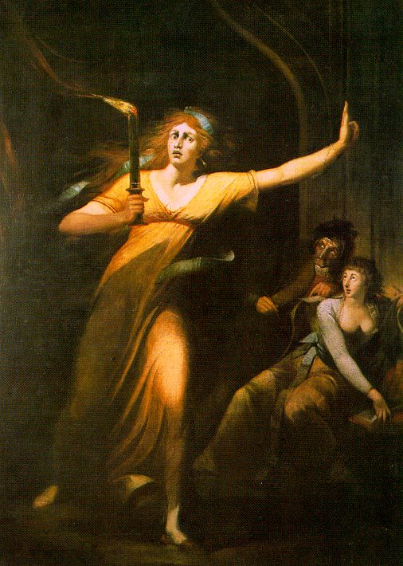
The Distressed Heroine
Jane Eyre
and the Gothic Plot
“Female Gothic”
Female protagonist is pursued and persecuted by a villainous patriarchal figure in unfamiliar settings and terrifying landscape.
The Mysteries of Udolpho by Ann Radcliffe
Lady Macbeth by Henry Fuseli 1784

Slide 11
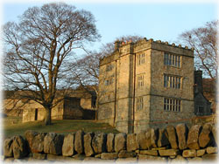
Architecture of the Mind
Jane Eyre
and the Gothic Plot
Gothic heroines explore their unknown inner selves as they wander through the mysterious house
North Lees Hall, c. 1590
Notes:
Thornfield, manorial seat of Rochesters becomes physical metaphor for Jane's mind.
Other famous haunted houses with psychological implications:
Poe's "Fall of the House of Usher"
Emily Bronte's "Wuthering Heights"--the estate of Earnshaws
Jane Austen's "Northanger Abbey" (spoof)
Daphne du Maurier's Manderley in "Rebecca"
CB visited North Lees Hal in Derbyshirel in 1845--her inspiration for Thornfield
Hall

Slide 12
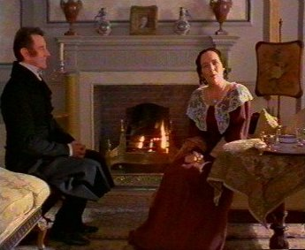
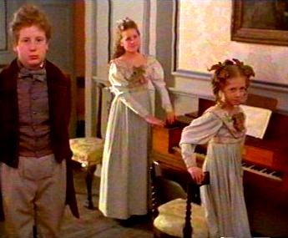
Jane Eyre and the Fairy-Tale Plot
Cinderella--Poor girl with heart of gold oppressed by wicked stepmother and stepsisters gets her chance to meet a Prince and prove her superiority, but not without serious obstacles along the way.
Notes:
Early chapters lives w/ Reeds (father's sister's family)
Obnoxious children ~ step-siblings

Slide 13
Jane Eyre and the Bildung Plot
Quest Plot
Bildungsroman: growing up story; a novel dealing with the growth and education of the protagonist
Typically a male hero, on a journey toward self-realization/independence
Often orphaned or presented with other challenges
e.g., Dickens’ Great Expectations, David Copperfield
Notes:
Bildung story special interest of post-Romantic world
"The child makes the man"
1. Interest and respect for children
2. Influence of theory of evolution and application to individual growth and development
Also a new sense in 19th century of "self-culture"--continuing development into adulthood based on life choices

Slide 14
Hyperbole
Definition: A figure of speech using deliberate exaggeration or overstatement
“but I declare I do not love you: I dislike you the worst of anybody in the world except John Reed; and this book about the liar, you may give to your girl, Georgiana, for it is she who tells lies, and not I.“ (31)

Slide 15
Imagery
Definition: the sensory details or figurative language used to describe, arouse emotion, or represent abstractions
”I looked up at -- a black pillar! -- such, at least, appeared to me, at first sight, the straight, narrow, sable-clad shape standing erect on the rug: the grim face at the top was like a carved mask, placed above the shaft by way of capital.”(30)

Slide 16
Juxtaposition
  Definition: The arrangement of two or more ideas, characters, actions, settings, phrases, or words side-by-side or in similar narrative moments for the purpose of comparison, contrast, rhetorical effect, suspense, or character development
“Bertha Mason is mad; and she came of a mad family; idiots and maniacs through three generations! Her mother, the Creole, was both a madwoman and a drunkard! -- as I found out after I had wed the daughter: for they were silent on family secrets before. Bertha, like a dutiful child, copied her parent in both points. I had a charming partner”(301)
"Do you think I can stay to become nothing to you? Do you think I am an automaton? -- a machine without feelings? and can bear to have my morsel of bread snatched from my lips, and my drop of living water dashed from my cup? Do you think, because I am poor, obscure, plain, and little, I am soulless and heartless? You think wrong! -- I have as much soul as you, -- and full as much heart!” (278).

Slide 17
Metaphor
Metaphor: A figure of speech in which a word or phrase is applied to an object or action to which it is not literally applicable.
Fire is an example of a metaphor in Jane Eyre, as the narrative repeatedly associates Jane with images of fire, brightness, and warmth. In Chapter 4, she likens her mind to “a ridge of lighted heath, alive, glancing, devouring" (Bronte).
We can recognize Jane’s kindred spirits by their similar links to fire

Slide 18
Narrative
Narrative: A collection of events that tells a story, which may be true or not, placed in a particular order and recounted through either telling or writing.
This is obviously a literary device that Bronte uses in Jane Eyre for example when Jane becomes aggravated at the thought of Rochester marrying Ms. Blanch “I saw he was going to marry her, for family, perhaps political reasons; because her rank and connections suited him; I felt he had not given her his love, and that her qualifications were ill adapted to win from him that treasure” (Bronte). Jane narrates her thought on the issue at hand.

Slide 19
Onomatopoeia
Onomatopoeia: The formation of words from a sound associated with what is named. (ex Sizzle)
“ Boh! Madam Mop!...where the dickens is she” (Bronte3).

Slide 20
Personification
Personification: The attaching of human traits and characteristics to inanimate objects, phenomena or animals.
“ This room was chill, because it seldom had a fire… it was silent…solemn…[and] lonely in spite of its grandeur”(Bronte7). Jane is describing the room as if it were a lonely person.

Slide 21
Realism
  In the novel Charlotte Bronte uses realism in order to show Jane’s most physically and mentally challenging moments. While Jane attends Lowood, the atrocious quality of food makes her sick to her stomach and takes away her appetite. For example in the novel it said, “Ravenous, and now very faint, I devoured a spoonful or two of my portion without thinking of its taste, but the first edge of hunger blunted, I perceived I had got in hand a nauseous mess- burnt porridge is almost as bad as rotten potatoes; famine itself soon sickens over it” (Bronte 39).

Slide 22
Symbolism
In the novel the “red-room” symbolizes the struggle and adversity which Jane has to overcome. The red-room represents a symbol of incarceration that prevents her from happiness, freedom and finding a true love. For example in the novel it said, “The next thing I remember is waking up with a feeling as if I had had a frightful nightmare, and seeing before me a terrible red glare, crossed with thick black bars. I heard voices, too…” (Bronte 12).

Slide 23
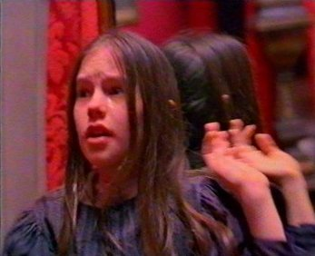
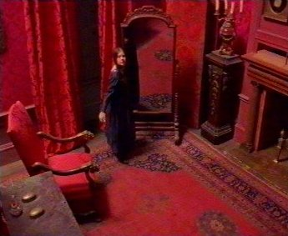
Red Room
The room at Gateshead where Uncle Reed died, and where Jane was locked up to be punished.
This punishment haunted Jane for the rest of her life.
Memories of the night in the Red Room occur when Jane is at a crossroads in her life.

Slide 24
Tone
The novel Jane Eyre has a diverse tone of romance and deep anguish. The emotions of romance and anguish are shown when it says, “I could risk no sort of answer by this time; my heart was full."Because," he said, "I sometimes have a queer feeling with regard to you…I am afraid that cord of communion will be snapped” (Bronte 239).The emotions between Rochester and Jane show their feelings towards one another.

Slide 25
Understatement
The author uses an understatement to show the horrible experience which Jane is having at Lowood. In the novel it said, “My first quarter at Lowood seemed an age, and not the golden age either; it comprised an irksome struggle with difficulties in habituating myself to new roles and unwonted tasks” (Bronte 52). J
Jane explains how bad her stay at Lowood as been by saying it seems like an entire age of difficulties not a good age like the golden period.

Slide 26
Vehicle
Definition: a method by which an author accomplishes his or her purpose
“Even for me life had its gleams of sunshine”(Bronte 33).
Bronte uses Bessie as a vehicle for Jane`s tolerance of her life.

