Slide 1
Computer Graphics
CSC342
Instructor: Dr. Shereen Aly Taie

Slide 2
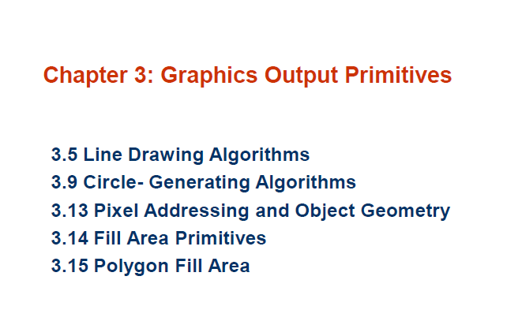

Slide 3
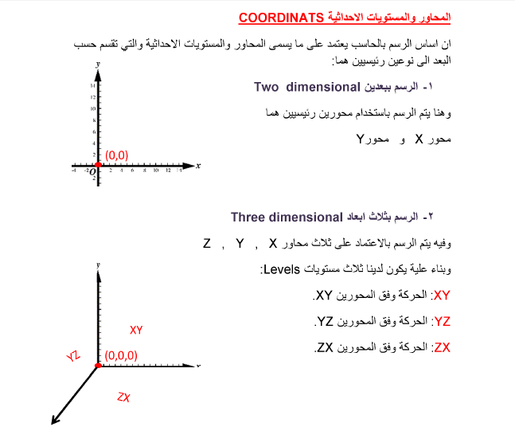


Slide 4
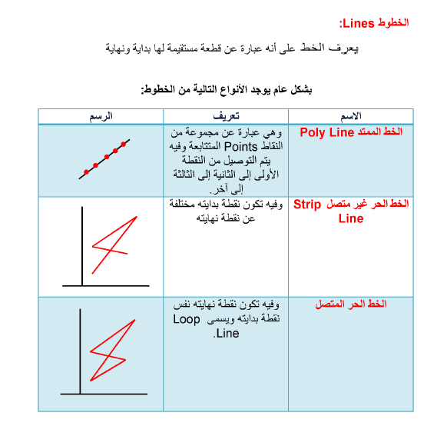

Slide 5
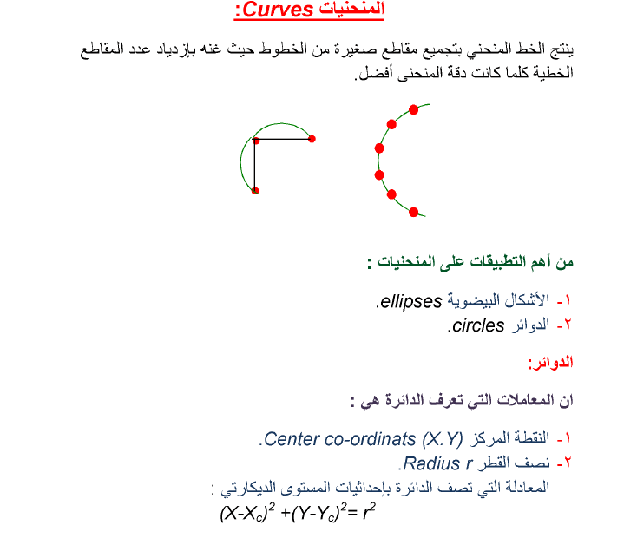
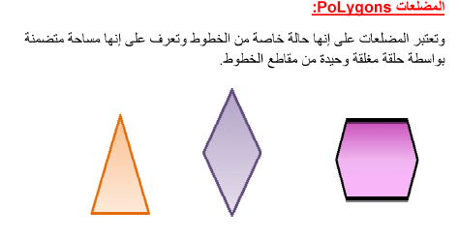

Slide 6
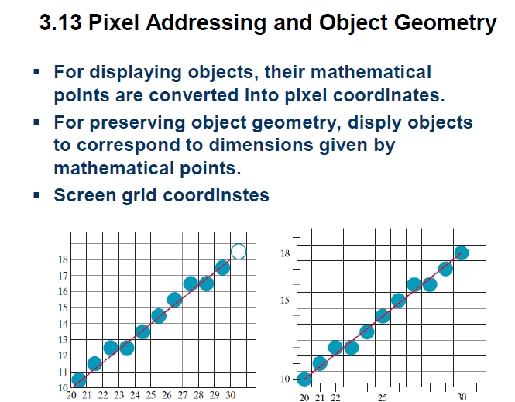

Slide 7
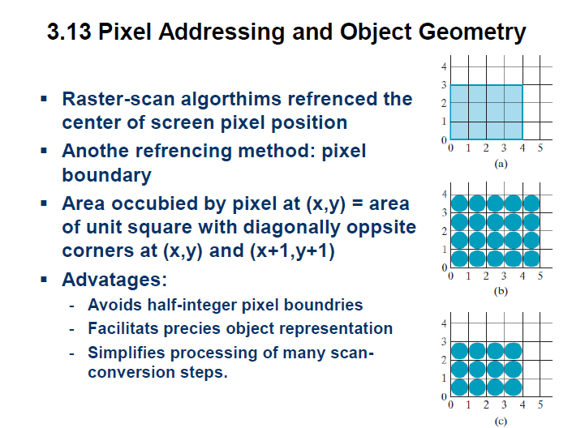

Slide 8
Filling Polygons
So we can figure out how to draw lines and circles
How do we go about drawing polygons?
We use an incremental algorithm known as the scan-line algorithm

Slide 9
Scan-Line Polygon Fill Algorithm
10
Scan Line
8
6
4
2
0
2
4
6
8
10
12
14
16

Slide 10
Scan-Line Polygon Fill Algorithm
The basic scan-line algorithm is as follows:
  Find the intersections of the scan line with all edges of the polygon
  Sort the intersections by increasing x coordinate
  Fill in all pixels between pairs of intersections that lie interior to the polygon

Slide 11
Scan-Line Polygon Fill Algorithm (cont…)

Slide 12
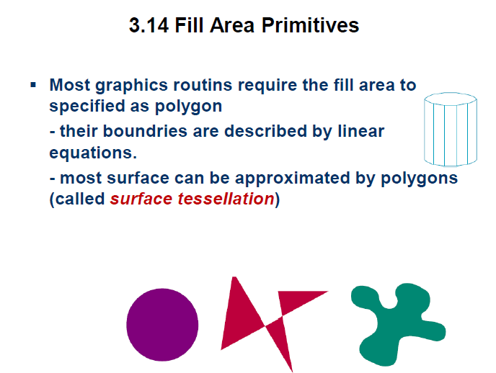

Slide 13
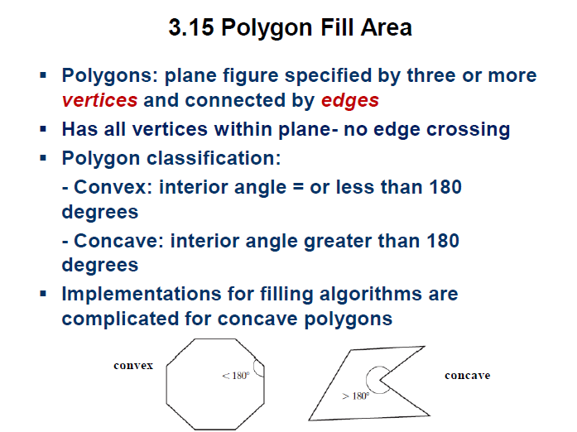

Slide 14
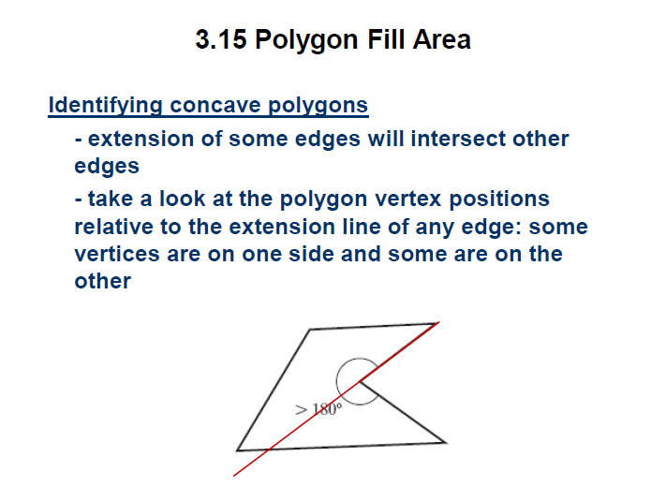

Slide 15
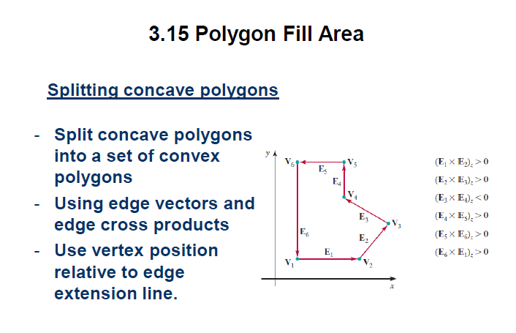

Slide 16
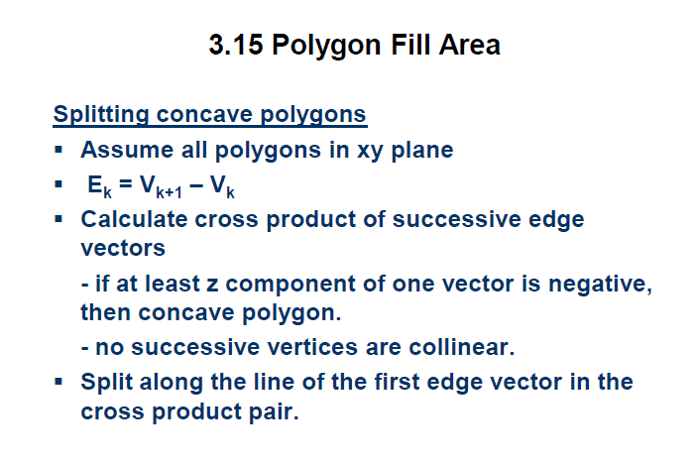

Slide 17
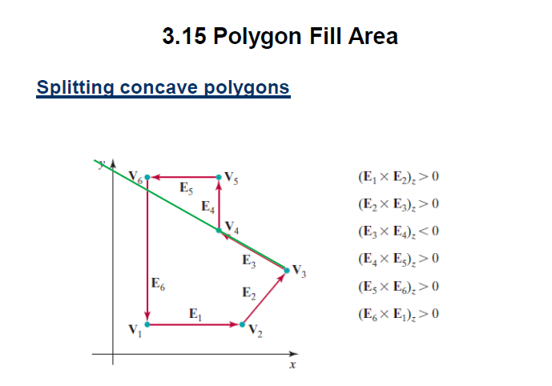


Slide 18
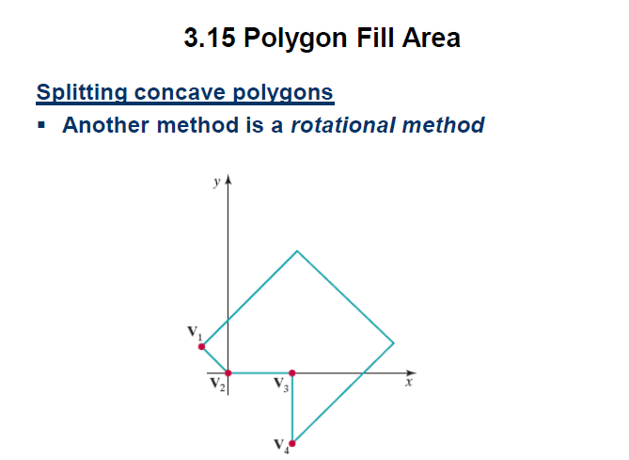

Slide 19
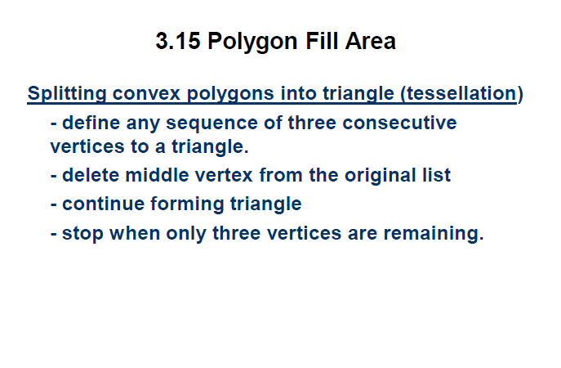

Slide 20
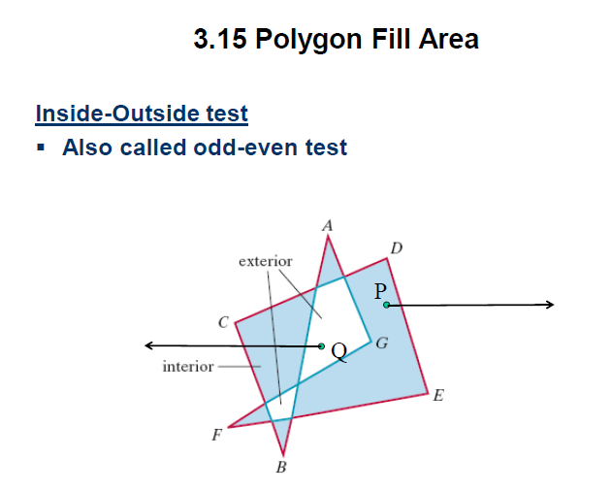

Slide 21
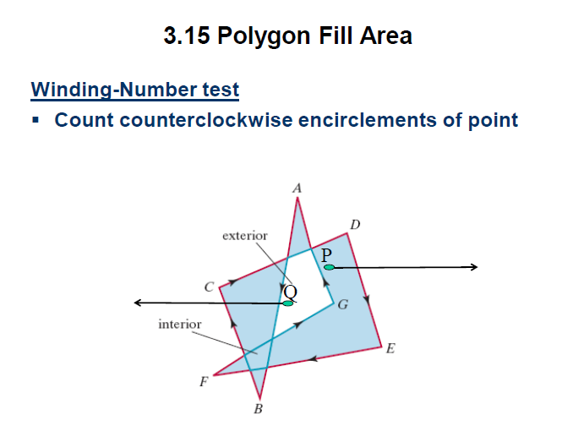

Slide 22
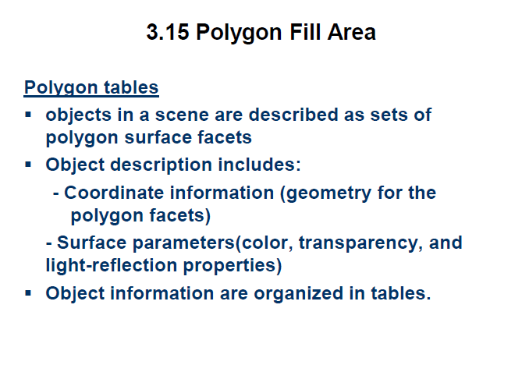

Slide 23
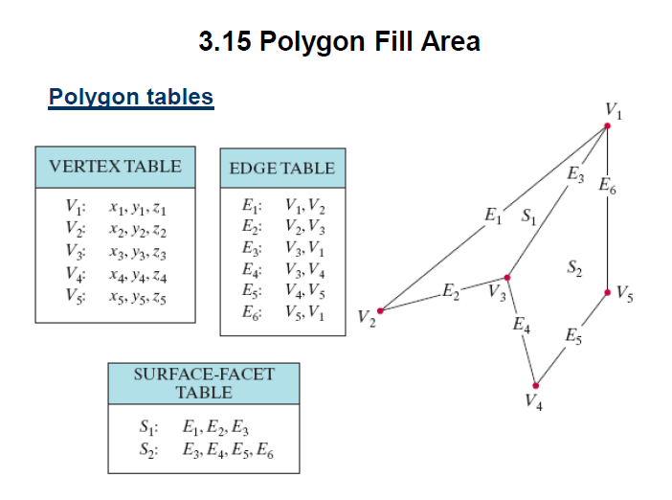

Slide 24
