Slide 1
Computer Graphics
(411 حسب)
Instructor: Dr. Shereen Aly Taie

Slide 2
Chapter 5:
Geometric Transformations
5.1 Basic Two-Dimensional Geometric Transformation
5.2 Matrix Representations and Homogeneous Coordinates
5.3 Inverse Transformations
5.4 Two-Dimensional Composite Transformations

Slide 3
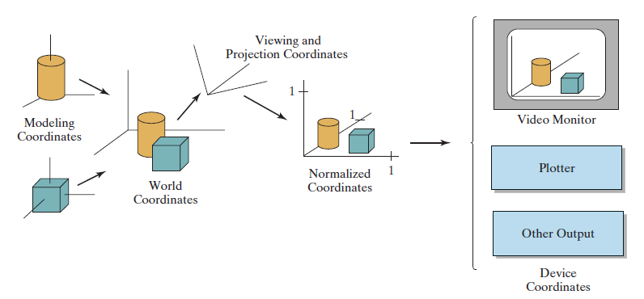
Coordinate representations of Objects

Slide 4
5.1 Basic Two-Dimensional Geometric Transformations
Basic geometric transformations:
- Translation
- Rotation
- Scaling
Other useful transformations:
- Reflection
- Shear

Slide 5
5.1 Basic Two-Dimensional Geometric Transformation
Two-Dimensional Translation
To translate a two-dimensional position, we add translation distances
(translation vector) t_{x} and t_{y} to the original coordinates (x, y )
to obtain the new coordinate
position (x', y')
x' = x + t_{x}
y' = y + t_{y}
y
6
5
4
3
2
1
0
1
2
3
4
5
6
7
8
9
10
x
Note: House shifts position relative to origin

Slide 6
5.1 Basic Two-Dimensional Geometric Transformation
Two-Dimensional Translation
With column-vector representation
, ,
Translation is a rigid-body
transformation
Example:
y
6
5
4
3
2
1
0
1
2
3
4
5
6
7
8
9
10
x
Note: House shifts position relative to origin

Slide 7
Transformations: Translation examples:
moving a point by
a given t_{x} and t_{y} amount
e.g. point P is translated to point P’
moving a line by a given t_{x} and t_{y} amount
e.g. translate each of the 2 endpoints

Slide 8
5.1 Basic Two-Dimensional Geometric Transformation
Two-Dimensional Rotation
Need to specify:
- Rotation angle
- Rotation point (pivot point)
- Rotation axis
Rotation is rigid-body
transformation
y
6
5
4
3
2
1
0
x
1
2
3
4
5
6
7
8
9
10

Slide 9
5.1 Basic Two-Dimensional Geometric Transformation
Two-Dimensional Rotation
We first consider rotation about the
origin in a two-dimensional plane
A positive value for the angle θ
defines a counterclockwise
rotation about the pivot point
y
x

Slide 10
5.1 Basic Two-Dimensional Geometric Transformation
Two-Dimensional Rotation
With column-vector representation

Slide 11
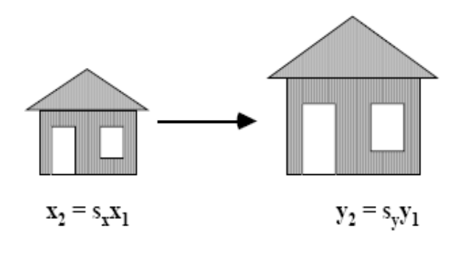
5.1 Basic Two-Dimensional Geometric Transformation
Two-Dimensional Scaling
Scaling transformation alter the
size of objects (non rigid-body transformation)
Performed by multiplying object positions (x,y) by scaling factors s_{x} and s_{y} to produce the transformed coordinates (x`,y`).

Slide 12
Transformations: Scaling examples:
Simple scaling - relative to (0,0)
General form:
Ex: s_{x} = 2 and s_{y}=1

Slide 13
5.1 Basic Two-Dimensional Geometric Transformation
Two-Dimensional Scaling
Any positive values can be assigned to the scaling factors.
  Values less than 1 reduce the size of object;
  Values greater than 1 produce enlargements.
  Uniform scaling : scaling factors have the same value
  Differential scaling : unequal values of the scaling factors

Slide 14
Shear:
To rotate a line or polygon, we must rotate each of its vertices
Shear
(x,y)
Original Data y Shear x Shear

