Slide 1

Good Morning
Prepared by: Ms.Amani AL-Buwardi

Slide 2

Unit: 1
How do you feel?

Slide 3


1A
Be happy!

Slide 4

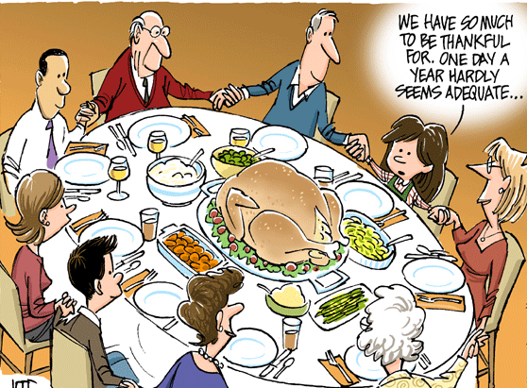
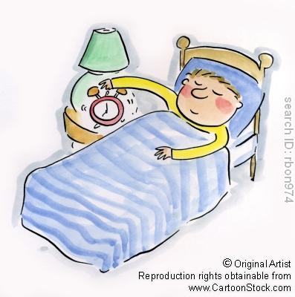
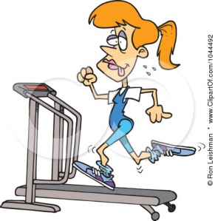
Discussion:
What do you like to do at the weekend?

Slide 5

Let’s learn more vocabulary to express our activities!!

Slide 6
Pg.4: 1- Match the verbs in A to the words/phrases in B:
A
B
visit
go
have
relatives
clubbing
a lie – in

Slide 7
A
B
meet up
do
have
with friends
some gardening
a quiet night in
tidy up
do
go
the house
some exercise
to exhibition

Slide 8
A
B
chat
have
go
to people online
people round for dinner
for a walk/ a run
Which of the activities above do you often/never do at the weekend?

Slide 9
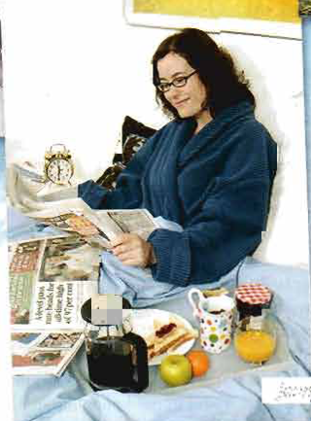
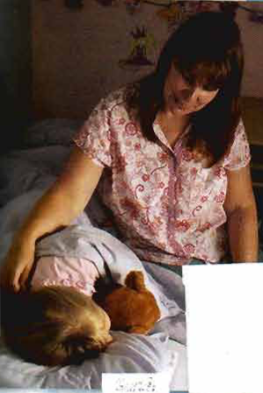

Listening & grammar:
What do you think makes Greg, Sarah & Jenny happy?
Jenny
Sarah
Greg

Slide 10



Listening & grammar:
Listen and write two things that make each person happy.

Slide 11
Listening & grammar:
Listen again and answer these questions.
Who does Sarah work for?
What are her children doing at the moment?
What did Sarah do last Saturday?

Slide 12
Listening & grammar:
Listen again and answer these questions.
How many countries has Greg been to?
Where did he go last year?
How often does he work in his garden?

Slide 13
Listening & grammar:
Listen again and answer these questions.
Does Jenny usually get up early on Saturday?
What did she have for breakfast last Sunday?
What makes her flatmate happy?

Slide 14
Listening & grammar:
Look at these questions carefully.
What are her children doing at the moment?
Where did he go last year?
How often does he work in his garden?
Try to know how questions are formed in English.

Slide 15
Question Forms
 | verb | subject | Auxiliary | Question word
 | doing go work ……. | her children he she they …….. | are did does ……. | What Where How When
 | any verb |  |  | Who

Slide 16
Examples
 | verb | subject | Auxiliary | Question word
the room? | studying? eat? wake up? paint | you she Reem they | are did does do | Where What When How
the pen? | took |  |  | Who

Slide 17
Exception
 | subject | verb | Question word
 | you | make | What
Example
 | subject | verb | Question word
upset? leave the room? | you Your friend | makes made | What What

Slide 18

Let’s practice!!

Slide 19
Ask about the underlined information?
1) John is looking for his wallet. (what)
What is John looking for?
2) I go to school by bus. (how)
How do you go to school?
3) Sarah went clubbing last Sunday. (when)
When did Sarah go clubbing?

Slide 20
Ask about the underlined information?
4) He lives in an apartment . (where)
Where does he live?
5) My mom bought this new dress. (who)
Who bough this new dress?
6) Having a warm shower makes me feel relaxed. (what)
What makes you feel relaxed?

Slide 21

2A
Love it or hate it!

Slide 22
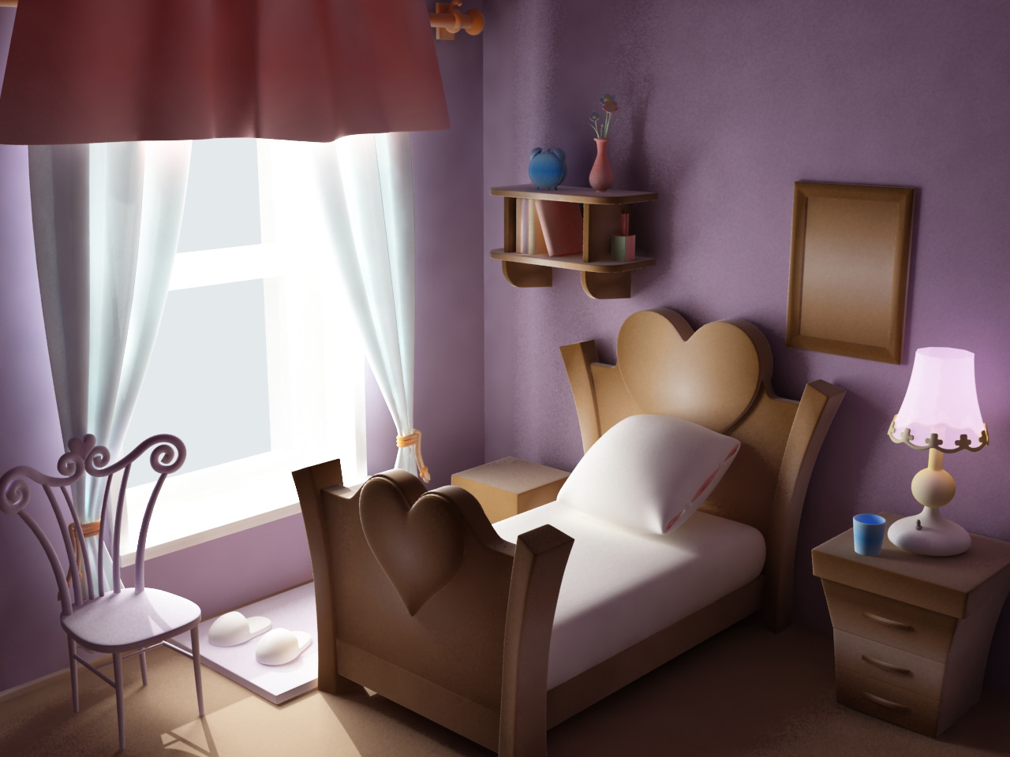
Discussion:
What do you like and dislike about your room?

Slide 23
Let’s learn more vocabulary to express what we like & dislike!!

Slide 24
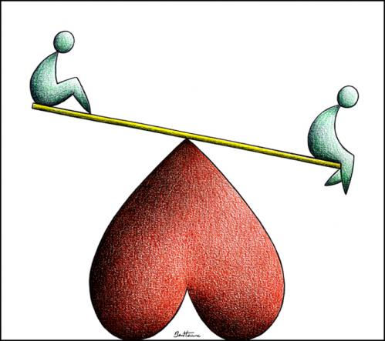
1- Read the phrases on pg.6 and decide which of them are used to:
a- say you like something b- something is ok c- you hate something

Slide 25
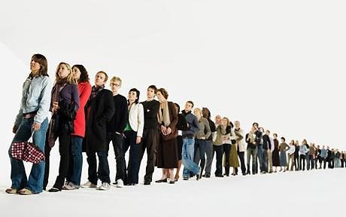

Use these phrases to describe your feeling about the following:
waiting in queues
Going on long journeys

Slide 26
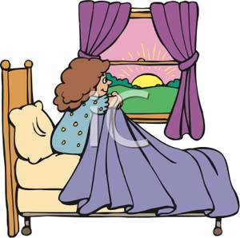
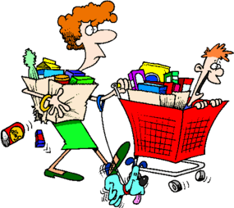

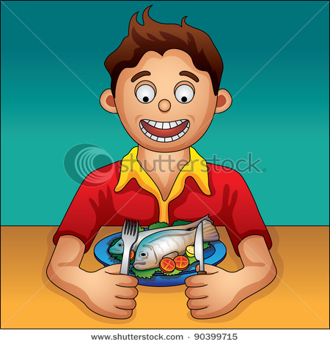
getting up early
Going shopping
Studying for exams
Eating seafood

Slide 27
Listening :
Listen to Amy and Jeremy talking about topics 1- 4.
Who talks about each topic? Do they love them or hate them .
cooking football on TV
flying customer service lines
Why do they love or hate each topic.

Slide 28

Bye for now!!
Prepared by: Ms.Amani AL-Buwardi

