Slide 1
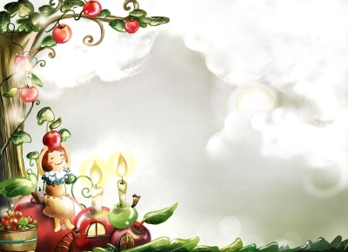
Good Morning
Prepared by: Ms.Amani AL-Buwardi

Slide 2
Unit: 1
How do you feel?

Slide 3
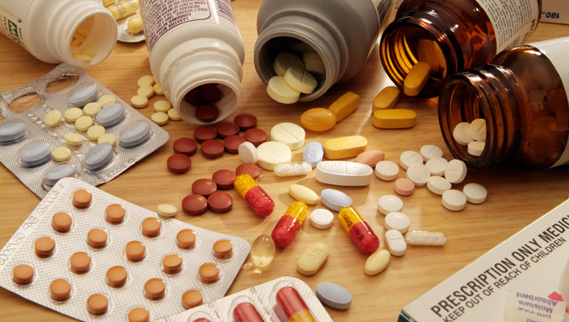
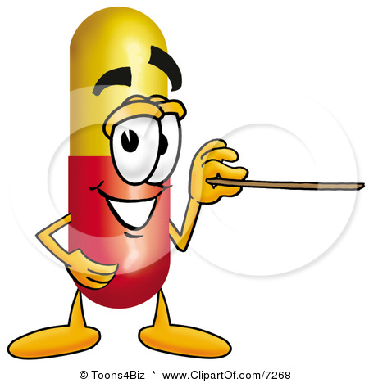
1C
The best medicine

Slide 4
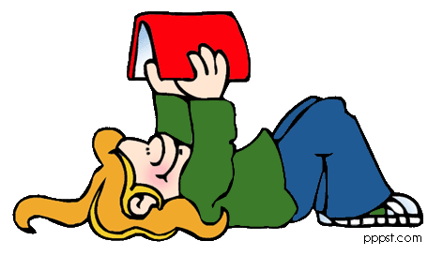
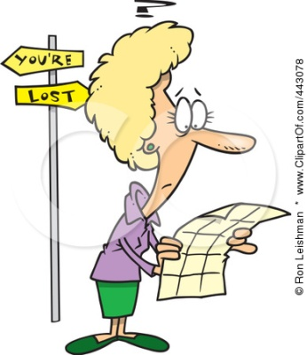
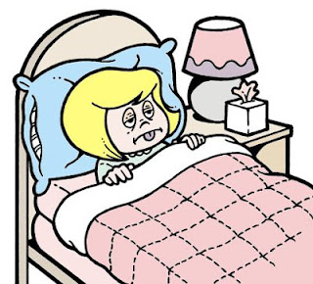
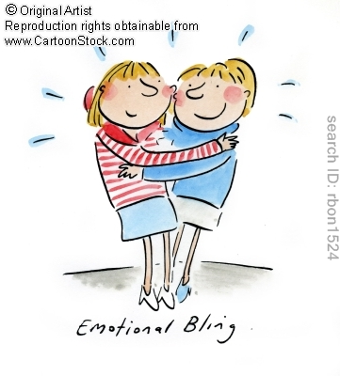
Vocabulary & Reading:
Describe your feelings at the following situations:
You get lost
Your mother is sick
You see a friend after a long time

Slide 5
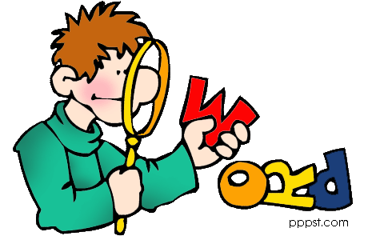
So, we use adjectives in order to describe feelings
Let’s learn more adjectives!!

Slide 6
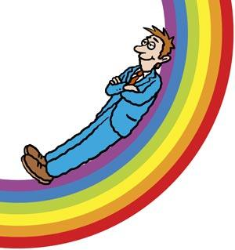
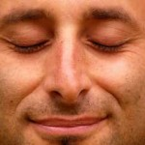

relaxed: happy because you are not worried about anything
calm: relaxed and peaceful
pleased: happy because something nice happened

Slide 7


satisfied: pleased because something has happened in the way you want
glad: happy and pleased

Slide 8


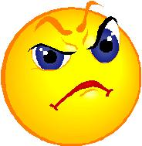
nervous: worried because something is going to happen
embarrassed: feel stupid because of something you did or something that happened
annoyed: a bit angry

Slide 9
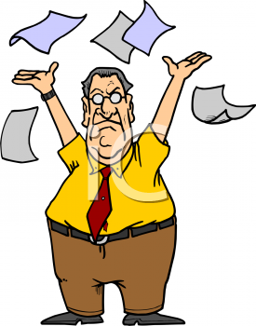


Fed up: annoyed or bored because you’ve done something for along time
disappointed: unhappy because something isn’t good as you wanted it to be
stressed: not able to relax

Slide 10




upset: unhappy or worried because something bad has happened
scared: frightened
confused: when you don’t understand something
shocked: very surprised & upset

Slide 11
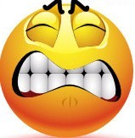
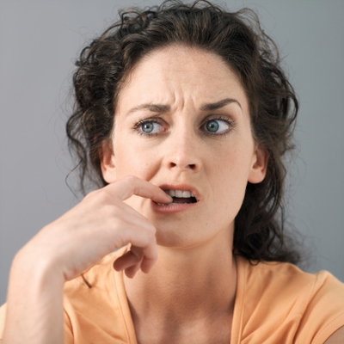
Frustrated: annoyed because things aren’t happening in the way you like
concerned: worried

Slide 12
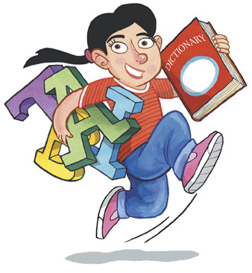
Which adjectives above describe positive feelings and which describe negative ones?
Let's Practice,,

Slide 13
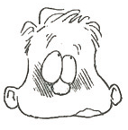
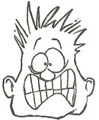
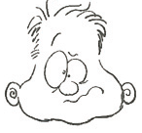
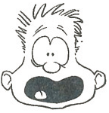
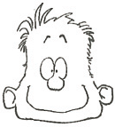
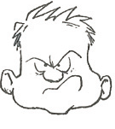
How do they feel ?

Slide 14
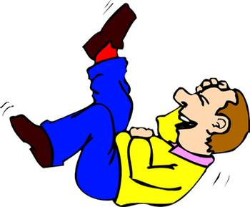

Discussion:
What usually makes you laugh?
Do you think that laugh is good for our health?

Slide 15
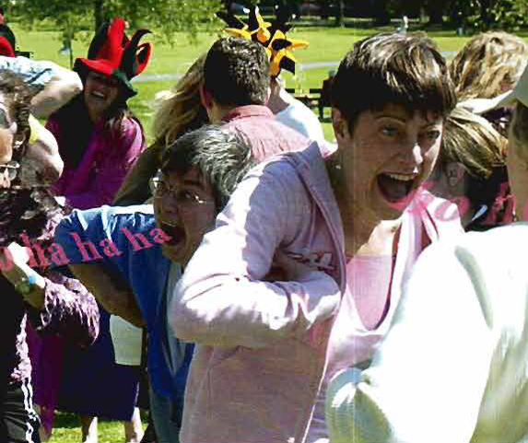
Vocabulary & Reading:
Look at the photo & article on pg.9
What do you think the people are doing? Where are they?

Slide 16
Vocabulary & Reading:
Look at the photo & article on pg.9
What is the title ?
How many paragraphs are there ?

Slide 17

It’s reading time!!
Read the article and match topics a-e to paragraphs 1-5:
Topics
Paragraphs
a) It worked for me – try it yourself
5
b) Why laughter is good for you
3
c) Start the day with a laugh
1
d) My first laughter Class
4
f) How Laughter Clubs began
2

Slide 18

Read again!!
Fill in the gaps with one or two words:
more
2) Children laugh ………….. than adults.
over 1,300
3) There are ……………....... Laughter Clubs in the world.
4) Doctors think laughing helps people stay ………….. .
healthy
good
5) Fake laugher is ………….. for your health.
laughed at
6) The reporter really …….…..……….. the class.

Slide 19
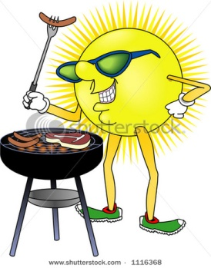
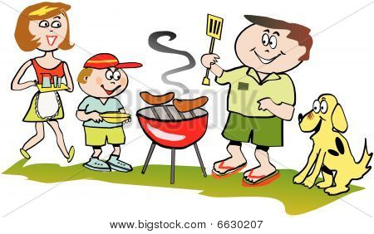
1D
At a barbeque

Slide 20
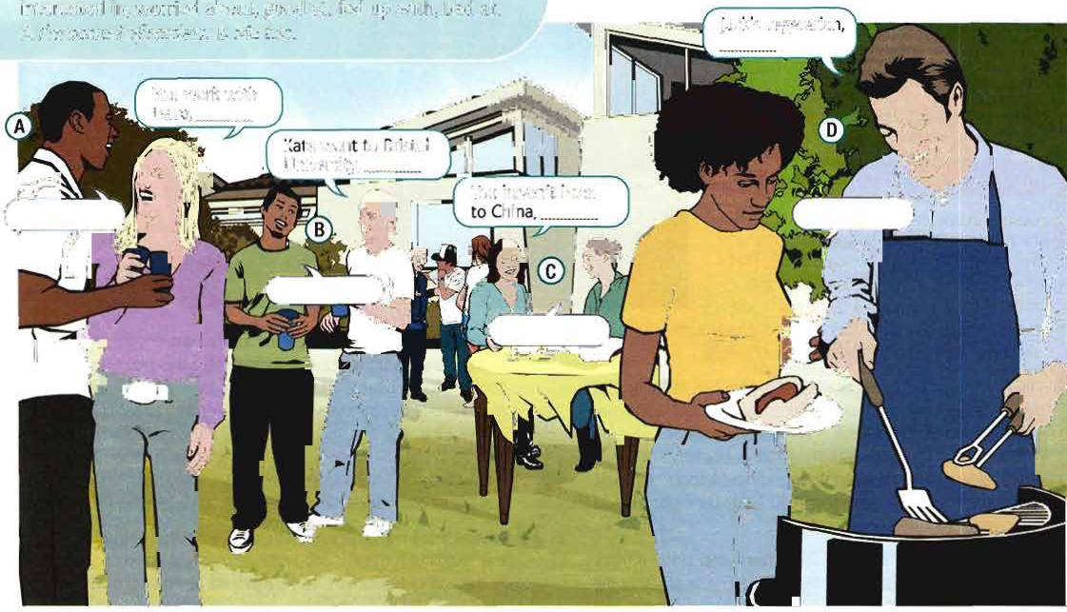
Look at the picture on pg.9
Where are the people?
What are they doing?

Slide 21
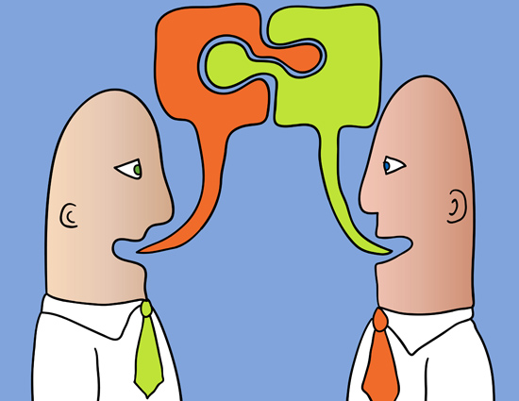
Let’s complete the conversations and then listen to check your answers!!

Slide 22
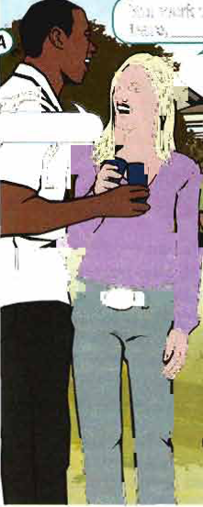
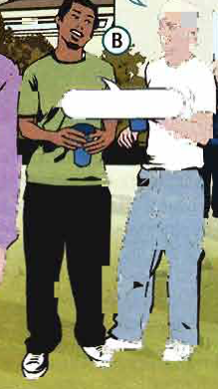

…………………………
didn’t she? - don’t you?
Yes, I do
Kate went to Bristol University, …………………………
You work with Dave,………………
didn’t she?
don’t you?
…………………………
Yes, she did
A
B

Slide 23
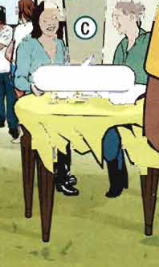
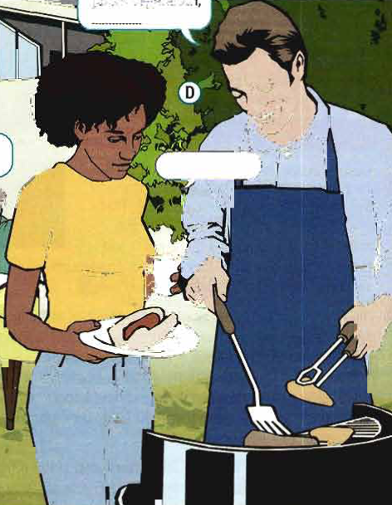
You haven’t been to China,…………………
isn’t he? – have you?
have, you?
…………………………
…………………………
Yes, he is
No, I haven’t
Jack’s vegetarian, …………………………
isn’t he?
C
D

Slide 24
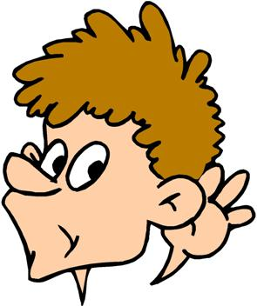
Listen to the next part of conversation A-D. Choose the correct answers.
The woman wants Dave’s ( mobile number – email address)
Steve's brother wants to (go – went ) to Bristol University )
Tom ( has – hasn’t ) been to China.
Jack ( eats – doesn't ) eat steak.

Slide 25
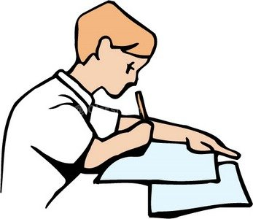
Let’s practice!!
Do exercise 5a on pg.11

Slide 26
Take Care..
See you..
Prepared by: Ms.Amani AL-Buwardi

