Slide 1
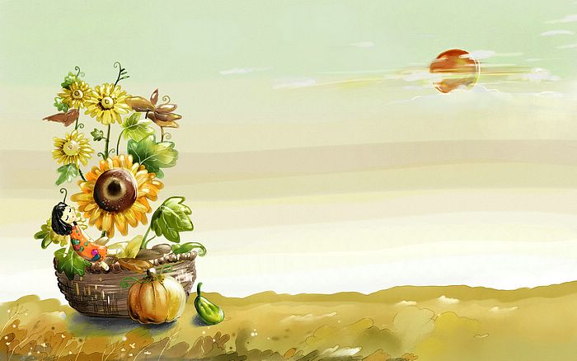
Good Morning
Prepared by: Ms.Amani AL-Buwardi

Slide 2
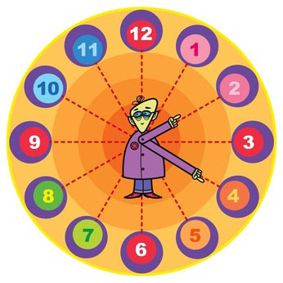
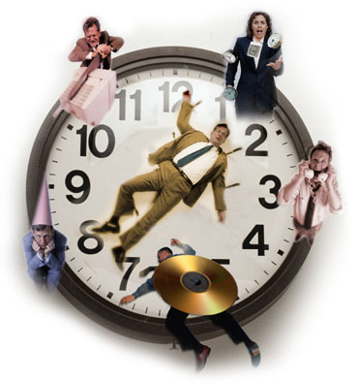

Unit: 2
We haven’t got time

Slide 3

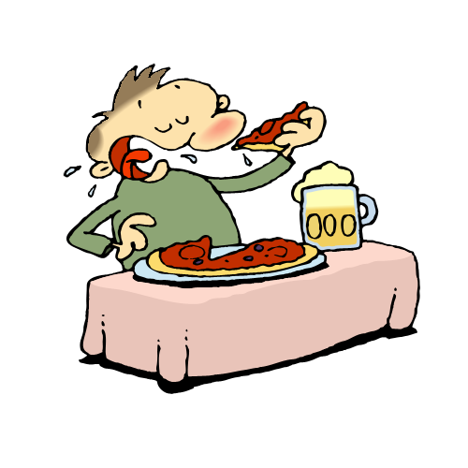
2B
Ready, steady, eat

Slide 4
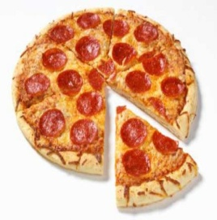
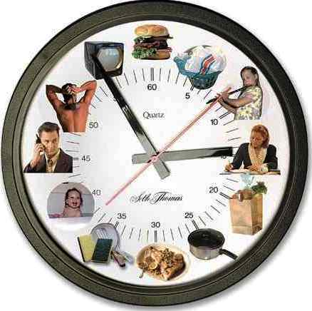
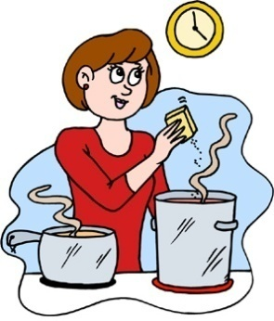
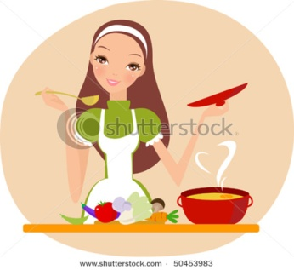
Discussion:
What is your favorite meal?
When do you have your main meal of the day?
Who cooks your main meal?
Do you like cooking? Why? Why not?

Slide 5
Vocabulary:
Look at the words/phrases in the box on pg.14 ?
Now,,
Put them into groups?
A- food broccoli
B- things in the kitchen fridge
C- ways (methods) of cooking boil

Slide 6
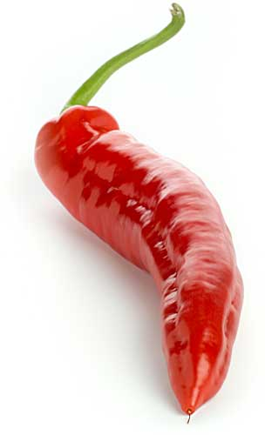
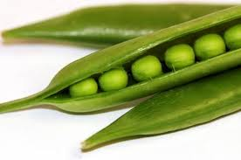
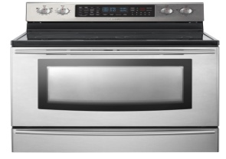
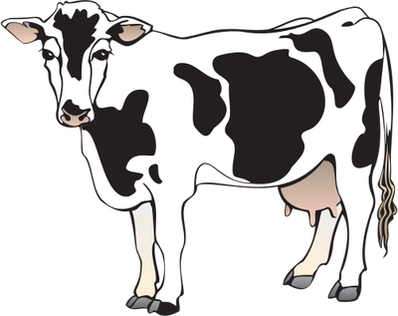
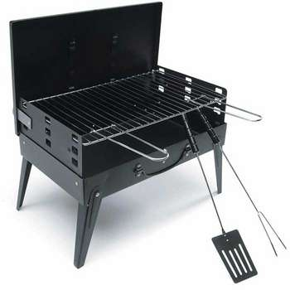
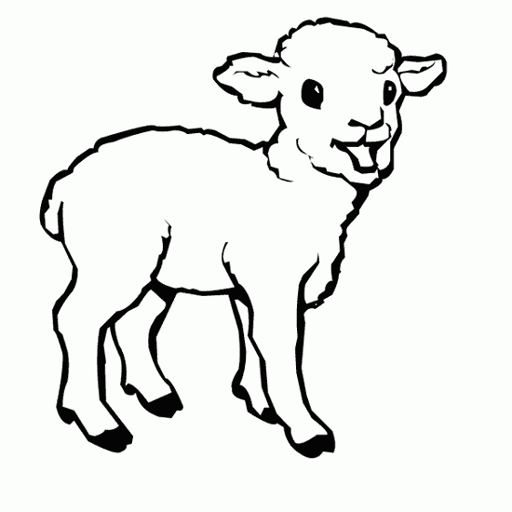
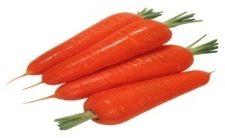
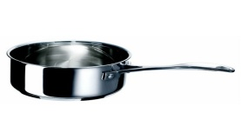
Ways of cooking | Things in the Kitchen | Food
Roast | a freezer | Red/green pepper
bake | a cooker/ an oven | Peas
grill | a grill | beef
fry | a microwave | lamb
heat up | a saucepan | Carrots

Slide 7
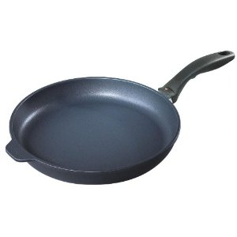
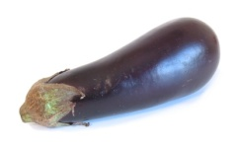
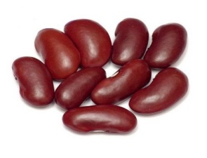
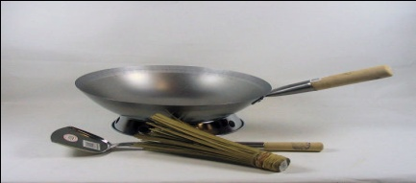
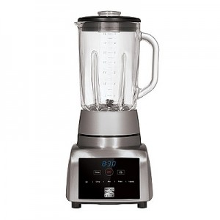
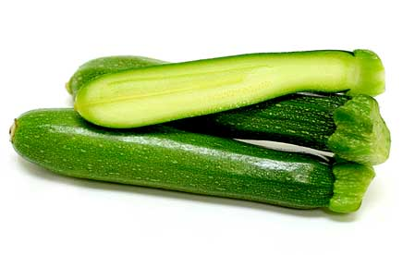
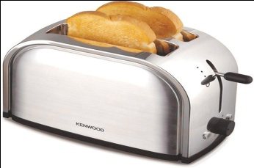
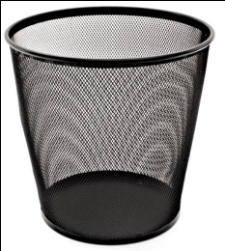
Ways of cooking | Things in the Kitchen | Food
microwave | a frying pan | Aubergine/ eggplant
steam | a wok | Beans
 | a blender | Courgettes/ zucchinis
 | a toaster
 | a rubbish bin

Slide 8
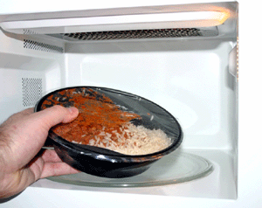
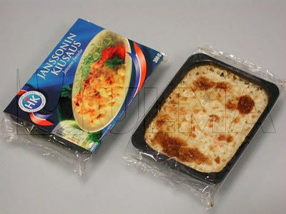
Discussion:
Do you like to eat ready meals?
How often do you eat ready meals at home?
Are ready meals popular in your country? Why?

Slide 9

Reading & Grammar:
Look at the cartoon of Linda and her mother on pg.14
What do you think the article is about?

Slide 10

Now.. Let’s enjoy
Read the article and match topics a-e to paragraphs 1-5:
Topics
Paragraphs
a) Ready meals around the world
4
b) How British eating habits are changing
2
c) Too busy to cook
1
d) How healthy are ready meals
3

Slide 11


Read again!!
Are sentences 1-5 true or false. Change the false ones:
1) Linda Roberts cooks a three-course meal every night.
2) We spent more time cooking 20 years ago than we do now.
3) Healthy advisers say we should never eat ready meals .
4) The Spanish eat a lot of ready meals.
5) Linda doesn’t think her mother will start eating ready meals.

Slide 12


Focus on grammar!!
Pg15 (5): Look at the article again.
On a piece of paper:
write the verb forms in bold.
Put them in two groups.
How can you name these two groups?

Slide 13
Present Continuous الحاضر المستمر | Present Simple المضارع البسيط
am cooking | cooks
am making | spend
am writing | believe
is growing | need
is becoming | live
is doing | buy
A- Match the verbs above to the meanings ?

Slide 14
Be (is/am/are) + V-ing
Meanings | Present Continuous
happening at the moment of speaking | I am cooking dinner
 | I am making
happening around now but not at this exact time | I am writing a book in my spare time
 | She is doing an evening course…….
changing over a period of time | They are becoming more common in Germany
 | The market is growing rapidly

Slide 15
Be (is/am/are) + V-ing
Meanings | Examples
happening at the moment of speaking | They are playing right now.
happening around now but not at this exact time | Maha is taking three courses this semester.
changing over a period of time | My writing is improving by the time

Slide 16
She/he/it + V-s
I/you/they/we/you + V
Meanings | Present Simple
Habits, daily routine | My mother still cooks a full three course meal in the evening
 | We only spend 2o minutes cooking.
things that are permanent or true | People who live in the UK …….
 | People also buy a lot of ready meals
Describe states (stative verbs) | We need to read the labels carefully.
 | Experts believe the are bad for our health

Slide 17
She/he/it + V-s
I/you/they/we/you + V
Meanings | Examples
Habits, daily routine | I read comic books at the weekends
things that are permanent or true | The world is round
describe states | The soup tastes so salty.

Slide 18
Let’s learn more about the stative verbs!
Verbs describe States:
Mental State: know- believe – forget – think – understand – remember – need – want – imagine
Emotional State: love – hate – like – please – amaze – surprise

Slide 19
Verbs describe States:
C) Possession: possess – have – own – belong
D) Sense perceptions: taste – hear – feel- see – smell
E) Existing States: seem – look -contain – include – sound – be - exist
Now.. Look at the verbs in exercise 5b and decide which of them describe activities and which describe states.

Slide 20
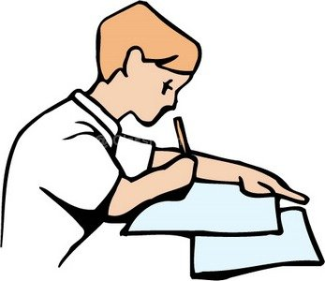
Let’s practice!!
Do exercise 7 on pg.15

Slide 21
Enjoy your day..
Prepared by: Ms.Amani AL-Buwardi

