Slide 1

Good Afternoon
Prepared by: Ms.Amani AL-Buwardi

Slide 2
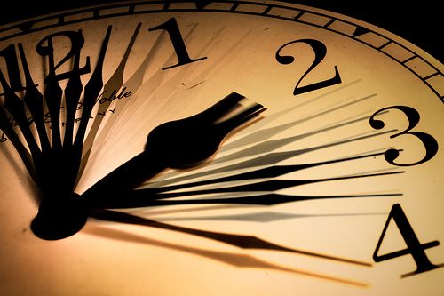
Unit: 2
We haven’t got time

Slide 3
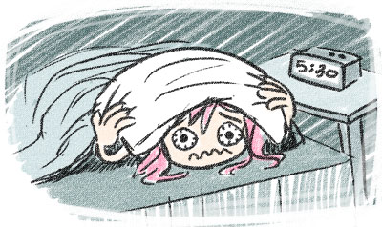
2C
It’s a nightmare!

Slide 4
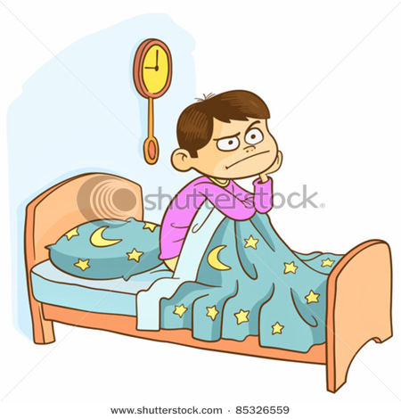

Discussion:
What do you usually do when you can’t get to sleep?
What do you think the most effective method of getting sleep?

Slide 5

Reading & vocabulary:
Look at the photo & article on pg.17.
What is the title of this article ?
How many paragraphs are there?

Slide 6
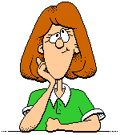
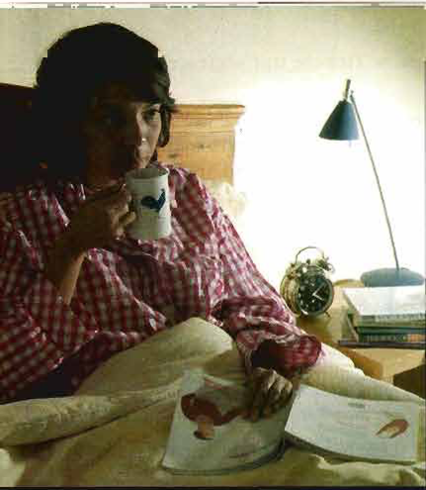
Now think!!
Who is the article talking about ?
What is the problem that she has?

Slide 7

Now Read!!
& answer the following questions:
How much sleep did Ema get last nigh ?
What happens on a typical night?
Why is her job very tiring?
Why does she have money problems?
Which cures for insomnia hasn’t she tried? Why not?

Slide 8

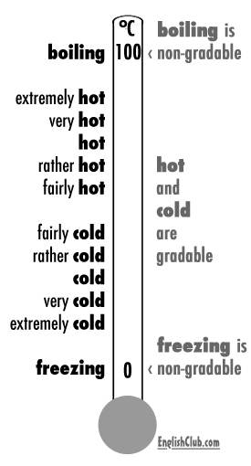
at these two sentences,,
Try to know the difference between the underlined adjectives
My room is cold.
=It could be 5°, 10°, or more or less than this
My room is freezing.
=It’s very, very cold. It can’t be more or less than this

Slide 9
at these other two sentences,,
The water is hot.
=It could be 5°, 10°, or more or less than this
The water is boiling.
=It’s very, very hot. It can’t be more or less than this

Slide 10

From this we come to know that:
* “hot” & “cold” are gradable adjectives (weak)
* “freezing” & “boiling” are non-gradable adjectives (strong) .

Slide 11
Adjectives
Gradable
adjectives that have different degrees (=can be graded)
Strong
adjectives that don’t have degrees . They already contain the idea of “very”
Ex. Beautiful, big
Ex. Gorgeous, enormous
Adverbs used: very, incredibly, extremely, fairly, really
Adverbs used: absolutely, completely, utterly, really

Slide 12
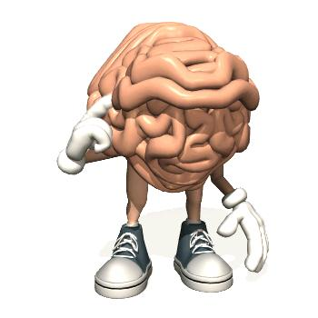
Now,,
Let’s go back to the article & find more gradable and strong adjectives,,
Let’s do Ex. 7 & 8 on pg.17

Slide 13

2D
What’s the matter?

Slide 14
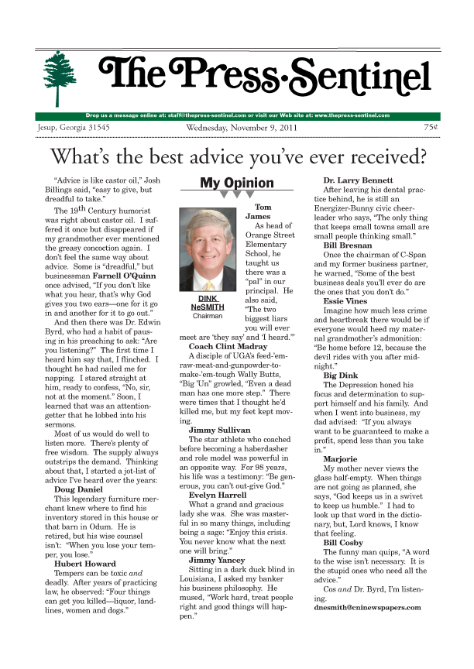
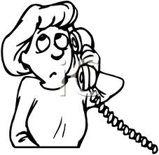

Discussion:
Do you ever read advice columns in magazines?
Who do you talk to when you need advice?
Who was the last person you gave advice to? What problem did she have? What did you say?

Slide 15
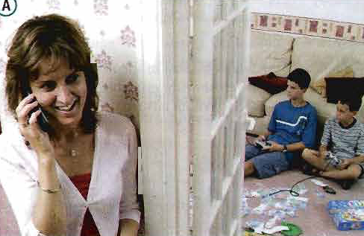
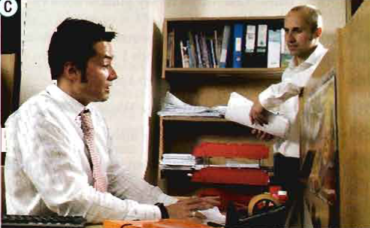
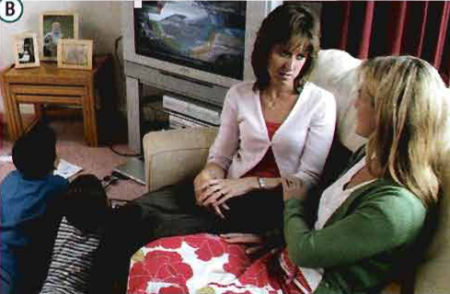
Look at the pictures on pg.18:
What do you think people are talking about ?
Listen & match these photos to conversations 1-3

Slide 16



Listen again!!
Are sentences 1-6 true or false. Change the false ones:
1) Lorna doesn’t think her husband work enough.
2) Lorna has talked to her husband about the problem before.
3) Andy thinks that Lorna is spending too much on herself.
4) Robin tells Andy to take his wife out to discuss the problem.
5) Lorna’s mother thinks Lorna should have a night off on her own.
6) Lorna’s mother is going to babysit for them.

Slide 17

Now,,
Let’s see what’s the matter in conversations a-c in Ex.4 on pg. 18

Slide 18
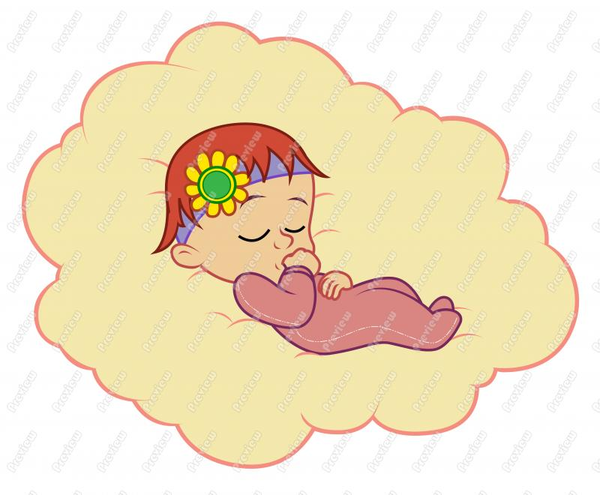
Wish you peaceful life & good sleep,,
Good bye,,
Prepared by: Ms.Amani AL-Buwardi

