Slide 1

Good Afternoon
Prepared by: Ms.Amani & Ms.Azzah

Slide 2
Unit: 3
The tourist trade

Slide 3
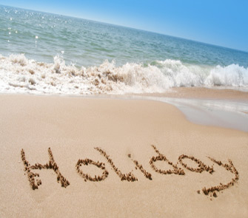
3A
Your holiday , my job

Slide 4
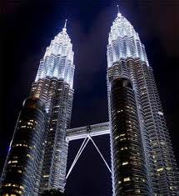
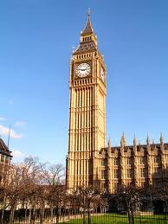
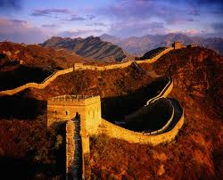
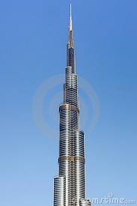
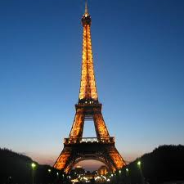
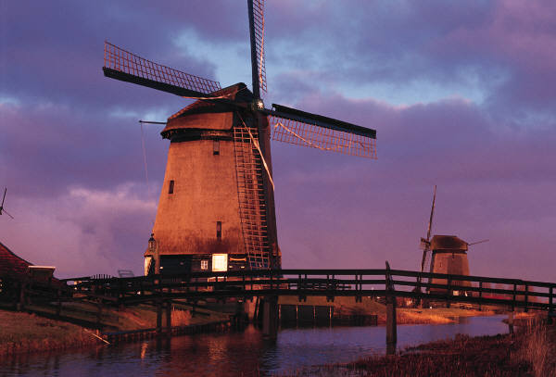
Do you like travelling ?
Tell us about the countries that you have been to ?

Slide 5
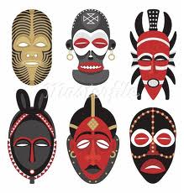
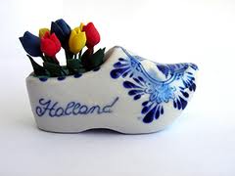
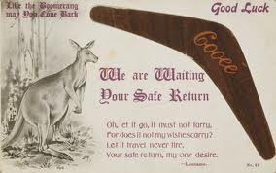
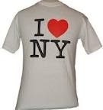
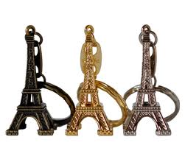
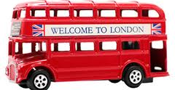
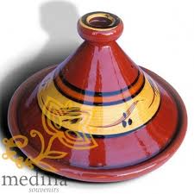
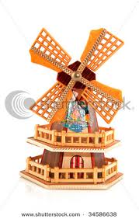
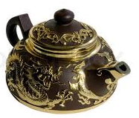

Do you like to collect souvenirs from different countries?

Slide 6

Vocabulary phrasal verbs
(1) travel

Slide 7

Look at the sentences on pg.20
Guess the meanings of the phrasal verbs in bold

Slide 8
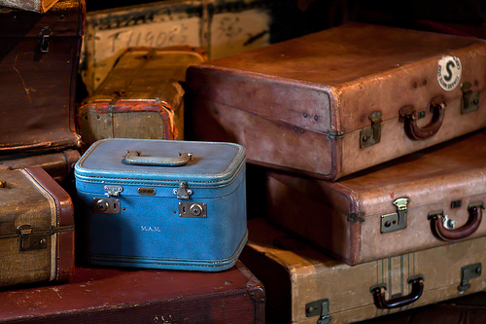
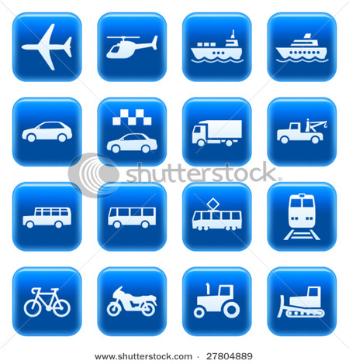
Set off
= Start a journey
e.g. They set off at 5 a.m.
=Travel to different places in the same town /city/area
e.g. What is the cheapest way to get around?
Get around

Slide 9
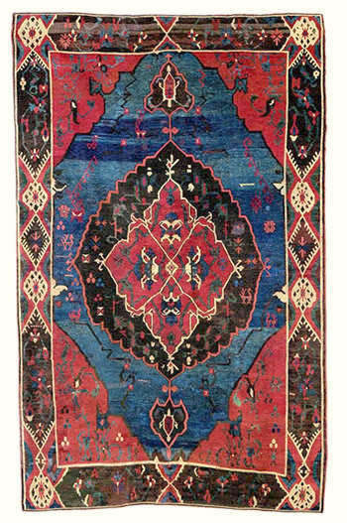
Bring (sth) back from a place
=Return from a place with something you bought there
e.g. We brought this carpet back from turkey.
=Do something in order to solve a problem or achieve something
e.g. I’ve to deal with a lot of difficult situations as part of my job.
Deal with (sth)

Slide 10
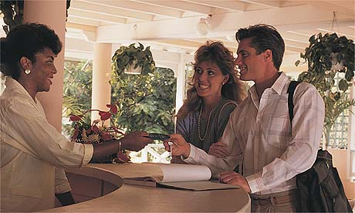
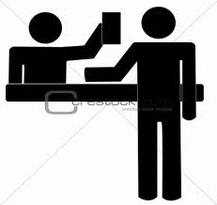

Check into (somewhere)
= Go to the reception desk to say you have arrived
e.g. Have you checked into the hotel yet?
= Go to the reception desk to pay your bill before you leave
e.g. We checked out of the hotel early this morning.
Check out of (somewhere)

Slide 11
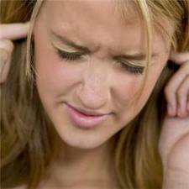
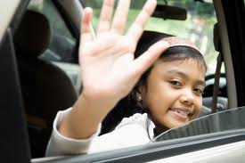
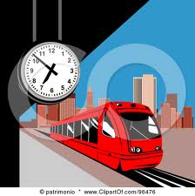
Put up with (sth)
=Accept a situation that you don’t like because you can’t change it
e.g. I don’t know how you put up with all this noise.
See (sb) off
=Go to the place where somebody is leaving from to say goodbye to them
e.g. My parents came to see me off at the airport.

Slide 12
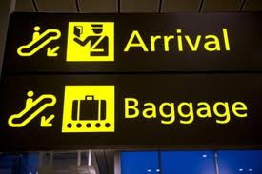

Pick (sb) up
= Go to a place where somebody is waiting and take them where they want to go
e.g. Can you pick me up from the station?
=return to a place after you have been somewhere else:
e.g. When did you get back from South Korea?
Got back (from/to)

Slide 13

= feel happy and excited about something that is going to happen
e.g. I’m really looking forward to my holiday.
Looking forward to (sth)

Slide 14
Let’s practice
In my job I have to a lot of difficult customers.
My sister me this red bus form London as a souvenir.
I'm really going on holiday next week.
I can’t the noise any longer. It’s driving me crazy.
I haven't the hotel yet.
The best way to Scotland is to hire a car.
deal with
brought
back
looking forward to
Put up with
checked into
get around

Slide 15
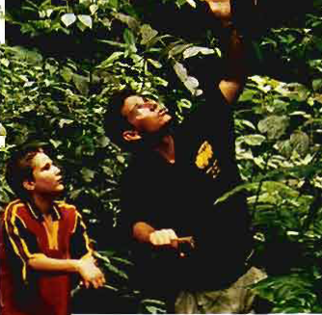
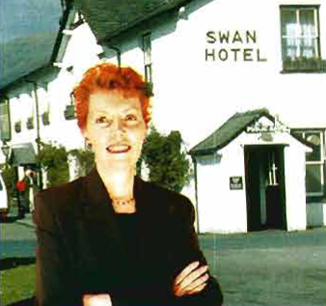
Listening and grammar:
Look at the photos of Sam & Marcia on pg.20
Listen to them talking about their jobs & answer the following questions:
Do they like their jobs ?
What problems do they have in their job?

Slide 16

Who said these sentences?
1) I’ve worked in two central American countries and I had a great time in both places.
2)We have been away together a few times, but each time there was a problem at the hotel.
3)I started working in the hotel industry 14 years a go.
4) Last month tow guys set off on their own.
5) I have lived in this county for three years.
6) My husband and I have had this place since 2010.
7) I’ve just been to San Isidro to pick up a guest.
8) My husband’s gone to see some friends off.
Sam
Marcia
Marcia
Sam
Sam
Marcia
Sam
Marcia

Slide 17
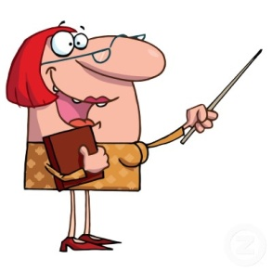
Grammar:
Hi, sweet ladies,,
This is Ms. Jenny.
Today I’d like to explain two tenses in English which are Past Simple and Present Perfect
So Let's learn when and how we use them?

Slide 18
Past Simple
We use the Past Simple in only 1 case:
1- To talk about actions started and ended at a particular time in the past
e.g. I bought a new dress yesterday.

Slide 19
Present Perfect
We use the Present Perfect in 4 cases:
1- to talk about actions started in the past and continued to the present
(for – since )
e.g. I have lived in Jubail for three years.
TIME ?
2- to talk about actions happened before now at unspecified time
(ever, never, already, yet, still, )
e.g. She has already seen that movie.

Slide 20
3- To talk about actions that happened short time ago
(just)
e.g. I have just finished my lunch.
4- to express the repetition of an activity before now. The time is not important
(so far)
e.g. We have had three tests this months so far.

Slide 21
Now,, How do we use these tenses?
Present Perfect
Past Simple
S + have/has + p.p (past participle)
S + p. s (past simple)
I , you, they, we + have
She, he, it + has

Slide 22
Now,, Who can tell us what is the difference between for & since?
for
With a duration of time
e.g. We have been here for two weeks
She has known Maha for years.
since
With a particular time
e.g. I have had this book since 2000.
He has studied English since her childhood.

Slide 23
Now,, Who can tell us what is the difference between been & gone?
been
= means go and come back
e.g. I’ve just been to San Isidro to Pick up a guest (= I’m back at the place I started from now).
Go
gone
= means go, but not come back yet e.g. My husband’s just gone to see some friends off ( = he is not back yet )

Slide 24

Now,,
Let’s do Ex.3+6 on pg.17

Slide 25
See you next class

