Slide 1


Slide 2
3C
Call that a holiday

Slide 3
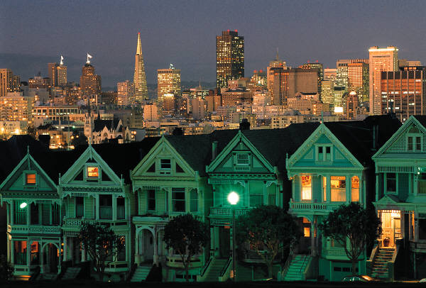
Which holidays can you remember from your childhood?
Have you or anyone you know ever had an unusual holiday ? If so , why was it unusual?

Slide 4
Reading and vocabulary

Slide 5
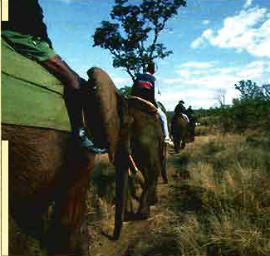
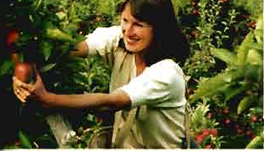
Now,,
Let’s read about Alan’s & Emily’s reviews on their holidays on pg.24

Slide 6
Alan’s holiday

Slide 7
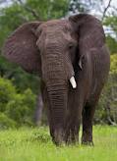

How long did he stay?
Where did he stay there?
What did he do during the holiday?
What was the best thing about the holiday?
What was the most difficult part about the holiday?
Would he go on the same holiday again?
3 weeks
Comfortable guest house in the jungle.
He had a facelift operation
In the third week he went on Safari .
He had to spend 5 days inside the hospital
Yes, he would come back again

Slide 8
Emily’s holiday

Slide 9
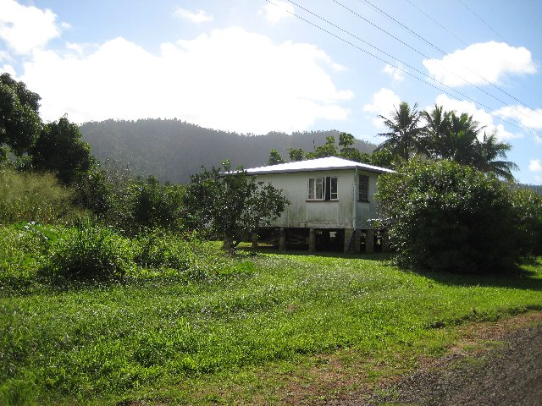
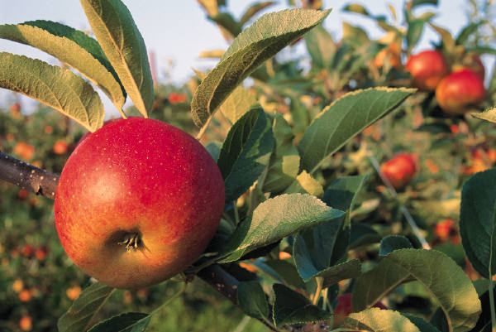
How long did she stay?
Where did she stay there?
What did she do during the holiday?
What was the best thing about the holiday?
What was the most difficult part about the holiday?
Would she go on the same holiday again?
2 weeks
Farmhouse but she missed the comfort of her own bed
She worked 5 hours a day six days a week.
The people she met there who were from all the world and it felt great to eat natural organic food everyday.
Doing what the couple asked because she was not very strong.
Yes, she would

Slide 10
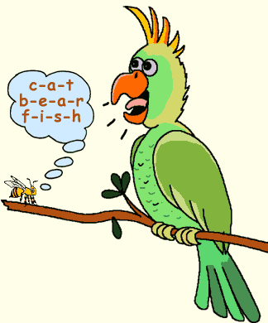
Attention,, attention !!
It’s vocabulary time!!

Slide 11
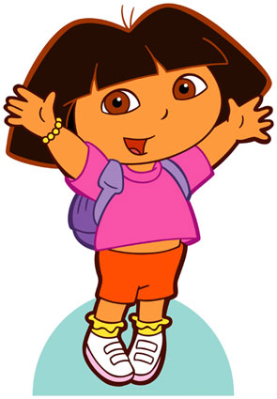
Let’s play with words!!
(adj)
(n)
happy
+ness
= happiness
(n)
(adj)
health
+y
= healthy
What happened to the parts of speech when we added (ness/y)?

Slide 12
What do we call (ness/y)?
suffixes
What is a suffix?
A letter (y) or group of letters (ness) which is added to the end of a word in in order to change its part of speech.
(From V to N or from N to Adj or from Adj to N or from Adj to Adv………)

Slide 13
In this lesson, we will learn only two types of suffixes:
1- suffixes change Adj to N
2- suffixes change N to Adj

Slide 14
Now,, Let’s go back to the holiday reviews,,,
Match the ADJECTIVES in pink to the NOUNS in blue & underline the suffixes

Slide 15
1-Suffixes change adjectives to nouns:
adjective | noun | suffix
Difficult | Difficulty | _y
Honest | Honesty
Modest | Modesty
Patient | Patience | _ence _ance
Confident | Confidence
Important | Importance
Kind | Kindness | _ness
Sad | Sadness
Lazy | Laziness
Popular | Popularity | _ity
Active | Activity
Tourist | touristy

Slide 16
1-Suffixes change nouns to adjectives:
noun | adjective | suffix
Danger | Dangerous | _ous
Adventure | Adventurous
Fame | Famous
Comfort | Comfortable | _able
Knowledge | Knowledgeable
Fashion | Fashionable
Nature | Natural | _al
Tradition | Traditional
Music | Musical
Health | Healthy | _y
Noise | Noisy
Possible | Possibility

Slide 17
C)
Popularity
Difficulty
Kindness
Dangerous
Comfortable
healthy

Slide 18
D)+E)

Slide 19
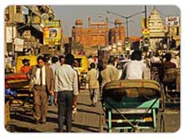
3D/A trip to India

Slide 20
What are the top 3 cities in the world that you would like to visit ?

Slide 21
Look at the photo of Delhi,in India. Would you like to go there?Why?Why not?

Slide 22
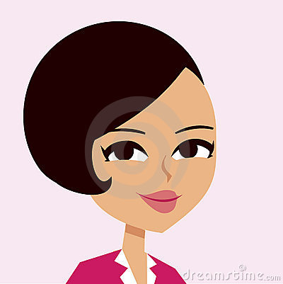
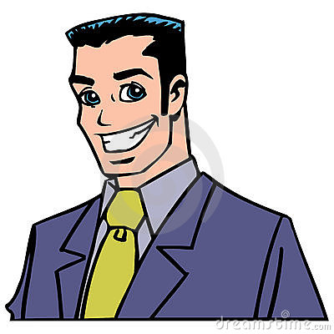
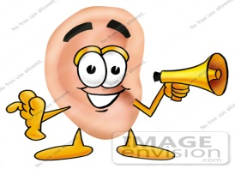
Michal is going to Delhi. He is asking Ellen for recommendations.
to the conversation and tick the topics that they talk about. Pg.26

Slide 23
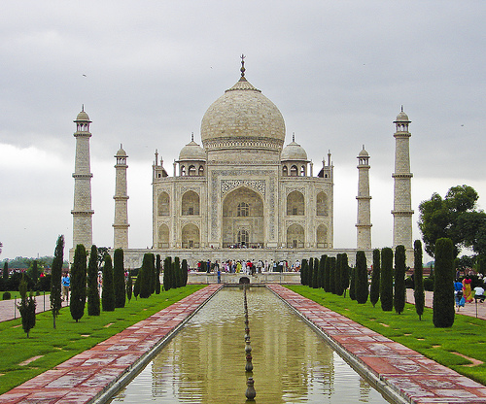
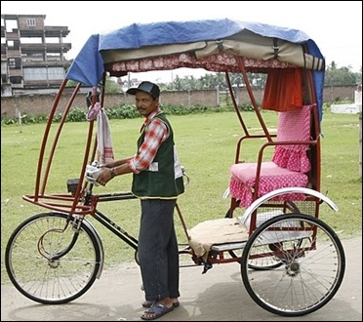
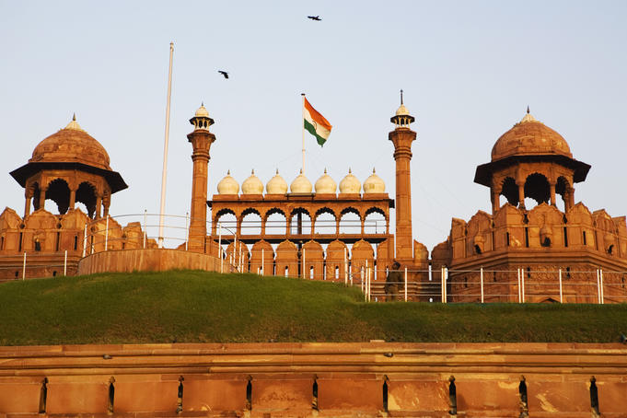

Slide 24
P.g:26) 2B. Ellen thinks:
rickshaws are the best way to get around the city.
It’s better to travel to other cities by bus.
Michael should visit the museums in Delhi.
He should go to the Red Fort in Old Delhi.
He can visit the Taj Mahal and come back the same day.
There’s only one good restaurant in Connaught Place.

Slide 25
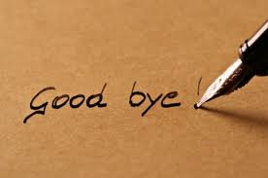
Prepared by,
Mrs.Azzah & Ms.Amani

