Slide 1
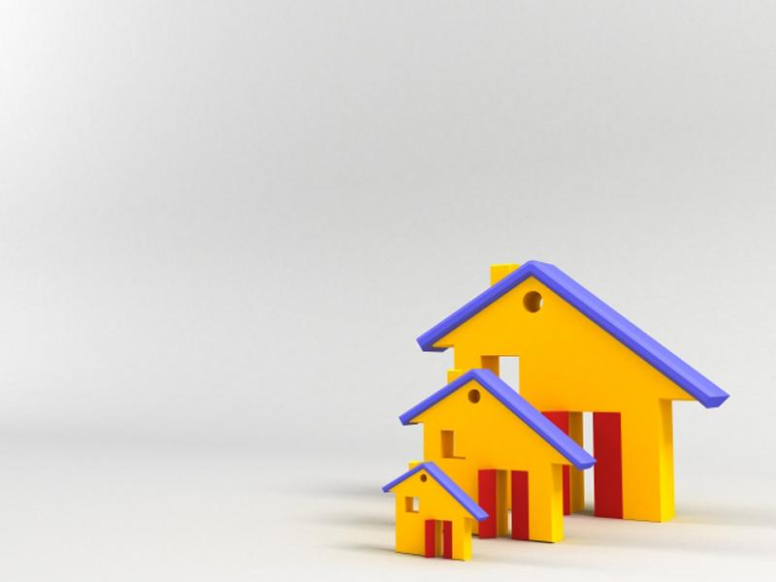

Unit 5
Home truths
Ms. Nehad A. Asiri
Powerpoint Templates

Slide 2

Objectives
By the end of this class, students
should be able to :
Use new vocabulary items and adjectives to describe houses, character and behavior.
Make caparisons using comparatives, superlatives , much , as……as , a bit, etc.
Listen to different descriptions of houses.
Give information about various
places to live in.

Slide 3
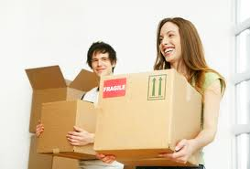
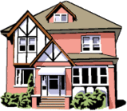
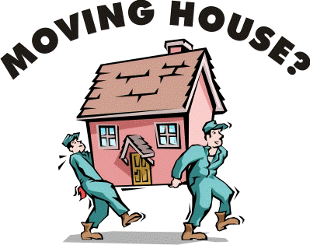
Moving house
5A

Slide 4
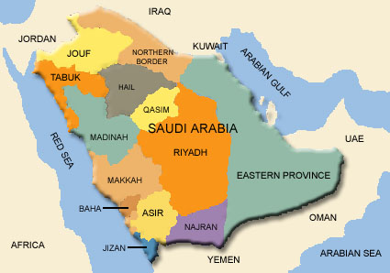

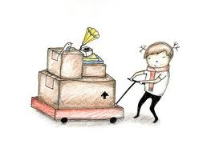
Moving house
5A
Introduction
Where do you live ?
What does your house look like? Describe it.
Do you want to move to another house? Why ? Why not?

Slide 5

1. Vocabulary - Homes
Let’s learn new words Pg. 37

Slide 6
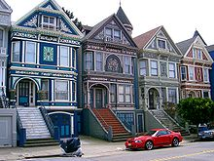
A terraced house: a row of identical houses share side walls.

Slide 7
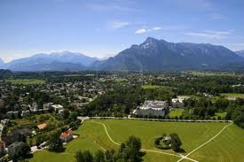
With a nice view
I live in a house with a nice view

Slide 8
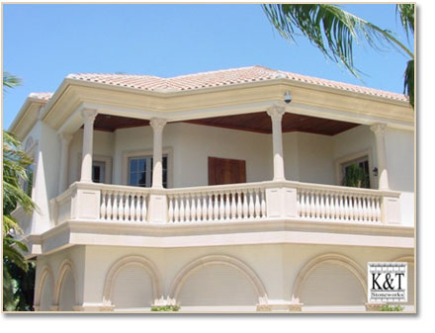
A balcony

Slide 9
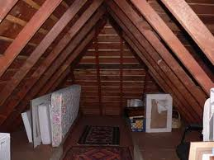
A detached house: a house that stands alone.
A loft A room or space directly under the roof of a house used for accommodations or storage.

Slide 10
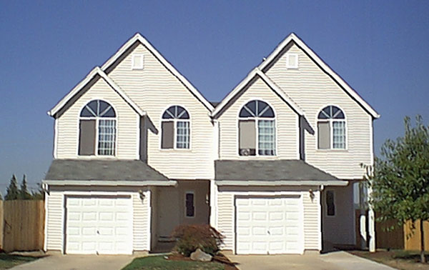
A semi detached house:
a house which joins to another house on one side but not on the other.

Slide 11
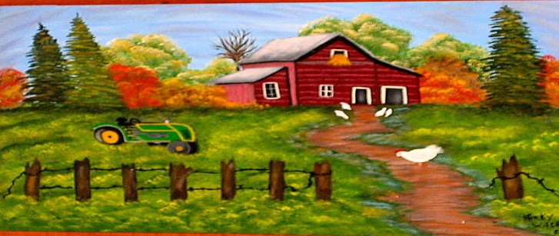
In the country
My father likes spending the summer in the country.

Slide 12
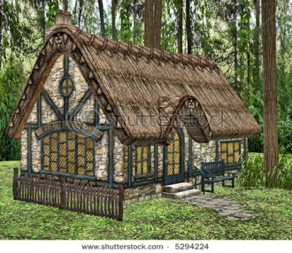
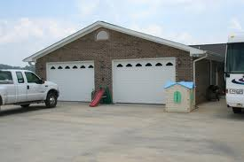
A cottage
A small, single-storied house, especially in the country.
A garage

Slide 13
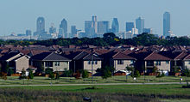
In the suburbs: an area where people live outside the center of a city .
A study: a room intended or equipped for studying or writing.
A basement: the lowest floor of a building, usually below ground level

Slide 14
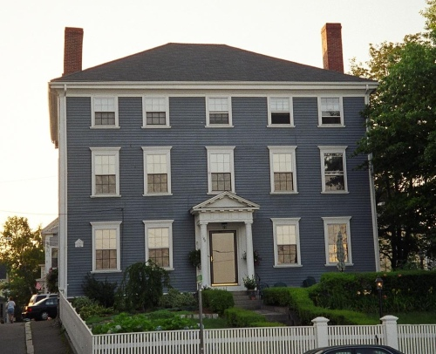
A cellar: a room or enclosed space under a house used for storage.
A three-storey house/building
Neighborhood: a district where people live.

Slide 15
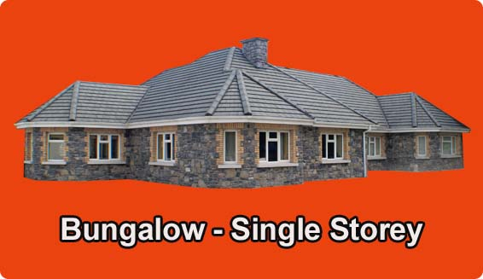
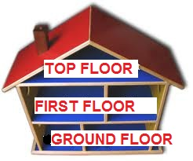
En-suite bathroom: connected directly to the bedroom.
A bungalow

Slide 16
Within walking distance of the shops: close enough to walk to.
My house is within walking distance from Rashid Mall.
Fitted kitchen : all the units are 'fitted' into the walls.
Carol has spent a lot of money on her new fitted kitchen.

Slide 17

After learning the meanings of these new words, let’s work in pairs to put them into groups 1, 2, and 3
Ex.1 – pg.36

Slide 18
3. PARTS OF A HOME | 2. LOCATION | 1.TYPES OF HOME
A balcony | With a nice view | A terraced house
A loft | In the country | A detached house
A garage | In the suburbs | A semi-detached house
A study | In a good/bad/rough neighborhood | A cottage
A basement | On the ground/first/top floor | A three-storey house
A cellar | Within walking distance of the shops | A bungalow
An en-suite bathroom | - | -
A fitted kitchen | - | -

Slide 19
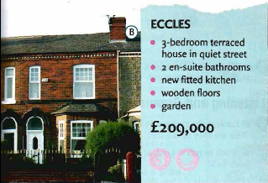
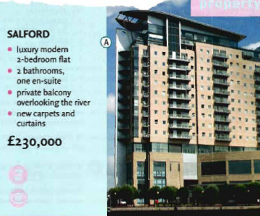
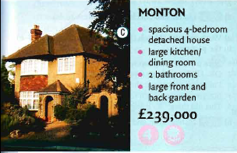
3. Reading , Listening and Grammar
a) Read this advertisement for places to live in Manchester, England. Pg.36-37
Which one do you like best? Why ?

Slide 20
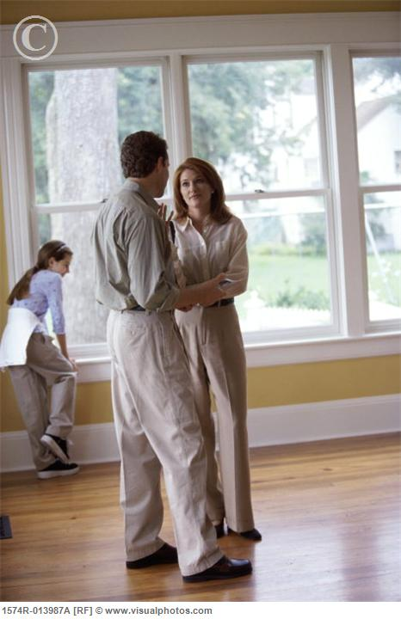

b) Ian and Liz are looking for a new place to live in. Listen to their conversation.
Which place do they both like?

Slide 21
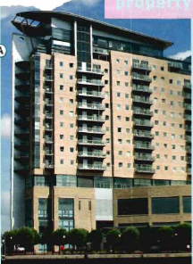
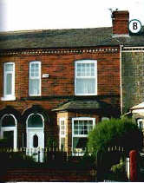
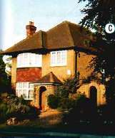
4. Look at these sentences. Are they about places A, B or C ?
It’s the least expensive place we’ve seen.
It seemed slightly bigger than our house.
It’s one of the oldest houses we’ve seen so far.
It was much noisier than the other two.
The garden was far smaller than I expected.
It felt a lot more spacious.
It had the most amazing view.
It’s a little further away from the city center.
It’s got the worst bathroom I’ve ever seen.
It’s a bit less expensive than the Monton house.
B
B
C
C
C
A
A
C
B
A

Slide 22
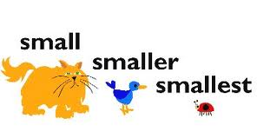
5. Making Comparisons Comparative & Superlative Adjectives
First you must ask yourself,
‘How many things am I comparing?‘
If you are comparing only two things then you must use a comparative, if it’s three or more, then it must be a superlative.

Slide 23
 | Adjective | Comparative | Superlative
Short Adjectives | tall big noisy | taller than bigger than noisier than | the tallest the biggest the noisiest
Long Adjectives | beautiful comfortable | more/ less beautiful than more/ less comfortable than | the most/ least beautiful the most/ least comfortable
Irregular Adjectives | good bad far | better than worse than further than | the best the worst the furthest

Slide 24
 | Adjective | Comparative | Superlative
Short Adjectives | tall | My sister is taller than me. | My sister is the tallest in the class.
Long Adjectives | beautiful | Our garden is more / less beautiful than yours. | Our garden is the most/ least beautiful garden in the district.
Irregular Adjectives | good | School A is better than school B. | School A is the best school in the city.

Slide 25
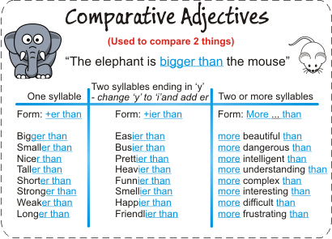
My sister is taller than me.
She's looking happier today.
Reema is more careful with her writing than I am with mine.

Slide 26
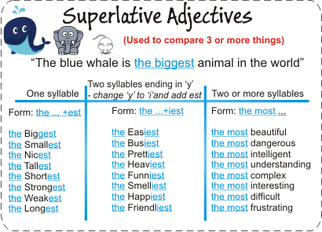
My brother is the tallest in our family.
The richest people are not always the happiest.
Albert Einstein was the most intelligent person at his time.

Slide 27
Other ways to make comparisons:
to say two things or people are the same we can use:
a) the same + noun + as
Example: It’s the same size as ours.
b) as + adjective + as
Example: It’ll be as good as having a garden.
2) to say two things or people are nearly the same we can use:
a) similar to + noun
Example: It’s very similar to this house.

Slide 28
Other ways to make comparisons:
3) to say two things or people are not the same we can use:
a) not as + adjective + as
Example: It’s not as big as the others.
b) different from + noun
Example: It was very different from anything else.

Slide 29

Now let’s try doing exercise 7 pg. 37

Slide 30

Do not forget to do your assignment
5A Exercise 8 – pg. 37
That’s it for today..
See you next time ..
Prepared by:
Ms. Nehad A. Asiri

