Slide 1
Ch.5 Home truths
5B A load of old junk
Ms. Nehad A. Asiri

Slide 2

“ A house divided against itself cannot stand.”
Abraham Lincoln

Slide 3
OBJECTIVES
Upon completion of this class, students must be able to:
Use and define different phrasal verbs.
Use the future tense correctly. (will – be going to )
Use the present continuous tense correctly.
Construct clear sentences using appropriate grammar rules.
Read for specific information.

Slide 4
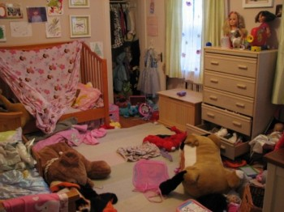
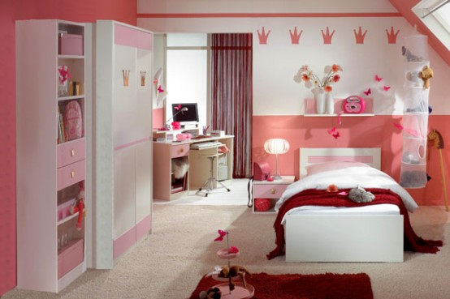
Discussion
Do you like to keep invaluable things things in your room ?
Where do you keep them?
Do you think your room is full of things that you don’t need or use?

Slide 5

READING TIME pg. 38
Now let’s read the article
Just Get Rid of IT!
Underline the new words & guess the meaning of the phrasal verbs in bold .
2

Slide 6
Check these words in the dictionary.
1-VOCABULARY
keep :to save .
Keep X get rid of
I will keep this old book. It’s very useful.

Slide 7

Check these words in the dictionary.
Stuff Different objects and things.
I need to buy some stuff for the party.

Slide 8
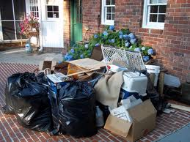
Check these words in the dictionary.
Junk: anything that is regarded as
worthless, meaningless; trash.

Slide 9
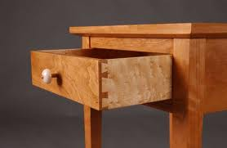
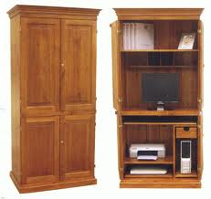
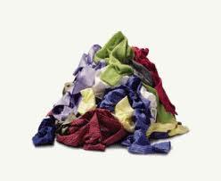
Check these words in the dictionary.
A drawer
A cupboard
A pile

Slide 10
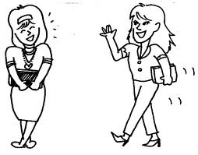
VOCABULARY – Phrasal verbs
A phrasal verb is a verb plus a preposition or adverb which creates a meaning different from the original verb.
Example:
I ran into my teacher at the movies last night. run + into = meet

Slide 11

a) Check these words in the dictionary.
1
Get rid of : to discard or throw away.
I need to get rid of old junk in the house.

Slide 12

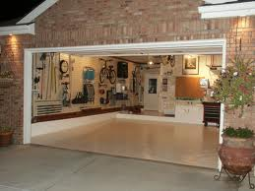
Clear (sth) out
To tidy or clean a room or a house and remove the things you don’t want any more.
I’m going to clear out the garage this weekend.

Slide 13
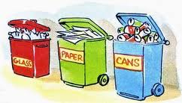
Sort (sth) out
To organize or arrange things.
I need to sort out the garbage according to it’s material.

Slide 14

Give (sth) away
To give something to someone for free.
I didn’t need my old TV so I gave it away.

Slide 15
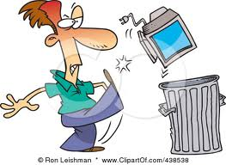
Throw (sth) away / throw (sth) out
To put something in the rubbish bin because you don’t want it anymore.
This chair is broken. I will throw it out.

Slide 16
Take (sth) out
Remove something from a place.
Can you take the garbage out for me , please?

Slide 17
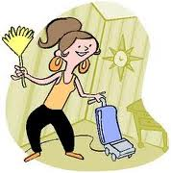
Tidy (sth) up
To make a place neat and organized by putting things back in their places.
Tidy up the house. Some friends are coming.

Slide 18
Put (sth) away
To put something in the place where you usually keep it.
Sarah, don’t leave your clothes on the floor. Put them away.

Slide 19
Come back
To return to a place.
We will have an exam when we come back after the holiday.

Slide 20
Go through (sth)
To look at things carefully in order to decide what to do with them.
I went through everything in these boxes and threw away a lot of junk.

Slide 21
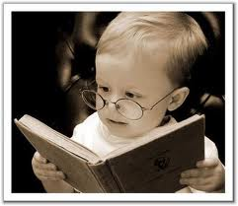

READ AGAIN!
b) Tick the true sentences. Correct the false ones.
The article tells you how to get rid of rubbish.
You need an hour for each room.
You should put things in three piles.
Put things you don’t want in a junk drawer.
Don’t buy things if you’ve got something similar.
c) What do you think of the advice in the article? Do you need to do this in your home?
2 hours
Things you can’t decide about

Slide 22
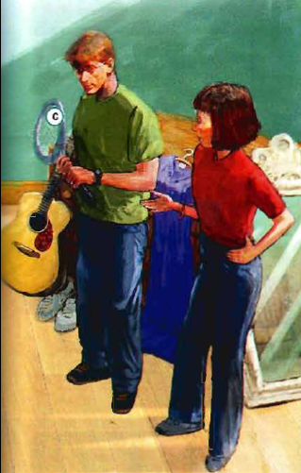
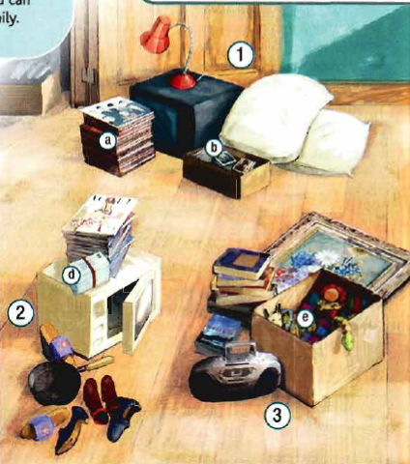

LISTENING & GRAMMAR pg. 38
4
Look at the picture. What are Ian an Liz doing ? Why are they doing this ?
continue answering b, c and d .

Slide 23

5
Work in pairs. Match these sentences to things a-e in the picture.
She’s picking them up tomorrow evening after work.
Ok, I’ll throw those away.
I’m going to sort out the rest of them at the weekend.
But you’ll never listen to them again.
That old thing? It’s going to break the first time he uses it!
e
d
b
a
c

Slide 24

The future: will, be going to , present continuous

Slide 25
WILL
When we decide to do something at the time of speaking.
I’ll throw those away.
2. A prediction or promise not based on present evidence.
Who do you think will get the job?
3. Future facts.
I’ll be 20 next birthday.
4. Offers or a Voluntary Action.
I’ll open the door for you.

Slide 26
WILL
Subject + ‘ll / will + infinitive
( positive)
She’ll be 20 next birthday.
Subject + won’t /will not + Infinitive (negative)
He won’t throw that away.
Her kids will probably / definitely like them.
I might finish it this weekend. = will possibly

Slide 27
WILL
Questions
Question word + will + subject + infinitive
When will it be here ?
Will it rain at the weekend ?

Slide 28
Be going to
Subject + am / are / is + going to + infinitive ( positive)
1. A plan or intention to do something.
I’m going to travel to Spain next summer.
2. A prediction based on present evidence.
It’s going to break the first time he uses it.
Subject + am / are / is + not + going to + infinitive ( negative)
They’re not going to use it again.

Slide 29
Be going to
Questions
Q.word + am/are/is + (not) +subject + going to+ infinitive
When am I going to see you again?
Aren’t they going to visit him ?

Slide 30
Present continuous
We us e it when we have an arrangement with another person and we know exactly when.
She’s picking them up tomorrow evening .

Slide 31

Grammar
Now let’s try to answer the questions in exercise 6 pg.39
☺

Slide 32

That’s it for today ..
Have a good day !
Ms. Nehad A. Asiri

