Slide 1
Work and Energy
المحاضرة الثامنة

Slide 2
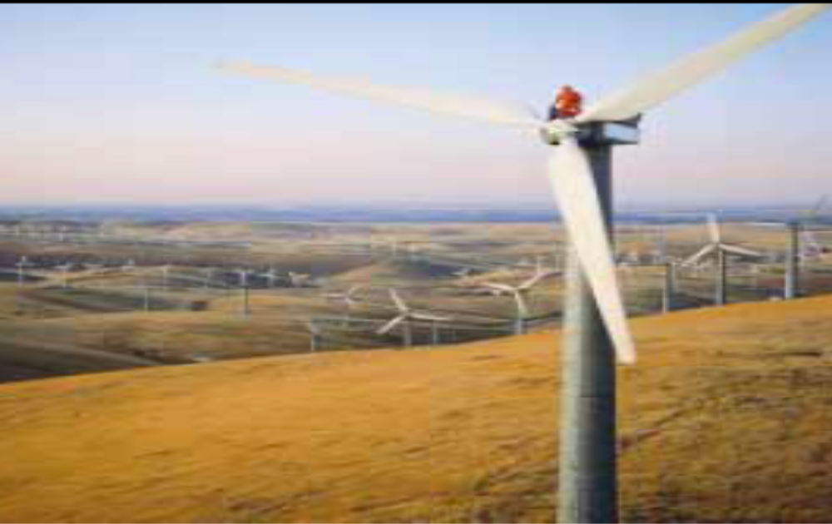

Works and Energy
Chapter 7

Slide 3
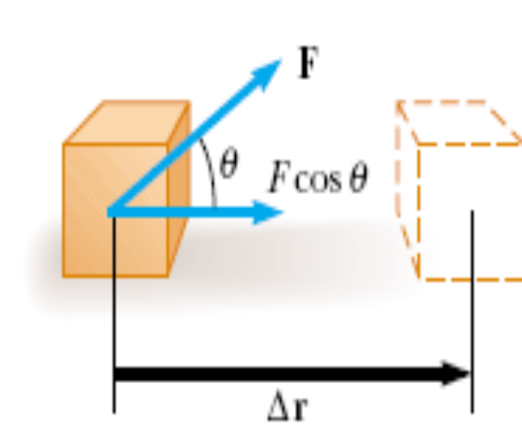

7.2 Work Done by a Constant
Force
Work (W)
How effective is the
force in moving a body ?
→ Both magnitude (F) and directions (θ ) must be taken into account.
Work’s unit is:
N.m = Joul

Slide 4
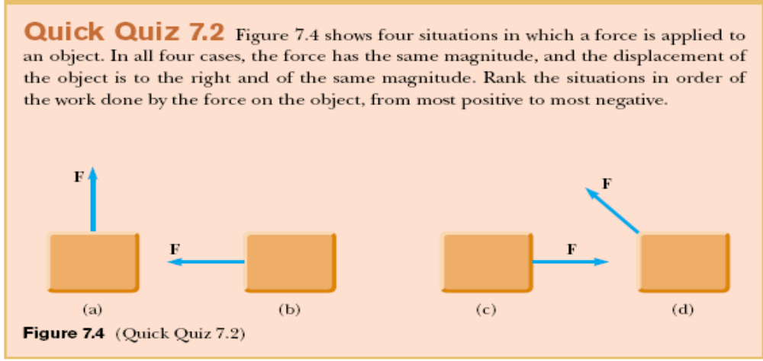
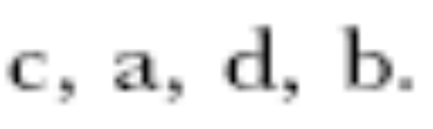
7.2 Work Done by a Constant
Force

Slide 5

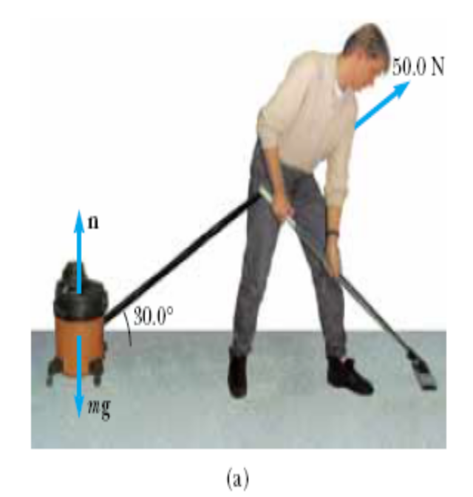
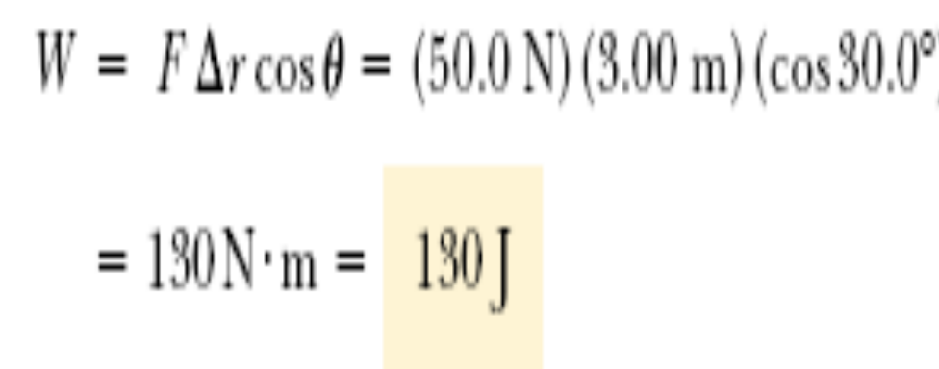
Example 7.1 Mr. Clean

Slide 6
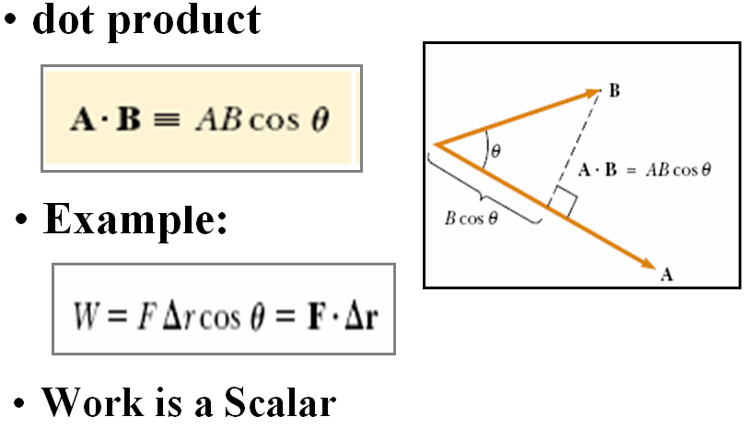
7.3 The Scalar Product of Two
Vectors

Slide 7

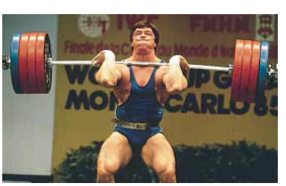
Keep in Mind:
The weightlifter does
no work on the
weights as he holds
them on his shoulders,
Why?

Slide 8
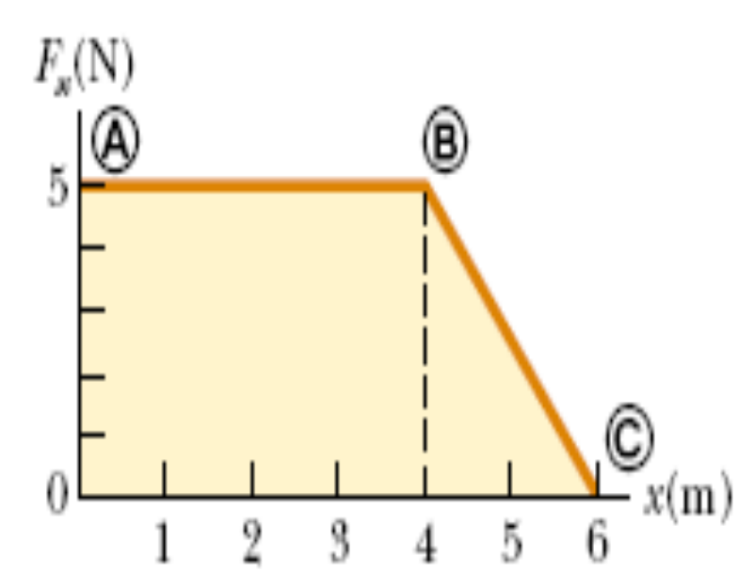
Example 7.4
A force acting on a particle varies with x,
as shown in figure. Calculate the work done
by the force as the particle moves from
x = 0 to x = 6.0 m.
Solution:
The work done by the force = The total area
under the curve from x_{A}= 0 to x_{C}= 6.0m.
The area = Area from A to B + Area from B to C
= (5.0) (4.0m) +1/2 (5.0N)(2.0m)
= 20 J + 5.0 J
= 25 J

Slide 9
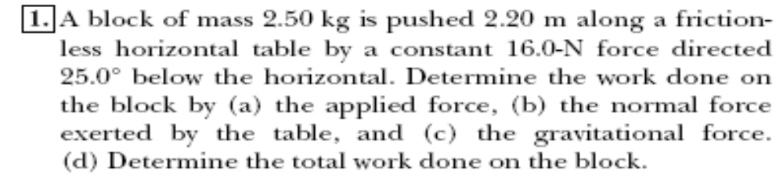
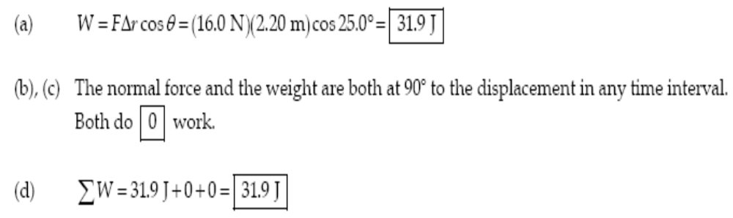
Problem 7.1

Slide 10
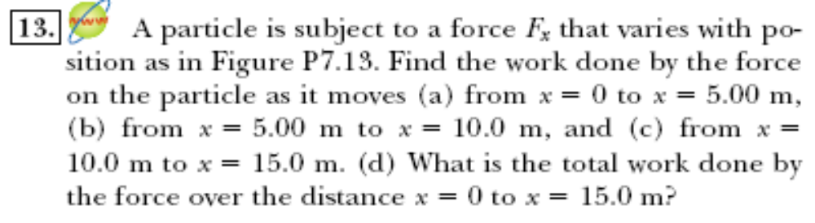
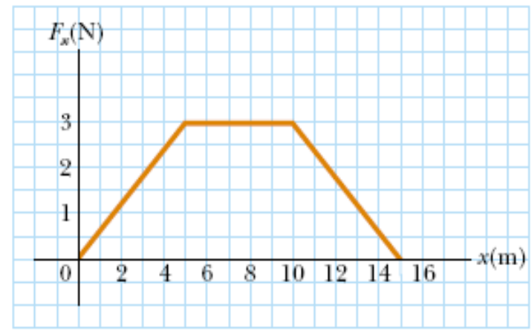
Problem 7.13

Slide 11
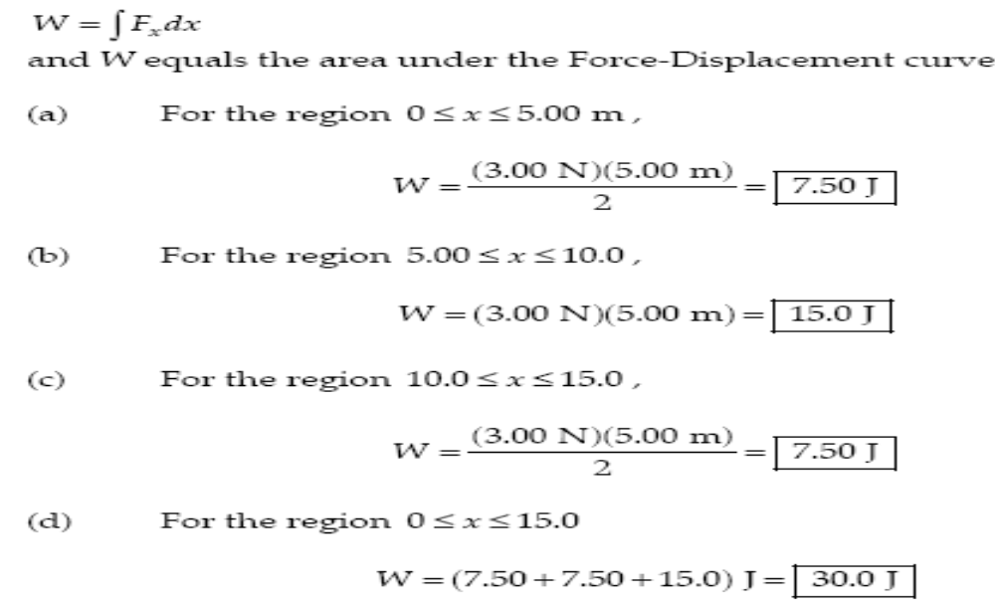
Problem 7.13

Slide 12
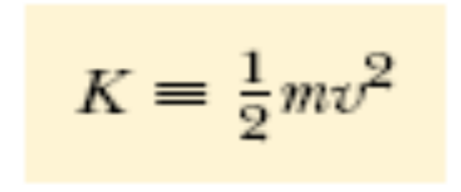
Kinetic Energy
• The Kinetic Energy represents the energy associated with the motion of the particle
• The Kinetic Energy of a particle of mass m and have a velocity v is defined as:
• The unit of the Kinetic Energy is:
kg/m² = Joule

Slide 13
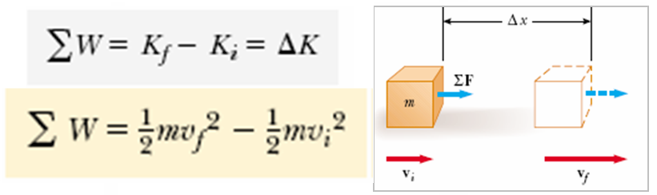
If the only change in the system is in its speed, the work done by the net force equals the change in kinetic energy of the system.
Work-Kinetic Energy Theorem:

Slide 14
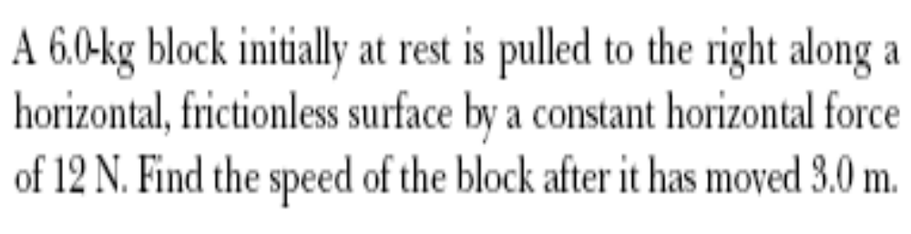
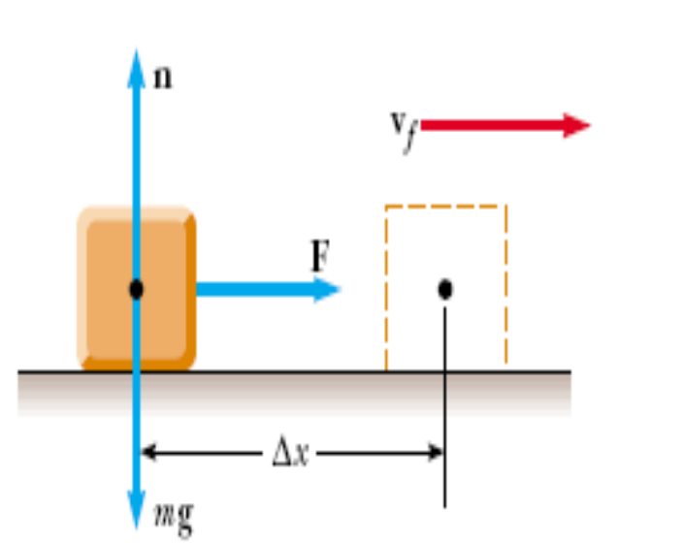
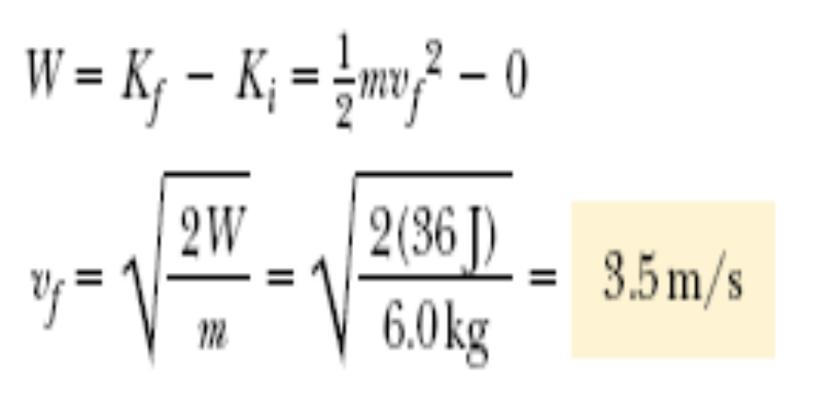
Example 7.7 A Block Pulled on a Frictionless Surface

Slide 15
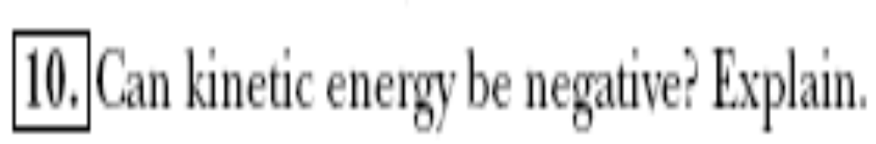
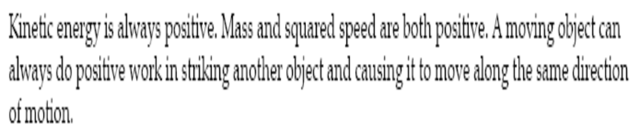
Question 7.10

Slide 16

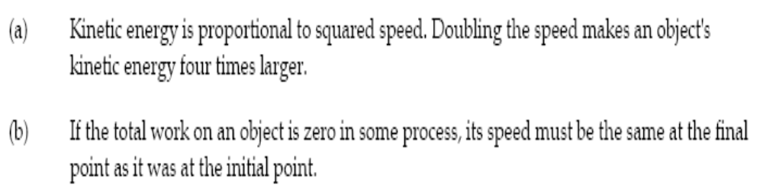
Question 7.14

Slide 17
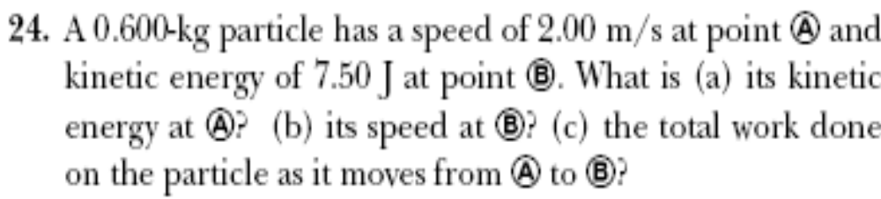
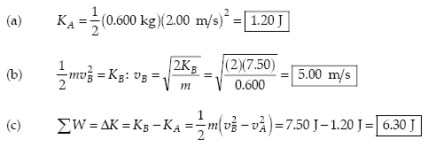
Problem 7.24

Slide 18
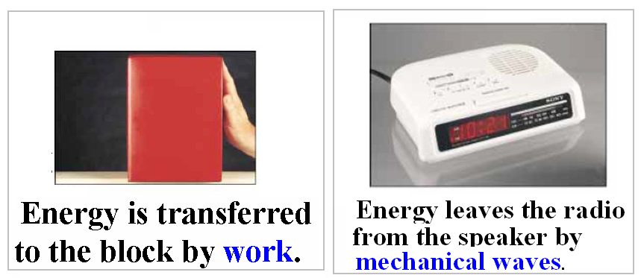
Energy Transfer mechanisms

Slide 19
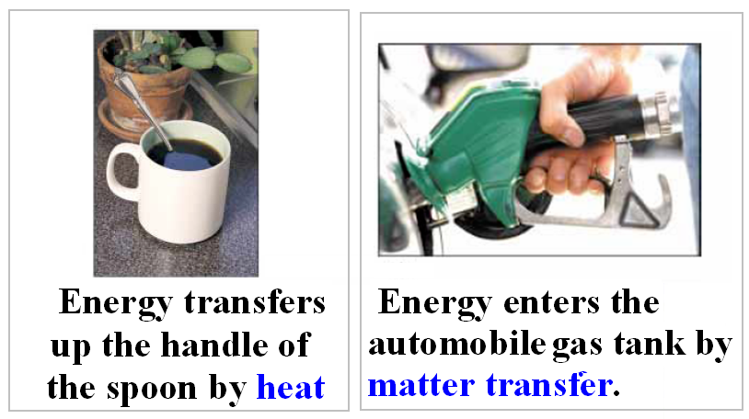
Energy Transfer mechanisms

Slide 20
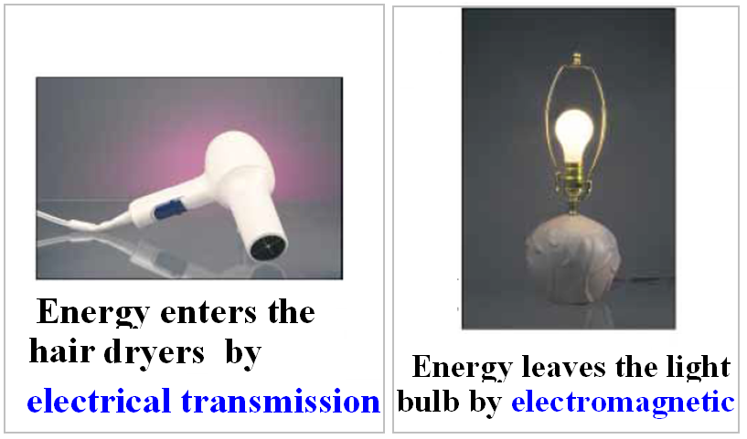
Energy Transfer
mechanisms

Slide 21
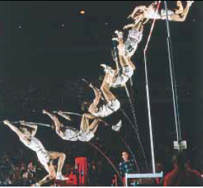
Potential Energy
Chapter 8

Slide 22

8.1: Potential Energy
• The Gravitational Potential Energy is Defined as:
• The unit of the potential energy is:
kg.m²/s² = Joules

Slide 23
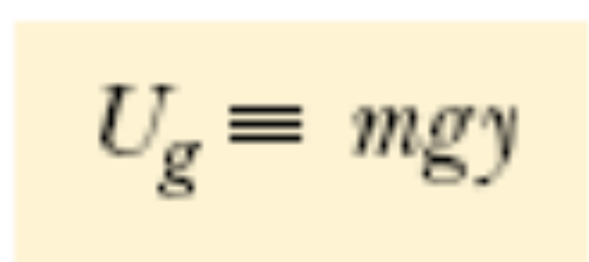
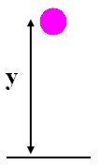
8.1: Potential Energy
. Gravitational potential energy (U):
Y is height above the ground

Slide 24
Quick Quiz 8.1:
Choose the correct answer. The
gravitational potential energy of a system
(a) is always positive.
(b) is always negative.
(c) can be negative or positive.

Slide 25
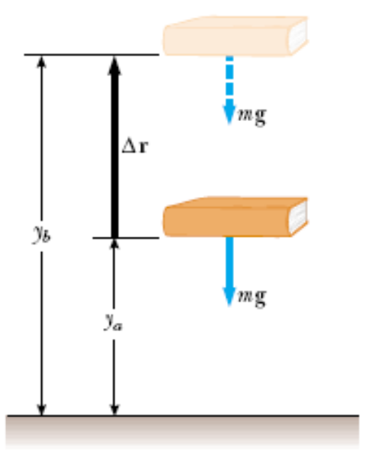

8.1: Potential Energy
The work done on the
Book is:

Slide 26
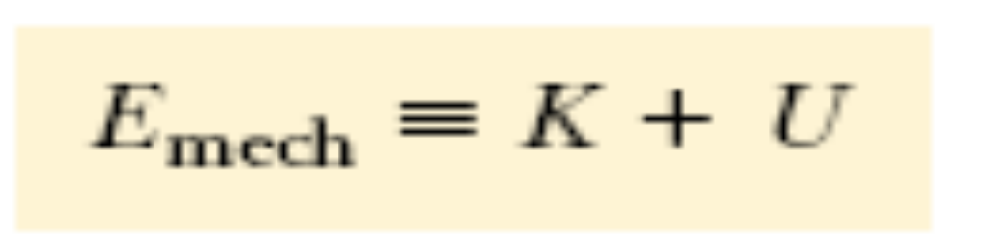
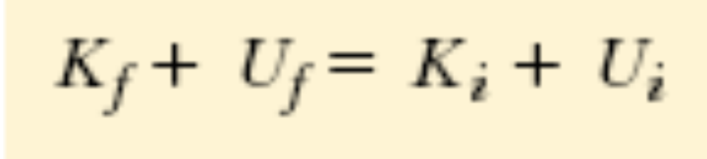
8.2: Mechanical Energy
• Mechanical Energy is defined as:
• The mechanical energy of a friction-free system is conserved:

Slide 27
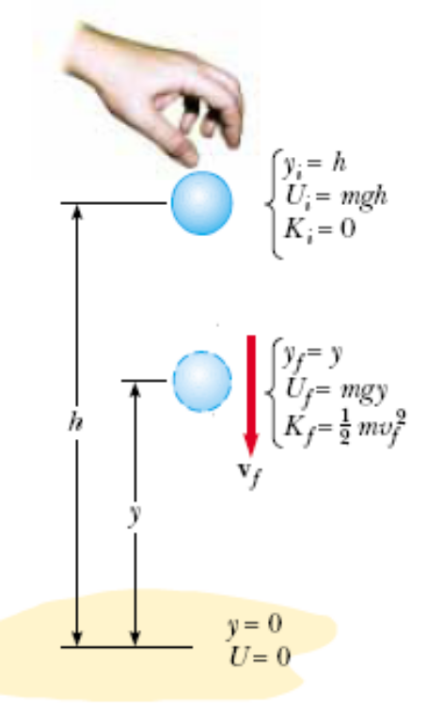
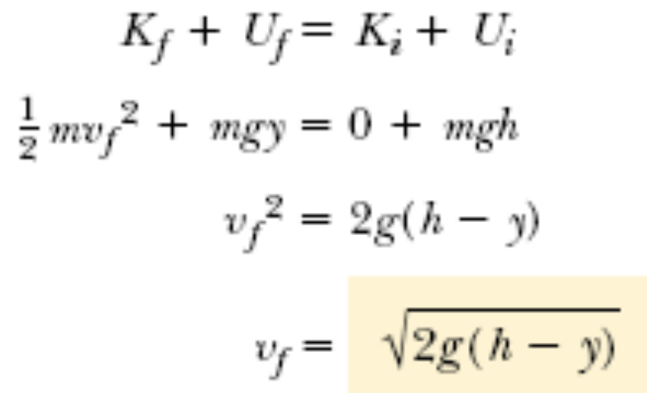
Example 8.2: Ball in Free Fall
A ball of mass m is dropped from a height h
above the ground.
(A) Neglecting air resistance, determine the
speed of the ball when it is at height y above
the ground.

Slide 28
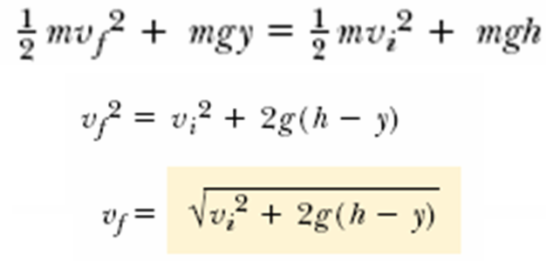
(B) Determine the speed of the ball at y if at the instant of release it already has an initial upward speed v_{i} at the initial altitude h.
Example 8.2 : Ball in Free Fall

Slide 29
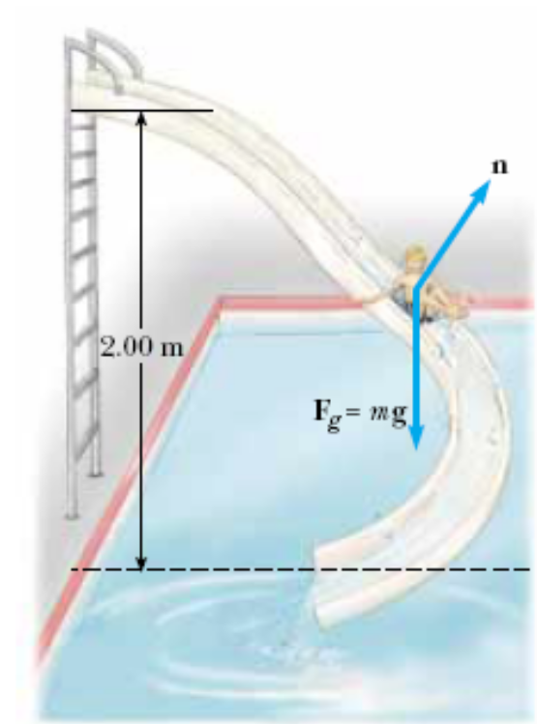

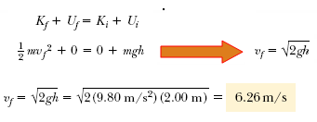
Example 8.7 Motion on a Curved Track

Slide 30
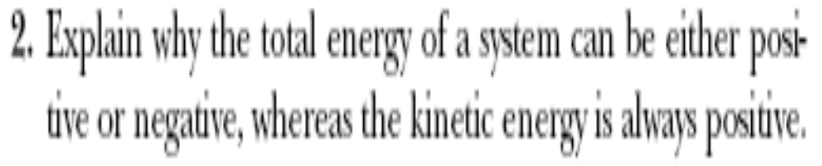
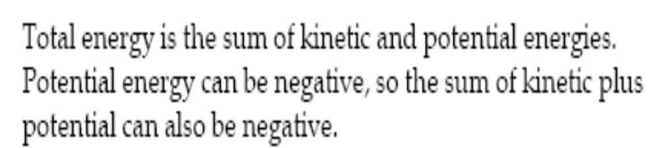
Question 8.2

Slide 31
8.3: Conservative and Non-Conservative Forces
Conservative Forces have these two equivalent properties:
(1) The work done on a particle moving between any two points is independent of the path taken by the particle.
(2) The work done by them on a particle moving through any closed path is zero.
• Non-Conservative Forces does not satisfy properties 1 and 2.

Slide 32
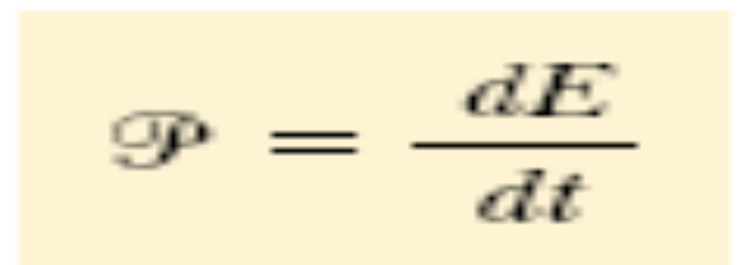
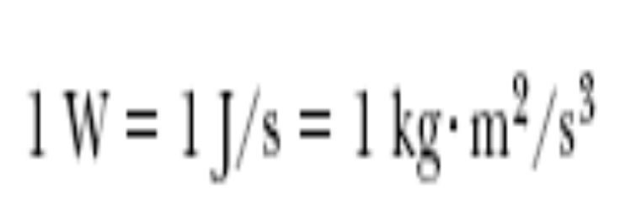
Power
The most general expression for power is:
The SI unit of power is called the watt (W)

Slide 33
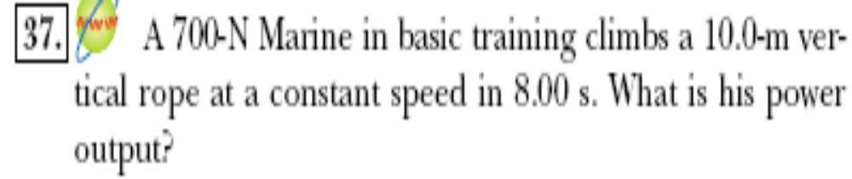
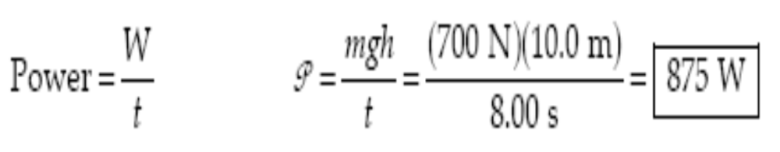
Problem 7.39

