Slide 1

Week (4)
Lecture (2)
Mrs.Shahnaz Akhtar, Miss Ahood, Miss Amani Department of English

Slide 2
Chapter 1 :
Academic Life Around the World
Reading Book
Interactions( 1) Reading Middle Gold Edition
Mrs.Shahnaz Akhtar, Miss Ahood, Miss Amani Department of English

Slide 3
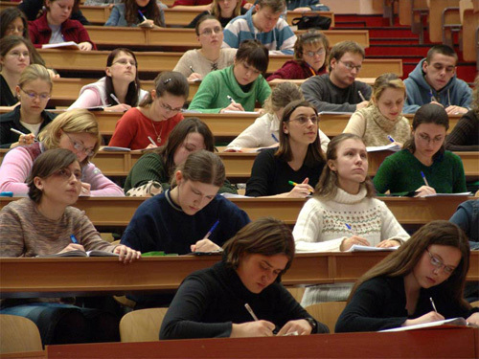
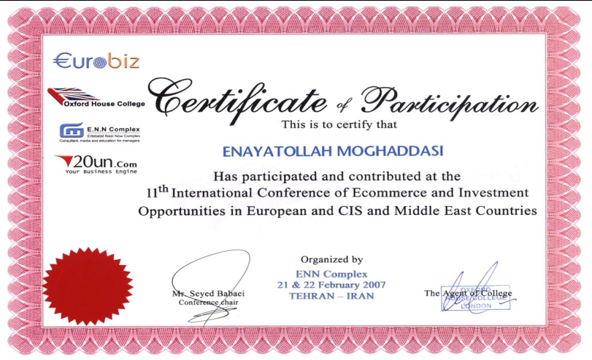
Vocabulary words
nouns
Academic lectures :
University classes.
Assignments :
A duty that you are assigned to, ex. homework.
Atmosphere :
The weather or climate at some place.
Certificates :
An official written statement
that declares something, ex. college degree.
Mrs.Shahnaz Akhtar, Miss Ahood, Miss Amani Department of English

Slide 4
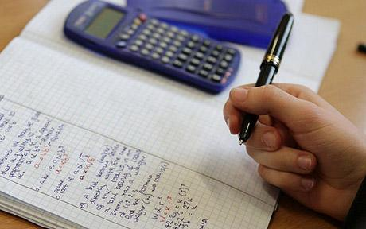
Distance learning :
Education in which students take academic
courses using a computer network.
Equipments :
Things that a person needs to do something.
Exit Exam :
The last exam in high school to determine
the student’s right to join a university.
Facilities :
Services given to make something easy or interesting.
Mrs.Shahnaz Akhtar, Miss Ahood, Miss Amani Department of English

Slide 5

Financial aid :
Money to support a person.
Instructors :
People who instruct or teach; teachers.
Learning resources centers:
The rooms where people use extra sources that help them in learning, ex. computers, books, Internet...etc.
Loan :
Money given for some time & should be returned back.
Mrs.Shahnaz Akhtar, Miss Ahood, Miss Amani Department of English

Slide 6

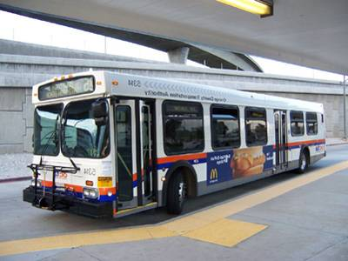
Materials :
Tools that are necessary for doing something.
Method :
Way of doing something.
Points :
Scores or marks given to students.
Public transportation :
Any way of moving people from a place
to another that is not for private use.
Mrs.Shahnaz Akhtar, Miss Ahood, Miss Amani Department of English

Slide 7


Quizzes :
Short tests done in short time.
Requirement :
Something that is necessary or important to have.
Resources :
Sources used to get something.
Scholarships :
Aids given to help students complete their
study.
Mrs.Shahnaz Akhtar, Miss Ahood, Miss Amani Department of English

Slide 8

Scores :
Grades or marks given to students.
Services :
Things for help.
Social life :
Life with people, friends or relatives.
Software programs :
Programs for a computer system.
Mrs.Shahnaz Akhtar, Miss Ahood, Miss Amani Department of English

Slide 9
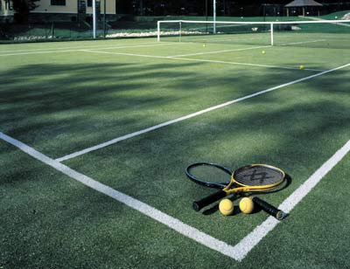

Styles :
Ways or manners.
Tennis courts :
A green area prepared for playing tennis.
Views :
Opinions or ideas.
Mrs.Shahnaz Akhtar, Miss Ahood, Miss Amani Department of English

Slide 10
verbs
Complete :
To continue doing something.
Differ :
To be different; not the same.
Mrs.Shahnaz Akhtar, Miss Ahood, Miss Amani Department of English

Slide 11
adjectives
Audio :
Something heard by ears.
Available :
Ready to be used.
Formal :
Done according to customs or rules.
Mrs.Shahnaz Akhtar, Miss Ahood, Miss Amani Department of English

Slide 12
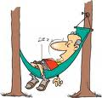

Individual :
Single; for one person.
Relaxed :
Less worried; comfortable.
Similar :
Alike; much the same.
Mrs.Shahnaz Akhtar, Miss Ahood, Miss Amani Department of English

Slide 13
adverbs
Casually :
Informally; not according to a plan.
Mrs.Shahnaz Akhtar, Miss Ahood, Miss Amani Department of English

