Slide 1

WEEK 5
Lecture 4
Mrs.Shahnaz Akhtar, Miss Ahood, Miss Amani Department of English

Slide 2
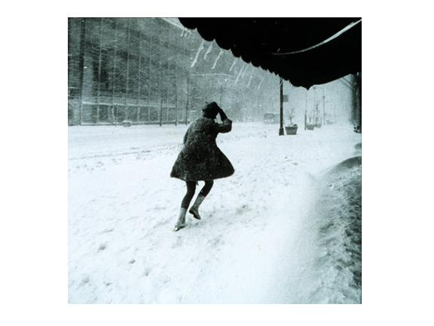
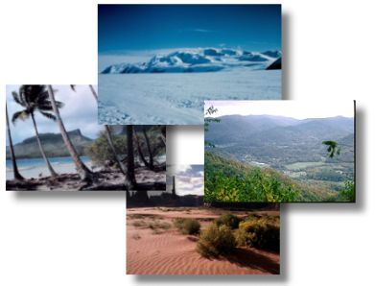
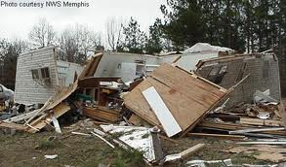
Nouns::
blizzard:
a very bad snowstorm with strong winds
climate :
A climate of a place is the general weather conditions that are typical of it.
damage:
physical harm that is caused to an object.
Mrs.Shahnaz Akhtar, Miss Ahood, Miss Amani Department of English

Slide 3
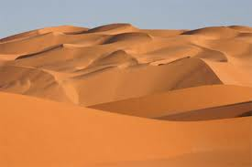
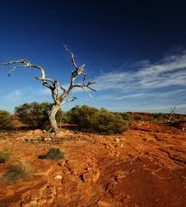
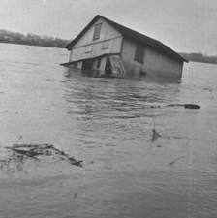
Nouns::
desert:
A large area of land where there is almost no water, rains or plants
drought :
A long period of time during which no rain .
floods :
A large amount of water covers an area which is usually dry.
Mrs.Shahnaz Akhtar, Miss Ahood, Miss Amani Department of English

Slide 4
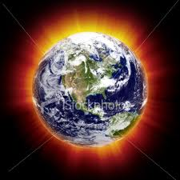
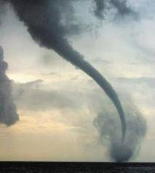
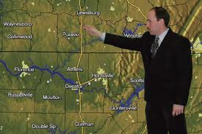
Nouns::
Global warming:
The gradual rise in the earth’s temperature caused by high levels of carbon dioxide and other gases in the atmosphere
hurricane :
An extremely violent storm.
meteorologist:
A person who is specialized in the earth’s atmosphere.

Slide 5
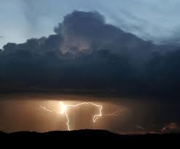
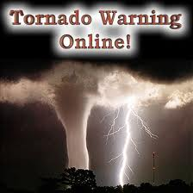
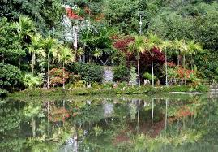
Nouns::
storms:
A very bad weather with heavy rain, strong wind and often thunder and lightening
tornado :
Violent storm consisting of a tall column of air.
Tropical rain forest :
Mrs.Shahnaz Akhtar, Miss Ahood, Miss Amani Department of English

Slide 6
verbs::
Cutting down:
If you cut down a tree, you cut through its trunk so that it falls to the ground.
vary :
Differ, change.
Mrs.Shahnaz Akhtar, Miss Ahood, Miss Amani Department of English

Slide 7
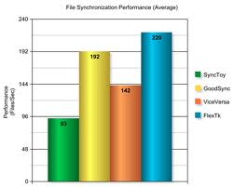
adjectives::
average:
something that is average is neither very good nor very bad.
common :
If something is common, it’s found in large numbers or it happens often.
extreme :
Very great in degree or intensity .
Mrs.Shahnaz Akhtar, Miss Ahood, Miss Amani Department of English

Slide 8
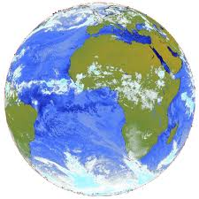
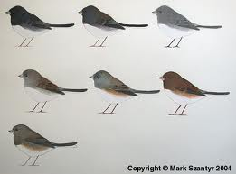
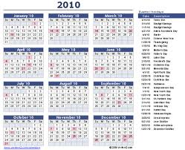
adjectives::
global:
World wide.
typical:
You use typical to describe someone or something the most usual characteristics of a particular type of person or thing.
yearly :
Happens every year or once a year.
Mrs.Shahnaz Akhtar, Miss Ahood, Miss Amani Department of English

Slide 9
Time to think
After reading the article, think
about the following questions to
find the answers.
Mrs.Shahnaz Akhtar, Miss Ahood, Miss Amani Department of English

Slide 10
Paragraph 1
How the words “weather” and “climate” are different ?
Are the climates in different regions in the world similar ?
Paragraph 2
Give some of the natural forces that change the earth’s climate?
Does the climate in any region in the world have an effect on the other regions ?
Mrs.Shahnaz Akhtar, Miss Ahood, Miss Amani Department of English

Slide 11
Paragraph 3
What is global warming?
What are the results of the seasonal change in the atmosphere of the tropical areas?
Paragraph 4
How some of the scientists believe that human beings are the main cause of the climate change?
Mrs.Shahnaz Akhtar, Miss Ahood, Miss Amani Department of English

Slide 12
The End

