Slide 1

Week (4)
Lecture (1)
Mrs.Shahnaz Akhtar, Miss Ohood, Miss Amani Department of English

Slide 2
Chapter 1 :
Academic Life Around the World
Reading Book
Interactions (1) Reading Middle Gold Edition
Mrs.Shahnaz Akhtar, Miss Ohood, Miss Amani Department of English

Slide 3
Objectives:
Skimming to recognize the main ideas
Recognizing supporting details
Summarizing paragraphs
Getting meaning of vocabulary from context
Mrs.Shahnaz Akhtar, Miss Ohood, Miss Amani Department of English

Slide 4
Part (1)::
International Students

Slide 5

Add to your vocabulary!!
Mrs.Shahnaz Akhtar, Miss Ohood, Miss Amani Department of English

Slide 6

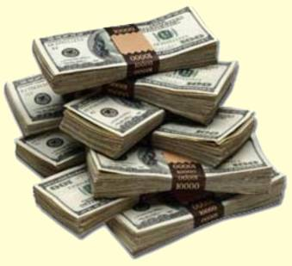

Nouns::
Campus :
An area of land that contains the main
buildings of a university or college.
Charge:
An amount of money that you have to pay for a service; fee.
Citizen :
A citizen of a particular country is legally accepted as belonging to that country.
Developing nations :
The countries with low level of industry and
technology.
Mrs.Shahnaz Akhtar, Miss Ohood, Miss Amani Department of English

Slide 7

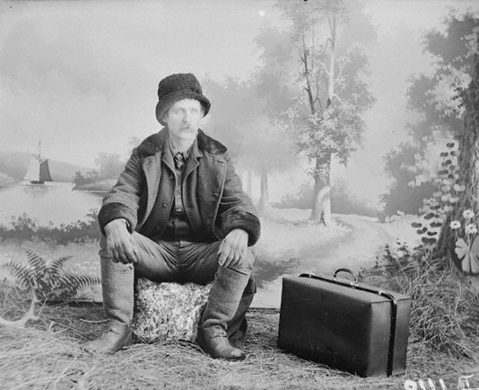
Nouns::
Engineering:
The subject studied by people who like to design and construct buildings, roads, bridges
Experience :
Knowledge or skill in a particular activity or job .
Government:
The people who rule a country of state.
Immigrant :
A person who comes into a foreign country
to live permanently.
Mrs.Shahnaz Akhtar, Miss Ohood, Miss Amani Department of English

Slide 8

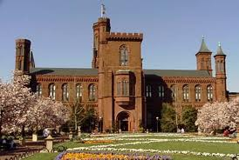

Nouns::
Industrialization:
A state of having an economy based on
industry.
Institution :
An organization for a particular
purpose.
Internationalism:
A belief that countries should work and be friendly with one another.
Mrs.Shahnaz Akhtar, Miss Ohood, Miss Amani Department of English

Slide 9
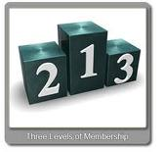
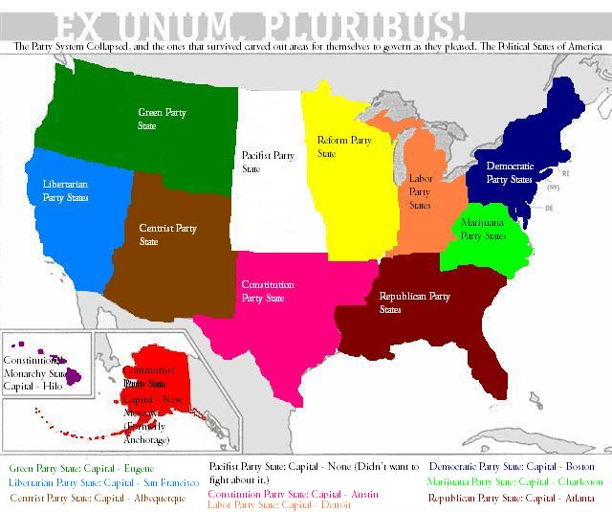
Nouns::
Level :
A point in a scale for example a scale of amount, quality or difficulty.
Nations:
A group of people sharing ideas, religion,
traditions, …etc.
Recreation :
Having pleasant activities which one enjoys in his free time.
Mrs.Shahnaz Akhtar, Miss Ohood, Miss Amani Department of English

Slide 10

Nouns::
Skill :
A type of work or activity which requires special training and knowledge.
Subject:
An area of study or knowledge which one studies at school or university.
Tuition :
The amount of money that you have to pay for being taught particular subjects especially in a university, college or private school.
Mrs.Shahnaz Akhtar, Miss Ohood, Miss Amani Department of English

Slide 11
verbs::
Attend :
To go to or be present at.
Charge:
To ask as the price of something.
leave:
To go away or depart from.
Save:
To keep money for future use.
Spend:
To use up or pay out.
Supported by:
Dependent on.
Mrs.Shahnaz Akhtar, Miss Ohood, Miss Amani Department of English

Slide 12
adjectives::
Abroad :
Away from the one’s own country.
Expensive :
Causing a great deal.
Foreign :
Belonging to a country other than the one’s own.
Mrs.Shahnaz Akhtar, Miss Ohood, Miss Amani Department of English

Slide 13

adjectives::
International :
Between or involving different countries.
Legal :
Allowed or required by law.
Private:
For a person or group; not for the general public.
Mrs.Shahnaz Akhtar, Miss Ohood, Miss Amani Department of English

Slide 14

adverbs::
Abroad :
In or to another country.
Mrs.Shahnaz Akhtar, Miss Ohood, Miss Amani Department of English

Slide 15

Time to think
After reading the article, think
about the following questions to
find the answers.
Mrs.Shahnaz Akhtar, Miss Ohood, Miss Amani Department of English

Slide 16
Paragraph A
Give a definition of an “international student” ?
What does ‘foreign’ mean?
Paragraph B
Which country has the largest number of international students?
What do you know about the developing nations? Give examples.
Mrs.Shahnaz Akhtar, Miss Ohood, Miss Amani Department of English

Slide 17
Paragraph C
Most students tend to study abroad. Give three reasons.
Paragraph D
Mention some of the advantages that encourage institutions of higher education to have international student.
Mrs.Shahnaz Akhtar, Miss Ohood, Miss Amani Department of English

Slide 18
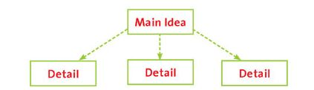
Strategy
Main Idea
The main idea of a paragraph tells the topic of the paragraph. The topic tells what all or most of the sentences are about.
It usually, not always, comes in the beginning of the paragraph.
Mrs.Shahnaz Akhtar, Miss Ohood, Miss Amani Department of English

Slide 19
Do it!
Read this short paragraph. Choose its main idea.
Football players learn many skills when playing football. They learn how to pass the ball. They also learn how to control the ball so they can eventually score. Most importantly, soccer players learn how to work together with their teammates.
Mrs.Shahnaz Akhtar, Miss Ohood, Miss Amani Department of English

Slide 20
Choose the main idea:
They also learn how to control the ball so they can eventually score.
Football players learn many skills when playing football.
Football players learn many skills when playing football.
Mrs.Shahnaz Akhtar, Miss Ohood, Miss Amani Department of English

Slide 21
Strategy
Supporting Details
Supporting details are the sentences that explain the main idea. They give examples, reasons, or elements of the main idea.
They are more specific than the main idea.
Mrs.Shahnaz Akhtar, Miss Ohood, Miss Amani Department of English

Slide 22
Do it!
Number the supporting details in this paragraph.
Football players learn many skills when playing football. They learn how to pass the ball. They also learn how to control the ball so they can eventually score. Most importantly, soccer players learn how to work together with their teammates.
Mrs.Shahnaz Akhtar, Miss Ohood, Miss Amani Department of English

