Slide 1

Week (5)
Lecture (2)
Mrs.Shahnaz Akhtar, Miss Ohood, Miss Amani Department of English

Slide 2
Chapter 1 :
Academic Life Around the World
Reading Book
Interactions (1) Reading Middle Gold Edition
Mrs.Shahnaz Akhtar, Miss Ohood, Miss Amani Department of English

Slide 3
Objectives:
Skimming to recognize the main ideas
Recognizing supporting details
Summarizing paragraphs
Getting meaning of vocabulary from context
Mrs.Shahnaz Akhtar, Miss Ohood, Miss Amani Department of English

Slide 4
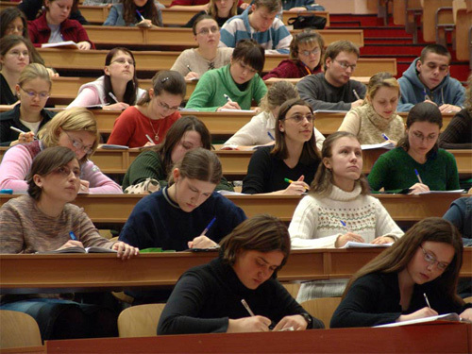
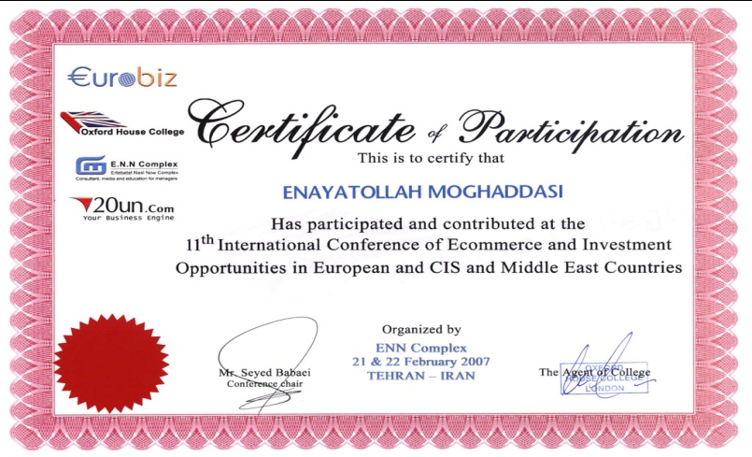
Vocabulary words
nouns
Academic lectures :
University classes.
Assignments :
A duty that you are assigned to, ex. homework.
Atmosphere :
The weather or climate at some place.
Certificates :
An official written statement
that declares something, ex. college degree.
Mrs.Shahnaz Akhtar, Miss Ohood, Miss Amani Department of English

Slide 5
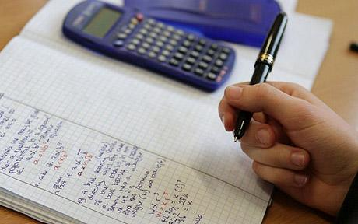
Distance learning :
Education in which students take academic
courses using a computer network.
Equipments :
Things that a person needs for doing something.
Exit Exam :
The last exam in high school to determine
the student’s right to join a university.
Facilities :
Services given to make something easy or interesting.
Mrs.Shahnaz Akhtar, Miss Ohood, Miss Amani Department of English

Slide 6

Financial aid :
Money to support a person.
Instructors :
People who instruct or teach; teachers.
Learning resources centers:
The rooms where people use extra sources that help them in learning, ex. computers, books, Internet...etc.
Loan :
Money given for some time & should be returned back.
Mrs.Shahnaz Akhtar, Miss Ohood, Miss Amani Department of English

Slide 7

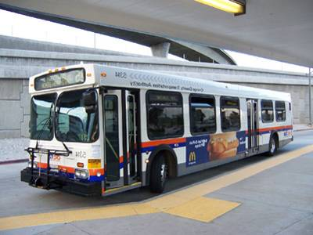
Materials :
Tools that are necessary for doing something.
Method :
Way of doing something.
Points :
Scores or marks given to students.
Public transportation :
Any way of moving people from a place
to another that is not for private use.
Mrs.Shahnaz Akhtar, Miss Ohood, Miss Amani Department of English

Slide 8


Quizzes :
Short tests done in short time.
Requirement :
Something that is necessary or important to have.
Resources :
Sources used to get something.
Scholarships :
Aids given to help students complete their
study.
Mrs.Shahnaz Akhtar, Miss Ohood, Miss Amani Department of English

Slide 9

Scores :
Grades or marks given to students.
Services :
Things for help.
Social life :
Life with people, friends or relatives.
Software programs :
Programs for a computer system.
Mrs.Shahnaz Akhtar, Miss Ohood, Miss Amani Department of English

Slide 10
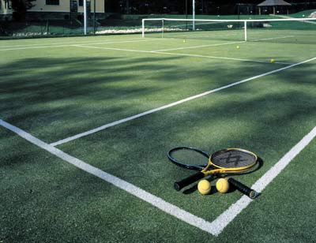

Styles :
Ways or manners.
Tennis courts :
A green area prepared for playing tennis.
Views :
Opinions or ideas.
Mrs.Shahnaz Akhtar, Miss Ohood, Miss Amani Department of English

Slide 11
verbs
Complete :
To continue doing something.
Differ :
To be different; not the same.
Mrs.Shahnaz Akhtar, Miss Ohood, Miss Amani Department of English

Slide 12
adjectives
Audio :
Something heard by ears.
Available :
Ready to be used.
Formal :
Done according to customs or rules.
Mrs.Shahnaz Akhtar, Miss Ohood, Miss Amani Department of English

Slide 13
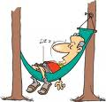

Individual :
Single; for one person.
Relaxed :
Less worried; comfortable.
Similar :
Alike; much the same.
Mrs.Shahnaz Akhtar, Miss Ohood, Miss Amani Department of English

Slide 14
adverbs
Casually :
Informally; not according to a plan.
Mrs.Shahnaz Akhtar, Miss Ohood, Miss Amani Department of English

Slide 15

Time to think
After reading the article, think
about the following questions to
find the answers.
Mrs.Shahnaz Akhtar, Miss Ohood, Miss Amani Department of English

Slide 16
Paragraph A
Where can university students live ?
Is students’ life around the world similar ?
Paragraph B
Why are American students given financial
aids ?
How can Asian students join good universities ?
Mrs.Shahnaz Akhtar, Miss Ohood, Miss Amani Department of English

Slide 17
Paragraph C
How many types of classes are mentioned
in this paragraph ? What are they ?
Are the teaching methods the same all
over the world ?
Paragraph D
Mention some kinds of facilities given
to students.
What is ‘Distance learning’ ?
Mrs.Shahnaz Akhtar, Miss Ohood, Miss Amani Department of English

Slide 18

Summarizing
Strategy
What is a ‘summary’?
Summarizing is how we take larger selections of text and reduce them to their main points.
Mrs.Shahnaz Akhtar, Miss Ohood, Miss Amani Department of English

Slide 19
Steps of Summarizing:
Skim the text to get a general idea of the topic.
Delete unnecessary material.
Find the main ideas in the text.
Find or create a topic sentence.
Substitute general terms (for example, trees instead of oak, maple, and pine)
Mrs.Shahnaz Akhtar, Miss Ohood, Miss Amani Department of English

Slide 20
Sample Summary
Look at this summary for paragraph C in the reading “University Life Around the World”
All over the world, teaching styles are not the same. There are two types of classes. The first type is formal classes, where students show much respect to their teachers, and teachers wear formal clothes. The other type is informal classes. The students feel more comfortable in these classes because they often have a close relationship with their teachers.
Mrs.Shahnaz Akhtar, Miss Ohood, Miss Amani Department of English

Slide 21
Another Example
Look at the sample summary of paragraph A on p.13.
Mrs.Shahnaz Akhtar, Miss Ohood, Miss Amani Department of English

Slide 22
Class Activity
Now, have a piece of paper and write a summary of paragraph B in your book.
Mrs.Shahnaz Akhtar, Miss Ohood, Miss Amani Department of English

