Slide 1
Wave Superposition
What happens when more than one wave is in the same medium at the same time?
Each wave acts on the medium independently
The displacement of medium (for mechanical waves) is the algebraic sum of all the waves acting on the medium. (This is called the principle of superposition)
. Independently - بشكل مستقل
algebraic sum جمع جبري

Slide 2
Waves that obey this principle are called linear waves. In the case of mechanical waves, linear waves are generally characterized by having amplitudes much smaller than their wavelengths. Waves that violate the superposition principle are called nonlinear waves and are often characterized by large amplitudes.
In this chapter, we deal only with linear waves.
Principleمبدا
Obey يطيع
Superpositionالتراكب
Violate تشتد

Slide 3
It is very easy to found f+ g
If two or more traveling waves are moving through a medium,
the resultant value of the wave function at any point is the algebraic sum of the values of the wave functions of the individual waves.
individual waves موجات فرديه

Slide 4
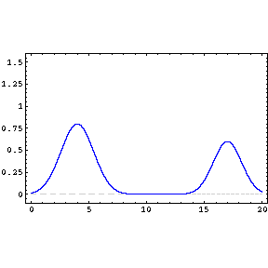
Wave Superposition
As I suspect
you have already guessed –
there are several different types of interference.
several عده
Interferenceتداخل

Slide 5
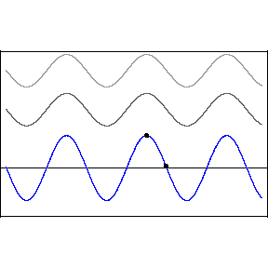
Wave Superposition
This animation shows both constructive and destructive interference.
What happens to the resulting waveform when destructive interference takes place?
Constructive بناء
Destructive هدام

Slide 6
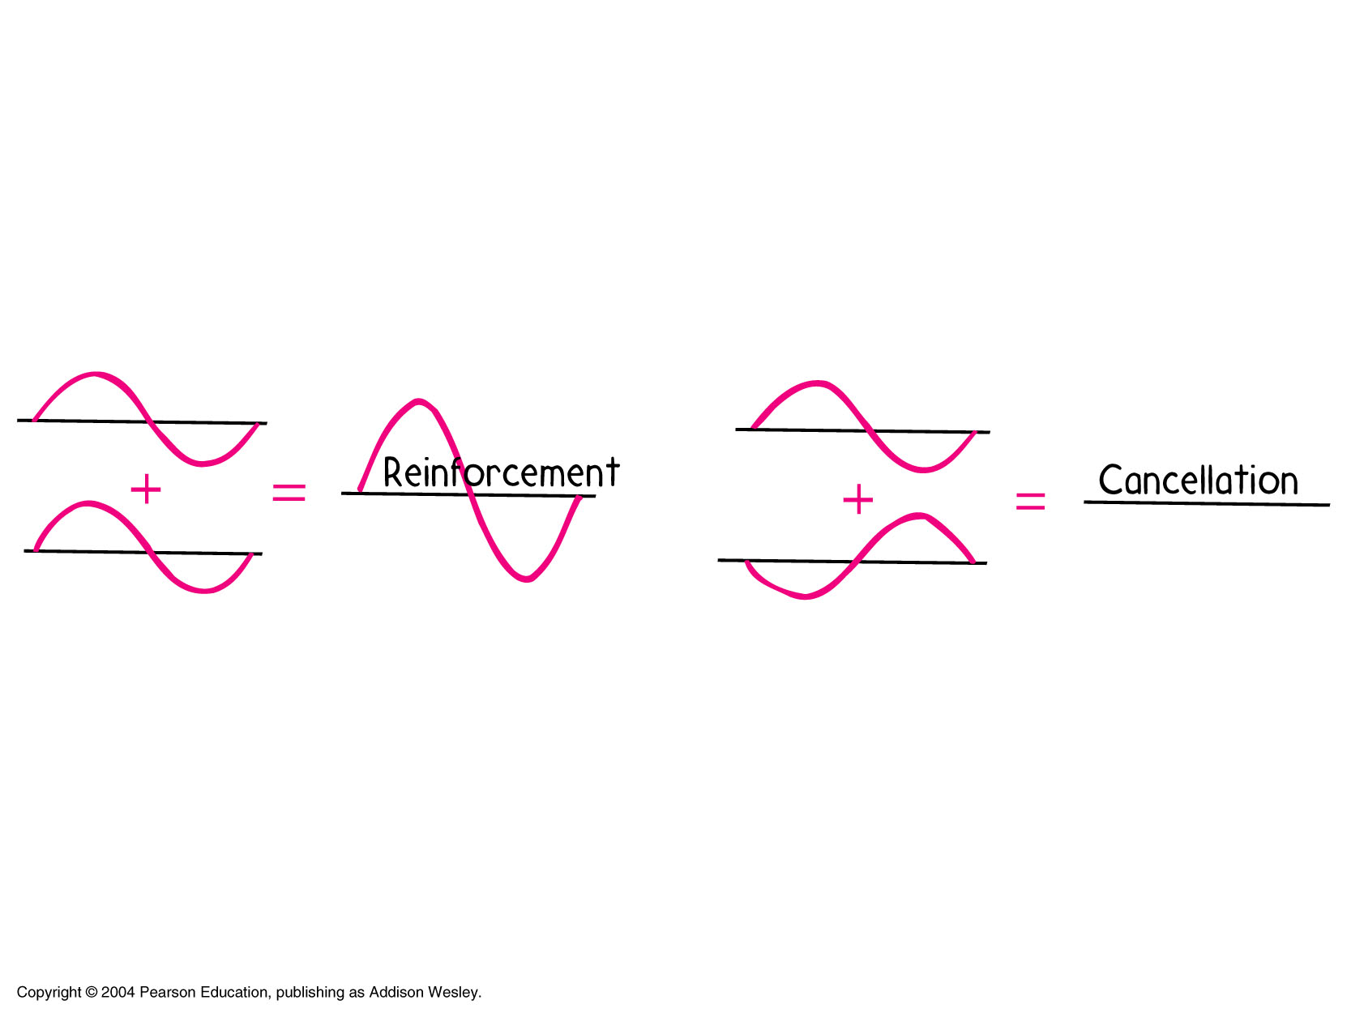
Principle of Superposition
Works for both longitudinal waves and for transverse waves
Reinforcement تعزز

Slide 7
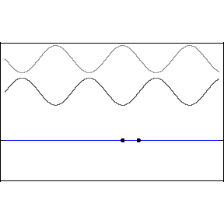
Wave Superposition
What is unique about the black dots on the bottom animation?
Unique فريد

Slide 8
Wave Superposition
The resultant wave is called a Standing Wave.
Nodes عقده
Antinodes يطن
We call the points that has the largest displacement antinodes.
We call the points that do not move nodes.

Slide 9
In general, constructive interference occurs when
cos(φ/2)= ± 1. This is true, for example, when φ= 0, 2π, 4π, ...rad when φ is an even multiple of π.
When φ is equal to π rad or to any odd multiple of π, then cos(φ/2) = cos(π/2)= 0. Thus, the resultant wave has zero amplitude everywhere, as a consequence of destructive interference.
even multiple مضاعفات زوجية
odd multiple مضاعفات فردية

Slide 10
Finally, when the phase constant has an arbitrary
value other than 0 or an integer multiple of π rad, the resultant wave has an amplitude whose value is somewhere between 0 and 2A.
Arbitrary التعسفي
integer عدد صحيح

Slide 11
