Slide 1
321:Networks Protocols
Lecture # 1 : Introduction

Slide 2
Attention!!!

Slide 3
Grade Components
5% Test.
30% lab.
5 % Project reports and presentations.
20% Made term exam.
40% Final exam.

Slide 4
Course Project
You need form your project team.
  Each team can have 5 students.
Each team should email me your team member list before, 15/2/2012.
Each team should submit a project report which clearly shows their contributions to the project.
Each team should prepare a 15-20 minutes presentation and answer related questions.

Slide 5
projects
1- Proxy Server
2- Data Communication Taxonoy.
3- Routing .
4- The TCP/IP Protocol Suite .
5- IP Address ( Subnetting).

Slide 6
Projects cont…
6-DNS.
7- X.25 protocol suite.
8- Frame relay.
9-ATM.
10- Router & Switch.

Slide 7
review
Networking concepts
An Overview of Networking
NET:
  A net is made up of individual pieces of rope woven together.
  The strength of a net comes from the pieces being connected together.

Slide 8
Network
A network is anything that resembles a net.
  Examples include a network of politicians or a network of roads.
Like a net, a network accomplishes more through being connected together.

Slide 9
Communication Network
(End system view)
Network offers a service:
  Information services: move information
    Bird, fire, messenger, telegraph, telephone, Internet …
  Transportation service: move objects
    horse, train, truck, airplane ...
Provided services distinguish different types of networks

Slide 10
Factors that distinguish the services
  Latency
  Bandwidth
  Loss rate
  Number of end systems
  Service interface (how to invoke?)
  Other details
    Reliability, unicast vs. multicast, real-time,...

Slide 11
Communication Network
(Infrastructure Centric View)
Electrons and photons
  as communication medium
Links:
  fiber, copper, satellite, …
Switches:
  mechanical/electronic/optical, crossbar.
Protocols:
  TCP/IP, ATM, MPLS, SONET, Ethernet, PPP, X.25, Frame Relay, AppleTalk, IPX.
Functionalities:
  Routing, error control, congestion control, Quality of Service (QoS)
Applications:
  FTP, WEB, ...

Slide 12
Computer Network
A computer network: is computers and devices connected together.
  A single computer is limited to its own hardware and software.
  The capabilities of a computer are increased when connected with other devices to form a computer network.

Slide 13

Why Networks?
Why they are interesting?
  Overcome geographic limits
  Access remote data
  Separate clients and server
Goal: Universal Communication (any to any)
Design the cloud
Network

Slide 14
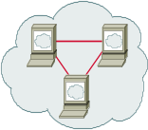
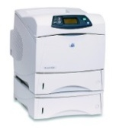




Why network? (cont.)
To share resources
Resources:
  Information (e.g. files),
  Equipment (e.g. printer)
  www.google.com

Slide 15
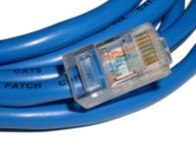
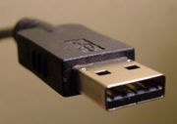
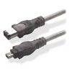

Connecting two PCs together
Network Cable
A
USB
B
FireWire
others

Slide 16
Network Applications
Sharing resources
  Printers, Disks, Folders
Communicating Information
  2-way: E-mail, Text Chat / Instant Messaging, Videoconferencing, Voice over IP.
  1-way: Web sites, IP-TV, music download
Distributed Applications
  Collaborative work, Gaming
Internet Connectivity

Slide 17



LAN Application
Disk shearing
Folder shearing
Printer shearing

Slide 18

How to network?
What
  Many PCs
  PC far away from each other
How
  it depends on many different facts such as Locations, quantities, requirements (e.g. performance, security).
    different types of networks.
Aldmmam
Jada

Slide 19
Network Classifications
Network Classified by
  device that controls network.
  distance between devices.

Slide 20
Network Classifications
Computer Networks
other
scale
connection
topology
service
PAN
HomePNA
Bus
SAN
LAN
Power line
communication
Star
SOHO
CAN
Ring
Data
Center
MAN
Ethernet
Mesh
WAN
WiFi
Tree
SAN: Storage Area Network
SOHO: Small Office/ Home Office
Home PNA: Home Phoneline Networking Alliance, also known as HPNA

Slide 21
Types of Networks
Geographical distance:
  Local Area Networks (LAN): Ethernet, Token ring, FDDI
  Metropolitan Area Networks (MAN): DQDB, SMDS
  Wide Area Networks (WAN): X.25, ATM, frame relay
  Caveat: LAN, MAN, WAN may mean different things
    (service, network technology, networks).
    FDDI: Fiber Distributed Data Interface
    DQDB: distributed-queue dual-bus network
    SMDS: Switched Multi-megabit Data Service
    ATM: Asynchronous Transfer Mode

Slide 22
Types of Networks cont…
Application Types
  Special purpose networks:
    airline reservation network, banking network, credit card network, telephony
  General purpose network:
    Internet

Slide 23
Types of Networks
Right to use
  private: enterprise networks
  public: telephony network, Internet
Ownership of protocols
  proprietary: SNA ( Secure Network Access)
  open: IP
Technologies
  terrestrial vs. satellite
  wired vs. wireless
Protocols
  IP, AppleTalk, SNA

Slide 24



Types of Networks cont…
Personal Area Networks (PANs)
  Interconnect personal devices (PDA, cell phone, portable game module, PC) within 30 feet or so.
  Example: Bluetooth.
Laptop
Bluetooth
Cell phone
PDA : Personal Digital Assistant :

Slide 25
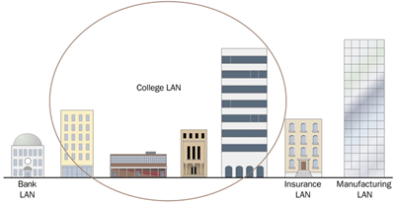
Types of Networks
Local Area Network
  Network computers are located relatively close to each other.
  They are generally limited to buildings owned by one organization.
  They operate at high speeds.
  They are low-cost networks..

Slide 26
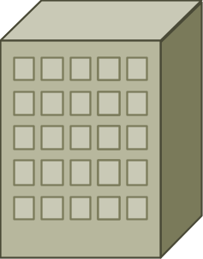

Types of Networks cont…
  Typical LAN
Engineering
Tower
5th floor
2nd floor
1st floor
Internet
data center

Slide 27
Types of Networks cont…
Campus Area Network (CAN):
  A network that connects two or more LANs but that is limited to a specific (possibly private) geographical area such
    as a college campus, industrial complex, or a military base.
    generally limited to an area that is smaller than a Metropolitan Area Network (MAN).

Slide 28
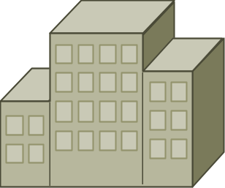
Types of Networks cont…
  Typical CAN
Engineering
Tower
Faculty of Arts
Administration
Building
Faculty
Science

Slide 29
Types of Networks
Metropolitan Area Networks (MANs)
  Interconnect customer sites controlled by a single telecommunications carrier within a metropolitan geographic region.

Slide 30
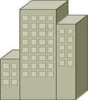


Types of Networks
  Typical MAN
ANU
DU
AKU
AEC
AFU

Slide 31
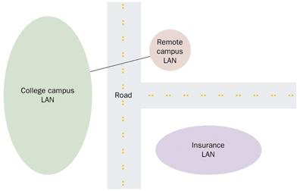
Types of Networks cont…
Wide Area Network
  Network computers are spread out over a larger area.
  They generally cross public thoroughfares.
  They are often managed by public carriers.
  They operate at lower speeds.
  They are a higher-cost network

Slide 32

Types of Networks cont…
  A packet passes through many networks!
WAN
Ministry of Foreign
Affairs
KSA Embassy
Sudan

Slide 33

Types of Networks cont…
  Typical WAN
  a packet passes through many networks!
Khartoum
local
ISP
Tier 3
ISP
local
ISP
local
ISP
local
ISP
Tier-2 ISP
Tier-2 ISP
Tier 1 ISP
NAP
Tier 1 ISP
Tier 1 ISP
Tier-2 ISP
Tier-2 ISP
Tier-2 ISP
local
ISP
local
ISP
local
ISP
local
ISP
al-Riad
NAP: Network Access Protection.
ISP: Internet service provider.

Slide 34
Types of Networks cont…
Peer-to-Peer Network:
  No single computer controls the network.
  Each computer is the same (a peer) to all others.
  It is suitable for small offices.

Slide 35
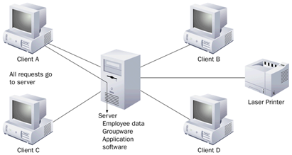
Types of Networks CONT…
Server-Based Network:
  The network is controlled by a special high-powered server.
  The server is dedicated to running the network.
  Print and file servers, application servers, communication servers, and directory service servers are common.

Slide 36
SOHO Network
What’s SOHO network?
  Small Office Home Office Network
Why it’s important to study SOHO?
  you are familiar with, more or less …
  It has good coverage from tech perspective (LAN, Wireless, Internet Access, Network App, Security, etc.)
  You can (DIY):Do It Yourself.

Slide 37

Home Network: Single PC
CATV or
DSL Line
SOHO router
Kitchen
Den
Living Room
Dining Room

Slide 38
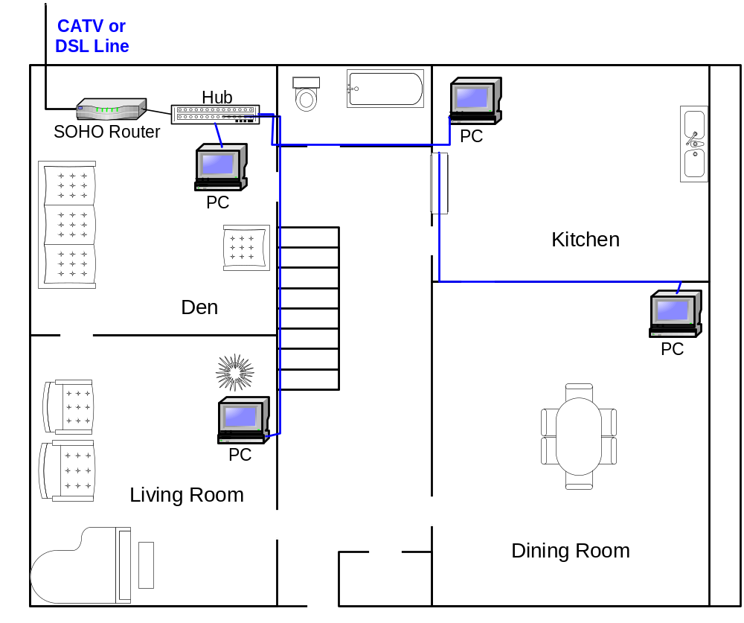
Home Network: Wired LAN

Slide 39
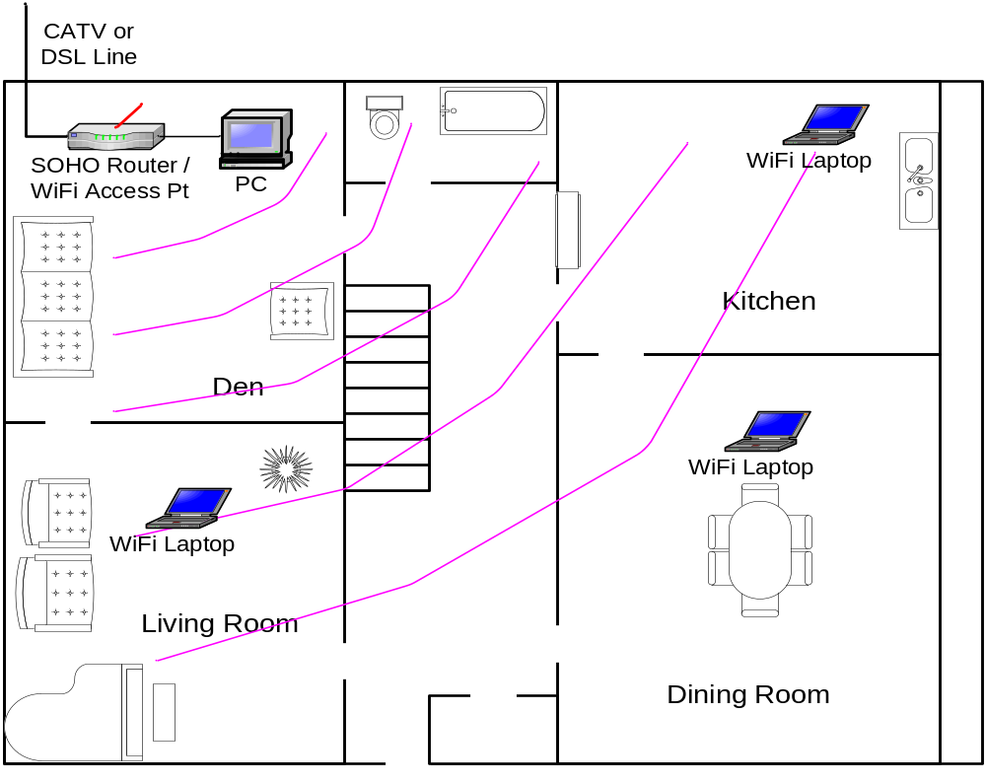
Wireless LAN

Slide 40
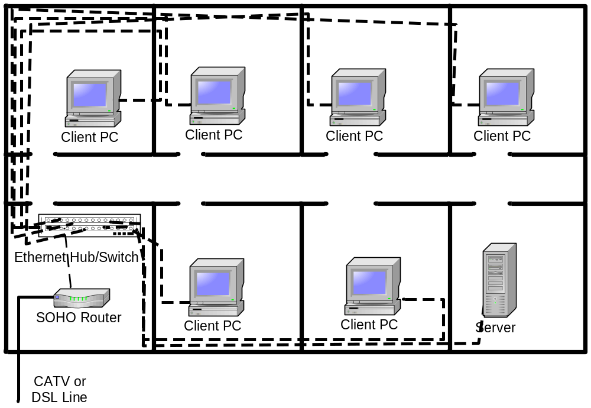
Small Office Network: Wired LAN

Slide 41
Typical SOHO network components
ADSL or cable modem
router/firewall.
Ethernet (switches, hubs)
Wireless access point
Workstations/Servers
ADSL: Asymmetric Digital Subscriber Line.

Slide 42
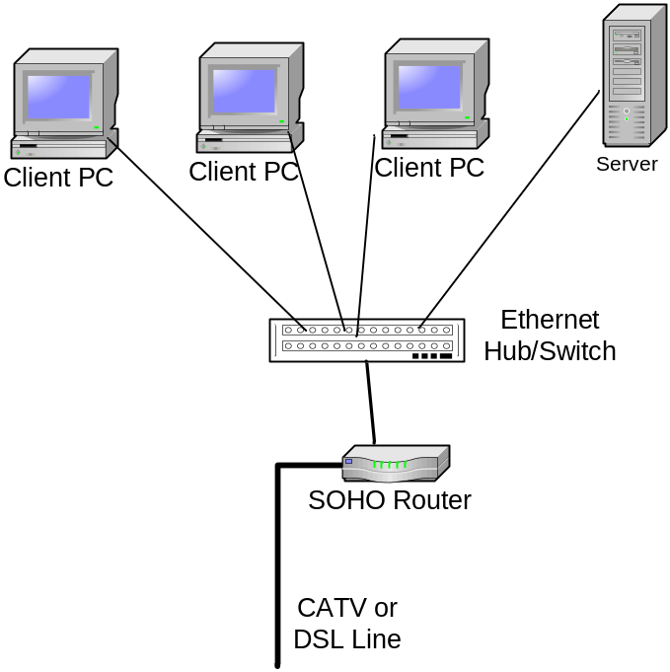
Small Office Network
Wired LAN - Logical Layout

Slide 43
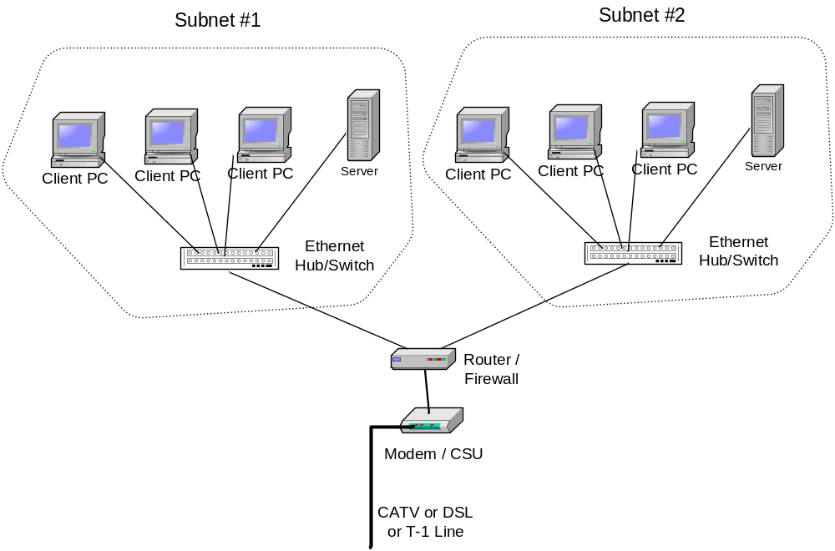
Small Office Network
Multiple Subnets

Slide 44
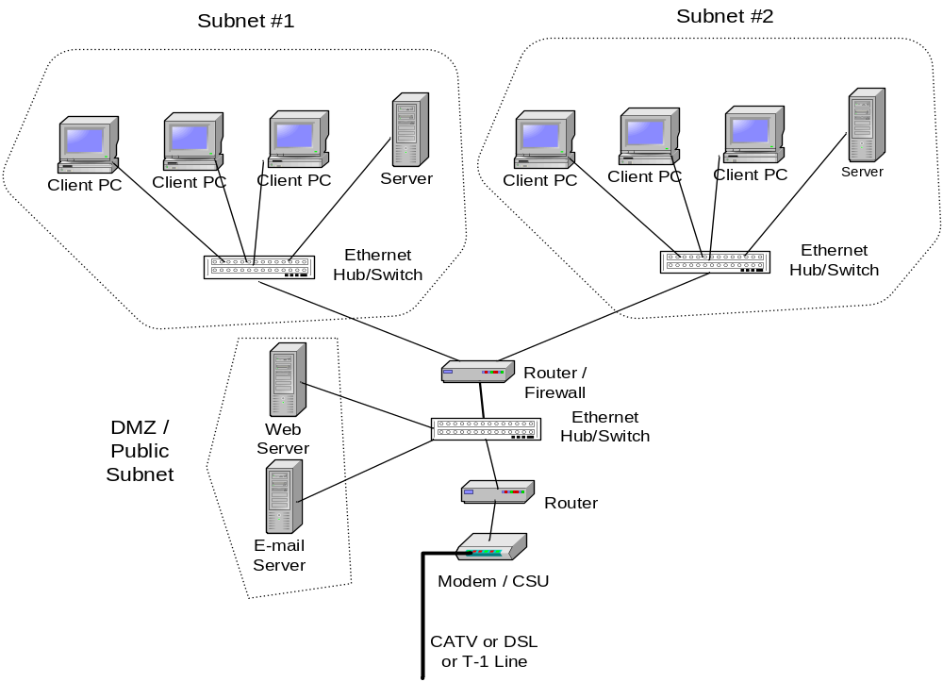
Small Office Network
Public/Private Subnets

Slide 45
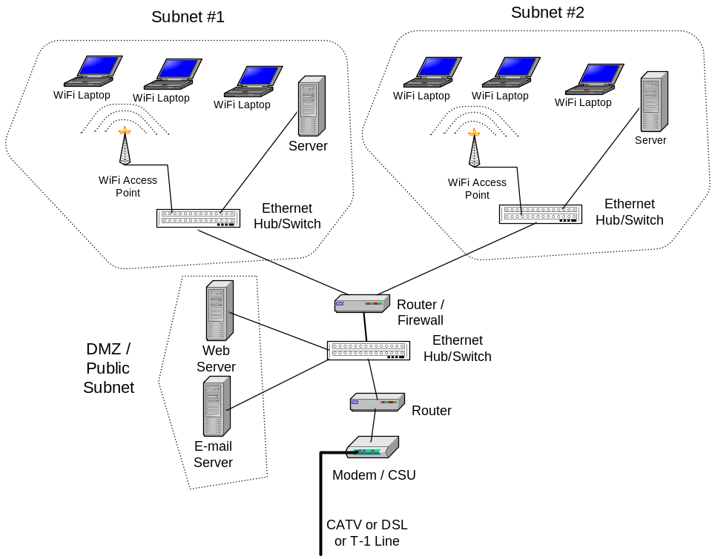
Small Office Network
Wireless LANs

Slide 46
End Slide Show # 1

