Slide 1
English Basics

Slide 2
Parts of speech

Slide 3

Verb
adjective
Noun
Conjunction
Preposition
Adverb
Interjection
Pronoun

Slide 4
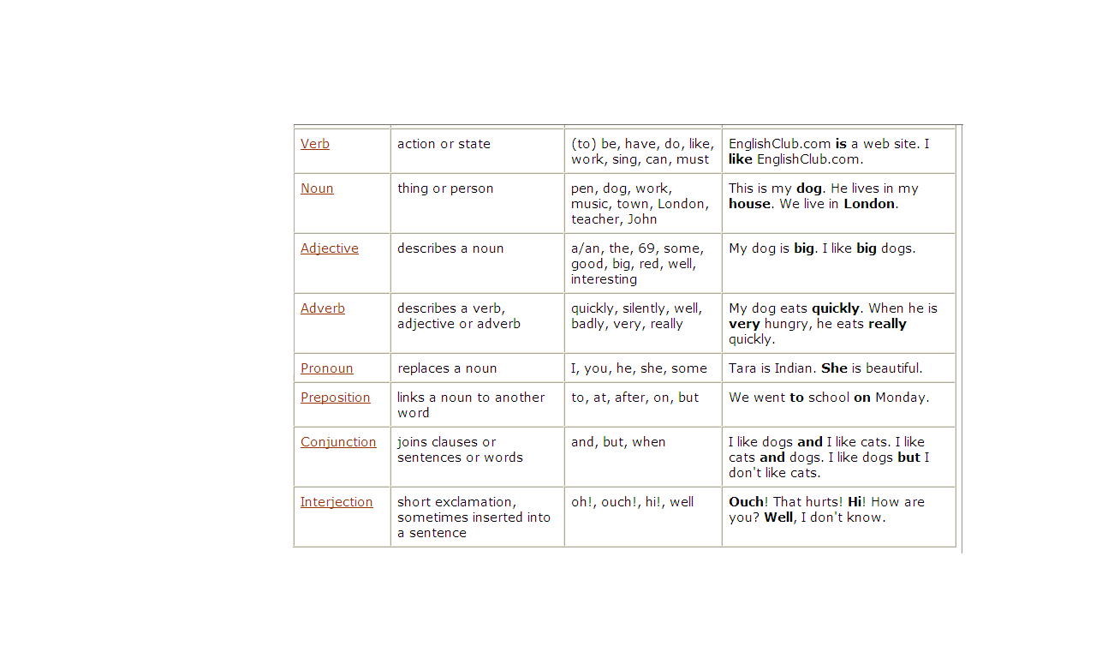

Slide 5
* Some grammar sources categorize English into 9 or 10 parts of speech. Here we use the traditional categorization of 8 parts of speech.
Examples of other categorizations are:
Verbs may be treated as two different parts of speech:
  Lexical Verbs (work, like, run)
  Auxiliary Verbs (be, have, must)
Determiners may be treated as a separate part of speech, instead of being categorized under Adjectives

Slide 6
Parts of Speech Examples

Slide 7
Verb
Stop !
Noun | Verb
John | works.
Noun | Verb | Verb
John | is | working.
Pronoun | Verb | Noun
She | loves | animals.

Slide 8
Noun | Verb | Adjective | noun
Animals | like | kind | people.
Noun | Verb | Adjective | Noun
Norah | speaks | good | English.
Noun | Verb | Adjective | Noun | Adverb
Norah | speaks | good | English | well.

Slide 9
Pronoun | Verb | Preposition | Adjective | Noun | Adverb
She | run | to | the | station | quickly.
Pron. | Verb | Adj. | noun | Conj. | Pron. | verb | Pron.
She | likes | big | snakes | but | I | hate | them

Slide 10
Here is a sentence that contain every part of speech
interjection | Pron. | Conj. | Adj. | noun | verb | Prep. | n. | Adv.
Well, | She | And | Young | John | Walk | To | School | Slowly.

Slide 11
Words with more than one job.
Many words in English can have more than one job, or be more than one part of speech. For example,
"work" can be a verb and a noun;
"but" can be a conjunction and a preposition;
"well" can be an adjective, an adverb and an interjection.
In addition, many nouns can act as adjectives.

Slide 12
In the table below you can see a few examples. Of course, there are more, even for some of the words in the table.
In fact, if you look in a good dictionary you will see that the word "but" has six jobs to do:
verb, noun, adverb, pronoun, preposition and conjunction!

Slide 13
word | Part of speech | Example
work | Noun | My work is easy
 | Verb | I work in London
but | Conjunction | John came but Mary didn’t come.
 | Preposition | Everyone came but Mary.
well | Adjective | Are you well?
 | Adverb | She speaks well.
 | Interjection | Well ! That’s expensive.
afternoon | Noun | We ate in the afternoon.
 | Noun acting as adjective | We had afternoon tea.

Slide 14
To analyze the part of speech, ask yourself:
"What job is this word doing in this sentence?"

Slide 15
Practice

Slide 16
I bought a beautiful dress at the mall.
What did she ask you to do?
I left my shoes under the kichen table.
If we finish our work quickly we can go to the movies.
On Saturdays I work from nine to five.
I want to go to a university in the United States.
I’m sure I’ve met your friend before.
Well , I don’t think I will be here to answer the phone.
Sarah knocked in the door but nobody answered.
After lunch let’s go out for a coffee.
Adj.
Pron.
Prep.
Adv.
V.
N.
V .
Interj .
Conj.
Prep.

Slide 17
The End

