Slide 1
Lecture # 2
WAN Technologies

Slide 2
Objectives
Define LAN and WAN and tell how they are used.
WAN Technologies Overview
WAN Technologies

Slide 3
Different LAN and WAN technologies.
LAN (Local Area Network) :
Local is generally referred to a network contained within a building or an office or a campus.
(You might have a LAN for example on a University campus or between office blocks in an office park).
Have a small geographical range and do not need any leased telecommunication lines

Slide 4
Different LAN and WAN technologies cont...
One LAN can be connected to other LANs over any distance via telephone lines and radio waves
LANs have a high data transfer rate
To set up a LAN -relatively speaking- is cheap If you want to put an extra couple of network points or an extra couple of devices on the network.

Slide 5
Different LAN and WAN technologies cont...
WAN (Wide Area Network):
A WAN is generally slow. If we compare that to a LAN, we said that Ethernet could run up to 1000 Mbps, currently, the fastest WAN is 155 Mbps, so you can see in a LAN we can talk up to 1000 Mbps whereas in a WAN, currently.
WAN is expensive. If we look at the path of telecommunications, we need to connect two offices, one in Aldmmam and one in Alkhartoum together - it 's an expensive operation even for a slow line.

Slide 6
Different LAN and WAN technologies cont...
Internet is the best example of a WAN
WANs (like the Internet) are not owned by any one organization but rather exist under collective or distributed ownership and management
WANs tend to use technology like ATM, Frame Relay and X.25 for connectivity over the longer distances

Slide 7
Different LAN and WAN technologies cont...
Have a large geographical range generally spreading across boundaries and need leased telecommunication lines .
Computers connected to a wide-area network are often connected through public networks, such as the telephone system. They can also be connected through leased lines or satellites.

Slide 8
WAN Terminology

Slide 9
WAN Terminology
Devices on the subscriber premises are called Customer Premises Equipment (CPE).
The subscriber owns the CPE or leases the CPE from the service provider.
A copper or fiber cable connects the CPE to the service provider’s nearest exchange or central office (CO).
This cabling is often called the local loop, or "last-mile".

Slide 10
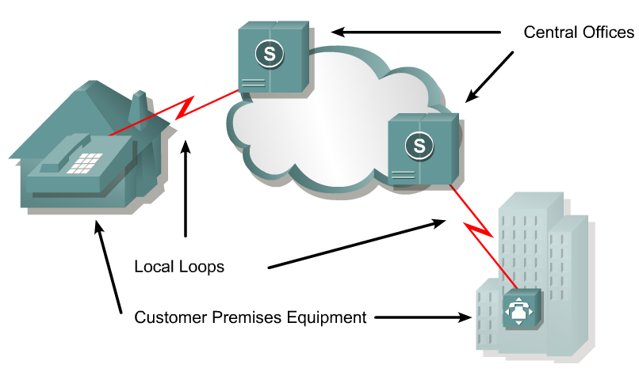

Slide 11
WAN Terminology cont…
A dialed call is connected locally to other local loops, or non-locally through a trunk to a primary center.
It then goes to a sectional center and on to a regional or international carrier center as the call travels to its destination.

Slide 12
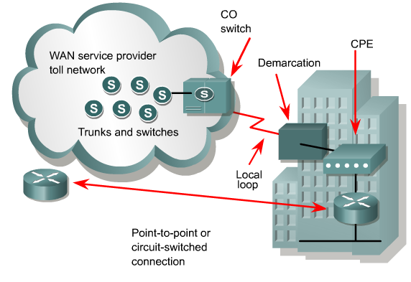
WAN Service Providers

Slide 13
WAN Terminology cont…
Devices that put data on the local loop are called data circuit-terminating equipment, or Data Communications Equipment (DCE).
The customer devices that pass the data to the DCE are called Data Terminal Equipment (DTE).
The DCE primarily provides an interface for the DTE into the communication link on the WAN cloud.

Slide 14
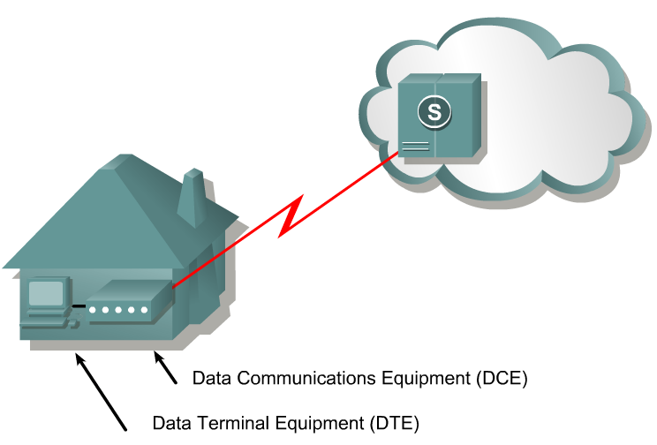
WAN Terminology cont…

Slide 15
WAN Terminology cont…
The DTE/DCE interface uses various physical layer protocols, such as High-Speed Serial Interface (HSSI) and V.35.
These protocols establish the codes and electrical parameters the devices use to communicate with each other.

Slide 16
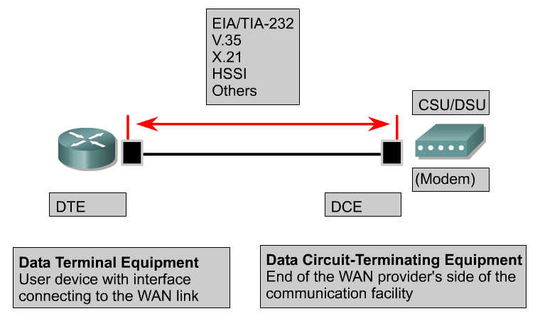
Physical Layer: WANs

Slide 17
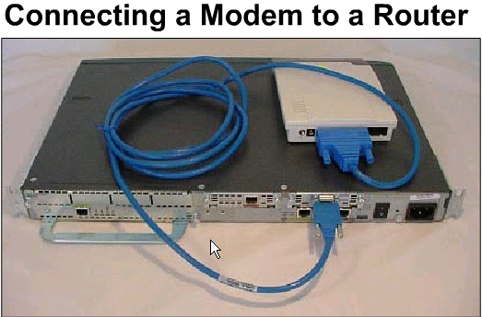
Connecting a Modem To a Router
Connecting to a serial interface:
  physical-layer async interface command
The Picture shows a connection between a Cisco 2620 series router and an external modem using an EIA/TIA-232 Smart Serial cable.

Slide 18
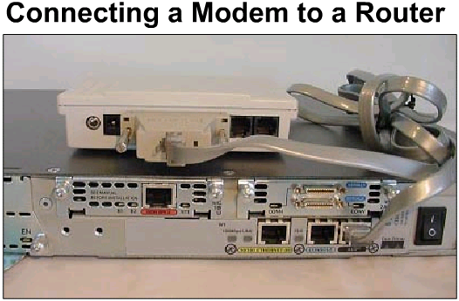
Connecting a Modem To a Router cont…
AUX (Auxiliary): To connect a modem to a Cisco router's AUX port, you typically use a rollover cable and a RJ-45-to-DB-25 male DCE modem adapter

Slide 19
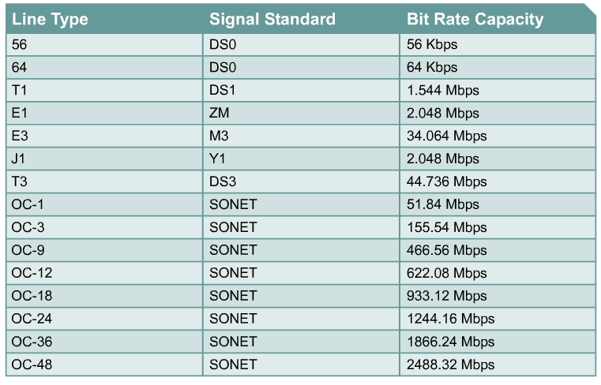
WAN Line Types and Bandwidth
The bps values are generally full duplex.

Slide 20
Name | Abbr. | Size
Kilo | K | 2^10 = 1,024
Mega | M | 2^20 = 1,048,576
Giga | G | 2^30 = 1,073,741,824
Tera | T | 2^40 = 1,099,511,627,776
Peta | P | 2^50 = 1,125,899,906,842,624
Exa | E | 2^60 = 1,152,921,504,606,846,976
Zetta | Z | 2^70 = 1,180,591,620,717,411,303,424
Yotta | Y | 2^80 = 1,208,925,819,614,629,174,706,176

Slide 21
Link establishment and full and half duplex
Link partners are allowed to skip offering configurations of which they are capable. This allows the network administrator to force ports to a selected speed and duplex setting, without disabling Auto-Negotiation.

Slide 22
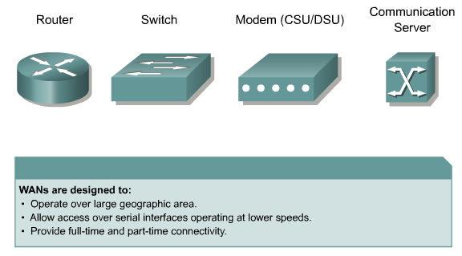
WAN Devices
Frame Relay, ATM, X.25 switch

Slide 23
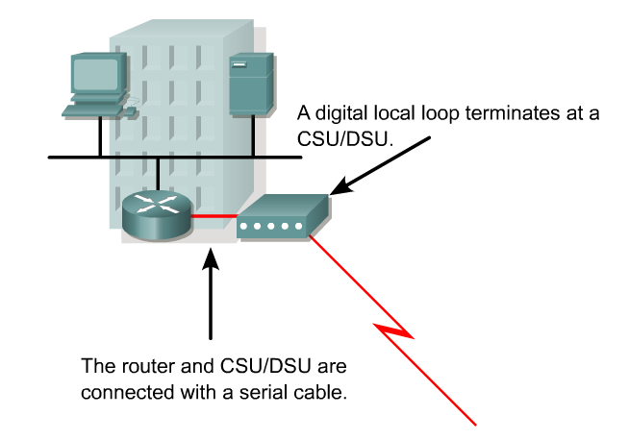
CSU/DSU

Slide 24
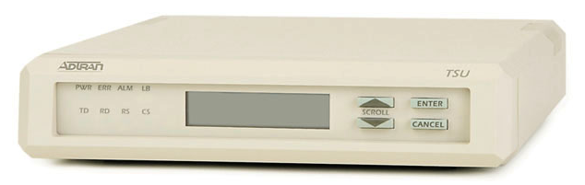

Slide 25
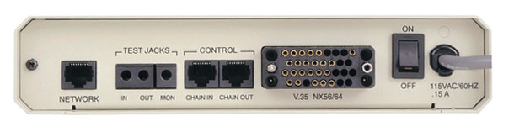
To T1 circuit
To router

Slide 26
For digital lines, a channel service unit (CSU) and a data service unit (DSU) are required.
  We won’t go into the differences here.
The two are often combined into a single piece of equipment, called the CSU/DSU.

Slide 27
CSU/DSU Interface Card
The CSU/DSU may also be built into the interface card in the router.

Slide 28
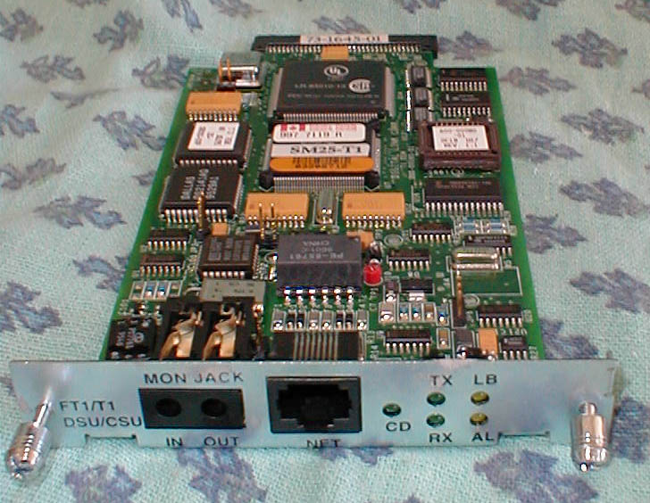

Slide 29
Modems
Modems transmit data over voice-grade telephone lines by modulating and demodulating the signal.
The digital signals are superimposed on an analog voice signal that is modulated for transmission.
At the receiving end the analog signals are returned to their digital form, or demodulated.

Slide 30
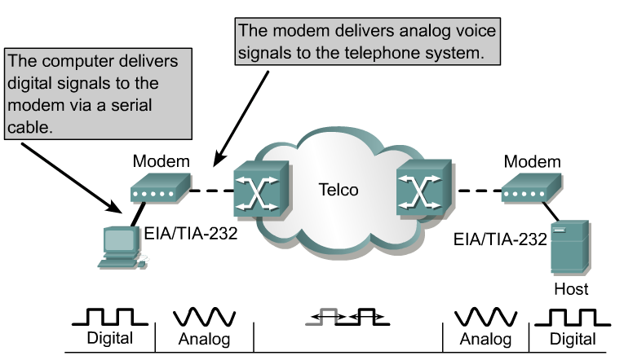
Modem Transmission

Slide 31
WAN Standards Organizations
WAN standards typically describe both physical layer delivery methods and data link layer requirements, including physical addressing, flow control, and encapsulation.
WAN standards are defined and managed by a number of recognized authorities.

Slide 32
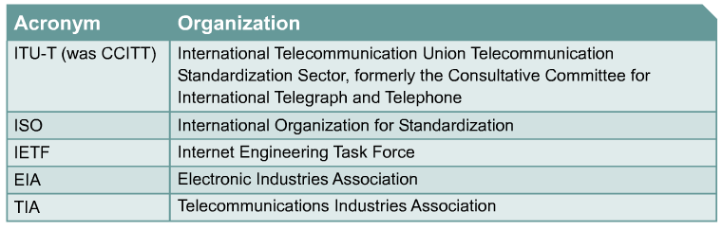

Slide 33
Physical Layer Standards
The physical layer protocols describe how to provide electrical, mechanical, operational, and functional connections to the services provided by a communications service provider.

Slide 34
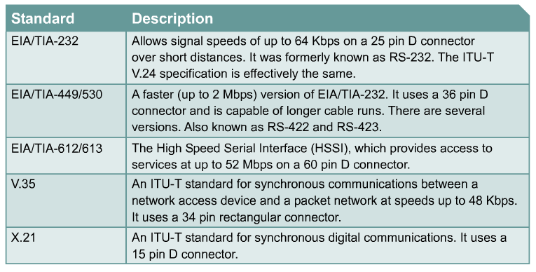

Slide 35
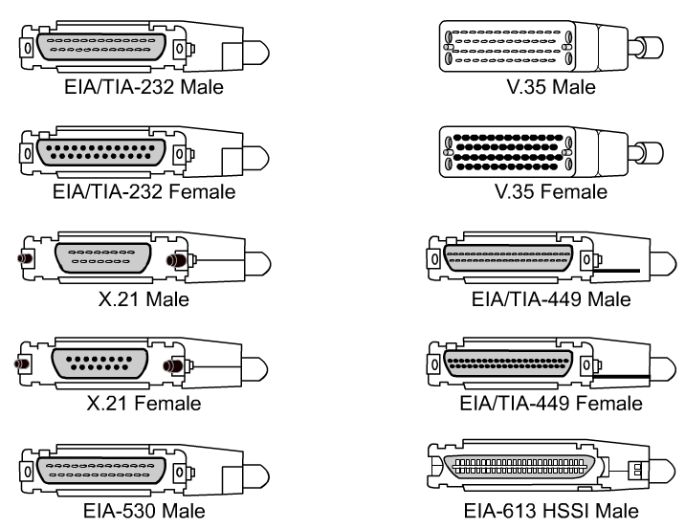

Slide 36
End Slide Show # 2

